Slide 1
Update for SW Plains Principals Council
Dr. Randy Watson, Kansas Commissioner of Education

Slide 2
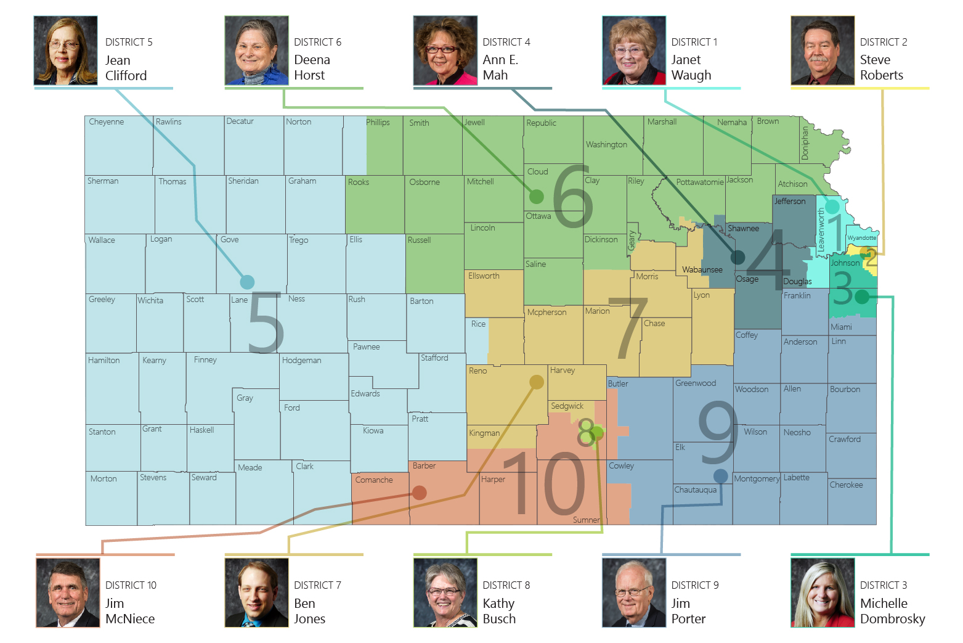

Slide 3
Our Vision for Kansas ...
Kansas leads the world in the success of each student
Notes:
Our business cards will stand out as innovative and memorable with a vertical or portrait orientation. Bonus it has a back side!
a portrait or vertical design. It’s also two-sided!
Another fundamental change you may notice (if not you will after I tell you) is that the main address for our agency has been simplified to the main desk in Suite 102. As all our mail is sorted in the print shop having everything labeled by a different team name and suite only made sense to us as we're used to it. It is less confusing and complex for those we serve.

Slide 4
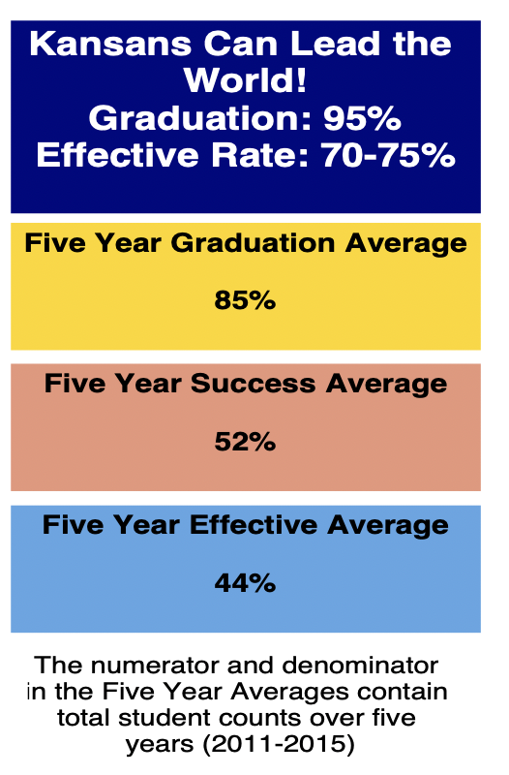
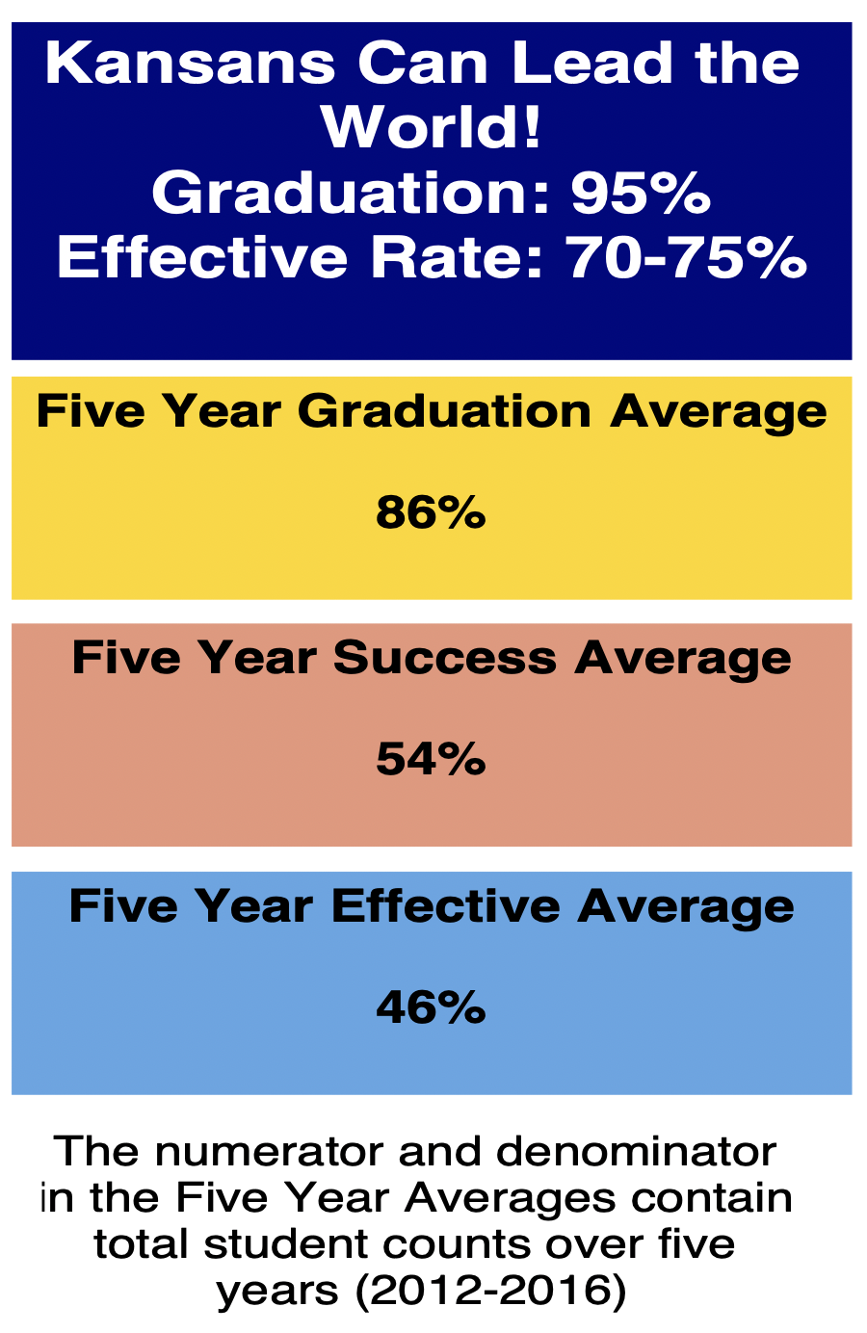
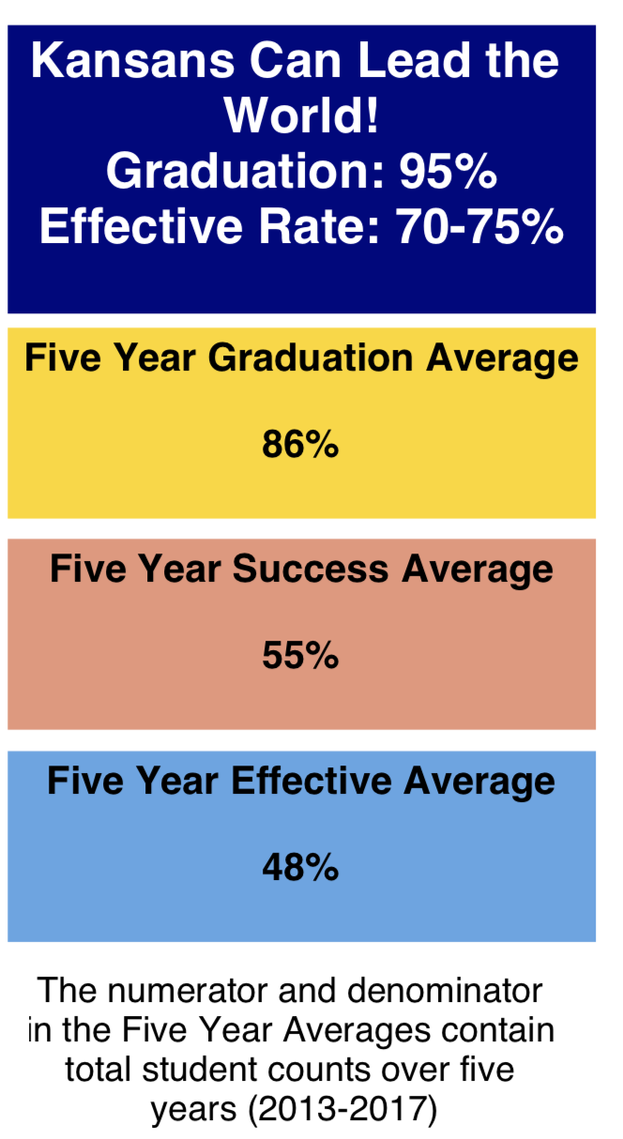

Slide 5
Notes:
Our business cards will stand out as innovative and memorable with a vertical or portrait orientation. Bonus it has a back side!
a portrait or vertical design. It’s also two-sided!
Another fundamental change you may notice (if not you will after I tell you) is that the main address for our agency has been simplified to the main desk in Suite 102. As all our mail is sorted in the print shop having everything labeled by a different team name and suite only made sense to us as we're used to it. It is less confusing and complex for those we serve.

Slide 6
Notes:
LiveSlide Site
https://www.mentimeter.com/s/2d92ed62b0a5e10608bc7df33533d0a3/5503cf4bd843/edit

Slide 7
One of the biggest reasons most of us don't set out to achieve a huge goal is that we think we first need to develop a comprehensively detailed grand plan, one where every step is charted, every milestone identified—where success is pre-ordained.
But because we don't have that kind of plan—because creating that kind of plan is basically impossible—we hesitate. We need to see an end before we see a beginning.
And so we never start.
Notes:
Our business cards will stand out as innovative and memorable with a vertical or portrait orientation. Bonus it has a back side!
a portrait or vertical design. It’s also two-sided!
Another fundamental change you may notice (if not you will after I tell you) is that the main address for our agency has been simplified to the main desk in Suite 102. As all our mail is sorted in the print shop having everything labeled by a different team name and suite only made sense to us as we're used to it. It is less confusing and complex for those we serve.

Slide 8
A C C O U N T A B I L I T Y
KESA
Notes:
Our business cards will stand out as innovative and memorable with a vertical or portrait orientation. Bonus it has a back side!
a portrait or vertical design. It’s also two-sided!
Another fundamental change you may notice (if not you will after I tell you) is that the main address for our agency has been simplified to the main desk in Suite 102. As all our mail is sorted in the print shop having everything labeled by a different team name and suite only made sense to us as we're used to it. It is less confusing and complex for those we serve.

Slide 9
Notes:
Our business cards will stand out as innovative and memorable with a vertical or portrait orientation. Bonus it has a back side!
a portrait or vertical design. It’s also two-sided!
Another fundamental change you may notice (if not you will after I tell you) is that the main address for our agency has been simplified to the main desk in Suite 102. As all our mail is sorted in the print shop having everything labeled by a different team name and suite only made sense to us as we're used to it. It is less confusing and complex for those we serve.

Slide 10
High School Graduating Class of 2020 | High School Graduating Class of 2021
Current QA Criteria Apply | Amended QA Criteria Apply
Current Freshmen Criteria – Under 21 Requirements for Accredited High School Graduate | Amendments Accredited High School Graduate
ESU, PSU, FHSU, KSU, and WSU | ESU, PSU, FHSU, and WSU | K-State
ACT: 21+ or Rank in top third of class | ACT: 21+ or Cumulative GPA of 2.25 | ACT: 21+ or Cumulative GPA of 3.25
Complete Precollege Curriculum with a 2.0 GPA (Resident)/2.5 GPA (Nonresident). Curriculum consists of: -English (4 units); Math (3 units with ACT benchmark of 22 or 4 units with one taken in senior year); Natural Science (3 units with one unit in chemistry or physics); Social Science (3 units); Electives (3 units) Note: As part of the admission application, students list each high school course taken along with the grade. | Units (but not specific courses) are recommended; units are not required. | Units (but not specific courses) are recommended; units are not required.
2.0 cumulative GPA on any college courses taken while in high school | 2.0 cumulative GPA on any college courses taken while in high school | 2.0 cumulative GPA on any college courses taken while in high school
Current Freshmen Criteria – Under 21 Requirements for Accredited High School Graduate | Amendments Accredited High School Graduate
KU | KU
Cumulative GPA of 3.25 and ACT 21+ or Cumulative GPA of 3.0 and ACT 24+ | Cumulative GPA of 3.25 and ACT 21+ or Cumulative GPA of 3.0 and ACT 24+
Complete the Precollege Curriculum as described above | Units (but not specific courses) are recommended; units are not required.
2.0 cumulative GPA on any college courses taken while in high school | 2.0 cumulative GPA on any college courses taken while in high school
Notes:
Our business cards will stand out as innovative and memorable with a vertical or portrait orientation. Bonus it has a back side!
a portrait or vertical design. It’s also two-sided!
Another fundamental change you may notice (if not you will after I tell you) is that the main address for our agency has been simplified to the main desk in Suite 102. As all our mail is sorted in the print shop having everything labeled by a different team name and suite only made sense to us as we're used to it. It is less confusing and complex for those we serve.

Slide 11
Pre-Service Recommendations

Slide 12
Pre-Service Recommendations
The Kansas State Board of Education should modify the Educator Preparation Program Standards to integrate the International Dyslexia Association's Knowledge and Practice Standards for Teachers of Reading*, so to provide specificity (clarity) of the essential elements of literacy instruction.
Standards Implemented by August 2021.
University Implementation in Programs: August 2023.
Board Document Page 1 Pre-Service #1
Notes:
The Center for Effective Reading Instruction first published these standards – IDA later adopted them.
*See board documents for these recommendations

Slide 13
Pre-Service Recommendations
Kansas State Board of Education should require candidates for K-6 teaching licenses, English Language Arts endorsements, reading specialist teaching licenses, and special education teaching licenses to pass an examination of their knowledge of the science of reading. KSBE should approve a test or multiple tests to satisfy this requirement.
Timeline August 2021for testing requirements to change
University Full Implementation Fall 2024.
Board Document Page 1 #2
Notes:
Previous Discussion: The new EST teacher licensure exam for K – 6 elementary teachers the – CKT covers what is needed to meet this recommendation for Elementary K – 6 candidates. `
Elementary Unified, Reading Spec, High Incidence Special Education, Early Childhood Unified Birth – K, Birth – 3rd grade, English 5 – 8, and English 6 -12
With same timeline as Fall 2021 with implementation Fall 2024
Notes for this will include: The new Elementary K-6 licensure exam (CKT) will fulfill this request. KSDE TLA Staff is still studying licensure for candidates receiving: Elementary Unified, Reading Specialist, High Incidence Special Education, Early Childhood Birth – Kindergarten, Early Childhood Birth – 3rd Grade, English Grades 5 – 8, and English Grades 6 - 12

Slide 14
Professional Learning Recommendations

Slide 15
Professional Learning Recommendations
Kansas State Board of Education should require school systems to provide evidence based and consistent professional learning opportunities consisting of training regarding the nature of dyslexia, an introduction to procedures to identify students who are struggling in reading, and an introduction to intervention strategies and procedures.
Content of Professional Learning next slide
Timeline July 2020.
Board Document Page 2 #1

Slide 16
Professional Learning Recommendations
Professional Learning Content:
Overview of science and how science works to solve problems and create solutions including the scientific method.
Information concerning the meaning of terms research based and science based and how to identify programs that are science based.
Definition of dyslexia.
Characteristics of dyslexia.
Dyslexia identification procedures.
Potential outcomes if students are not taught explicitly to become competent readers, including results of additional socio-emotional difficulties.
Information regarding writing systems, including differences in transparent and opaque writing systems.
Information concerning how the English writing systems contributes to reading failure.
Dyslexia intervention strategies and how to implement them.
Dyslexia progress monitoring and progress monitoring systems
Board Document Pages 2-3 #1
Notes:
ESSA needs to be mentioned here

Slide 17
Professional Learning Recommendations
The Kansas State Board of Education should encourage colleges of education in Kansas to develop a course of study with a specialization in dyslexia and struggling readers. This course should be geared toward a Science of Reading endorsement, and align with the IDA Knowledge and Practice Standards. It should include practica experiences with appropriate supervision and leadership development skills such that the person who graduates with this endorsement can train other classroom teachers and reading specialists within their school district.
Timeline July 2020.
Board Document Page 3 #2

Slide 18
Screening and Evaluation Recommendations

Slide 19
Screening & Evaluation Recommendations
The Kansas State Board of Education should require every accredited school district to screen and identify students at risk of dyslexia or demonstrating characteristics of dyslexia, in accordance with universal screening evidence-based practices.
Timeline August 2020
Board Document Page 4 #1
Notes:
Screening would occur 3 times per year in grades K – 6. Screeners should include timed assessment of the following literacy components:
Letter naming fluency (LNF), Non-sense word fluency (NWF), Phoneme segmentation fluency (PSF), Letter word sounds fluency (LWSF), Oral Reading Fluency (ORF).
**In the NOTES section of this slide to discuss with the KSBE: Timeline Fall of 2020, accountability in KIDS, some recommended screeners include AIMSweb Plus, Acadience (DIBELS), TPRI, Predictive Assessment of Reading (PAR), FASTBridge

Slide 20
Screening & Evaluation Recommendations
The Kansas State Board of Education should amend the Kansas Education Accreditation (KESA) model to require districts to implement a rigorous tiered system of supports (as defined in the Foundational Structures of KESA) subject to external review.
Timeline August 2021
Board Document Page 4 #2
.
Notes:
Timeline Fall of 2021 – OVT will be considered the external review using the guide on the next slide
Notes which will be shared for this recommendation are: Timeline Fall of 2021 – OVT will be considered the external review

Slide 21
Screening & Evaluation Recommendations
Kansas State Board of Education should develop and provide to school districts criteria for vetting and approving tools for screening and assessing students for characteristics of dyslexia.
Timeline January 2020
Board Document Page 4 #3

Slide 22
Evidence-Based Reading Practices Recommendations

Slide 23
Evidence Based Reading Practices
The Kansas State Board of Education should require each accredited school district to utilize structured literacy as the explicit and evidence-based approach to teaching literacy skills to all students and promote early intervention for students with characteristics of dyslexia. KSDE should create a checklist to guide selection and implementation of structured literacy practices for accreditation purposes. KSDE should ensure school districts are made aware of information concerning structured literacy training and information currently available from TASN.
Timeline August 2020 for checklist publication
August 2021 structured literacy practices implemented
Board Document Page 5 #1
Notes:
Consensus is to approve this as is. KESA should make this change and include OVT training.
Structured literacy brief from IDA states the outcomes of Structured Literacy
Checklist needed for resources to check on components of SL
Dissemination of information is very important.
Notes on this will include:
Checklist for resources (already drafted in handbook draft - just need to include a time percentage for instruction recommendations.)

Slide 24
Evidence Based Reading Practices
Kansas State Board of Education should direct the creation of a dyslexia handbook for use by schools in Kansas. The creation of the handbook should involve input from a broad array of stakeholders.
Timeline August 2020
Board Document Page 5 # 2
Notes:
Determine the Audience – teachers, administration, with a section for parents
Determine the Purpose – a document with required information, which is fully comprehensive, can be print or electronic, easy to use, includes a glossary and connects to other pieces of reading research
Deadline to have draft by May 2020 final copies by Fall (October) 2020 for informational purposes

Slide 25
Evidence Based Reading Practices
Kansas State Board of Education should identify a dyslexia coordinator within the Kansas State Department of Education.
Timeline July 2020
Board Document Page 6 #3
Notes:
Discussion was to have this position be within the constructs of TASN.

Slide 26
Notes:
Our business cards will stand out as innovative and memorable with a vertical or portrait orientation. Bonus it has a back side!
a portrait or vertical design. It’s also two-sided!
Another fundamental change you may notice (if not you will after I tell you) is that the main address for our agency has been simplified to the main desk in Suite 102. As all our mail is sorted in the print shop having everything labeled by a different team name and suite only made sense to us as we're used to it. It is less confusing and complex for those we serve.

Slide 27
Notes:
Today’s students are the future workforce and future leaders of Kansas. Kansans Can achieve anything and, together, Kansans Can lead the world in the success of each student.

