Slide 1
Summary of Gap Causes and Where the Most Prominent Gaps Are in Kansas
Tony Moss
Researcher / Data Analyst
Kansas State Dept. of Education
Gap Workgroup Meeting
KSDE, 19 August 2014

Slide 2
We reviewed research and data which confirmed that:
Gaps are leading indicators of the health and competitiveness of a society. The smaller the gaps, the healthier and more economically competitive the society. The rapid growth in the proportion of single mothers is a global phenomenon, but countries that have high-quality Early Education and Child Care (EECC), universal access to health care, and high-quality teachers in every school, have practically eliminated the gaps associated with poverty and single-parenthood.
Health and academic gaps, because of developmental sensitivities, originate in early child development and social interactions. Damage done to the architecture of developing brains and to biological systems subject to stress can emerge years, even decades, later.

Slide 3
We reviewed research and data which confirmed that:
Poverty, particularly for children of single parents, tends to damage the biological architecture of developing brains. This damage increases the probability of lower academic performance, heart disease, diabetes, mental illnesses, and many other illnesses and damaging behaviors.
As income and wealth gaps have increased over the last three decades, the upper classes are investing more in their children, increasing academic gaps by 30 to 60 percent.
Social and Economic Status (SES) has become a much stronger predictor of gaps than ethnicity or race. But lower SES, particularly the high-risk associated with single-parent poverty, is disproportionately greater among African-Americans and Hispanics.

Slide 4
Researchers can now show how poverty, through chronic stress, and a dirth of language and emotional play, suppresses optimal brain development and social and emotional skills:
Notes:
Dev Sci. 2012 Jul;15(4):516-27. doi: 10.1111/j.1467-7687.2012.01147.x. Epub 2012 Mar 29.
Neural correlates of socioeconomic status in the developing human brain.
Noble KG¹, Houston SM, Kan E, Sowell ER.
Author information
¹Department of Pediatrics, Columbia University, USA. kgn2106@columbia.edu
Abstract
Socioeconomic disparities in childhood are associated with remarkable differences in cognitive and socio-emotional development during a time when dramatic changes are occurring in the brain. Yet, the neurobiological pathways through which socioeconomic status (SES) shapes development remain poorly understood. Behavioral evidence suggests that language, memory, social-emotional processing, and cognitive control exhibit relatively large differences across SES. Here we investigated whether volumetric differences could be observed across SES in several neural regions that support these skills. In a sample of 60 socioeconomically diverse children, highly significant SES differences in regional brain volume were observed in the hippocampus and the amygdala. In addition, SES × age interactions were observed in the left superior temporal gyrus and left inferior frontal gyrus, suggesting increasing SES differences with age in these regions. These results were not explained by differences in gender, race or IQ. Likely mechanisms include differences in the home linguistic environment and exposure to stress, which may serve as targets for intervention at a time of high neural plasticity.

Slide 5
The 3 most important early factors for a child’s future academic success are:
Rich language & intellectual stimulation and reciprocity
Warm, positive bonding & attachment & emotional reciprocity
Normal, not chronically stressful or neglectful, social environments
Notes:
The quality of parenting accounts for about one-third of the health and education gaps between rich and poor children.
Richard Reeves and Kimberly Howard, 2013, The Parenting Gap.

Slide 6
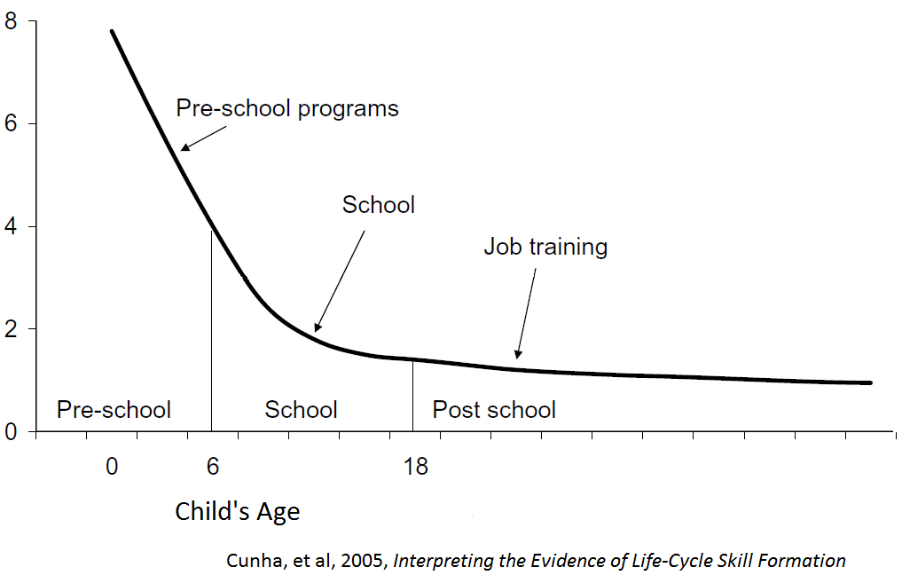
Investments in early childhood return 3 times as much as school investments, and 8 times as much as adult remediation programs.
return
per $1
invested
Notes:
In practical terms, the sensitivity and plasticity of early childhood makes it the most cost-effective period in which to invest. Perversely, even stupidly, it is the period that as a society we invest the least in. Older people vote and can more effectively direct collective resources toward their benefit. See James Heckman’s work.
Luckily, it is both moral and practical to invest more in the early stages of life. In as much as development can be optimized, we can prevent the loss of potentials, and many bad, and expensive outcomes.
But U.S. educational spending is terribly contradictory to early childhood investments. We spend one-and-a-half times the average of other wealthy countries on school-age children—about $12,000 per pupil per year nationally, but almost nothing on very young children, though that is where we would get the most benefit from our investments. (see “Choose your parents wisely,” in The Economist, July 26th, 2014, 21-25.
Our school curricula do not teach young people the basics of good parenting and healthy family life. Some of this blindness to practicality is ideological: conservatives know that parents and families matter, but want all the responsibility for whatever goes wrong to be blamed on the parent, and to avoid any public spending obligations. Liberals tend to be in favor of public investments in early childhood, but want to avoid holding parents responsible for the investments made in their children or the lack of them.

Slide 7
Where are the biggest gaps and what solutions might be tested there?
Which ten Kansas districts have the greatest numbers of Hispanics, African-American, and lower SES students?
How well are these 3 overlapping groups performing academically?
Do the descriptive facts of these districts and schools fit with our causal hypotheses?

Slide 8
What school and district level gaps should we examine?
[Do I have the data to compare the following?] We can compare:
high poverty to low poverty schools; high minority to low minority schools.
Preschool availability (I don’t have).
Advanced course availability (calculus, physics, AP courses)
Teacher preparation, salaries, experience, turnover (e.g., major in the subject matter)
Teacher instructional support (not available)
Student attachment and trust (not available)
Measures of the quality of the curriculum (not available)
Peer support or undermining (not available)
Parental employment and income and food security (census track data?)
Parental aspirations for their children
Staff collaboration and mutual support (not available)
Measures of the quality of school leadership (someday? Not validated)

Slide 9
What effect does poverty have on academic achievement?
We’ll use state reading assessments to measure academic achievement.
Rather than just take one threshold into account—proficiency—it is more accurate to take all performance levels into account—from academic warning, approaching standard, at standard, exceeds standard, to exemplary.
The Assessment Performance Index, the API, does this by awarding more points for each higher performance level.

Slide 10
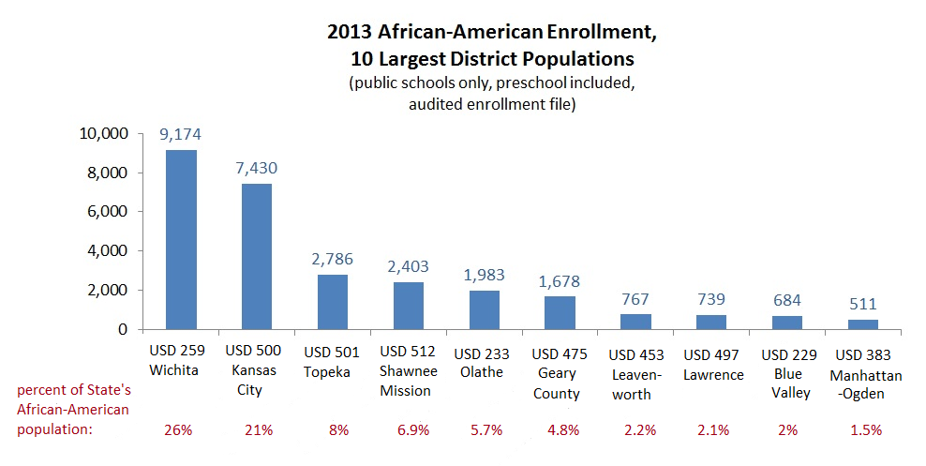
Background first: Where are the greatest numbers of each of the 3 groups?
Notes:
Wichita has about 26% of all the African Am students in the state; Kansas City about 21%; Topeka about 8%. African-Americans are more concentrated in urban areas than Hispanics and Whites.
“Double segregation” segregation by both ethnicity and poverty. Gary Orfiled

Slide 11
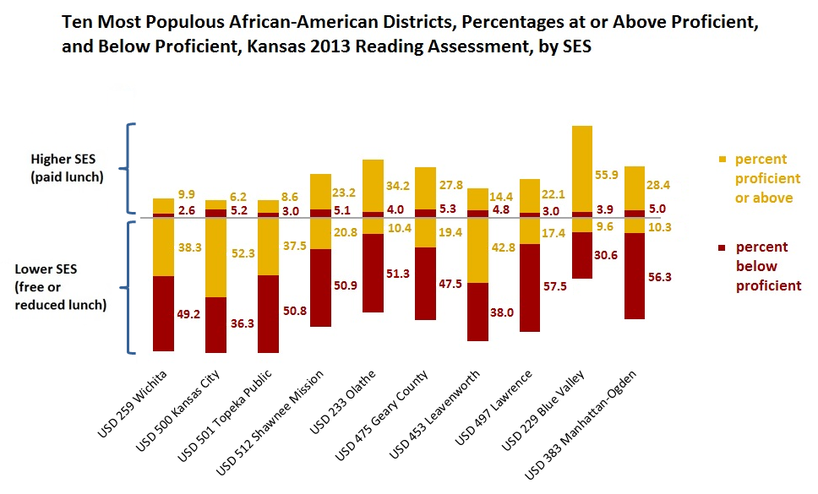
How well do African-American students do on state reading assessments in these 10 districts?

Slide 12
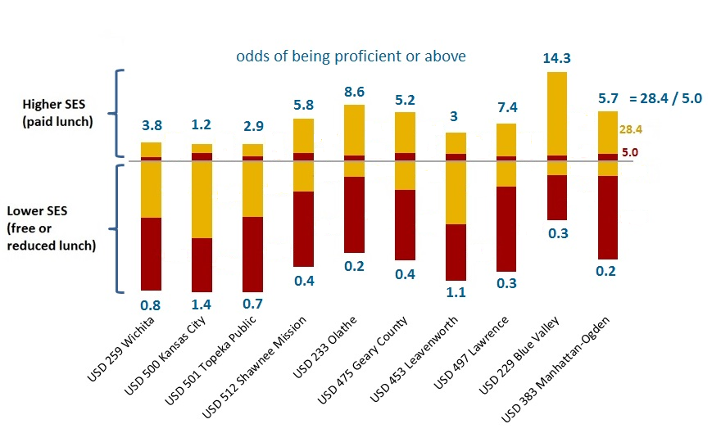
If we compare the percent proficient to the percent below, for higher and lower SES African-American students, we see that the odds of being proficient or above vary a lot by district, especially for middle-class African-American students. The odds are 14 to 1 that a middle-class African-American will be proficient or above in Blue Valley, but only about even for a middle-class African-American in Kansas City. The districts having the most success with middle-class African-Americans tend to have the lowest success with lower SES African-Americans.
Notes:
In these 10 districts, only 30 percent of the African American students are from higher SES families. The districts where the higher SES African-Am. Students perform well—Blue Valley, Lawrence, Olathe—also show lower proportions of lower SES African-Americans scoring at proficient. Kansas City, where higher SES African American students have the worst odds of success, is also the district where lower SES African-American students have the best odds among these 10 districts of scoring proficient or above. What would explain this? In districts where most students seem to be doing well, do more disadvantaged students stand out, and get labeled as failures? Do they get discouraged faster? Is there social status lowered because of their relatively much lower economic class? Maybe all of these are true.
A similar phenomena is observable at the state level: Massachusetts is among the highest performing states on the NAEP, but blacks and Latinos there are eight time more likely to underperform in 4th grade than are whites.

Slide 13
In which districts do African-American students show higher achievement?
There is greater variability when there are fewer students. To capture only systematic differences, we’ll only include those districts with at least 50 or more students in each of the 3 groups.

Slide 14
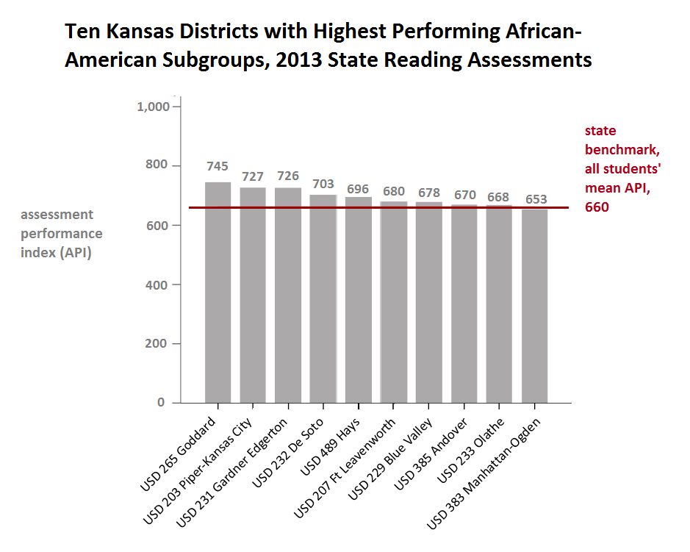

Slide 15
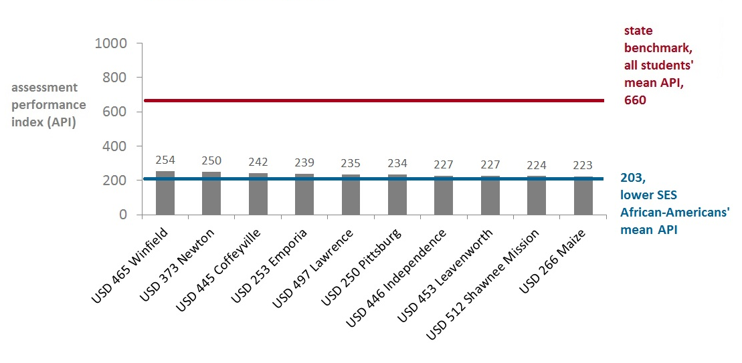
The ten districts with the highest performing lower SES African-American groups don’t perform much better than the group average.
Lower SES African-American Students API,
Ten Highest API Districts, 2013 Reading
Notes:
This echoes the trend chart above, showing how consistently low are the academic measures from the lower SES groups. This confirms our hypothesis that lower SES, particularly for children of single-parents, of which there are a higher proportion among African-Americans, tend to perform poorly academically.

Slide 16
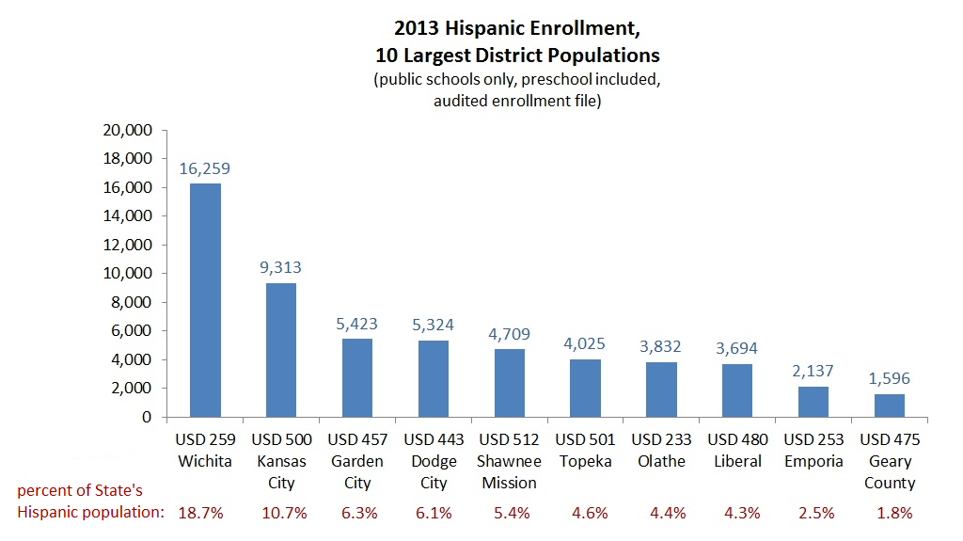
Where are the greatest numbers of Hispanic students?
Notes:
Wichita has about 18 % of the State’s Hispanic students; Kansas City a little less than 11 %; Dodge about 6 %.

Slide 17
How well do Hispanic students do on state reading assessments in these 10 districts?

Slide 18
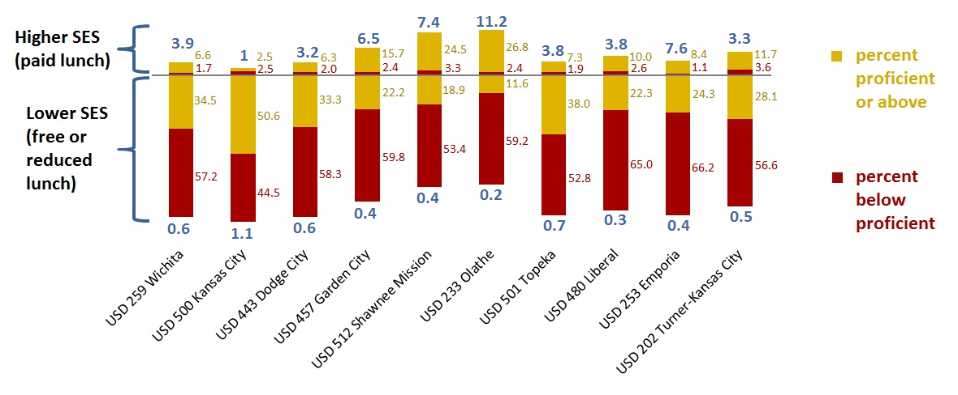
Less than 15 percent of the Hispanics in these 10 schools are higher SES. Combining the data in the 10 districts, higher SES Hispanics have a 5 to 1 chance of being proficient. Lower SES Hispanics, just like lower SES African-Americans, have only a 1 in 3 chance. Again, the districts that show more success with higher SES Hispanic students, also show less success with lower SES Hispanic students, and vice versa.
Notes:
As with the ten districts with the largest African-American populations, there is more variability among the higher SES students, with the odds of being proficient running from a low of 50/50 to a high of more than 11 to one.

Slide 19
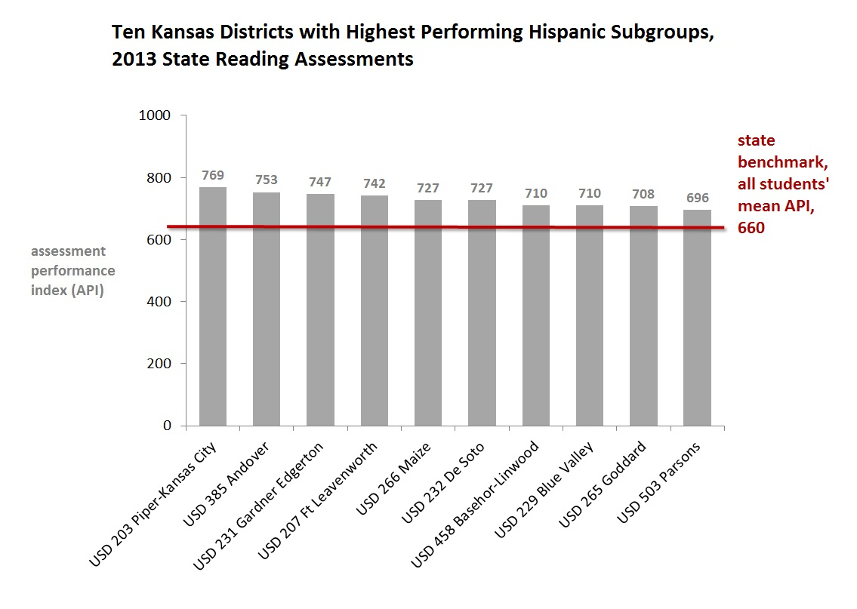

Slide 20
The ten districts with the highest performing lower SES Hispanic groups don’t perform much better than the group average.

Slide 21
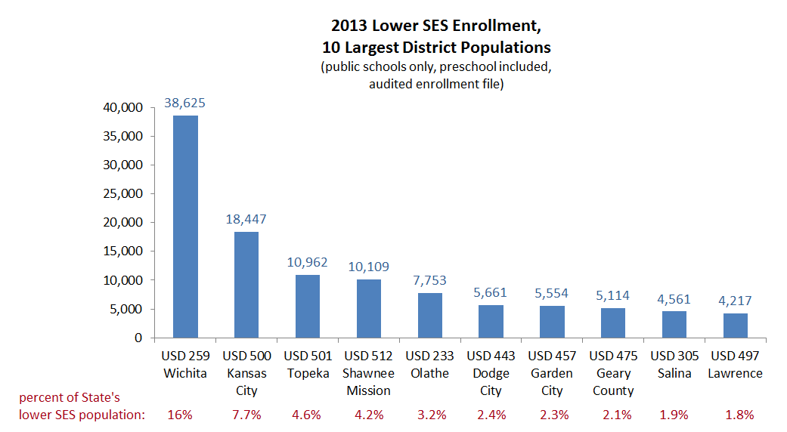
Where are the greatest numbers of lower social & economic status students?

