Slide 1
PURPOSE OF THE
OCR Methods of Administration PROGRAM
To ensure students enjoy equal access to CTE programs and activities regardless of race, color,
national origin, sex, or disability.
OCR’s mission is to ensure equal access to education and to promote educational excellence
throughout the nation through vigorous enforcement of civil rights.

Slide 2
HOW THE MOA PROGRAM WORKS
OCR delegates the authority to conduct compliance reviews of CTE subrecipients AND
Oversees the work of state agencies by:
• Reviewing biennial reports
• Reviewing targeting plans
• Providing technical assistance
State Agencies (Secondary and Postsecondary):
Formulate targeting plans to identify subrecipients where violations are more likely
Conduct broad civil rights compliance reviews of subrecipients

Slide 3
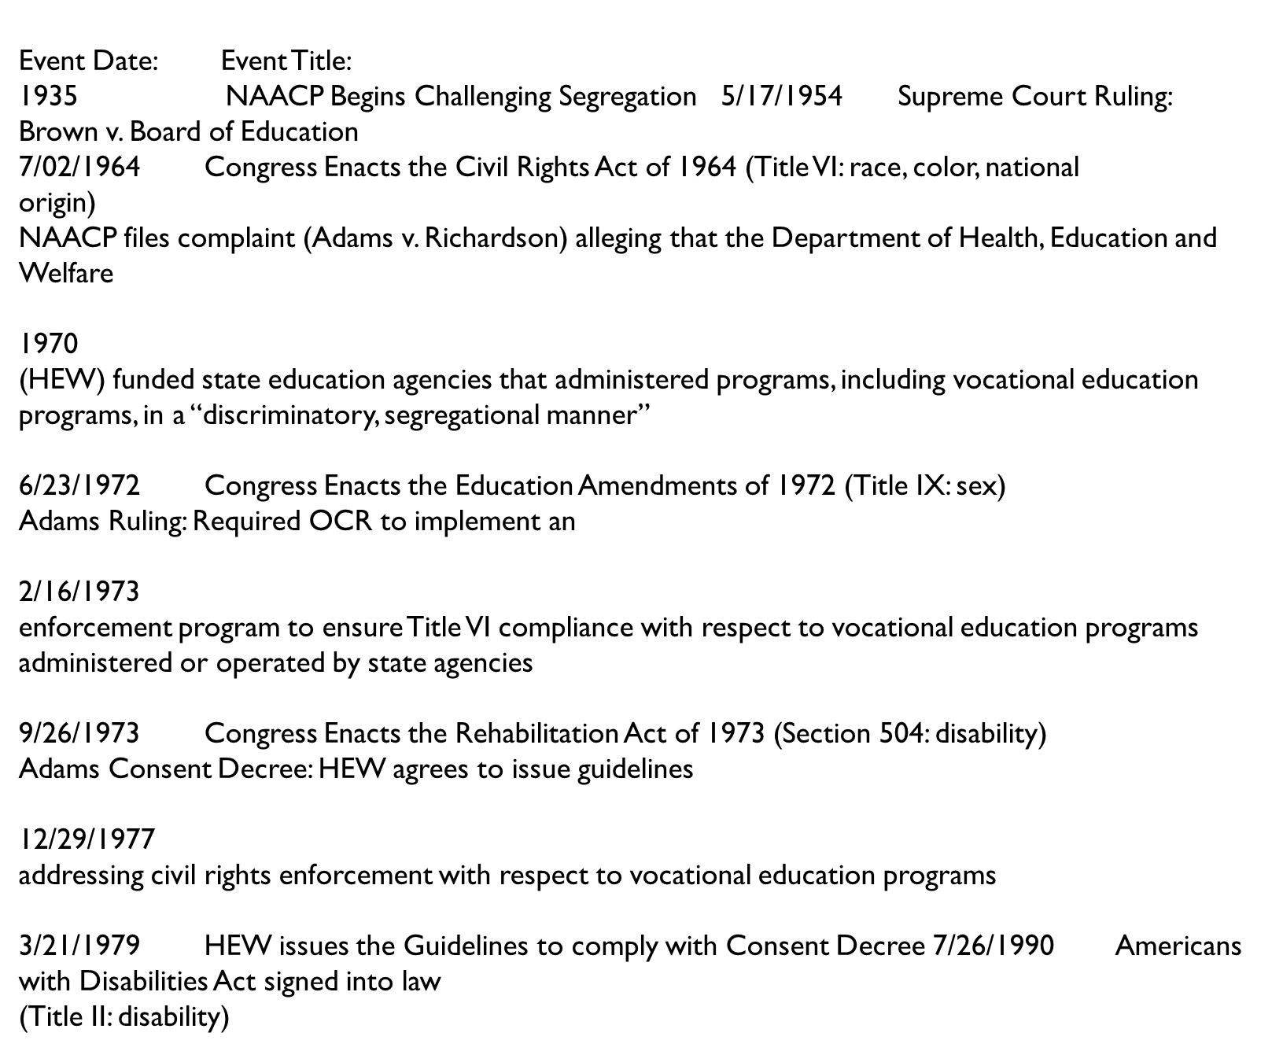

Slide 4
Setting the MOA Stage:
• “The following Guidelines explain how civil rights laws and Department regulations apply to vocational education programs. They are issued as a result of injunctive orders entered by the United States District Court for the District of Columbia in Adams v. Califano. They are also issued because the Department has found evidence of continuing unlawful discrimination in vocational education programs.”
- Supplementary Information Preamble to The Guidelines

