Slide 1
Kansas Reading Gap: 2000 – 2012 (includes ACT) (all grades, Report Card population)

Slide 2
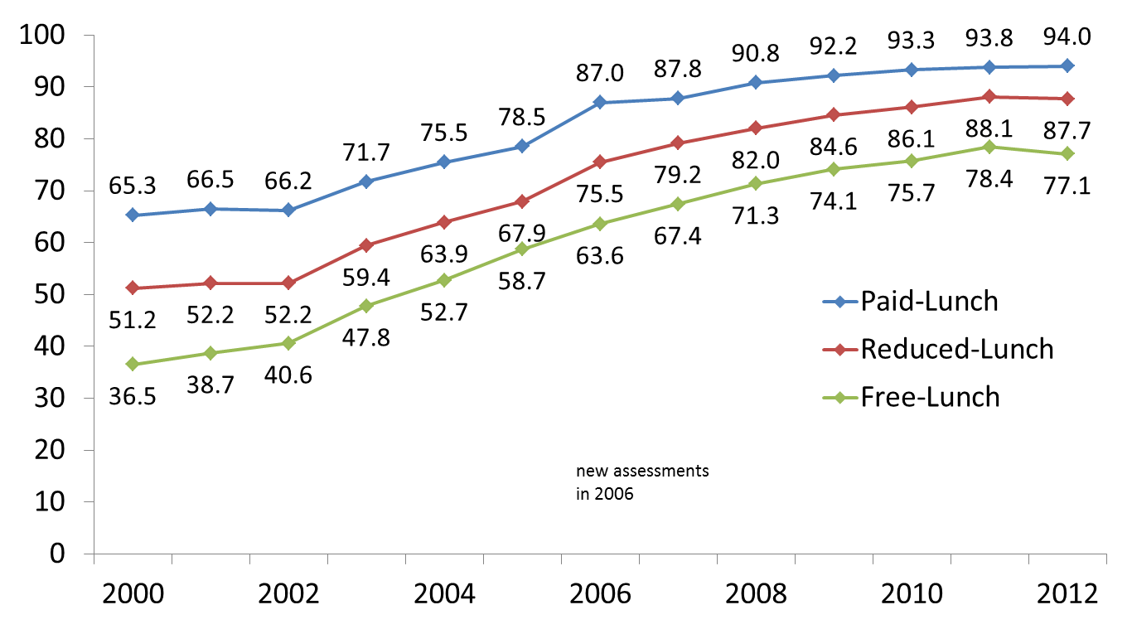
Kansas Reading Gap: 2000 – 2012 (excludes ACT) (all grades, Report Card population)
Notes:
JRD – re-embedded data chart, replaced and revised chart for both 2011 and 2012

Slide 3
Reading Gap by Ethnicity: 2000 – 2012 (includes ACT) (all grades, Report Card population)

Slide 4
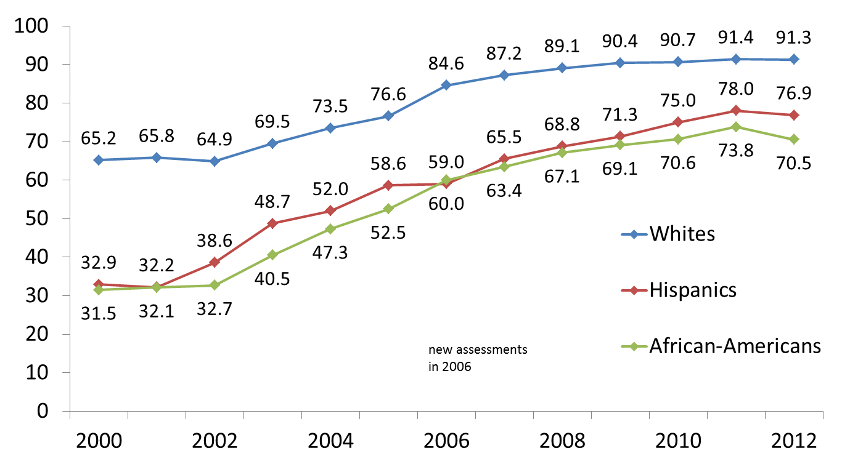
Reading Gap by Ethnicity: 2000 – 2012 (excludes ACT) (all grades, Report Card population)
Notes:
JRD – re-embedded data chart, replaced and revised chart for both 2011 and 2012

Slide 5
Kansas Math Gap: 2000 – 2012 (includes ACT) (all grades, Report Card population)

Slide 6
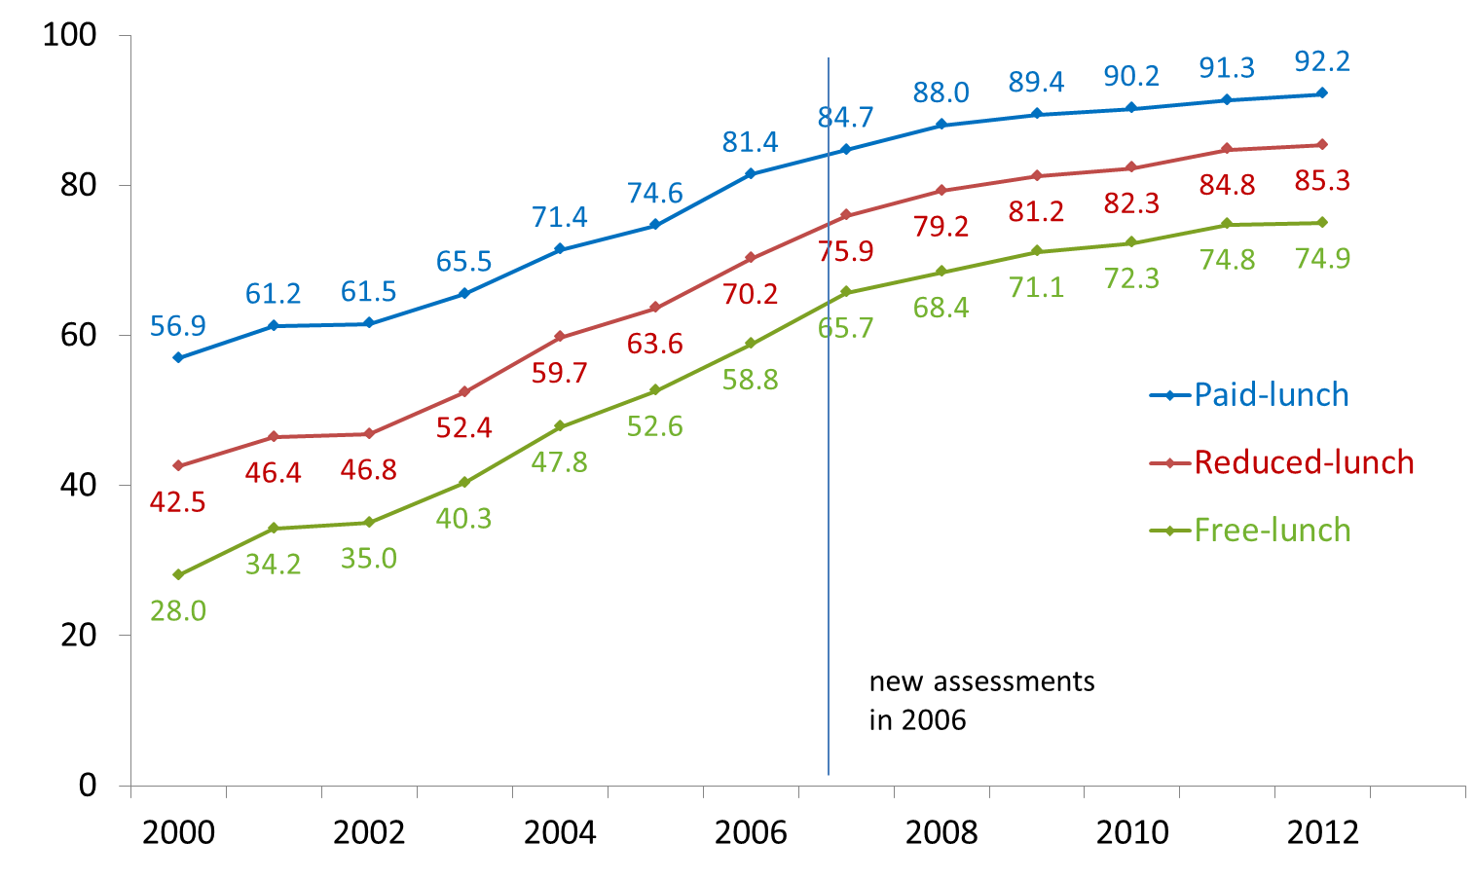
Kansas Math Gap: 2000 – 2012 (excludes ACT) (all grades, Report Card population)
Notes:
JRD – 2011 and 2012 revised

Slide 7
Math Gap by Ethnicity: 2000 – 2012 (includes ACT) (all grades, Report Card population)
Notes:
We are hoping that MTSS and adding Early Childhood to the accreditation system will help districts continue to narrow these gaps.

Slide 8
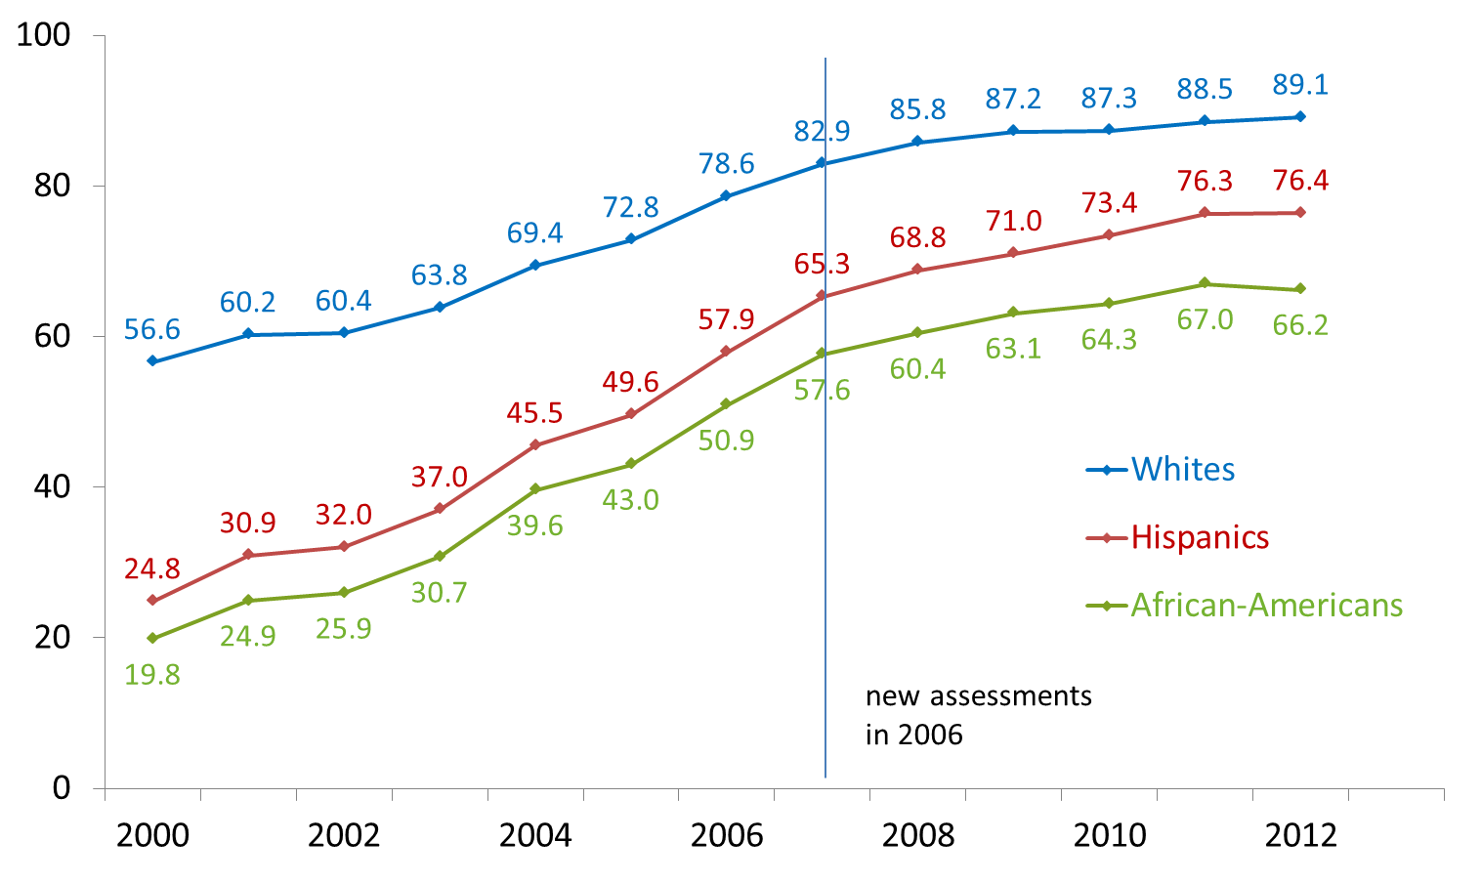
Math Gap by Ethnicity: 2000 – 2012 (excludes ACT) (all grades, Report Card population)
Notes:
We are hoping that MTSS and adding Early Childhood to the accreditation system will help districts continue to narrow these gaps.

