Slide 1
Inaugural Meeting - September 14, 2012

Slide 2
AGENDA
Introductions
Why Are You Here?
What Do We Need To Accomplish?
Overview of Kansas Educator Evaluation Protocol (KEEP)
Group Norms
Planning for the Work
Knowledge, Resources and Materials
Meeting the Waiver Requirements
Milestones
Next Steps

Slide 3
Introductions
Name
School, district, organization affiliation
Position
One interesting thing about YOU!

Slide 5
Kansas ESEA Flexibility Waiver Overview
Teaching in Kansas Commission II – September 14, 2012

Slide 6
Why Was ESEA Waiver Available?
Congress has not reauthorized Elementary & Secondary Education Act (ESEA), currently known as No Child Left Behind (NCLB)
U.S. Department of Education (ED) offered states relief from certain provisions of ESEA
In order to improve academic achievement and increase the quality of instruction for all students through state and local reforms
Notes:
ESEA was due to be reauthorized in 2007
Given a lack of action in Congress, the administration announced in Sept. 2011 the ability for states to apply for waivers from some NCLB provisions

Slide 7
Why Kansas Sought a Waiver
To move away from the narrowly defined accountability system in NCLB (100% proficient)
To develop new accountability system using multiple measures and goals unique to each school/district
To gain a more meaningful measure of the success and progress of Kansas schools
Already doing many of the parts of the waiver
Notes:
For too long, schools that had made tremendous gains in achievement were being labeled as failing simply because they had not met a prescribed target. Kansas wanted to define an accountability system that would set goals and measurements appropriate to each school’s unique circumstance and recognize and give credit to schools that were fostering strong improvements in student achievement.

Slide 8
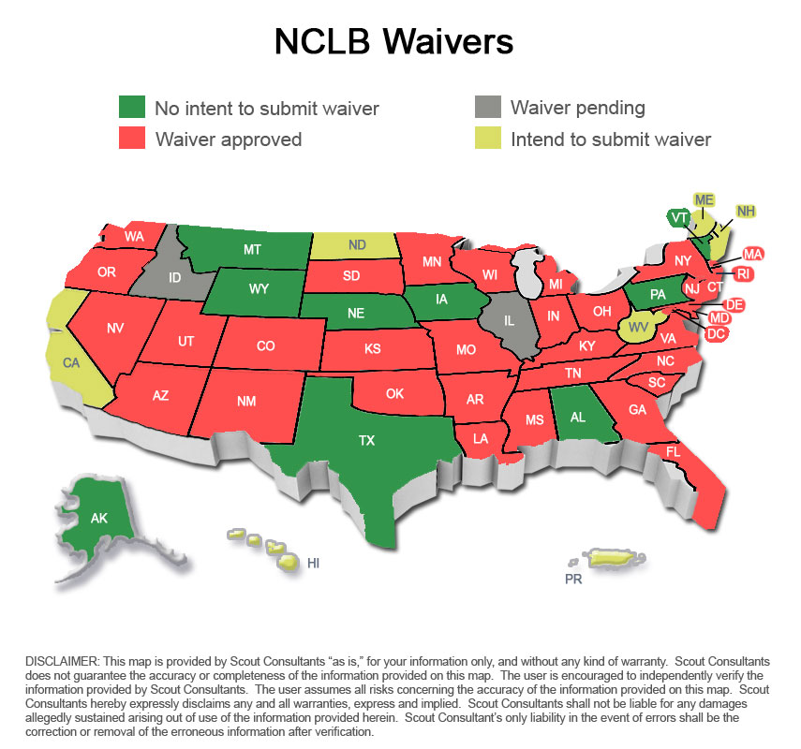

Slide 10
What Changes in New System?
No more Adequate Yearly Progress (AYP) beginning with 2013 assessments
No more 100% proficient by 2014
No more Title I schools or districts on improvement
No more sanctions for Title I schools - choice or supplemental educational services (SES—after school tutoring), etc.
Notes:
The state’s final AYP determinations will be made for the 2011-2012 school year and will be released on report cards issued in Sept. 2012.
With the elimination of AYP, there is no longer a requirement to reach 100% proficiency in reading and math by 2014
Under the new accountability plan, we will no longer be identifying Title I schools or districts as being on improvement, which means there will no longer be a requirement for those schools to provide choice or supplemental educational services.

Slide 11
Principles of the Waiver
College- and Career-Ready Expectations for All Students
State-Developed Differentiated Recognition, Accountability, and Support
Supporting Effective Instruction and Leadership
Notes:
As part of the waiver application, the state had to address these three principles.

Slide 12
Principle 1: College- and Career-Ready Expectations for All Students
Implement KS Common Core Standards (College & Career Ready) in English/language arts and mathematics by 2013-2014
Implement new high quality assessments aligned with CCS in 2014-2015
Smarter Balanced Assessment Consortium
Assessments in grades 3-8 and HS
Notes:
Much of the work to address Principle 1 of the waiver application was already underway in Kansas.
The Kansas State Board of Education adopted the Kansas Common Core Standards in Oct. 2010, establishing college and career ready expectations in those content areas. The state had already become a governing state in the SMARTER Balanced Assessment Consortium, working to develop assessments aligned to the Common Core Standards.

Slide 13
Principle 1: College- and Career-Ready Expectations for All Students
Adopt English Language Proficiency (ELP) standards aligned to CCS by 2013-2014
Administer new ELP assessments aligned to new ELP standards by 2014-2015 (revise or replace the KELPA)
Notes:
The state is working to develop and adopt new ELP standards aligned to the Common Core, and to develop and implement revised or new assessments aligned to those standards by 2014-2015.

Slide 14
Principle 2: Differentiated Recognition, Accountability, and Support
Accountability
Still use state assessments for reading and math
Look at state assessment data in four ways
Improving achievement
Increasing growth
Decreasing gap
Reducing non-proficient
Participation rates on state assessments
Graduation rates
Establish Annual Measurable Objectives (AMOs)
for each
Notes:
Much of the work in developing the state’s waiver application was in Principle 2, where we needed to define how schools, districts and the state would be held accountable for improving student achievement. The waiver required that the focus remain on reading and math results, but we were able to design a system that allowed us to look at the data in multiple ways so we could get a better picture of how the school was actually performing. Participation rates and graduation rates remain a part of the accountability system and will be measured in the same manner as in the previous system.

Slide 15
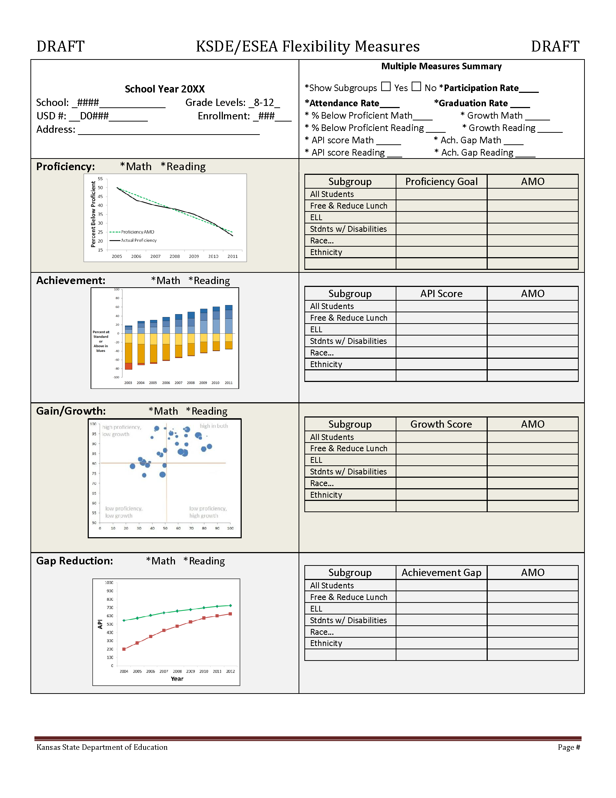
Notes:
This is an example of what a building report might look like in the new accountability system. The graphic elements depict progress toward the AMOs, which are based on the all-student population, while the charts to the right report information for subgroups. We won’t be reporting based on the new accountability system until 2013, so we continue to work on what that reporting system might look like.

Slide 16
Principle 2 Accountability—AMOs
Each performance area has its own annual measurable objective (AMO)
AMOs calculated for schools, districts and state
AMOs unique to each school/district
All students, traditional subgroups, and lowest 30% group (if 30 students in group)
Notes:
There are 6 annual measurable objectives (AMOs) in the accountability system; four that relate to state assessments. Unlike the previous accountability system, where every school in the state had to hit the same target, the new accountability system establishes unique AMOs for each school and district. The four assessment AMOs are all based on showing improvement. The amount of improvement that needs to be made each year will vary from school to school. Schools that already have high levels of performance will have a goal based on a smaller percentage of improvement as compared to schools that may not be performing as well.
AMOs will be determined for the all-student population and for subgroups, and we’re adding an additional subgroup that represents the lowest performing 30% of students in the school or district. This new subgroup will be used with the gap measure.
In order to show that they’re making progress, schools will have to meet just one of the four AMOs for each content area (reading and math), as well as the participation rate AMO.

Slide 17
Example: Achievement AMO
Assessment Performance Index - API
Acknowledges results at all performance levels
AMO—Amount of Improvement based on what quartile school is in
Notes:
The AMO related to achievement relies on the API – Assessment Performance Index. The API assigns a specific point value for each student performing in one of the five performance levels, granting a higher point value for students in higher performance levels. In this way, we’re able to look at performance across all of the levels and recognize when students are being moved out of lower levels and into higher levels. In that way, the index works in a similar fashion to our current Standard of Excellence calculation.

Slide 18
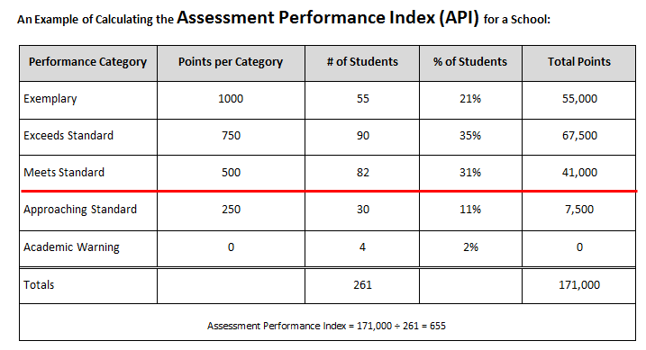
Calculating API
Notes:
In this example of an API calculation, you can see how credit is given in increasing amounts as students are moved from one performance level to the next. In the previous system, schools were only given credit for getting students above the red line. There was no credit given based on how far above the red line they moved students, and no credit for upward movement that occurred below the red line.

Slide 19
Notes:
This is an example of what performance looked like for one school under the old AYP system of accountability. While the school showed high performance, it wasn’t necessarily reflecting any improvement in performance.

Slide 20
Notes:
This is what performance looks like for the same school using the API in the new accountability system. Because the API looks at improvement in all five performance levels, you can see that the school was effecting improvements in student performance, helping them move from lower performance levels into higher performance levels.

Slide 21
Principle 2 Recognition & Support
Identify Title I Reward, Priority and Focus Schools:
Reward Schools: Highest performance or highest progress (10% of Title I schools= 66)
Priority Schools: Lowest performing (5% of Title I schools= 33)
Focus Schools: Largest gaps between state benchmark and lowest achieving students in school (10% = 66)
Notes:
The new accountability plan provides a mechanism for recognizing high-performing Title I schools. These Reward Schools will be identified based on high performance or high progress among the all-students group as measured by the Assessment Performance Index, using four years of reading and math assessment data. Ten percent of Title I schools will be identified as Reward Schools and will receive recognition. Rewards will be provided to these schools as funding is available.

Slide 22
Principle 2 Recognition & Support
Identification of these schools is based on
Reading and math assessment results combined
Multiple years of data
“All Students” group
Priority & Focus schools implement interventions
Federal School Improvement Grants & Title I funds available for the Priority & Focus Schools
Kansas Learning Network provides support
Notes:
We will no longer be identifying Title I schools on improvement, however, we will identify Title I priority and focus schools. Priority schools are the lowest achieving Title I schools based on their all-students API score. The determination is made using the most recent four years of assessment data for reading and math combined. We must identify five percent of Title I schools as priority schools. These schools will receive support from KSDE through the Kansas Learning Network and the Technical Assistance Support Network to implement interventions aligned with the turnaround principles. The list is good for three years; while schools may be removed the list prior to the end of the three-year period, no new schools will be added to the list during that time.

Slide 23
Principle 3 Supporting Effective Instruction and Leadership
Implement teacher & principal evaluation & support systems that:
Are used for continual improvement of instruction
Use at least 3 performance levels
Use multiple measures including student growth as significant factor
Are used to evaluate on a regular basis
Provide clear, timely, and useful feedback
Are used to inform personnel decisions
Notes:
The third principle that had to be addressed in the waiver application was around supporting effective instruction and leadership and focused primarily on teacher and principal evaluations. The waiver requirements related to this principle are outlined on this slide.

Slide 24
Which Evaluation System?
No specific system is required; however, all teacher and principal evaluation systems must meet the Kansas guidelines for educator evaluation
Kansas Educator Evaluation Protocol (KEEP) is a model which districts may use
If districts use own system, it will be reviewed by KSDE to ensure it meets guidelines
Notes:
Kansas is not mandating a specific evaluation system for all districts, however we are requiring that all evaluation systems meet the state’s educator evaluation guidelines.
Through a collaborative effort with a variety of stakeholders, KSDE developed a model evaluation system known as the Kansas Educator Evaluation Protocol, or KEEP, and began piloting the system during the 2011-2012 school year. Districts may choose to use KEEP as their evaluation system, but they are not required to. If they choose to use a different system, it will need to be reviewed by KSDE to ensure it is in compliance with the state guidelines.

Slide 25
Principle 3 Timeline
2011-12— Kansas guidelines submitted for ED Peer Review
By end of 2012-2013 define student growth & how used as significant factor in educator evaluations
State assessments
Other measures to be determined
Teaching in Kansas Commission II
Makes recommendations on student growth as significant factor in educator evaluations
State Board makes final decision
Notes:
Principle three is an area in which our work is not yet complete, but we do have a plan for achieving the objectives of this principle. The waiver criteria stipulates that student growth must be a significant factor in educator evaluations. In Kansas, we are appointing a commission to make recommendations on the best method for integrating student growth in educator evaluation systems, including KEEP. Those recommendations will be presented to the State Board of Education, which will make the final decision. That work is set to be complete by the end of the 2012-2013 school year.

Slide 26
Timeline (cont’d)
2012-13—
Districts determine whether use KEEP or own system; submit own system for review
Teaching in Kansas Commission II
Pilot KEEP
2013-14—Pilot
2014-15—Fully implement
Notes:
In the 2012-2013 school year, we will continue the pilot of KEEP. The Teaching in Kansas Commission will meet and by the end of that school year we will know what the state guidelines for educator evaluations are. At that time, districts will need to decide which evaluation system they will use. If they decide to use a system other than KEEP, they will need to submit it to KSDE for review.
An additional pilot of KEEP, which will include the integration of student growth measures, will take place in the 2013-2014 school year. By 2014-2015, KEEP will be fully implemented, and those districts using a different evaluation system will need to have their system fully implemented, as well.

Slide 27
Waiver Helps with Transition
Focus on common core standards
Develop and implement next generation of state assessments
Design a new accreditation system
Prepare for a future reauthorized ESEA
Notes:
It’s important to keep in mind that the waiver is not the end-game in terms of school accountability. That will come with the reauthorization of ESEA. The waiver allows us to be better positioned for the transition once ESEA is reauthorized. It allows us to focus on our implementation of the Kansas Common Core Standards and the development of our new assessments aligned to those standards. It also helps us as we design a new system of accreditation for our state.

Slide 28
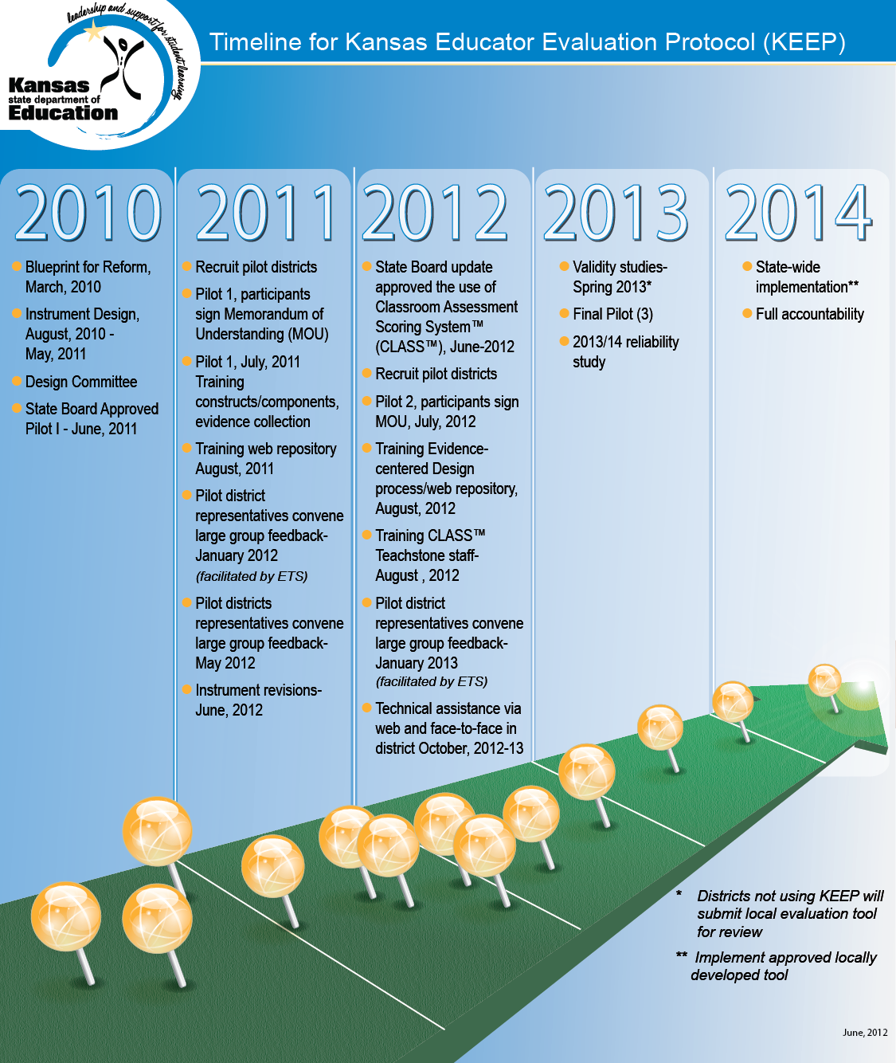

Slide 29
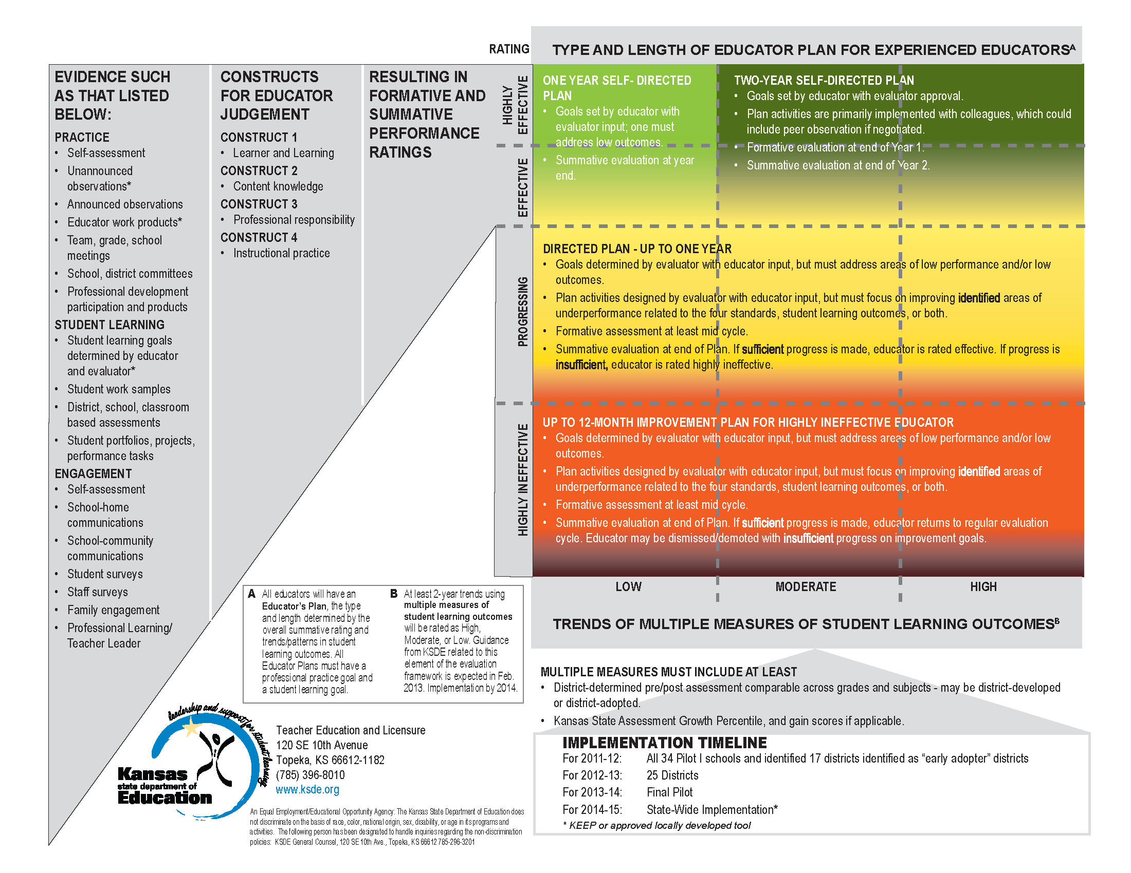
Adapted with permission of the Massachusetts Teacher Association

