Slide 1
Welcome to the Special Education Advisory Council Meeting
Please be sure your microphone is muted until you wish to participate in an open discussion with the council.
The meeting will start promptly at 9:00.

Slide 2
How to pin the Interpreters Video
Our Interpreters today are Tanya Northcraft and Robin Olson.
At the top of your meeting window, hover over the video of the participant you want to pin and click ...
From the menu, click Pin.
Optional: If you want to pin additional videos (up to 9 total), follow steps 1 & 2 again as needed.
Optional: If you have at least 3 participants in the meeting and dual monitor enabled, you will have the option to pin to your first screen or your second screen.

Slide 3
Special Education Advisory Council
September 16, 2021

Slide 4
Call to Order
Welcome
Roll Call

Slide 5
Approvals
Agenda for today, September 16, 2021
Minutes July 15, 2021
Notes:
Poll I and 2

Slide 6
Public Comment
Guidelines for Testimony
Prior to start of the SEAC meeting, be sure to email Kelli Byrne, kbyrne@ksde.org expressing desire to speak during public comment.
All comments will be taken under advisement by the council.
Any response from the Council to public comments will come at a later date.
Verbal Public Comment
Verbal comments are limited to three minutes.
Cue will be given one minute before time expires.
Written Testimony
Written input must include the name, address and county of residence of the person submitting comment.
Written comments can be submitted via email, mail, or fax to the secretary of the SEAC.

Slide 7
State Performance Plan/Annual Performance Report SEAC Data and Information Requests
Brian Dempsey
Notes:
Brian will need to share his screen.

Slide 8
Indicator 2 Dropout Data Request and GED Discussion

Slide 9
Indicator 2 Dropout
SPP/APR offered 2 options:
Option 1: Leaver/Exiter Dropout Rate (ages 14-21)
KSDE will utilize with the SPP/APR FFY20 (February 1, 2022) submission forward.
Option 2: Annual event measuring dropouts over all SWD enrolled in grades 9-12.
KSDE utilized with SPP/APR submissions prior to FFY20.

Slide 10
Option 1: Leaver/Exiter Dropout Rate
Number of SWD
dropouts
3,437
Number of SWD
regular diplomas
Number of SWD
alternate diplomas
Number of SWD
reached max age
Number of SWD
certificates
Number of SWD
dropouts
9,100
+ + + +
=
413 0 611 3,437
13,561
Dropout Calculation: 3,437 / 13,561 = 25.34%
Students with disabilities (SWD)
Illustrative and not Kansas data
8

Slide 11
Option 2: Annual Event Dropout Rate
Number of SWD
dropouts
3,437
Number of SWD
enrolled in Gr. 9–12
67,679
Dropout Calculation: 3,437 / 67,679 = 5.08%
Illustrative and not Kansas data
9

Slide 12
KSDE Dropout Data SWOD and SWD
SWOD: Students without disabilities:
Option 1 for school years 2010-2020:
Numerator: Sum of the number of Students that are not students with disabilities (ages 14-21 years) who exited due to dropping out
Denominator: Sum of number of Students that are not students with disabilities. (ages 14-21 years) with the following exiting categories: (a) graduated with a regular high school diploma; (b) reached maximum age; or (c) dropped out.

Slide 13
KSDE Dropout Data SWOD and SWD
School Year | SWOD Rate | SWD Rate
2019-2020 | 6.5% | 14.11%
2018-2019 | 7.2% | 17.95%
2017-2018 | 7.2% | 16.81%
2016-2017 | 8.5% | 17.90%
2015-2016 | 8.7% | 15.26%
2014-2015 | 8.5% | 16.77%
2013-2014 | 7.2% | 15.26%
2012-2013 | 7.5% | 15.73%
2011-2012 | 7.5% | 18.63%
2010-2011 | 7.4% | 18.64%
2009-2010 | 12.2% | 18.80%

Slide 14
GED Discussion: Graduation
Indicator 1: Graduation
Percent of youth with Individualized Education Programs (IEPs) exiting from high school with a regular high school diploma.
GED Guidance: FILE 009 – Children with Disabilities (IDEA) Exiting Special Education File Specifications – V17.0 (SY 2020-21)
As defined in 34 CFR 300.102(a)(3)(iv), the term regular high school diploma means the standard high school diploma awarded to the preponderance of students in the State that is fully aligned with State standards, or a higher diploma, except that a regular high school diploma shall not be aligned to the alternate academic achievement standards described in section 1111(b)(1)(E) of the ESEA. A regular high school diploma does not include a recognized equivalent of a diploma, such as a general equivalency diploma, certificate of completion, certificate of attendance, or similar lesser credential. (emphasis added)

Slide 15
GED Discussion: Dropout
Indicator 2: Dropout
Percent of youth with IEPs dropping out of high school.
GED Guidance: FILE 009 – Children with Disabilities (IDEA) Exiting Special Education File Specifications – V17.0 (SY 2020-21)
This includes dropouts, runaways, GED recipients (in cases where students are required to drop out of the secondary educational program in order to pursue the GED certificate), expulsions, status unknown, students who moved but are not known to be continuing in another educational program, and other exiters from special education.
GED - In states where students may receive a GED without dropping out of school, these students may be reported as having received a certificate. These are students who were jointly enrolled in secondary education and a GED program. In all other cases, GED recipients should be reported as dropped out. (emphasis added)

Slide 16
GED Discussion: Eligibility
Eligibility to take the GED test:
K.A.R. 88-24-1. Eligibility to take GED test.
Each applicant to take the general education development (GED) test shall meet the following requirements:
(1) Be neither currently enrolled at nor graduated from an accredited public, private, denominational, or parochial high school in the United States or Canada; and
(2) be 16 years of age or older.

Slide 17
GED Discussion: Eligibility
K.A.R. 88-24-1(b) In addition to meeting the requirements specified in subsection (a), each applicant who is 16 or 17 years old shall meet the following requirements: (1) Provide one of the following: (A) Written permission from a parent or legal guardian; or (B) written proof of legal emancipation; and (2) provide proof of meeting one of the following requirements: (A) Have participated in a final counseling session conducted by the school district where the applicant currently resides and signed a disclaimer pursuant to K.S.A. 72-1111(b)(2), and amendments thereto; (B) have disenrolled from an alternative education program approved by a Kansas unified school district; (C) have graduated or disenrolled from a program of instruction approved by the state board of education pursuant to K.S.A. 72-1111(g), and amendments thereto; (emphasis added) or (D) be exempt from compulsory attendance pursuant to a court order.

Slide 18
Brian Dempsey Attorney SETS (785) 296-6518 bdempsey@ksde.org

Slide 19
Stakeholder Input on State Performance Plan/Annual Performance Report
Laura Jurgensen
Notes:
Laura will share her screen.

Slide 20
ESI Longitudinal Data Discussion
Shanna Bigler
Notes:
Shanna will share her PowerPoint slides.

Slide 21
TASN Survey
Amy Gaumer Erickson
Crystal Davis
Notes:
Amy Gaumer Erickson will share her screen. Handout emailed out prior to the meeting.

Slide 22
Lunch Break

Slide 23
Proposed Changes to the SIMR and Indicator 17 (SSIP)
Kerry Haag

Slide 24
State Performance Plan and Annual Performance Report
(SPP/APR) FFY 2020-2025 Stakeholder Involvement
Indicator 17: State Systemic Improvement Plan

Slide 25
State Systemic Improvement Plan (SSIP)
SPP/APR Indicator 17
Each State is required to submit in the FFY 2020 SPP/APR, Part B Indicators 1-17 by February 1, 2022.
A comprehensive, ambitious, achievable, multi-year State Systemic Improvement Plan (SSIP) to improve results for children with disabilities. The plan is comprised of three phases; Analysis, Plan, Implementation, and Evaluation.
Measured annually using: 1) analysis of the State-Identified Measurable Result (SIMR) progress data; and 2) report on implementation of principle SSIP improvement strategies, activities, measures, and outcomes

Slide 26
Requirements for Indicator 17 Measurement
Baseline Data: Expressed as % and aligned with State Identified Measurable Result (SIMR)
SIMR must measure performance of students with disabilities.
Updated Data: Aligned with SIMR, expressed as % and whether target was met

Slide 27
Last Thoughts Target Setting
Targets may remain the same several years in a row.
Targets must show improvement over baseline in the end.
The state must clearly and completely explain the rationale and method used.

Slide 28
State Systemic Improvement Plan (SSIP)
Indicator 17

Slide 29
What is Indicator 17?
State Systemic Improvement Plan (SSIP)
Measured by locally administered Curriculum-Based Measure – General Outcome Measure (CBM-GOM) from a state-selected cohort of districts
State-selected cohort: Kansas MTSS and Alignment districts who are installing an integrated school improvement framework for academics, behavior, social and emotional learning
Indicator 17 - The SSIP is a comprehensive, ambitious, yet achievable multi-year plan measuring the results for children with disabilities. Its goal is to improve results for children with disabilities, with stakeholder involvement in each phase: analysis, planning, implementation and evaluation.
2013-2020 State Identified Measurable Result (SIMR)
Percentage of children with disabilities in grades K-5 who perform at benchmark or above in Reading

Slide 30
State Systemic Improvement Plan (SSIP) Strategies
Coherent Improvement Strategy 1.0 infrastructure development through strategically realigning, reallocating, and leveraging current State Education Agency (SEA) policies, organization, and infrastructure for increased capacity of districts to implement evidence-based practices.
Coherent Improvement Strategy 2.0 supports the implementation of evidence-based practices through designing, implementing, and evaluating an integrated school improvement-planning framework built on the existing Kansas Multi-Tier System of Supports (Kansas MTSS) and Alignment.
Coherent Improvement Strategy 3.0 evaluates the degree to which the state infrastructure supported district implementation of evidence-based practices to improve reading results for students with disabilities kindergarten through fifth grade.

Slide 31
Changes to Indicator 17 for the 2020-2025 SPP/APR Reporting Period
FFY 2014-2019 SSIP Evaluation data indicated:
Steady increase in percentage of students with disabilities reading at benchmark or above
KSDE is proposing changing SIMR calculation from a percentage at grade level benchmark to one based on the rate of improvement.
Change will take effect in data collected during the 2021-2022 school year.

Slide 32
Indicator 17 – Historical Data for the State Systemic Improvement Plan (SSIP) Kansas State Identified Measurable Result (SIMR)
FFY | 2013 | 2014 | 2015 | 2016 | 2017 | 2018 | 2019
Target >= |  | 29.95% | 30.00% | 27.52% | 28.50% | 29.50% | 29.50%
Data* | 29.95%* | 24.41% | 26.37% | 27.52%** | 31.11% | 30.25% | --
*Baseline
**Baseline Re-Established

Slide 33
Reading Proficiency & Reading Accuracy, children K–5 in the SIMR Cohort districts

Slide 34
Proposed Revision to SIMR Measurement
The measurement tool for the Kansas SIMR will remain the same, a curriculum-based measure/general outcome measure, however, the calculation from this assessment will be shifting. Kansas proposes moving from a grade level benchmark to a Rate of Improvement calculation. This is a new calculation, offered by the assessment product FastBridge, is based on the same reading skills as grade level benchmarks but is reflective of student growth opposed to mastery. Focusing on a rate of improvement calculation ensures students with disabilities are not falling farther behind non-disabled peers, reflecting their actual growth even if they remain below grade level. This measurement approach is consistent with the spirit of IDEA by ensuring that students with disabilities are not only making progress but also not falling farther behind.

Slide 35
COVID-19 Impacts
In FFY2020, no data could be collected on this indicator due to the shift to remote instruction across the state as result of Covid-19 pandemic.
In FFY2021, while data collection itself has not been impacted; the level of student performance has yet to be determined/analyzed.
Hypothesis: FFY2021 data collected in Spring of 2021may indicate a learning loss and lower than typical percentage of students with disabilities scoring at benchmark.

Slide 36
Baseline Changes to Indicator 17 for the 2020-2025 SPP/APR Reporting Period
A new performance baseline was established in FFY 2016
While KSDE must establish a FFY 2020* performance baseline there is no recent data to use in reliably inform establishment said baseline.
As a result,
Proposal is to continue the SIMR and use the 2019 target of 29.50% as a baseline for FFY2020.
*Reminder: In FFY2020 no data could be collected on this indicator due to shift to remote instruction across the state as result of Covid-19 pandemic.

Slide 37
Proposed Targets for Indicator 17
FFY2020*: 29.50% baseline proposed
FFY2021- FFY 2025: 29.51 % target proposed
FFY2022: Proposed change in SIMR measurement criteria calculation requires establishment of new baseline and targets.
Proposed 2021 SIMR Measurement Criteria: Measure rate of reading improvement for students with disabilities within a NEW cohort of Kansas MTSS and Alignment buildings.
SIMR data collected during the 2021-2022 school year and stakeholder input to inform new baseline and targets

Slide 38
How were Proposed Targets Determined?
Reviewed data from FFY 2014 to FFY 2019.
Baseline was changed in FFY 2016.
Discussed carrying the 2019 target forward and, then in FFY 2021, the baseline and target will reset.
Linear forecasting was used as a tool for discussion.
Ensured FFY 2025’s target was higher than baseline year FFY 2005 per OSEP’s guidance.

Slide 39
Data Visualizations and Feedback
KSDE has created and established interactive visualizations of indicator’s historical and projected data on a site called Tableau Public.
Indicator 17 SIMR Data: Five years of performance that can be reported.
Data Visualizations are not available for Indicator 17.

Slide 40
Contact Information
Kerry Haag
Assistant Director,
Special Education Title Services (785) 291-3097 khaag@ksde.org

Slide 41
Fiscal Update
Dean Zajic

Slide 42
SEAC Fiscal Update
September 16, 2021
Notes:
How addressing impact of pandemic on children and youth with disabilities and learning…
CEIS- how funds being used?
LEA MOE adjustment- are LEAs aware? Notification?
Strategies for long-term and short-terms needs?
Lot of money and a short amount of time- strategies

Slide 43
Update On Federal Aid

Slide 44
Federal relief funds intended to further support LEAs and nonpublic schools in addressing these needs
Elementary & Secondary School Emergency Relief Fund (ESSER)
Emergency Assistance to Non-Public Schools (EANS)
Description
Awarded to SEAs based on Title I formula to provide emergency relief funds to LEAs to address the impact that COVID-19 has had, and continues to have, on elementary and secondary schools across the Nation
Awarded to Governors to provide services or assistance to eligible non-public schools
Intended Use
Used by LEAs for preventing, preparing for, and responding to COVID-19
Address the impact of COVID-19 on non-public school students & teachers
ESSER I
ESSER II
ESSER III
EANS I
EANS II
Bill
CARES Act (Mar '20)
CRRSA Act (Dec '20)
ARP Act (Mar ‘21)
CRRSA Act (Dec '20)
ARP Act (Mar ‘21)
KS Amount
$85M
$370M
$830M
$27M
$25M
Timeframe
Usable from Mar ‘20
ARP-IDEA 28M SPED
Obligate by Sep '24
Obligate by Sep '24
Usable from Mar ‘20
8M SPED
Obligate by Sep '22
Usable from Mar ‘20
24M SPED
Obligate by Sep '23
Usable from Mar '20
Obligate by Aug '21
Services through Sep '23

Slide 45
Maintenance of Effort Concerns
No extraordinary waivers are available to reduce state Maintenance of Fiscal Support (MFS)
No extraordinary waivers are available to reduce local Maintenance of Effort (MOE)
No additional waivers for IDEA to extend the period of availability have been provided.
This surge in funding is needed but temporary. Plan accordingly.

Slide 46
Additional Reading

Slide 47
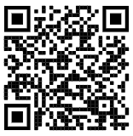
Strategies for Using American Rescue Plan Funding
https://www2.ed.gov/documents/coronavirus/lost-instructional-time.pdf

Slide 48
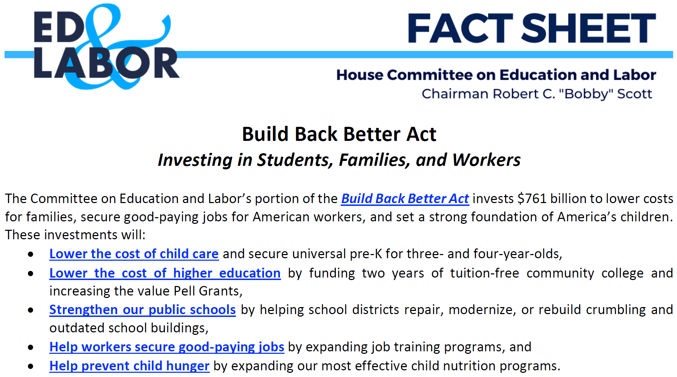
Factsheet on the ED & Labor Committee Portion of the Build Back Better Act
https://edlabor.house.gov/download/build-back-better-fact-sheet

Slide 49
Questions?

Slide 50
Dean Zajic Coordinator
Special Education and Title Services (785) 296-2425 dzajic@ksde.org

Slide 51
KSDE Updates
Bert Moore

Slide 52
Break
Notes:
L

Slide 53
Council Ex-Officio Member Reports

Slide 54
Ex-Officio Member Reports
Families Together
Kansas Association of Special Education Administrators (KASEA) – Ashley Enz
Disability Rights Center
Kansas State Board of Education
Others

Slide 55
Council Meeting Dates 2021-2022
November 17, 2021, Virtual
January 12-13, 2022 Virtual or In-person to be determined
April 14, 2022 Virtual or In-person to be determined

Slide 56
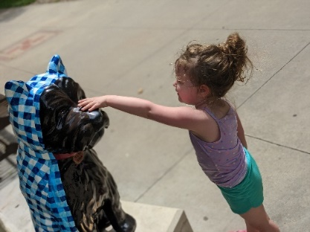
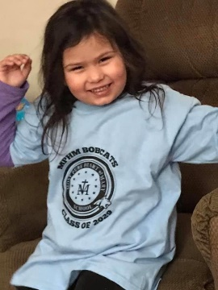
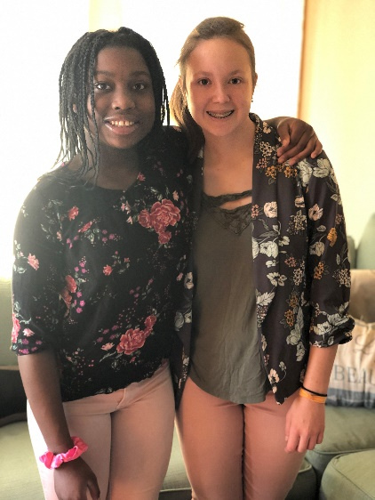
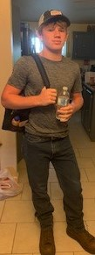
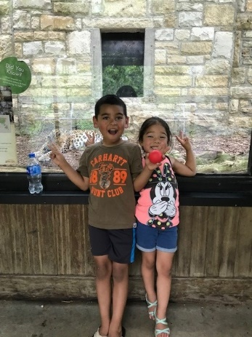
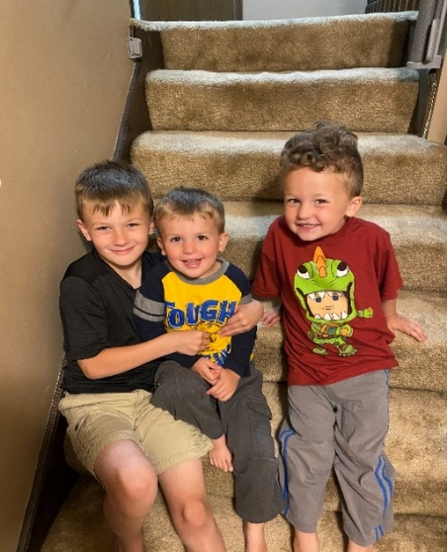
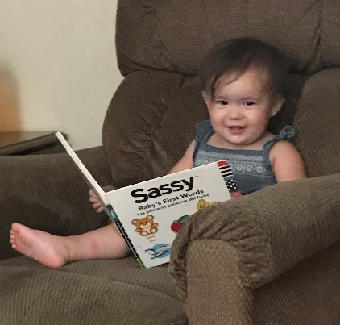
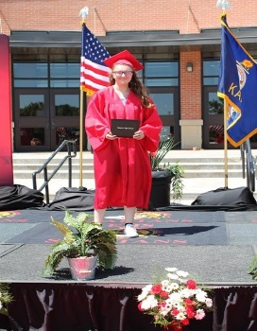
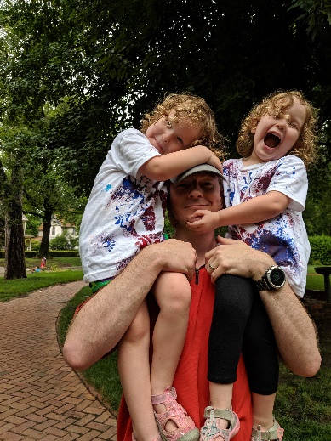
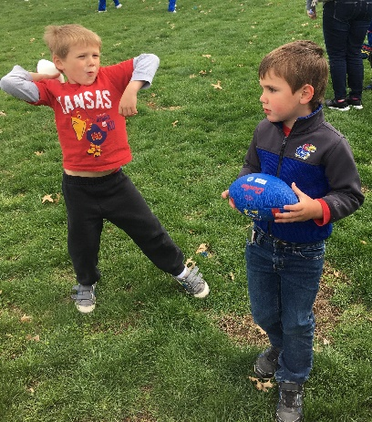
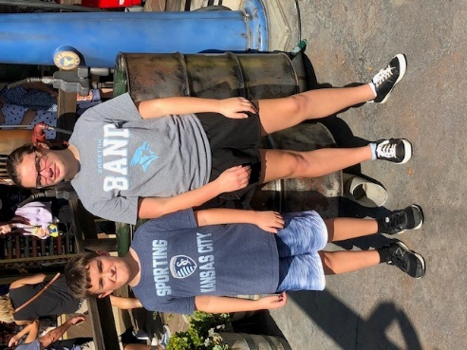
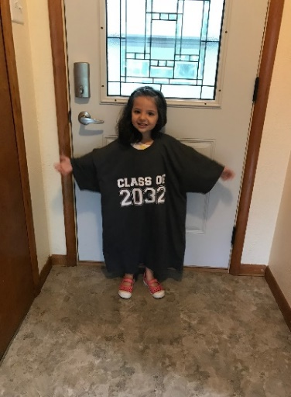
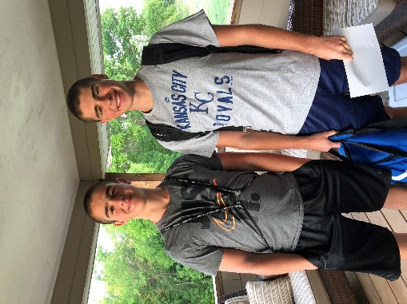
Keep The Main Thing The Main Thing

Slide 57
Closing Comments/Adjournment
Next SEAC Meeting: November 17, 2021
Virtual 9am-3pm
Items for next agenda
Motion to adjourn

Slide 58
Bert Moore Director Special Education & Title Services (785) 291-3097 bmoore@ksde.org
Kelli Byrne Administrative Specialist Special Education & Title Services (785) 291-3097 kbyrne@ksde.org

