Slide 1
Changing our Path, Maintaining our Purpose
Dr. Randy Watson, Kansas Commissioner of Education

Slide 2
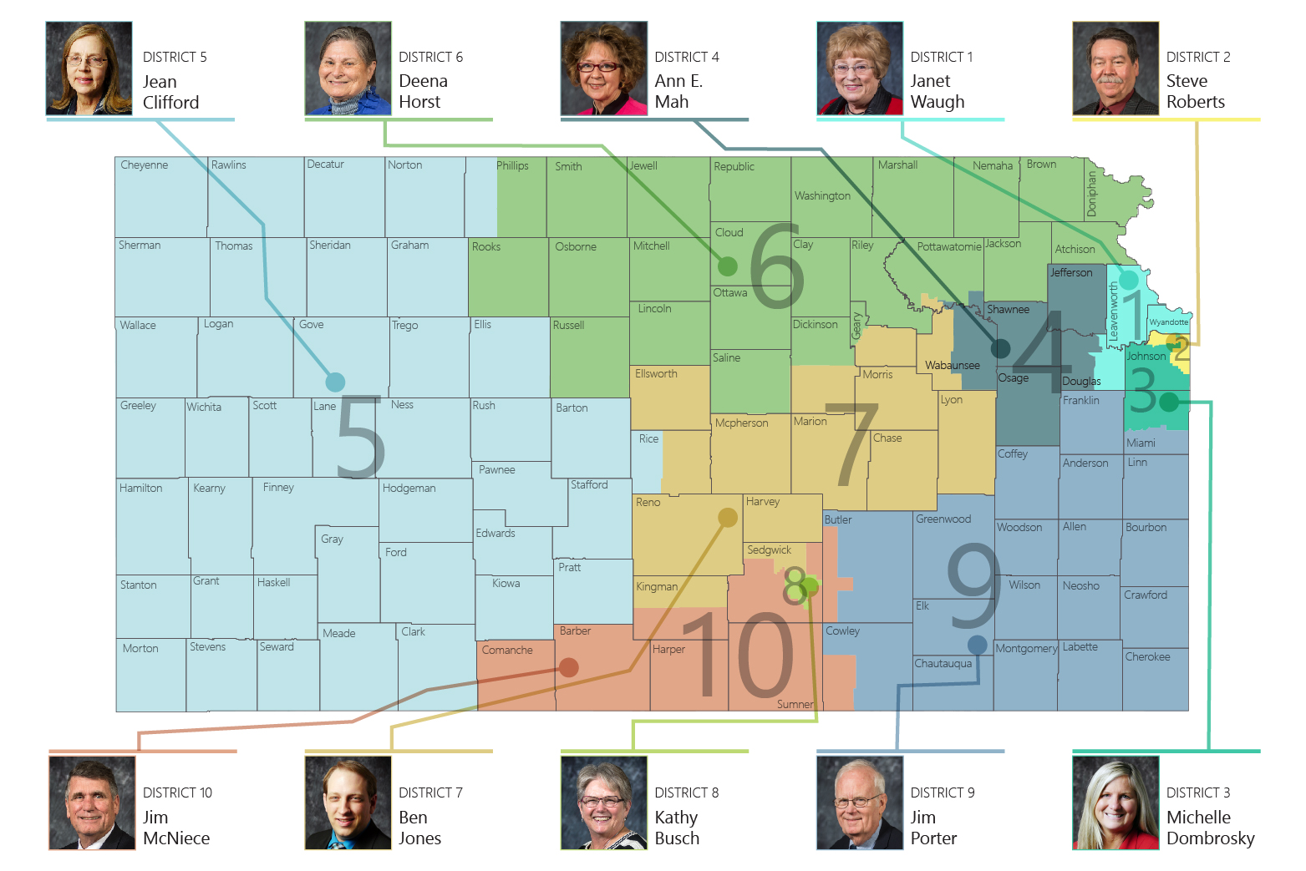

Slide 3
More than 418,000 mostly young Americans the same ages as today’s Millennials and GenZers died in WWII…
A soldier’s strength came from loved ones and fellow citizens supporting them on the Homefront. They were the impetus for people being willing to give their lives. A country isn’t anything without the people and the values it represents.

Slide 4
The Greatest Generation weren’t braggards or whiners; they were more laconic. They didn’t question putting their ambition on hold to serve their country. And back home, their loved ones—neighborhood by neighborhood, farm by farm, church by church, community by community—rallied by willingly embracing sacrifice. Gas and food were rationed, recycling happened in mass and materialism as an expression of vanity was frowned upon. - Tom Brokaw

Slide 5
Our Vision for Kansas ...
Kansas leads the world in the success of each student
Notes:
Our business cards will stand out as innovative and memorable with a vertical or portrait orientation. Bonus it has a back side!
a portrait or vertical design. It’s also two-sided!
Another fundamental change you may notice (if not you will after I tell you) is that the main address for our agency has been simplified to the main desk in Suite 102. As all our mail is sorted in the print shop having everything labeled by a different team name and suite only made sense to us as we're used to it. It is less confusing and complex for those we serve.

Slide 6
Our dilemma as Educational Leaders
Ensure maximum opportunities for student success skills to be learned
Ensure maximum safety for all students and staff
Custodial Care and Economic Engine
Students will be a remote learning environment
Students will be a ”normal” school environment

Slide 8
Stage 1- May 2020
Operations Team
Operational Sample Guidelines
Instructional Team Competencies and Assessments
Stage 2 – June 2020
Oversight Team
Consistent Messaging, Clarity, Formatting, Support/Feedback to Teams
Co-Chairs: Cory Gibson and Shannon Ralph
Operations Team
Transitions, Classroom Spaces, Facilities, Food Service, Transportation, Common Spaces and Extra and Co-Curricular
Co-Chairs: Frank Harwood and Ashley Goss
Implementation Team
Blended Models of Learning Competency Based Instruction Measuring Student Learning
PreK-2
Rachel Meenen
Tammy Mitchell
3-5
April Baugh
Cindy Hadicke
6-8
Keil Hileman
Joann McRell
9-12
Nathan McAlister
Jay Scott

Slide 9
Partners who contribute to Navigating Change

Slide 11
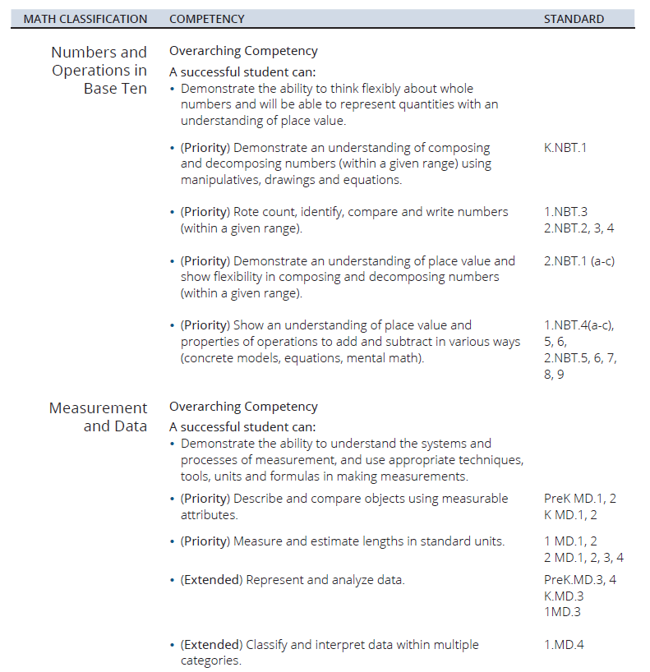

Slide 12
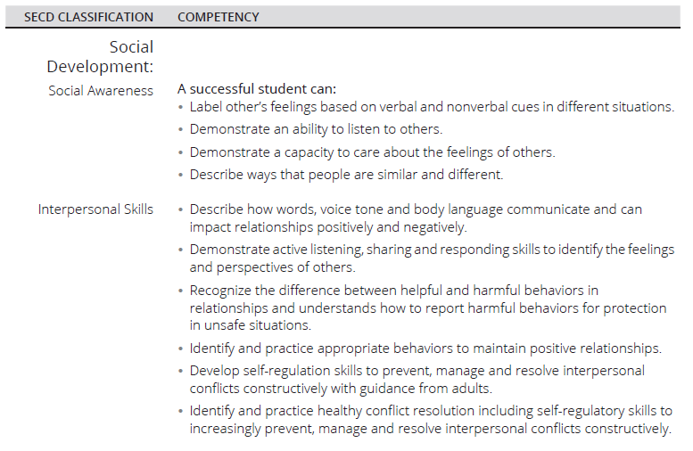

Slide 13
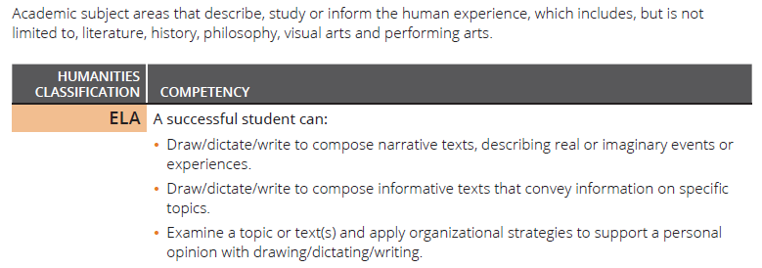

Slide 15
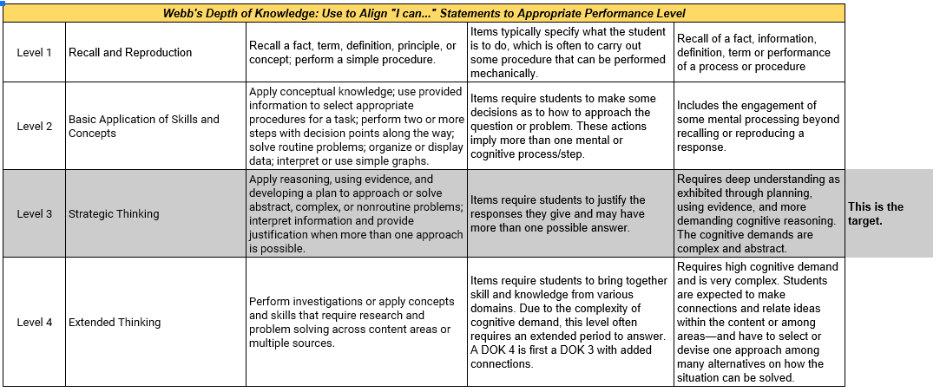
Measuring Student Learning

Slide 16
https://kansasteachingandleadingproject.org/
Notes:
Our business cards will stand out as innovative and memorable with a vertical or portrait orientation. Bonus it has a back side!
a portrait or vertical design. It’s also two-sided!
Another fundamental change you may notice (if not you will after I tell you) is that the main address for our agency has been simplified to the main desk in Suite 102. As all our mail is sorted in the print shop having everything labeled by a different team name and suite only made sense to us as we're used to it. It is less confusing and complex for those we serve.

Slide 17
Questions to ask now, then plan for the future
Social-Emotional Needs
How have you addressed the social-emotional needs of staff and students?
What data are you collecting to verify that you have effective interventions and supports?
What does your analysis of your data tell you?
What is your plan now to mitigate any social-emotional loss and what is your plan once the pandemic has ended to correct any areas of need?
Academic Needs
What local assessments and measures are you using to gauge your student growth?
What does the evidence from those assessments and measures tell you about student progress?
What is your plan now to mitigate any academic loss and what is your plan once the pandemic has ended to correct any areas of need?

Slide 18
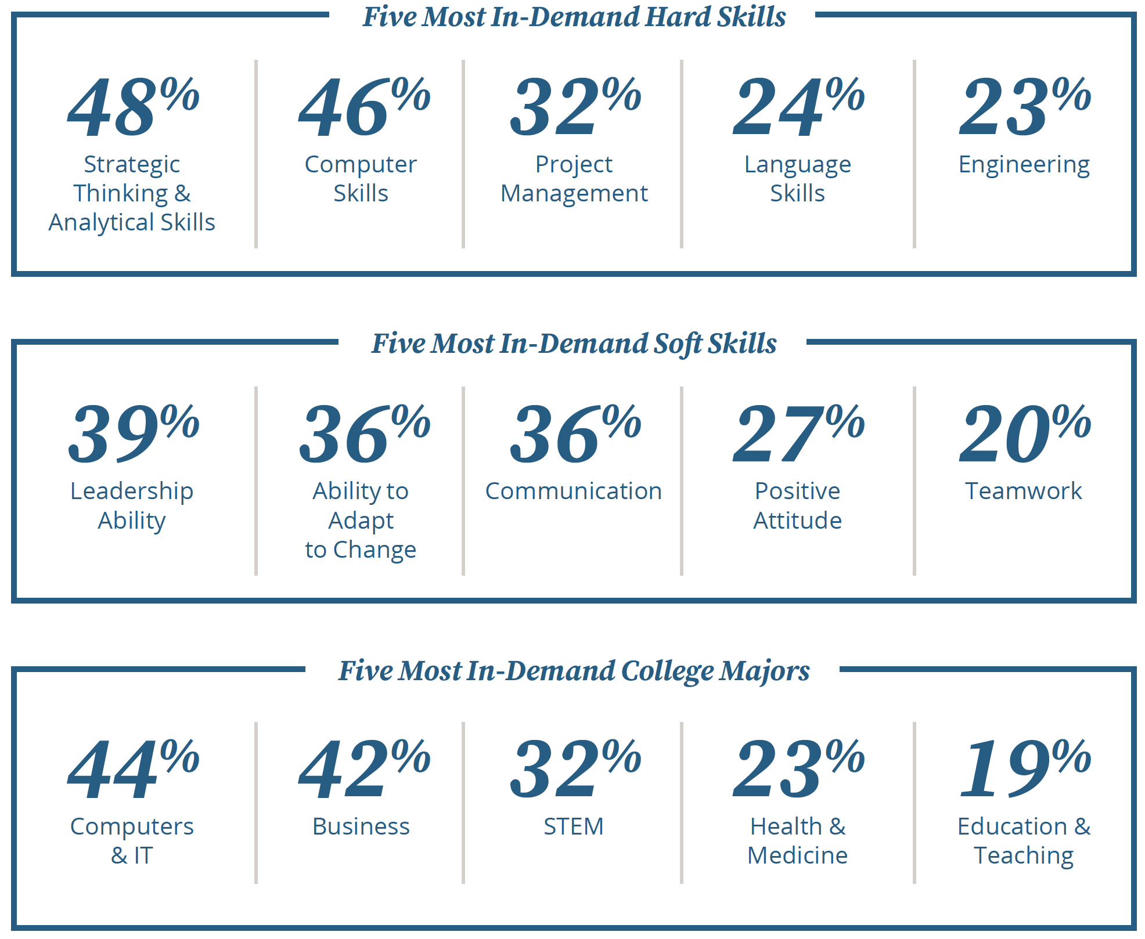

Slide 19
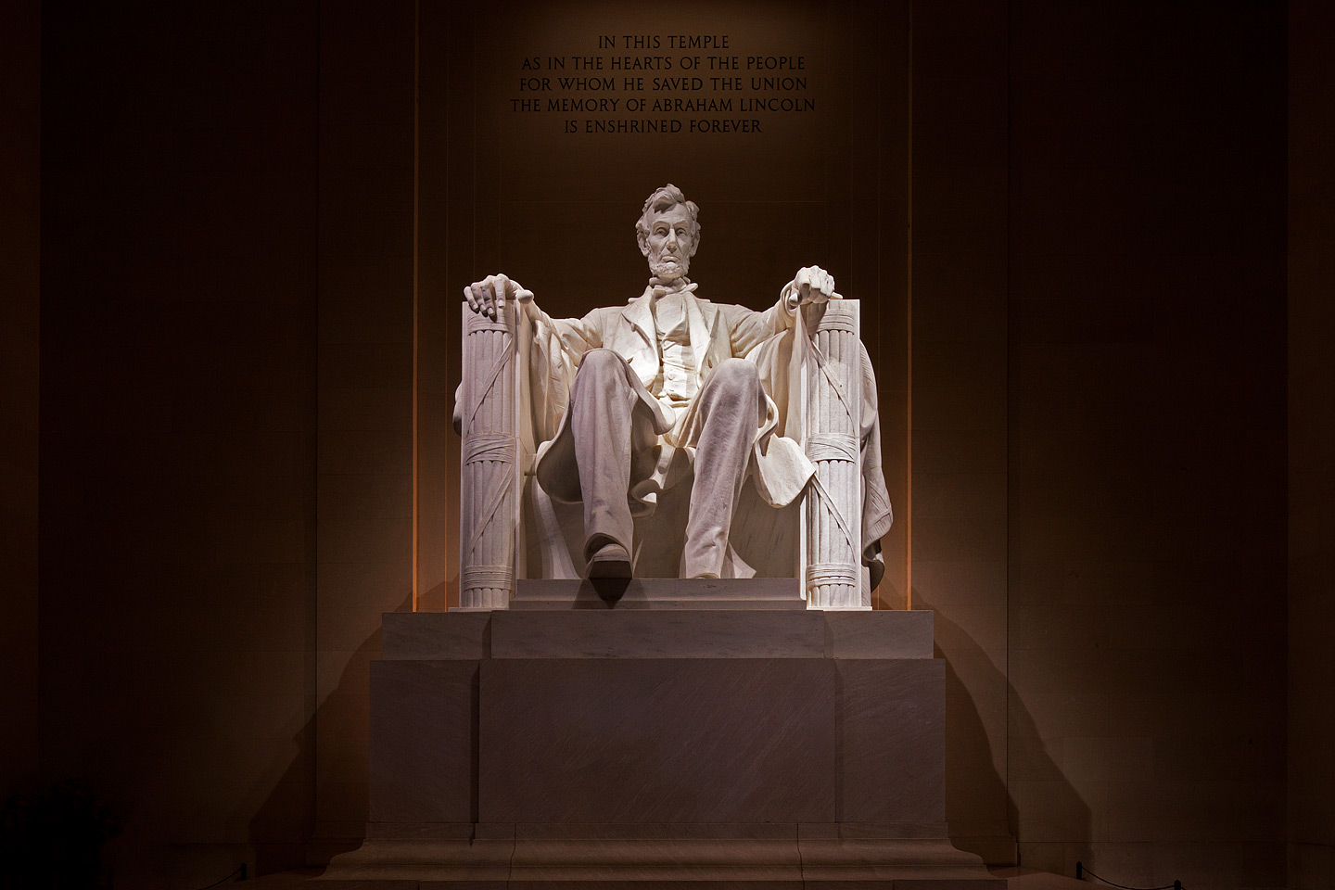
Board Leadership Challenge
“The dogmas of the quiet past, are inadequate to the stormy present. The occasion is piled high with difficulty, and we must rise -- with the occasion.” Annual Message to Congress - December 1, 1862

Slide 20
Notes:
Today’s students are the future workforce and future leaders of Kansas. Kansans Can achieve anything and, together, Kansans Can lead the world in the success of each student.

Slide 24
Notes:
Our business cards will stand out as innovative and memorable with a vertical or portrait orientation. Bonus it has a back side!
a portrait or vertical design. It’s also two-sided!
Another fundamental change you may notice (if not you will after I tell you) is that the main address for our agency has been simplified to the main desk in Suite 102. As all our mail is sorted in the print shop having everything labeled by a different team name and suite only made sense to us as we're used to it. It is less confusing and complex for those we serve.

Slide 25
Notes:
Our business cards will stand out as innovative and memorable with a vertical or portrait orientation. Bonus it has a back side!
a portrait or vertical design. It’s also two-sided!
Another fundamental change you may notice (if not you will after I tell you) is that the main address for our agency has been simplified to the main desk in Suite 102. As all our mail is sorted in the print shop having everything labeled by a different team name and suite only made sense to us as we're used to it. It is less confusing and complex for those we serve.

