Slide 1
Kansas Leads the World in the Success of Each Student.
Dr. Randy Watson, Kansas Commissioner of Education

Slide 2
A NEW Vision for Kansas ...
Kansas leads the world in the success of each student
KANSAS STATE DEPARTMENT OF EDUCATION | www.ksde.org

Slide 3
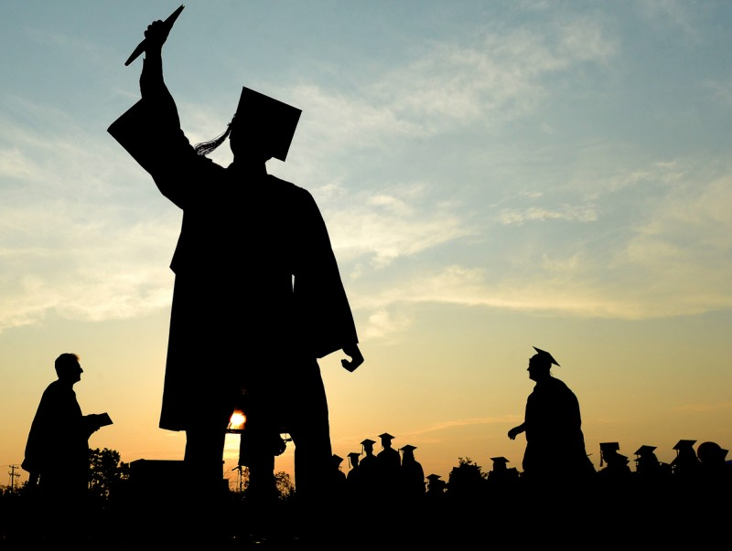
Defining Success
A Successful Kansas High School Graduate has the
Academic preparation,
Cognitive preparation,
Technical skills,
Employability skills and
Civic engagement
to be successful in postsecondary education, in the attainment of an industry recognized certification or in the workforce, without the need for remediation.
A Successful Kansas High School Graduate has the
Academic preparation,
Cognitive preparation,
Technical skills,
Employability skills and
Civic engagement
to be successful in postsecondary education, in the attainment of an industry recognized certification or in the workforce, without the need for remediation.

Slide 4
Creating a Vision for Kansas – State Outcomes
Social Emotional Growth
Kindergarten Readiness
Individual Plan of Study
High School Graduation Rates
Post Secondary Completion
Notes:
Among the outcomes being considered by the state board are:
High School Graduation Rates
Post Secondary Completion/Attendance
Remedial Rate of Students Attending Post-Secondary
Kindergarten Readiness
Individual Plan of Study Focused on Career Interest
Social/Emotional Growth Measured Locally
Education Commissioner Randy Watson and members of the State Board of Education will meet with business, education and state leaders to build agreement on how we will work together to achieve this vision for Kansas education.
Kansas schools are already doing tremendous work to address the needs of individual students, but in order to achieve this new vision we cannot expect schools to go it alone. This requires a unified effort with businesses, communities, parents, higher education, and elected officials working with educators to help provide the supports and experiences Kansas students need for their future success.

Slide 8
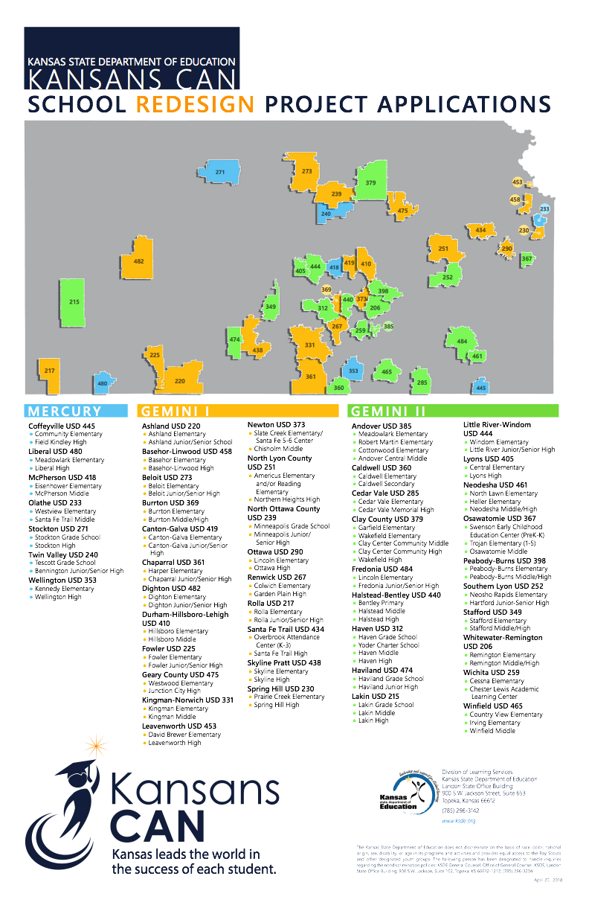

Slide 9
Redesign?
Personalized
Project Based
Intense focus on social and emotional development
Immersion with parents and the community
Notes:
Personalized Learning
What is Personalized Learning?
A personalized learning environment includes the following elements:
Personal learning paths for each student
Personalized learning time
Project-based learning
Student mentor program
Flexible learning environment
Mastery-based education
Performance-based assessments (project-based learning, portfolios, etc.)
What do teacher and student roles look like in Personalized Learning?
Teachers Students Personalize instruction by providing opportunities for students to practice skills, give real-time feedback and support students to make their own plans to reach academic goals.
Provide small group workshops based on individual student needs.
Mentors students to become self-directed learners who can set and achieve goals and maximize opportunities.
Demonstrate student agency by having choice in when, where, and how they learn.
Select content that best meets their learning style.
Establish weekly obtainable academic goals.
Establish long term college goals. Work collaboratively with small groups
What is Connect? Connect is Pasadena ISD’s personalized learning initiative.
Personalized Every Connect student has a digital Personalized Learning Plan and is able to access all of the learning tools and resources they need at any time.
Empowering Connect students are self-directed learners. Connect students are encouraged and coached to develop in the elements of self-directed learning - Challenge Seeking, Persistence, Strategy-shifting, Response to Setbacks and Appropriate Help Seeking are key habits that are invaluable for college and life success.
Relevant Connect students receive consistent, relevant, and personalized support seamlessly integrated into their school day as they drive towards their academic and personal goals.
College and Career Readiness Student success in college and career must extend far beyond college acceptance. We focus on helping students to develop in four areas that form the foundation for a lifetime of success.
Mentor Support ​​Student-teacher bond is the heart of learning. Students meet weekly with their mentor teacher to set academic goals and discuss their progress.
Empowering students to engage in self-directed learning and develop key habits that are invaluable for college and life success.

Slide 10
Notes:
Today’s students are the future workforce and future leaders of Kansas. Kansans Can achieve anything and, together, Kansans Can lead the world in the success of each student.

