Slide 1
Welcome Back Ft. Scott
Dr. Randy Watson, Kansas Commissioner of Education

Slide 4
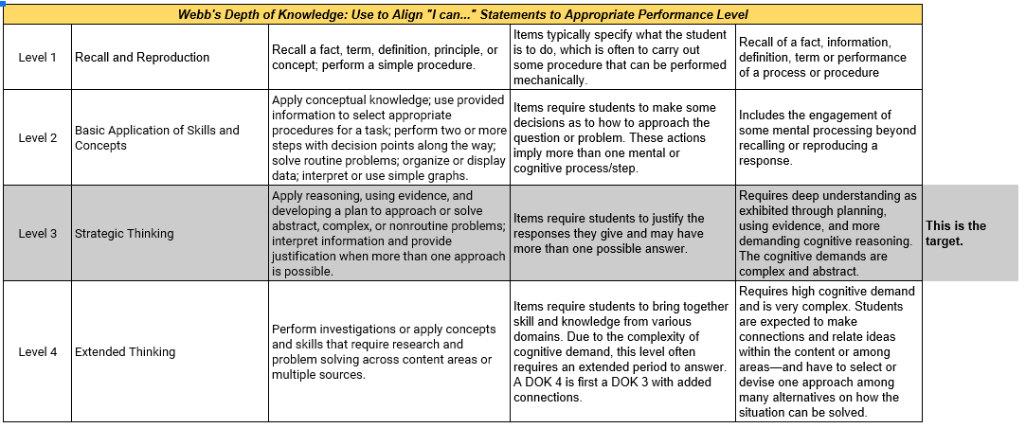
Measuring Student Learning

Slide 5
Notes:
Our business cards will stand out as innovative and memorable with a vertical or portrait orientation. Bonus it has a back side!
a portrait or vertical design. It’s also two-sided!
Another fundamental change you may notice (if not you will after I tell you) is that the main address for our agency has been simplified to the main desk in Suite 102. As all our mail is sorted in the print shop having everything labeled by a different team name and suite only made sense to us as we're used to it. It is less confusing and complex for those we serve.

Slide 6
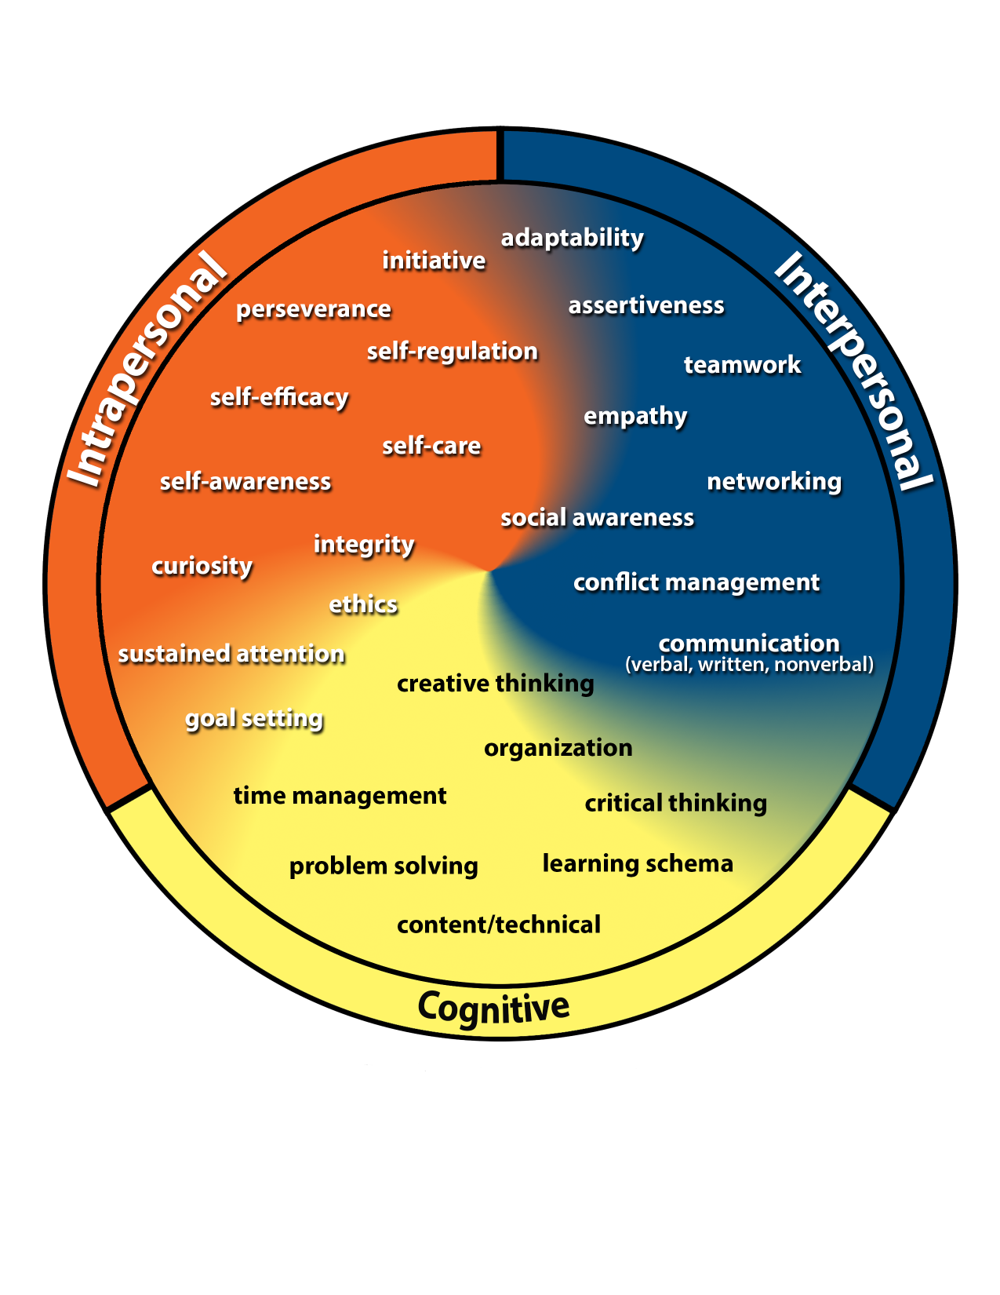
Kansans Can
Competencies

Slide 7
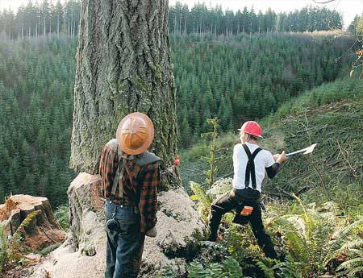
Notes:
Our business cards will stand out as innovative and memorable with a vertical or portrait orientation. Bonus it has a back side!
a portrait or vertical design. It’s also two-sided!
Another fundamental change you may notice (if not you will after I tell you) is that the main address for our agency has been simplified to the main desk in Suite 102. As all our mail is sorted in the print shop having everything labeled by a different team name and suite only made sense to us as we're used to it. It is less confusing and complex for those we serve.

Slide 8
Notes:
Today’s students are the future workforce and future leaders of Kansas. Kansans Can achieve anything and, together, Kansans Can lead the world in the success of each student.

