Slide 1
Building the
Rocket
Meeting 2

Slide 2
Agenda
9:00-9:20 Welcome, Share Out, Phase Overview
9:20-10:00 Coach Check In
10:00-10:15 Celebrations
10:15-10:30 Break
10:30-11:15 Staying Accountable
11:15-11:30 Break
11:30-12:00 Pivoting
12:00-12:45 Lunch
12:45-1:30 Model an Accountability Meeting
1:30-1:45 Break
1:45-2:45 Plan Time
2:45-3:00 Wrap Up and Closing

Slide 3
Links
Slides -

Slide 4
Kansas Vision for Redesign
Kansas leads the world in the success of each student
It’s what Kansans said they wanted. It’s what the job trends and our current K-12 outcomes are telling us.

Slide 6
Launch Readiness Rubric
Show & Launch Readiness Expectations:
All four Redesign Principles are addressed in your Redesign Plan
There is documentation of your work throughout the Plan Year (i.e. blueprint, action plans, and gap analyses for each strategy)
Evidence supports that you have regularly updated your Local Board of Education
Your School Vision & Goals align with your District Vision & Goals
Your School Vision & Goals are aligned to the State Vision, Definition of a Successful High School Graduate, and the State Board Outcomes
Category |  | Low | Medium | High
Strategy Selection, Prototyping, and Testing |  | Strategies are missing multiple components: Researched by the GAIT Supported with an Action Plan Connected to the Gap Analysis Measured through data-tracking and monitoring (scoreboards) Adjusted based on accountability meetings and reflection | Some strategies were... Researched by the GAIT Supported with an Action Plan Connected to the Gap Analysis Measured through data-tracking and monitoring (scoreboards) Adjusted based on accountability meetings and reflection | All strategies were... Researched by the GAIT Supported with an Action Plan Connected to the Gap Analysis Measured through data-tracking and monitoring (scoreboards) Adjusted based on accountability meetings and reflection
Process for Continuous Improvement | Plan to Scale | Resource implications have not been determined for strategies selected for scale and support plans have not been created. | For some strategies selected for scale, the resource implications have not been determined OR a complete support plan has not yet been created. | For each strategy selected for scale, the resource implications have been determined and a support plan has been created.
 | Sustainability & Growth | Strategy support through professional development and GAIT team maintenance has not been incorporated into the plan for scale. | Some plans exist regarding professional development for strategies selected for scale, but there is no designated GAIT time set aside for accountability meetings. | There is a plan for ongoing professional development, GAIT time, and accountability meetings so that strategies can be evaluated, monitored, and adjusted in a timely manner.
 | Process for Ongoing Improvement | The district and school have not worked to align improvement plans. It is unclear how school goals and strategies connect with district goals and strategies. Plans exist in multiple places, and they are not aligned. | The district and school improvement plans overlap, but direct alignment and connection is missing in areas.The district supports the school plans for improvement, but there is little alignment across buildings and plans. | The district and school have aligned the school Redesign Plan with the district’s plan for continuous improvement, and support is in place to continue work within the defined Goal Areas.
Internal & External Stakeholder Engagement and Communication |  | The school has not engaged both internal and external stakeholders in the Redesign process. Two-way communication is not developed and feedback loops are not in place. | The school has engaged all stakeholders, but two-way communication has not always been ensured. Feedback loops might exist for some stakeholder groups but not all. | The school has authentically and meaningfully engaged all stakeholders (students, staff, parents, community, business) in the Redesign work and has established two-way communication, opportunities for input, and feedback loops.
Notes:
Rubric- https://www.ksde.org/LinkClick.aspx?fileticket=vnD9-j4k9No%3d&tabid=1207&portalid=0&mid=3630

Slide 7
Objectives
01
Develop & Implement a Prototype Plan
Create Gap Analysis and Action Plan for each strategy
Create timeline for implementation
Create success criterion for implementation
02
Keep Score and Stay Accountable
Create scoreboards for every strategy
Establish cadence of accountability for each GAIT
Create team roles and responsibilities for meeting
03
Identify Scaling Needs
Create Gap Analysis around each strategy for scaling
Create project plan and needs statement
Generate PD/Budget/Resource Plan for scaling
04
Conduct School Visits
Goal Areas, Investigation Teams, and Capacity
In State, Out of State, and/or Virtual
Set up a Why and Goals before each visit
05
Communicate with Stakeholders
Why, Who, How, and When
Continue developing your plan
Over communicate
Notes:
We have already done 1 and 2. If you have not done those in your school, then that should be your priority. 5 is ongoing and should be happening all of the time. This phase really focuses on 3 and 4.

Slide 8
Building the Rocket
FOCUS
LEVERAGE
ENGAGEMENT
ACCOUNTABILITY
Your Vision for Education
Engage in Disciplines 3 & 4 Prototype and Test Engage Stakeholders Strategies & Communicate
-Define Lead & Lag -Prioritize Strategies to -Document and Share Measures Prototype Progress
-Create Scoreboards -Complete Gap Analysis -Update Communication
-Establish Cadence -Create Action Plans and Business Plan
of Accountability -Create Plan for Scale -Share Resource
and Sustainability Implications with System
Notes:
Focus on the wildly important.
Act on lead measures.
Keep a compelling scoreboard.
Create a cadence of accountability.

Slide 9
TURNKEY PROCESS
Regional Training Team will experience workshop + modify turnkey materials to train the School redesign Teams in their service centers
RTT
School Redesign Team receives training from RTT and makes key decisions to modify expectations for their district and school context
SRT
School teams receive training from their School redesign team and engage staff through participation in investigation teams
FULL SCHOOL
Notes:
Two Things:
While you are at these trainings, we are giving you content and walking you through activities to assist you in engaging in design thinking to plan your school redesign. As you participate, you should always be thinking about what you will take back to your staff and how you will deliver it.
To assist you with planning your ‘turnkey’, we have a communication log that you were asked to create in the beginning of our time together. You are not obligated to use this, but it is highly encouraged. Use this communication log to help you plan, to track your progress, and to implement a system of accountability.

Slide 10
WHAT
Determine what is the essential learning for all.
WHY
Establish a clear purpose for the learning.
Turnkey Considerations
HOW
Determine the best time, place, and delivery model for the learning.

Slide 11
Coach Check-In: Prototype → Test
Leadership & Culture- What does it mean to stay accountable?
When do you pivot?
How do you know you are making progress?
Turnkey Planning & Closing

Slide 12
Today’s Goals
What will coaches and schools accomplish?
Review Redesign Workbook
Update on Action Plans (Gap Analysis)
Debrief School Visits

Slide 13
Notes:
Coaching Questions; make sure coaches have this log and use it during this phase.
https://www.ksde.org/LinkClick.aspx?fileticket=_N0WnOh3ZuQ%3d&tabid=1509&portalid=0&mid=6012

Slide 14
Celebrations
Share Accomplishments
Notes:
You can do this whole group, or in break-out groups.
What is something you are looking forward to doing in the redesign?
What is something you are personally going to do this year?
What is something you are still struggling with?

Slide 15
BREAK

Slide 16
Coach Check-In: Prototype → Test
Leadership & Culture- What does it mean to stay accountable?
When do you pivot?
How do you know you are making progress?
Turnkey Planning & Closing

Slide 17
Leadership Focus- Principals
Coach those you lead: Give Constructive Feedback
Maintain Accountability Meetings
Focus on the needs of the receiver
Be specific with descriptive facts
Tough on the performance (data)
Focus on the future and suggest positive alternatives
(McBride, 2019)
Ensure staff have time to hold weekly accountability meetings within their Goal Area Investigation Teams.
Provide technical support to teams when called upon.
Assist in facilitating tough conversations.
Notes:
KLC Guidebook, by Julia Fabris McBride, Kansas Leadership Center, 2020
Criticism:
A way of unloading anger or disappointment
Focused on the needs of the giver
Angry, dismissive, emotional
Ignore positive
Tough on the person
Vague, generalized, evaluative
Attributes opinions to others
Looks backward; laments missed opportunities
One-way pronouncements

Slide 18
Leadership Focus- Teachers
Giving and Receiving Constructive Feedback
Analyzing Data in Objective Conversations
Focus on the needs of the receiver
Be specific with descriptive facts
Tough on the performance (data)
Focus on the future and suggest positive alternatives
(McBride, 2019)
Focus on the facts and not the feelings
Establish and stick to conversation outcomes
Ex- Strategies are evaluated to determine if they should be continued, revised, or stopped.
Notes:
KLC Guidebook, by Julia Fabris McBride, Kansas Leadership Center, 2020
Criticism:
A way of unloading anger or disappointment
Focused on the needs of the giver
Angry, dismissive, emotional
Ignore positive
Tough on the person
Vague, generalized, evaluative
Attributes opinions to others
Looks backward; laments missed opportunities
One-way pronouncements

Slide 19
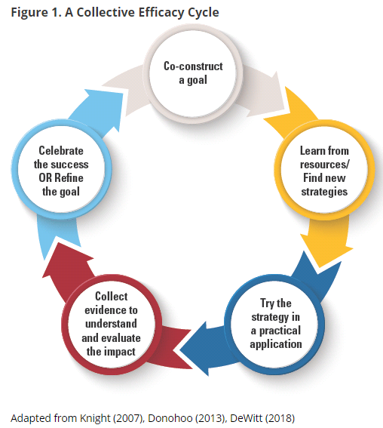
Grow Collective Efficacy
(Liang, Mitchell, & Scott, 2020)
Notes:
Sarah
The graphic on the left walks through the steps necessary for growing collective efficacy in your organization. In order to grow and build collective efficacy, you must allow all staff an opportunity to co-construct the goal; learn from resources and investigate strategies; staff must have a chance to ‘try a strategy on’ while collecting evidence to understand impact; and lastly, staff must have a collective opportunity to celebrate and reflect.
If you compare that to the process used in Redesign of design thinking and the four disciplines of execution, you see that there is quite a significant alignment between them. In redesign, you use design thinking and 4dx to empathize with students and define your wildly important goals. You ideate and investigate strategies that become your lead measures. Your build prototypes the you test in small groups and while doing so, you create data scoreboards and you hold accountability meetings where ‘pivots’ or ‘adjustments’ are determined. And at the end of your test window, you reflect, celebrate and create a plan for scale or revise and begin again.
To put it simply, using the redesign process with fidelity and integrity will allow you to grow teacher collective efficacy. Let’s move on to learn a little bit more!
Donohoo, Jenni, and Steven Katz. “What Drives Collective Efficacy?” What Drives Collective Efficacy? - Educational Leadership, ASCD, July 2019, www.ascd.org/publications/educational-leadership/jul19/vol76/num09/What-Drives-Collective-Efficacy%C2%A2.aspx.
Liang, J. “Grace,” Mitchell, T., & Scott, J. (2020). Statewide School Redesign: Integrating Design Thinking and the Four Disciplines of Execution as a Continuous School Improvement Process. Journal of Case Studies in Educational Leadership, 1(13). Retrieved from https://journals.sagepub.com/doi/10.1177/1555458920975462

Slide 20
Supporting Prototype
STAYING ACCOUNTABLE

Slide 21
Discipline 4- Staying Accountable
Keep these separate from teacher collaboration time!
Short, ~10 minutes, 3 questions: what did you do, what was the result, what will you do by next time?
If issues are identified, then you flag that issue for discussion in a sit-down meeting.
Consider:
How can you stay accountable without face-to-face meetings? (if you are on too many, etc)
How do you want to represent the data? How will this work with your staff?
Goal is to see, analyze, and adjust based on data...on a consistent basis!

Slide 22
Creating a Cadence of Accountability
Purpose - Keeping your team focused on what’s important despite the daily whirlwind
Through these consistent touchpoints, team members can:
Learn from each other about how to improve the strategy being tested
Give each other the support needed to keep commitments
Adapt on the fly
Celebrate progress and get re-engaged

Slide 23
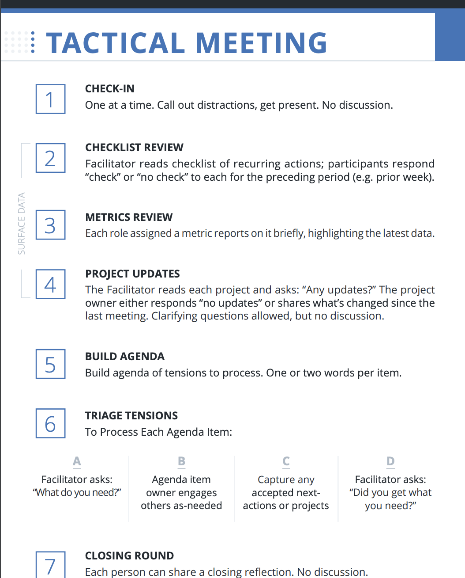
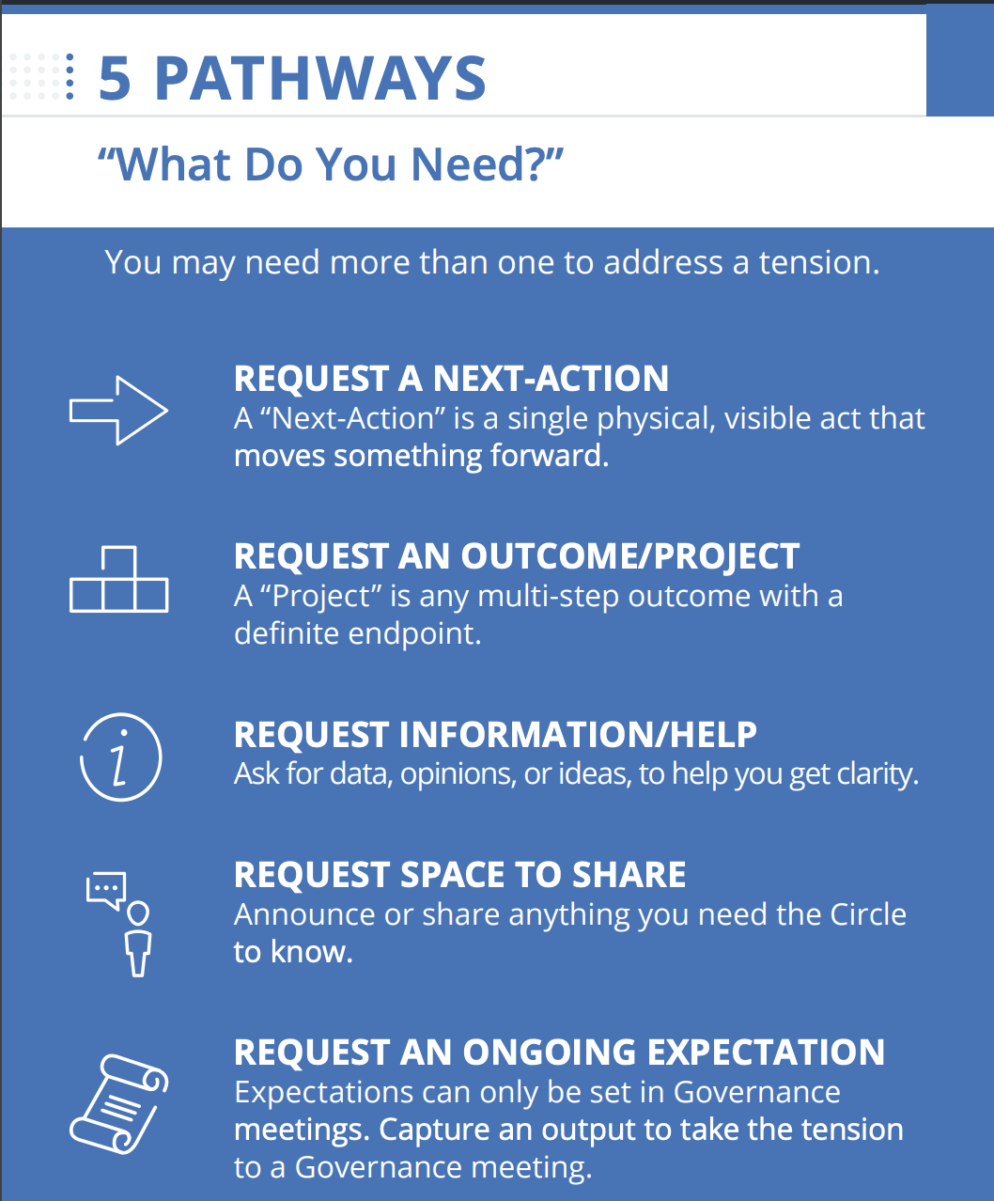
Resources for Exploration
Holacracy
4 Disciplines of Execution
The New School Rules
Notes:
Holacracy Tactical Meeting
Meeting card- https://static1.squarespace.com/static/5d1239a79c02150001db74d4/t/5d262f366c03c80001ad40ec/1562783542971/Tactical-Card_02-25-19.pdf
KSDE Accountability Talks
New School Rules (Rule 6- Learning Organizations)

Slide 24
Exploration: Directions
Directions:
Groups of 3-6
Review your assigned resource (15 minutes to review)
Each resource team shares out to the group (5 minutes for each group to share out)
Whole Group Discussion:
What is the importance of checking in? How does it benefit teams?
Compare/Contrast the resources and their use within our redesign process.
How can you structure your meetings to get the most valuable information to monitor and adjust prototypes?
How will you keep track of your progress?

Slide 25
Considerations for Accountability Meetings
Determine:
Time available for check ins (before, during or after school)
Frequency of check ins (weekly, bi-weekly)
Structure of meetings Virtual vs. in-person, use of scoreboard, (time of individual check ins)
Roles of team members during check in (facilitator needed?)

Slide 26
BREAK

Slide 27
Coach Check-In: Prototype → Test
Leadership & Culture- What does it mean to stay accountable?
When do you pivot?
How do you know you are making progress?
Turnkey Planning & Closing

Slide 28
Implementation Process Planning
1
2
3
4
Teaming & Planning
Training & Coaching
Stakeholder Communication
Data Based Decision Making
What practices, policies, or resources are necessary?
What data is necessary?
What supports are needed and for whom? By when? For how long?
What information needs to be shared and with whom? By when? How often?
Notes:
From TASN

Slide 29
Prototyping
Before you prototype, determine a) how you will collect and evaluate your data and b) how frequently you will review the data.
When should a strategy be:
Continued- valid data has been collected; initial results look optimistic; key questions posed by the data have been/can be answered; teachers and students feel successful
Notes:
Be PROACTIVE and REFLECTIVE instead of REACTIVE and IMPULSIVE
“The key issue for teacher researchers studying their own practice, and hence, collecting data primarily based on student outcomes, relates to the fact that they are not only acting as the researchers, but also as the change agents who have the power and authority to bring about change in their classrooms. Teachers are active participant observers of their classrooms, continually monitoring and adjusting their teaching based on formal and informal observations of students.”

Slide 30
Prototyping Continued...
When should a strategy be:
Changed- valid data has been collected; a few essential elements have presented themselves as in need of adjustment; educators believe that with these adjustments there will be success
Stopped- invalid data is being collected; valid data is presenting striking issues; too many adjustments would need to be made; students and teachers are not feeling successful
Notes:
“The key issue for teacher researchers studying their own practice, and hence, collecting data primarily based on student outcomes, relates to the fact that they are not only acting as the researchers, but also as the change agents who have the power and authority to bring about change in their classrooms. Teachers are active participant observers of their classrooms, continually monitoring and adjusting their teaching based on formal and informal observations of students.”

Slide 31
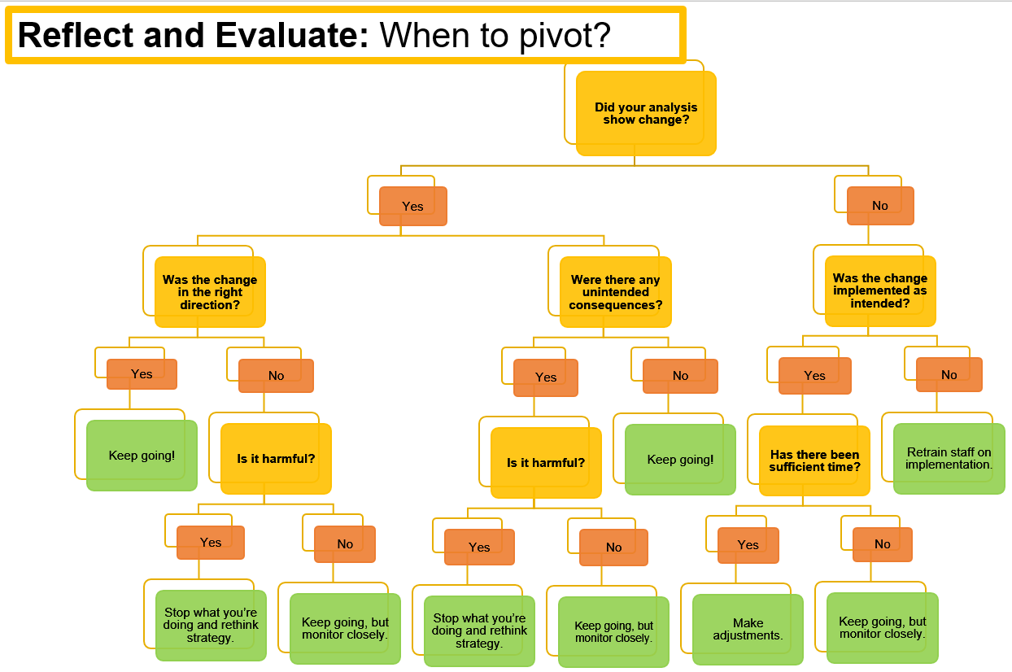

Slide 32
LUNCH

Slide 33
Coach Check-In: Prototype → Test
Leadership & Culture- What does it mean to stay accountable?
When do you pivot?
How do you know you are making progress?
Turnkey Planning & Closing

Slide 34
Meeting Option 1: Create a Strategy Progress Document
Look back at your Strategy Action Plan.
List which project milestones were met.
List which project milestones were not met.
Identify what challenges existed during implementation and testing.
List out next steps for each strategy.

Slide 35
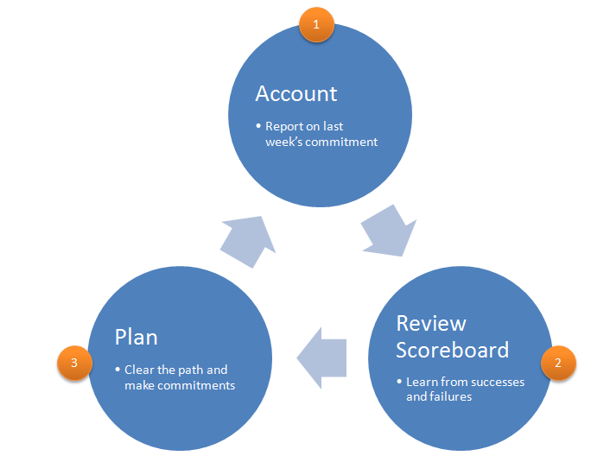
Meeting Option 2: 4DX Model
Meetings should last 20-30 minutes
Step 1 & 3- Commitments:
What did you bring? What will you do?
Tied to a deliverable
Act on lead measure
Timely
Notes:
https://www.franklincovey.com.au/discipline-4-create-a-cadence-of-accountability/
https://www.slideshare.net/BradMease/4-disciplines-of-execution-presentation

Slide 36
Meeting Option 3: 15 Minute Data-Dive
Easy to use 5 step process that can be adapted for any data set.
Allows for conversation about what has been done, how it’s going, and what needs to occur moving forward.

Slide 37
Accountability Meetings- Recommendations
Standards for Meeting Structures
Principles of (Meeting) Design
Groups should address only one topic at a time.
Groups should only use one process at a time.
Meetings should be interactive and engage in balanced participation.
Decision-making meetings should encourage cognitive conflict.
All parties should understand and agree on meeting roles.
Allocentrism- plan with the group in mind
Relevance- connect to the members and unit goals
Information- ensure that groups have the information they need to do their task
Interaction- keep minds and voices active
Congruence with organizational values and beliefs
Notes:
From “Adaptive Schools” (Garmston & Wellman)
CLEAR OBJECTIVES & AGENDAS

Slide 38
Let’s Practice
Using your baseline data, walk through what an accountability meeting might look like.
Use the protocol that works best for you!

Slide 39
Reflect- How well did you stick to the process?
Were you able to get through the steps in a timely manner?
Did you dive into tangential issues? Did you ‘bunny trail’?
How will you manage these meetings effectively when you get back to your teams?

Slide 40
Coach Check-In: Prototype → Test
Leadership & Culture- What does it mean to stay accountable?
When do you pivot?
How do you know you are making progress?
Turnkey Planning & Closing

Slide 41
Grow Collective Efficacy
(Liang, Mitchell, & Scott, 2020)
Notes:
The graphic on the left walks through the steps necessary for growing collective efficacy in your organization. In order to grow and build collective efficacy, you must allow all staff an opportunity to co-construct the goal; learn from resources and investigate strategies; staff must have a chance to ‘try a strategy on’ while collecting evidence to understand impact; and lastly, staff must have a collective opportunity to celebrate and reflect.
If you compare that to the process used in Redesign of design thinking and the four disciplines of execution, you see that there is quite a significant alignment between them. In redesign, you use design thinking and 4dx to empathize with students and define your wildly important goals. You ideate and investigate strategies that become your lead measures. Your build prototypes the you test in small groups and while doing so, you create data scoreboards and you hold accountability meetings where ‘pivots’ or ‘adjustments’ are determined. And at the end of your test window, you reflect, celebrate and create a plan for scale or revise and begin again.
To put it simply, using the redesign process with fidelity and integrity will allow you to grow teacher collective efficacy. Let’s move on to learn a little bit more!
Donohoo, Jenni, and Steven Katz. “What Drives Collective Efficacy?” What Drives Collective Efficacy? - Educational Leadership, ASCD, July 2019, www.ascd.org/publications/educational-leadership/jul19/vol76/num09/What-Drives-Collective-Efficacy%C2%A2.aspx.
Liang, J. “Grace,” Mitchell, T., & Scott, J. (2020). Statewide School Redesign: Integrating Design Thinking and the Four Disciplines of Execution as a Continuous School Improvement Process. Journal of Case Studies in Educational Leadership, 1(13). Retrieved from https://journals.sagepub.com/doi/10.1177/1555458920975462

Slide 42
Leadership Focus- Principals
Coach those you lead: Give Constructive Feedback
Maintain Accountability Meetings
Focus on the needs of the receiver
Be specific with descriptive facts
Tough on the performance (data)
Focus on the future and suggest positive alternatives
(McBride, 2019)
Ensure staff have time to hold weekly accountability meetings within their Goal Area Investigation Teams.
Provide technical support to teams when called upon.
Assist in facilitating tough conversations.
Notes:
KLC Guidebook, by Julia Fabris McBride, Kansas Leadership Center, 2020
Criticism:
A way of unloading anger or disappointment
Focused on the needs of the giver
Angry, dismissive, emotional
Ignore positive
Tough on the person
Vague, generalized, evaluative
Attributes opinions to others
Looks backward; laments missed opportunities
One-way pronouncements

Slide 43
Leadership Focus- Teachers
Giving and Receiving Constructive Feedback
Analyzing Data in Objective Conversations
Focus on the needs of the receiver
Be specific with descriptive facts
Tough on the performance (data)
Focus on the future and suggest positive alternatives
(McBride, 2019)
Focus on the facts and not the feelings
Establish and stick to conversation outcomes
Ex- Strategies are evaluated to determine if they should be continued, revised, or stopped.
Notes:
KLC Guidebook, by Julia Fabris McBride, Kansas Leadership Center, 2020
Criticism:
A way of unloading anger or disappointment
Focused on the needs of the giver
Angry, dismissive, emotional
Ignore positive
Tough on the person
Vague, generalized, evaluative
Attributes opinions to others
Looks backward; laments missed opportunities
One-way pronouncements

Slide 44
Conditions for a Learning Culture
Sh
Principals
Model Learning Leadership
Motivate Teachers
Support Inquiry, Innovation, and Exploration
Shared Leadership
Shared Leadership
-Shared Vision
-Psychological Safety
-Communication & Feedback
-Growth Mindset
Teachers
Collective Efficacy
Change Agents
Collegial Collaboration and Practices
Additional Stakeholders
Input in Goals and Strategies
Communicate about and Invest in the Work
Shared Leadership

Slide 45
Turnkey & School Planning Time
Redesign Blueprint
Blueprint/Overview
Goal Areas & Target Areas
Lag & Lead Measures
Establish Scoreboards
Gap Analysis
Begin Action Planning
Establish Cadence of Accountability
Test Strategies & Maintain Accountability
Execute on Disciplines 2, 3, and 4
Feedback & Communication
Communication Plan
Business/Community Engagement Plan
WHY
WHAT
Turnkey Considerations
HOW

Slide 46
Share your commitments between now and the next Training.
Each school will share out loud.
Notes:
Note- This is like an ‘accountability meeting’. Reporting on last time’s commitments, giving a status update based on data (i.e. checklist), and talking about what’s next...that’s discipline 4 ‘create a cadence of accountability’!

Slide 47
SURVEY
Please take the survey at the end of each training.
Your feedback is incredibly valuable.

Slide 48
Follow us on Twitter
@KSDEredesign
#kstothemoon

Slide 49
Site Visits & Connections
KSDE Redesign Webpage- Videos Tab
Redesign Google Site- School Models Tab

