Slide 1
Building the
Rocket
Meeting 3

Slide 2
Agenda
9:00-9:20 Welcome, Share Out, Phase Overview
9:20-10:00 Coach Check In & Celebrations
10:00-10:30 Technical vs Adaptive Challenges
10:30-10:45 Break
10:45-12:00 Resource Implications
12:00-12:45 Lunch
12:45-1:15 Strategy Analysis
1:15-1:30 Break
1:30-2:45 Plan Time
2:45-3:00 Wrap Up and Closing

Slide 3
Links
Slides -

Slide 4
Kansas Vision for Redesign
Kansas leads the world in the success of each student
It’s what Kansans said they wanted. It’s what the job trends and our current K-12 outcomes are telling us.

Slide 6
Launch Readiness Rubric
Show & Launch Readiness Expectations:
All four Redesign Principles are addressed in your Redesign Plan
There is documentation of your work throughout the Plan Year (i.e. blueprint, action plans, and gap analyses for each strategy)
Evidence supports that you have regularly updated your Local Board of Education
Your School Vision & Goals align with your District Vision & Goals
Your School Vision & Goals are aligned to the State Vision, Definition of a Successful High School Graduate, and the State Board Outcomes
Category |  | Low | Medium | High
Strategy Selection, Prototyping, and Testing |  | Strategies are missing multiple components: Researched by the GAIT Supported with an Action Plan Connected to the Gap Analysis Measured through data-tracking and monitoring (scoreboards) Adjusted based on accountability meetings and reflection | Some strategies were... Researched by the GAIT Supported with an Action Plan Connected to the Gap Analysis Measured through data-tracking and monitoring (scoreboards) Adjusted based on accountability meetings and reflection | All strategies were... Researched by the GAIT Supported with an Action Plan Connected to the Gap Analysis Measured through data-tracking and monitoring (scoreboards) Adjusted based on accountability meetings and reflection
Process for Continuous Improvement | Plan to Scale | Resource implications have not been determined for strategies selected for scale and support plans have not been created. | For some strategies selected for scale, the resource implications have not been determined OR a complete support plan has not yet been created. | For each strategy selected for scale, the resource implications have been determined and a support plan has been created.
 | Sustainability & Growth | Strategy support through professional development and GAIT team maintenance has not been incorporated into the plan for scale. | Some plans exist regarding professional development for strategies selected for scale, but there is no designated GAIT time set aside for accountability meetings. | There is a plan for ongoing professional development, GAIT time, and accountability meetings so that strategies can be evaluated, monitored, and adjusted in a timely manner.
 | Process for Ongoing Improvement | The district and school have not worked to align improvement plans. It is unclear how school goals and strategies connect with district goals and strategies. Plans exist in multiple places, and they are not aligned. | The district and school improvement plans overlap, but direct alignment and connection is missing in areas.The district supports the school plans for improvement, but there is little alignment across buildings and plans. | The district and school have aligned the school Redesign Plan with the district’s plan for continuous improvement, and support is in place to continue work within the defined Goal Areas.
Internal & External Stakeholder Engagement and Communication |  | The school has not engaged both internal and external stakeholders in the Redesign process. Two-way communication is not developed and feedback loops are not in place. | The school has engaged all stakeholders, but two-way communication has not always been ensured. Feedback loops might exist for some stakeholder groups but not all. | The school has authentically and meaningfully engaged all stakeholders (students, staff, parents, community, business) in the Redesign work and has established two-way communication, opportunities for input, and feedback loops.
Notes:
Rubric- https://www.ksde.org/LinkClick.aspx?fileticket=vnD9-j4k9No%3d&tabid=1207&portalid=0&mid=3630

Slide 7
Objectives
01
Develop & Implement a Prototype Plan
Create Gap Analysis and Action Plan for each strategy
Create timeline for implementation
Create success criterion for implementation
02
Keep Score and Stay Accountable
Create scoreboards for every strategy
Establish cadence of accountability for each GAIT
Create team roles and responsibilities for meeting
03
Identify Scaling Needs
Create Gap Analysis around each strategy for scaling
Create project plan and needs statement
Generate PD/Budget/Resource Plan for scaling
04
Conduct School Visits
Goal Areas, Investigation Teams, and Capacity
In State, Out of State, and/or Virtual
Set up a Why and Goals before each visit
05
Communicate with Stakeholders
Why, Who, How, and When
Continue developing your plan
Over communicate
Notes:
We have already done 1 and 2. If you have not done those in your school, then that should be your priority. 5 is ongoing and should be happening all of the time. This phase really focuses on 3 and 4.

Slide 8
Building the Rocket
FOCUS
LEVERAGE
ENGAGEMENT
ACCOUNTABILITY
Your Vision for Education
Engage in Disciplines 3 & 4 Prototype and Test Engage Stakeholders Strategies & Communicate
-Define Lead & Lag -Prioritize Strategies to -Document and Share Measures Prototype Progress
-Create Scoreboards -Complete Gap Analysis -Update Communication
-Establish Cadence -Create Action Plans and Business Plan
of Accountability -Create Plan for Scale -Share Resource
and Sustainability Implications with System
Notes:
Focus on the wildly important.
Act on lead measures.
Keep a compelling scoreboard.
Create a cadence of accountability.

Slide 9
TURNKEY PROCESS
Regional Training Team will experience workshop + modify turnkey materials to train the School redesign Teams in their service centers
RTT
School Redesign Team receives training from RTT and makes key decisions to modify expectations for their district and school context
SRT
School teams receive training from their School redesign team and engage staff through participation in investigation teams
FULL SCHOOL
Notes:
Two Things:
While you are at these trainings, we are giving you content and walking you through activities to assist you in engaging in design thinking to plan your school redesign. As you participate, you should always be thinking about what you will take back to your staff and how you will deliver it.
To assist you with planning your ‘turnkey’, we have a communication log that you were asked to create in the beginning of our time together. You are not obligated to use this, but it is highly encouraged. Use this communication log to help you plan, to track your progress, and to implement a system of accountability.

Slide 10
WHAT
Determine what is the essential learning for all.
WHY
Establish a clear purpose for the learning.
Turnkey Considerations
HOW
Determine the best time, place, and delivery model for the learning.

Slide 11
Coach Check-In: Prototype → Test
Leadership & Culture- How do you address technical and adaptive challenges?
Resource Implications- Sustainability & Scaling
How will you evaluate progress?
Turnkey Planning & Closing

Slide 12
Today’s Goals
What will coaches and schools accomplish?
Review Redesign Workbook
Review Strategy Action Plan
Review Project Milestones
Review Data Evaluations since Last Meeting
Discuss Plan/Timeline for Testing
Update Communication Log

Slide 13
Building the Rocket- Coaching Look-fors
School conducted a thorough Gap Analysis Is your future state clearly articulated and easy to explain? Future state is concrete and measurable as seen by behaviors or habits you hope to see or hear. SRT has identified appropriate resources (i.e. PD, Time, Visits/Travel) to address the gaps between present and future state Gaps are within your control to address There is a plan for how to address gaps between the present and the future state Stakeholders are aware of the vision for the future state Messages are differentiated based on the stakeholder group (Modality or level of details) School developed an Action Plan to identified gaps Big actions address each of the directly identified gaps. Big actions are broken into short-term achievable tasks. Team is aware of challenges challenges might exist in the execution of this plan and have a general idea of how they will pivot. The team knows who will oversee this action plan The team knows when each action will be completed The team knows how the action will be completed The team knows what resources are needed (time, budget, staff, etc)
Notes:
Check-in with coach
https://www.ksde.org/LinkClick.aspx?fileticket=_N0WnOh3ZuQ%3d&tabid=1509&portalid=0&mid=6012

Slide 14
Celebrations
Share Accomplishments
2 Glows and 1 Grow
Notes:
What is something you are looking forward to doing in the redesign
What is something you are personally going to do this year
What is something you are still struggling with

Slide 15
Coach Check-In: Prototype → Test
Leadership & Culture- How do you address technical and adaptive challenges?
Resource Implications- Sustainability & Scaling
How will you evaluate progress?
Turnkey Planning & Closing

Slide 16
Technical Challenges
Solutions applied with technical knowledge; top down management.
Directive Leadership
Assigning roles, setting expectations, monitoring, guiding performance.
Empowering Leadership
Sharing responsibility, encouraging dissent and innovation.
Requires…
Defined ideals & beliefs
Define purpose
Root issues identified
Adaptive Challenges
Solutions outside current modes of operation; professional learning; bottom up leadership.
Complexity of Change

Slide 17
Reflect-
Principles for Leading Adaptive Work:
Get on the balcony
Identify the adaptive challenges
Regulate distress
Maintain disciplined attention
Give work back to people
Protect voices of leadership from below
Were there any challenges you thought were technical but have now proven to be adaptive?

Slide 18
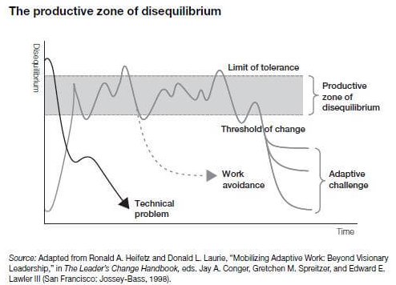
Reflect- How have you engage all staff in the work? How have you kept them in the ‘productive zone’?
How have you supported…
Culture?
Communication?
Input?
Order?

Slide 19
BREAK

Slide 20
Coach Check-In: Prototype → Test
Leadership & Culture- How do you address technical and adaptive challenges?
Resource Implications- Sustainability & Scaling
How will you evaluate progress?
Turnkey Planning & Closing

Slide 21
Introductory Directions- Resource Implications
Get a piece of poster paper and divide it into 6 sections.
Section Titles- Budget, Curriculum, Policy, Professional Development, Staffing, and Technology
Choose 1 strategy from each goal area. Choose a strategy that you plan on scaling and/or implementing next year.
Generate ideas for implications within the 6 areas. Do one strategy at a time. Follow the guidelines on the next slide.
Notes:
KEY CONSIDERATION- Is your strategy a new process or does it also involve purchasing a product? If you ARE purchasing a product, consider the district office involvement. How can you ensure there is cohesion across buildings? Grade levels? etc.

Slide 22
Brainstorming Protocol- Part 1
• Ideas should be developed as quickly as possible.
• Everyone on the team should contribute ideas.
• Unique and off-the-wall ideas are welcome.
• Do not critique or evaluate ideas during the brainstorming period.
• No discussion during this time! Just throw out ideas.

Slide 23
Resource Implications Template
Strategy Name:
Budget Implications- What are the implications for the budget?
Curriculum Implications- What are the implications for the curriculum?
Policy Implications- What are the implications for policy changes?
Professional Development Implications- What are the implications for professional development?
Staffing Implications- What are the implications for staffing?
Technology Implications- What are the implications for technology?
Notes:
20 Minutes

Slide 24
Brainstorming Protocol- Part 2
Put a checkmark next to ideas that are not going to impede implementation and can be dismissed.
Circle the implications that must be immediately addressed.
Notes:
15 Minutes

Slide 25
Resource Implication Statements- Part 3
Create a summary of the resource implications that will need to be addressed for the strategy you plan on scaling next year.
Take into account the six implication areas when you write your statement.
Create an action plan for addressing the implications in advance of scaling.
Or, you might consider adding these actions to your strategy action plan that might already exist.
Notes:
20 minutes

Slide 26
Share Out
What did you learn by working through this activity?
How does this activity help you advance the work?

Slide 27
LUNCH

Slide 28
Coach Check-In: Prototype → Test
Leadership & Culture- How do you address technical and adaptive challenges?
Resource Implications- Sustainability & Scaling
How will you evaluate progress?
Turnkey Planning & Closing

Slide 29
How do you gauge implementation fidelity?
1- Quality
Was the strategy implemented at the appropriate level? Was it done with rigor and adherence to the criteria?
2- Consistency
Was the strategy consistently implemented? Was it done in the intervals prescribed?
3- Intensity
Was the strategy appropriately rigorous? Did the strategy occur often enough?
4- Fidelity
Was the strategy implemented uniformly? Was it implemented the same across teachers/groups?

Slide 30
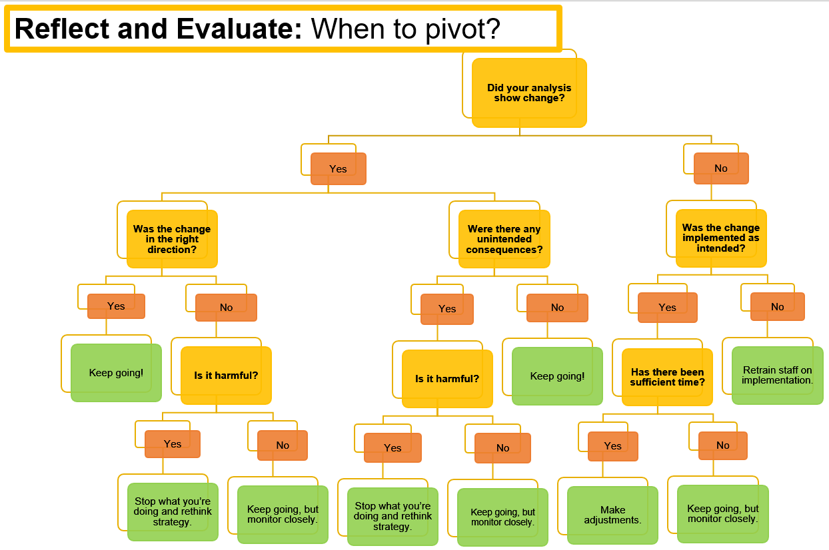

Slide 31
Strategy Report
Optional tool for evaluating tested strategies for scaling across your launch and ascent years.

Slide 32
How do you prioritize scale?
Re-examine your future state. Consider,
What desired state element should come first?
Which element, if done well, would allow me to establish other elements?
Does this strategy positively impact all students?
Has this strategy proven to be effective?
Do you have the capacity to scale this strategy?
Does this strategy move you closer toward your vision and the state board outcomes?
Does it align with the 4 Redesign Principles?

Slide 33
BREAK

Slide 34
Coach Check-In: Prototype → Test
Leadership & Culture- How do you address technical and adaptive challenges?
Resource Implications- Sustainability & Scaling
How will you evaluate progress?
Turnkey Planning & Closing

Slide 35
Conditions for a Learning Culture
Sh
Principals
Model Learning Leadership
Motivate Teachers
Support Inquiry, Innovation, and Exploration
Shared Leadership
Shared Leadership
-Shared Vision
-Psychological Safety
-Communication & Feedback
-Growth Mindset
Teachers
Collective Efficacy
Change Agents
Collegial Collaboration and Practices
Additional Stakeholders
Input in Goals and Strategies
Communicate about and Invest in the Work
Shared Leadership

Slide 36
Turnkey & School Planning Time
Redesign Blueprint
Blueprint/Overview
Goal Areas & Target Areas
Lag & Lead Measures
Update Scoreboards
Gap Analysis
Stay Accountable to Action Plans
Test Strategies & Maintain Accountability
Execute on Disciplines 2, 3, and 4
Consider Scale through Strategy Analysis
Feedback & Communication
Communication Plan
Business/Community Engagement Plan
WHY
WHAT
Turnkey Considerations
HOW

Slide 37
Share your commitments between now and the next Training.
Each school will share out loud.
Notes:
Note- This is like an ‘accountability meeting’. Reporting on last time’s commitments, giving a status update based on data (i.e. checklist), and talking about what’s next...that’s discipline 4 ‘create a cadence of accountability’!

Slide 38
SURVEY
Please take the survey at the end of each training. Your feedback is incredibly valuable.

Slide 39
Follow us on Twitter
@KSDEredesign
#kstothemoon

