Slide 1
Kansans Can - Why we need to change education in Kansas
Dr. Randy Watson, Kansas Commissioner of Education

Slide 2
“We choose to go to the moon in this decade and do the other things, not because they are easy, but because they are hard, because that goal will serve to organize and measure the best of our energies and skills, because that challenge is one that we are willing to accept, one we are unwilling to postpone, and one which we intend to win.” - John F. Kennedy

Slide 3
What are the skills, attributes, and abilities of a successful Kansan?

Slide 4
The business and industry focal groups cited non-academic skills with greater frequency than the community groups:

Slide 5
What should schools do to produce the student described in question #1?
Family engagement items complemented the career planning items, but the partnership between schools and families started early—birth through preK in some items. Some advocate joint planning for the child’s future, and others, opportunities for family participation and family education.
human capital
Less frequently cited strategies:
School climate activities were diverse and sometimes conflicting. Some advocate creating an environment of high expectations, while others recommend realistic expectations, or a positive supportive culture.
Career planning items called for individual goals and planning, of classes, pathways, further education, transitions, and careers. Some items included the family in the planning. When career planning should begin—middle school? 8th grade?--wasn’t clear.
Project-based learning items emphasize the learning and demonstration of applied skills, sometimes in contrast to standardized curricula and assessments. Some suggest projects as part of community service, a qualification for graduation, or a better way to teach or measure personality skills.
teaching techniques
Community collaboration items emphasized mutual obligations between students and the community and better social networking. Some advocate student community service, sometimes as a requirement; others, partnerships with local businesses and social agencies, especially early childhood agencies.
Individualized instruction and experience varied in intensity, from career interest diagnostics to universally required individual plans that the student must personally defend. The timing varied from beginning in Kindergarten, to middle school, to 8th grade.
Real-world instruction items advocate for concrete, real-life, relevant problems to solve, sometimes including their social dimensions. Some suggest integrating academics with applied skills, to improve motivation. Timing? As early as preK.
Early childhood strategies include strengthening the foundations of language and social skills at this sensitive stage, and the early establishment of parental collaboration.
accountability
extracurricular activities
college collaboration
funding
prevention
Notes:
Our business cards will stand out as innovative and memorable with a vertical or portrait orientation. Bonus it has a back side!
a portrait or vertical design. It’s also two-sided!
Another fundamental change you may notice (if not you will after I tell you) is that the main address for our agency has been simplified to the main desk in Suite 102. As all our mail is sorted in the print shop having everything labeled by a different team name and suite only made sense to us as we're used to it. It is less confusing and complex for those we serve.

Slide 6
What Kansans want from their schools
Changes need to be made to address school culture
New dynamic roles for counselor and social workers
Collaboration between schools and businesses
Reorganize schools around students, not the system
Community service needs to play a bigger role
Kansas children need quality preschool including all day kindergarten
Notes:
We also learned that Kansans believe
Every child needs access to quality preschool education
School culture needs to be addressed – we must value the student going to a two-year or certification program as much as a student attending a four-year institution.
Counselors need to be able to help students identify and explore career interests
Must be collaboration between schools and businesses to prepare students for postsecondary pursuits
Schools must be reorganized around the student, not the system to meet unique needs
Community service is an important part of preparing students for life after high school.

Slide 7
What is success?
Happy
Fulfilled
To give back to the community and be in the service of others
Skills and attributes that allow one to earn a living in the middle class or beyond

Slide 8
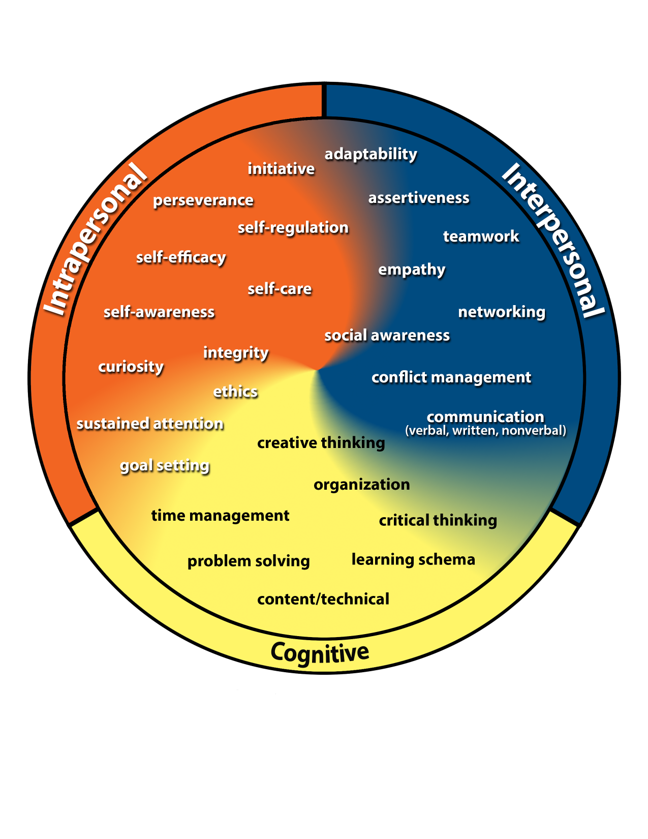
Kansans Can Competencies

Slide 9
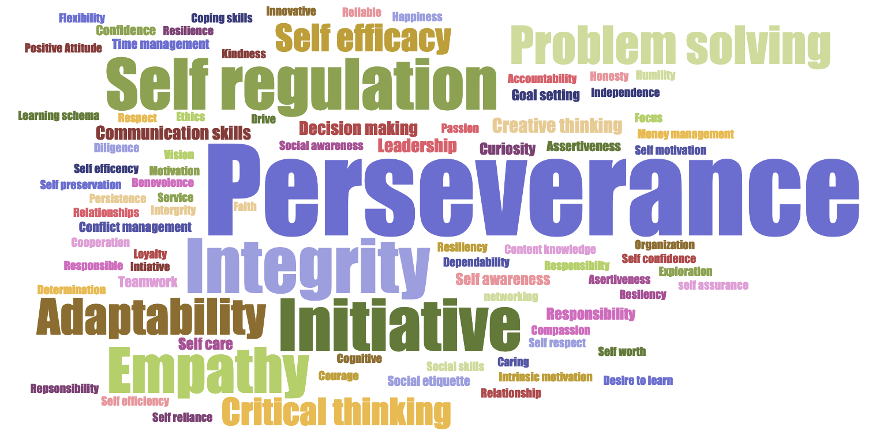
Kansans said…

Slide 10
Highest Need Competencies Identified by Over 7,300 Kansas Students
Overall Rank by Highest Need | Males | Females | 6th Grade | 9th Grade | 12th Grade
Sustained Attention Self-Regulation | Sustained Attention Self-Regulation | Sustained Attention Self-Regulation | Sustained Attention Self-Regulation | Sustained Attention Self-Regulation | Sustained Attention Self-Regulation
Initiative | Initiative | Assertiveness | Initiative | Initiative | Assertiveness
Assertiveness | Conflict Management | Initiative | Conflict Management | Assertiveness | Communication Networking
Self-Efficacy Goal Setting | Communication | Conflict Management | Assertiveness | Communication | Conflict Management
Conflict Management | Assertiveness | Self-Efficacy | Goal Setting | Conflict Management | Self-Efficacy Goal Setting
Notes:
Our business cards will stand out as innovative and memorable with a vertical or portrait orientation. Bonus it has a back side!
a portrait or vertical design. It’s also two-sided!
Another fundamental change you may notice (if not you will after I tell you) is that the main address for our agency has been simplified to the main desk in Suite 102. As all our mail is sorted in the print shop having everything labeled by a different team name and suite only made sense to us as we're used to it. It is less confusing and complex for those we serve.

Slide 11
Our Vision for Kansas ...
Kansas leads the world in the success of each student
Notes:
Our business cards will stand out as innovative and memorable with a vertical or portrait orientation. Bonus it has a back side!
a portrait or vertical design. It’s also two-sided!
Another fundamental change you may notice (if not you will after I tell you) is that the main address for our agency has been simplified to the main desk in Suite 102. As all our mail is sorted in the print shop having everything labeled by a different team name and suite only made sense to us as we're used to it. It is less confusing and complex for those we serve.

Slide 12
A Successful Kansas High School Graduate has the
Academic preparation,
Cognitive preparation,
Technical skills,
Employability skills and
Civic engagement
to be successful in postsecondary education, in the attainment of an industry recognized certification or in the workforce, without the need for remediation.
Notes:
Our business cards will stand out as innovative and memorable with a vertical or portrait orientation. Bonus it has a back side!
a portrait or vertical design. It’s also two-sided!
Another fundamental change you may notice (if not you will after I tell you) is that the main address for our agency has been simplified to the main desk in Suite 102. As all our mail is sorted in the print shop having everything labeled by a different team name and suite only made sense to us as we're used to it. It is less confusing and complex for those we serve.

Slide 13
Creating a Vision for Kansas – State Outcomes
Social Emotional Growth
Kindergarten Readiness
Individual Plan of Study
High School Graduation Rates
Post Secondary Completion
Notes:
Among the outcomes being considered by the state board are:
High School Graduation Rates
Post Secondary Completion/Attendance
Remedial Rate of Students Attending Post-Secondary
Kindergarten Readiness
Individual Plan of Study Focused on Career Interest
Social/Emotional Growth Measured Locally
Education Commissioner Randy Watson and members of the State Board of Education will meet with business, education and state leaders to build agreement on how we will work together to achieve this vision for Kansas education.
Kansas schools are already doing tremendous work to address the needs of individual students, but in order to achieve this new vision we cannot expect schools to go it alone. This requires a unified effort with businesses, communities, parents, higher education, and elected officials working with educators to help provide the supports and experiences Kansas students need for their future success.

Slide 14
Georgetown Center on Education and the Workforce?

Slide 15
“To succeed in the modern economy, students need a mix of specific and general education and skills.”
The Overlooked Value of Certificates and Associate’s Degrees,
GEORGETOWN UNIVERSITY CENTER ON EDUCATION AND THE WORKFORCE 2020
Notes:
Our business cards will stand out as innovative and memorable with a vertical or portrait orientation. Bonus it has a back side!
a portrait or vertical design. It’s also two-sided!
Another fundamental change you may notice (if not you will after I tell you) is that the main address for our agency has been simplified to the main desk in Suite 102. As all our mail is sorted in the print shop having everything labeled by a different team name and suite only made sense to us as we're used to it. It is less confusing and complex for those we serve.

Slide 16
Time to Redesign Schools!
WHAT SKILLS DO BUSINESS & INDUSTRY SAY ARE LACKING IN HIGH SCHOOL, TWO-YEAR and FOUR-YEAR COLLEGE PROGRAM GRADUATES?

Slide 17
HIGH SCHOOL GRADUATES LACKING…
Professionalism/Work Ethic . . . . . . . . . 80.3%
Teamwork/Collaboration . . . . . . . . . . . 75.7%
Verbal Communication. . . . . . . . . . . . . 70.8%
Ethics/Social Responsibility. . . . . . . . . . 63.4%
Critical Thinking/Problem Solving. . . . . 57.5%
Information Technology Applications. 53.0%
Written Communication. . . . . . . . . . . . 52.7%
Diversity. . . . . . . . . . . . . . . . . . . . . . . . 52.1%
Lifelong Learning/Self-Direction. . . . … 42.5%
Creativity/Innovation. . . . . . . . . . . . . . . 36.3%
Consolidated Survey of Corporate America
Notes:
Our business cards will stand out as innovative and memorable with a vertical or portrait orientation. Bonus it has a back side!
a portrait or vertical design. It’s also two-sided!
Another fundamental change you may notice (if not you will after I tell you) is that the main address for our agency has been simplified to the main desk in Suite 102. As all our mail is sorted in the print shop having everything labeled by a different team name and suite only made sense to us as we're used to it. It is less confusing and complex for those we serve.

Slide 18
TWO YEAR COLLEGE GRADUATES LACKING…
Professionalism/Work Ethic. . . . . . . . . . . 83.4%
Teamwork/Collaboration. . . . . . . . . . . . 82.7%
Verbal Communication. . . . . . . . . . . . . 82.0%
Critical Thinking/Problem Solving. . . . . . 72.2%
Written Communication. . . . . . . . . . . . . 71.5%
Ethics/Social Responsibility. . . . . . . . . . . 70.6%
Information Technology Applications. . 68.6%
Lifelong Learning/Self-Direction. . . . . . . 58.3%
Diversity. . . . . . . . . . . . . . . . . . . . . . . . . 56.9%
Creativity/Innovation. . . . . . . . . . . . . . . 45.5%
Consolidated Survey of Corporate America
Notes:
Our business cards will stand out as innovative and memorable with a vertical or portrait orientation. Bonus it has a back side!
a portrait or vertical design. It’s also two-sided!
Another fundamental change you may notice (if not you will after I tell you) is that the main address for our agency has been simplified to the main desk in Suite 102. As all our mail is sorted in the print shop having everything labeled by a different team name and suite only made sense to us as we're used to it. It is less confusing and complex for those we serve.

Slide 19
FOUR YEAR COLLEGE GRADUATES LACKING…
Verbal Communication. . . . . . . . . . . . . 95.4%
Teamwork/Collaboration. . . . . . . . . . . . 94.4%
Professionalism/Work Ethic. . . . . . . . . . . 93.8%
Written Communication. . . . . . . . . . . . . 93.1%
Critical Thinking/Problem Solving. . . . . 92.1%
Ethics/Social Responsibility. . . . . . . . . . 85.6%
Leadership . . . . . . . . . . . . . . . . . . . . . . . 81.8%
Information Technology Applications. 81.0%
Creativity/Innovation. . . . . . . . . . . . . . . 81.0%
Lifelong Learning/Self-Direction. . . . . . 78.3%
Consolidated Survey of Corporate America
Notes:
Our business cards will stand out as innovative and memorable with a vertical or portrait orientation. Bonus it has a back side!
a portrait or vertical design. It’s also two-sided!
Another fundamental change you may notice (if not you will after I tell you) is that the main address for our agency has been simplified to the main desk in Suite 102. As all our mail is sorted in the print shop having everything labeled by a different team name and suite only made sense to us as we're used to it. It is less confusing and complex for those we serve.

Slide 20
Harvard, Stanford and the Carnegie Foundation

Slide 21
Lessons from Gallup Research
“Caring (not content) is King”
Mentors are needed
Excitement about the Future
Strengths, not Weaknesses
Long-term Projects
Project-based Learning
Work Experiences Connected to Learning (Intern, Apprentice, etc.)
Deep, Lasting Engagement
“Someone who encourages my development”
“Do what I do best every day”
21
Notes:
Our business cards will stand out as innovative and memorable with a vertical or portrait orientation. Bonus it has a back side!
a portrait or vertical design. It’s also two-sided!
Another fundamental change you may notice (if not you will after I tell you) is that the main address for our agency has been simplified to the main desk in Suite 102. As all our mail is sorted in the print shop having everything labeled by a different team name and suite only made sense to us as we're used to it. It is less confusing and complex for those we serve.

Slide 22
Gallup - It’s How You Do It
32%
30%
20%
Long-term project taking a semester or more to complete
Internship or job where applied learning
Extremely involved in extracurricular activities and organizations
6%
Of All Graduates Experienced All Three
Notes:
Our business cards will stand out as innovative and memorable with a vertical or portrait orientation. Bonus it has a back side!
a portrait or vertical design. It’s also two-sided!
Another fundamental change you may notice (if not you will after I tell you) is that the main address for our agency has been simplified to the main desk in Suite 102. As all our mail is sorted in the print shop having everything labeled by a different team name and suite only made sense to us as we're used to it. It is less confusing and complex for those we serve.

Slide 24
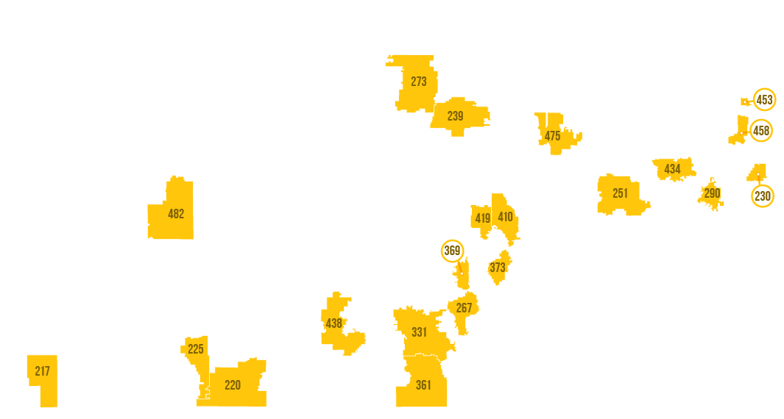
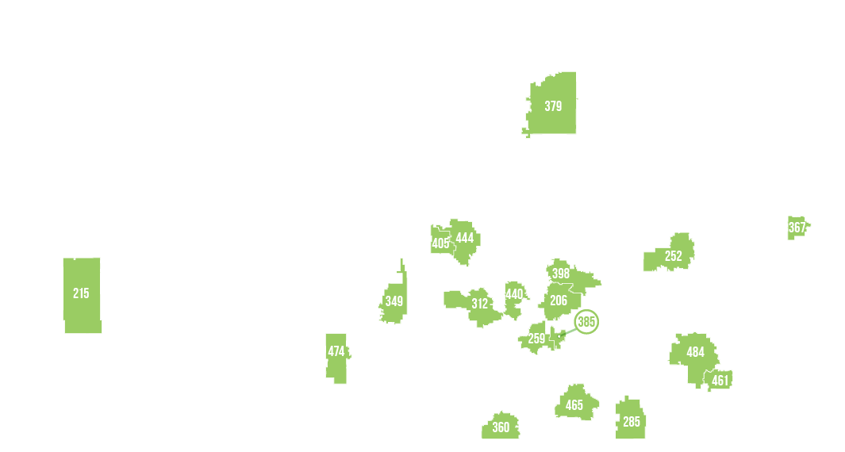
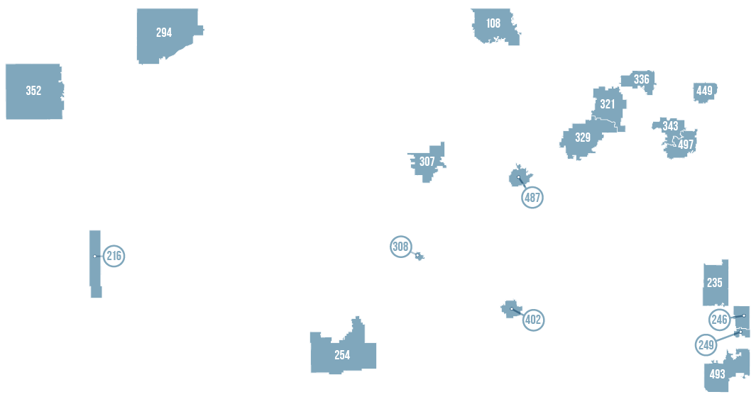
Notes:
Our business cards will stand out as innovative and memorable with a vertical or portrait orientation. Bonus it has a back side!
a portrait or vertical design. It’s also two-sided!
Another fundamental change you may notice (if not you will after I tell you) is that the main address for our agency has been simplified to the main desk in Suite 102. As all our mail is sorted in the print shop having everything labeled by a different team name and suite only made sense to us as we're used to it. It is less confusing and complex for those we serve.

Slide 25
Kansas School Redesign Principles
Student Success Skills | Family, Business, and Community Partnerships
There is an integrated approach to develop student social-emotional learning. | Partnerships are based on mutually beneficial relationships and collaboration.
Personalized Learning | Real World Application
Teachers support students to have choice over their time, place, pace and path. | Project-based learning, internships, and civic engagement makes learning relevant.
Notes:
Our business cards will stand out as innovative and memorable with a vertical or portrait orientation. Bonus it has a back side!
a portrait or vertical design. It’s also two-sided!
Another fundamental change you may notice (if not you will after I tell you) is that the main address for our agency has been simplified to the main desk in Suite 102. As all our mail is sorted in the print shop having everything labeled by a different team name and suite only made sense to us as we're used to it. It is less confusing and complex for those we serve.

Slide 26
Notes:
Today’s students are the future workforce and future leaders of Kansas. Kansans Can achieve anything and, together, Kansans Can lead the world in the success of each student.

