Slide 1
Kansas Leads the World in the Success of Each Student.
Dr. Randy Watson, Kansas Commissioner of Education

Slide 2
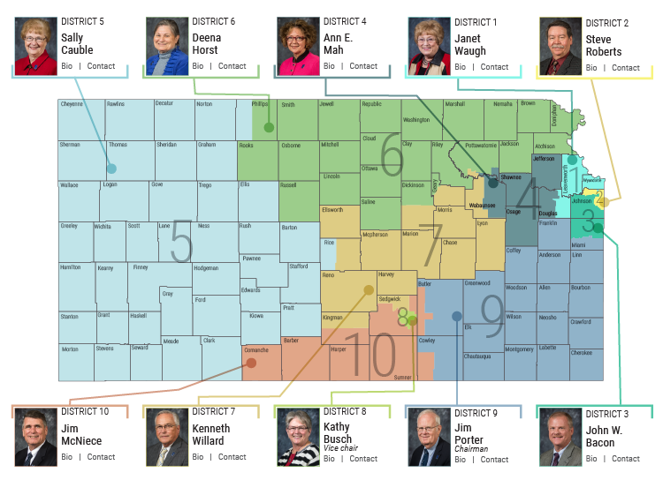

Slide 3
A NEW Vision for Kansas ...
Kansas leads the world in the success of each student
KANSAS STATE DEPARTMENT OF EDUCATION | www.ksde.org

Slide 4
Defining Success
A Successful Kansas High School Graduate has the
Academic preparation,
Cognitive preparation,
Technical skills,
Employability skills and
Civic engagement
to be successful in postsecondary education, in the attainment of an industry recognized certification or in the workforce, without the need for remediation.
A Successful Kansas High School Graduate has the
Academic preparation,
Cognitive preparation,
Technical skills,
Employability skills and
Civic engagement
to be successful in postsecondary education, in the attainment of an industry recognized certification or in the workforce, without the need for remediation.

Slide 5
Creating a Vision for Kansas – State Outcomes
Social Emotional Growth
Kindergarten Readiness
Individual Plan of Study
High School Graduation Rates
Post Secondary Completion
Notes:
Among the outcomes being considered by the state board are:
High School Graduation Rates
Post Secondary Completion/Attendance
Remedial Rate of Students Attending Post-Secondary
Kindergarten Readiness
Individual Plan of Study Focused on Career Interest
Social/Emotional Growth Measured Locally
Education Commissioner Randy Watson and members of the State Board of Education will meet with business, education and state leaders to build agreement on how we will work together to achieve this vision for Kansas education.
Kansas schools are already doing tremendous work to address the needs of individual students, but in order to achieve this new vision we cannot expect schools to go it alone. This requires a unified effort with businesses, communities, parents, higher education, and elected officials working with educators to help provide the supports and experiences Kansas students need for their future success.

Slide 6
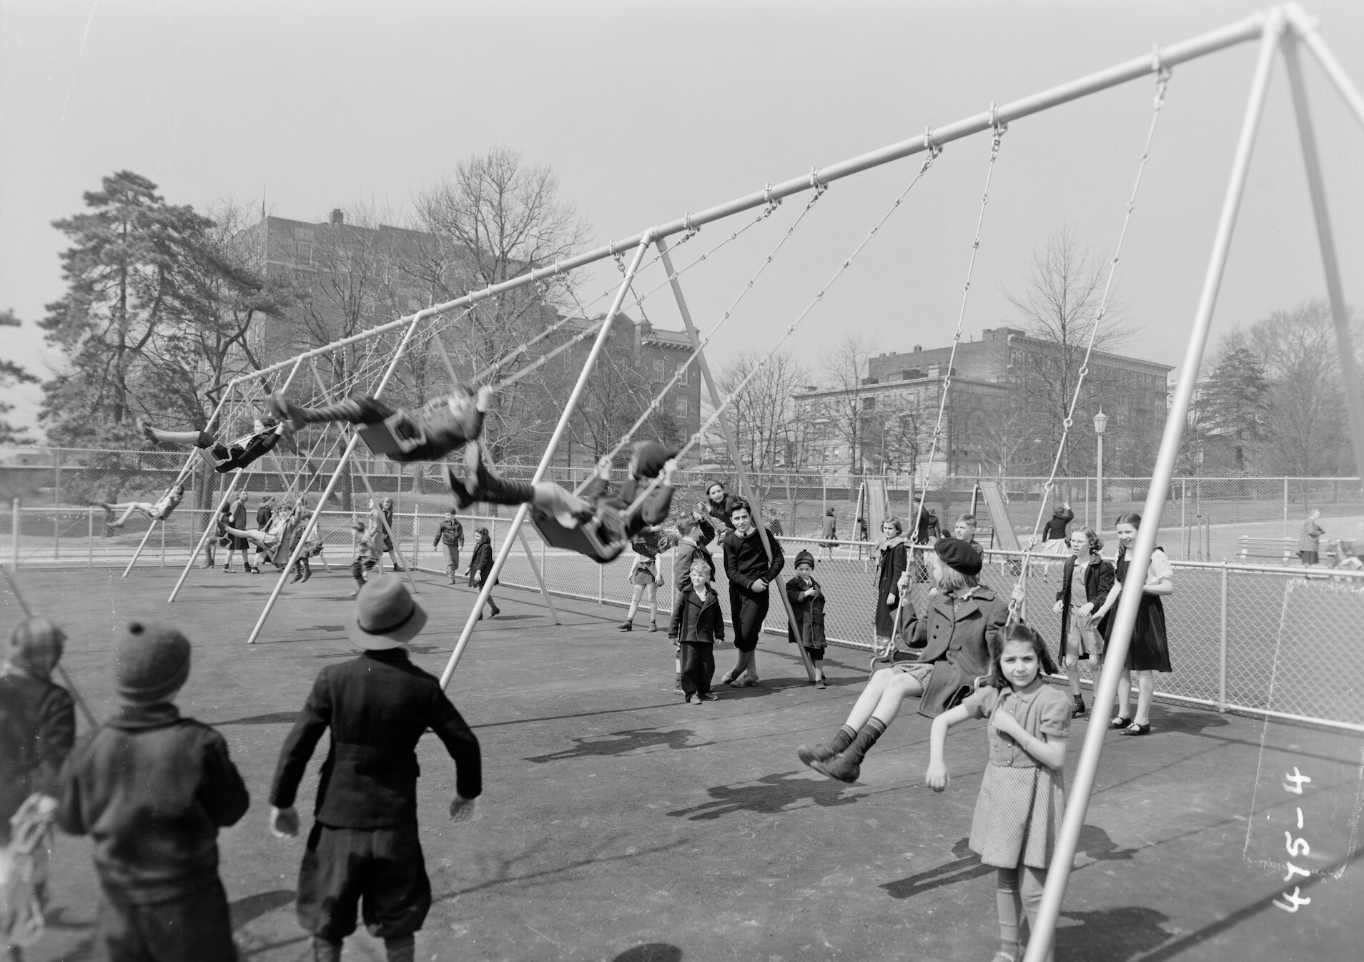
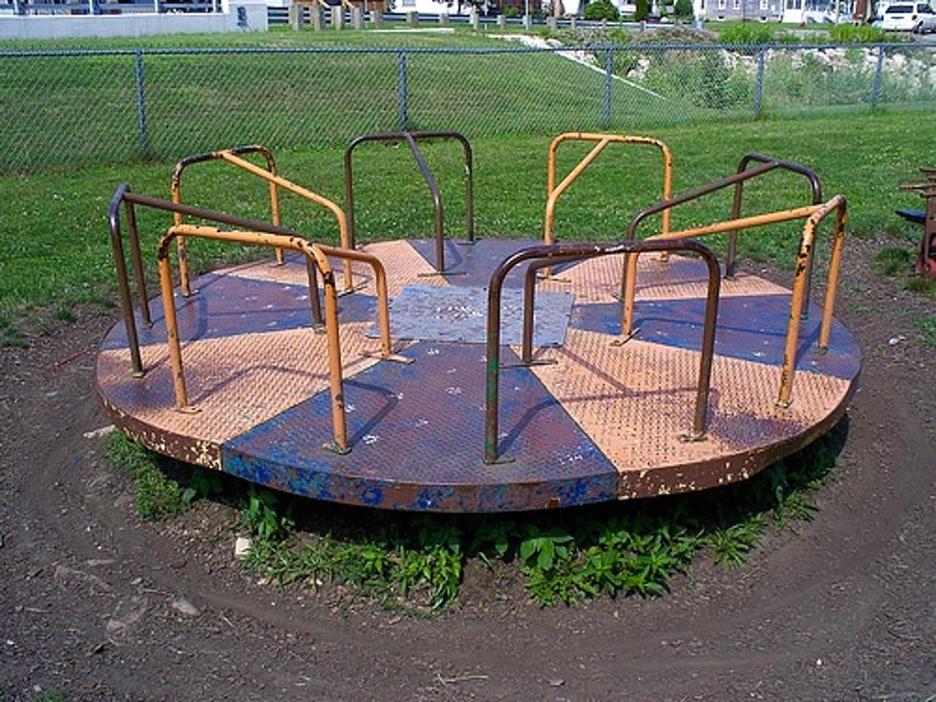
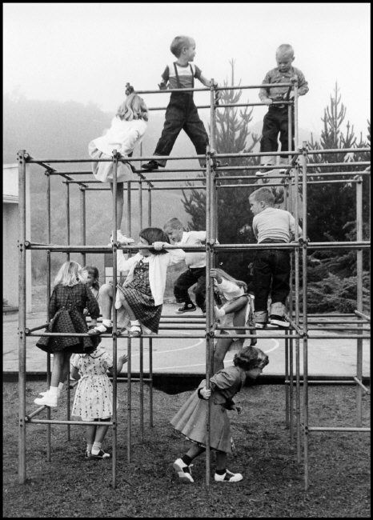
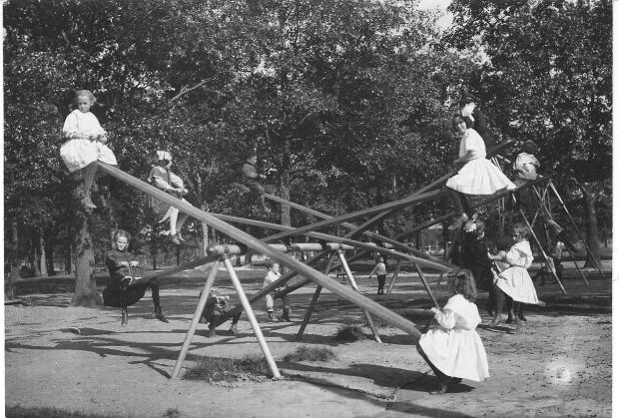
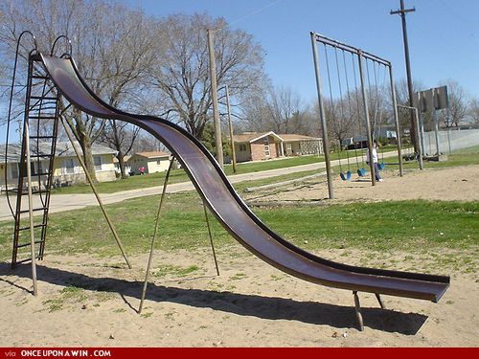
Where Students on this Playground Safe?

Slide 7
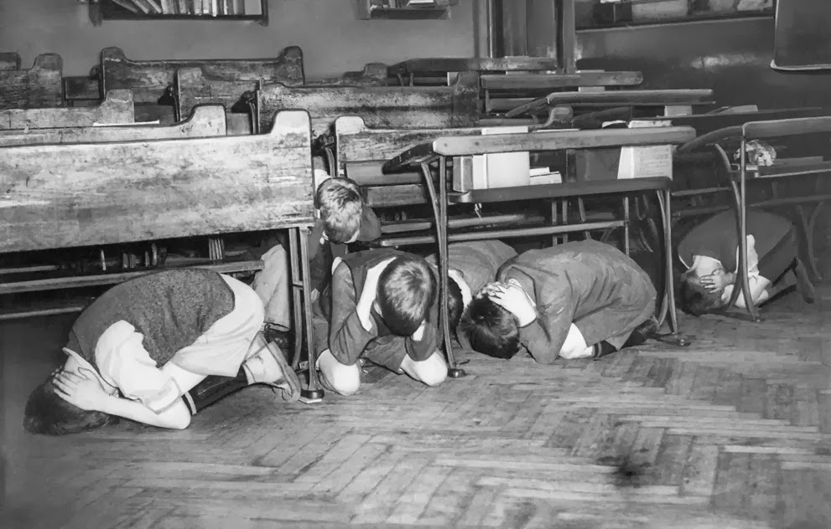
Does Anyone Remember this Safety Drill?

Slide 8
Information from PDK…
“34% of parents fear for their child’s physical safety in school.”

Slide 9
Safe and Secure Schools Act
The bill requires the State Board of Education to develop statewide standards for making all public schools safe and secure.
● The infrastructure of school buildings, including secured entrances, windows, and other facets of the structural integrity of school buildings;

Slide 10
Safe and Secure Schools Act
The bill requires the State Board of Education to develop statewide standards for making all public schools safe and secure.
● Security technology to be utilized in school buildings, including, but not limited to, intrusion detection systems and security cameras;

Slide 11
Safe and Secure Schools Act
The bill requires the State Board of Education to develop statewide standards for making all public schools safe and secure.
● Communications systems, including for
communication between school districts and law enforcement agencies; and
● Any other systems or facilities deemed necessary by the State Board.

Slide 12
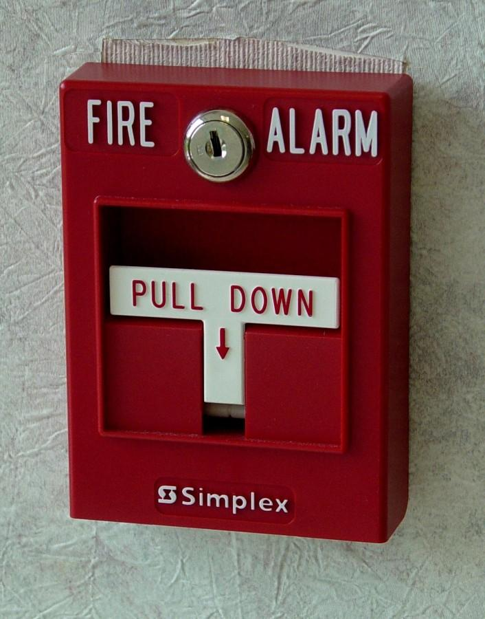
What Makes Schools Safe?

Slide 13
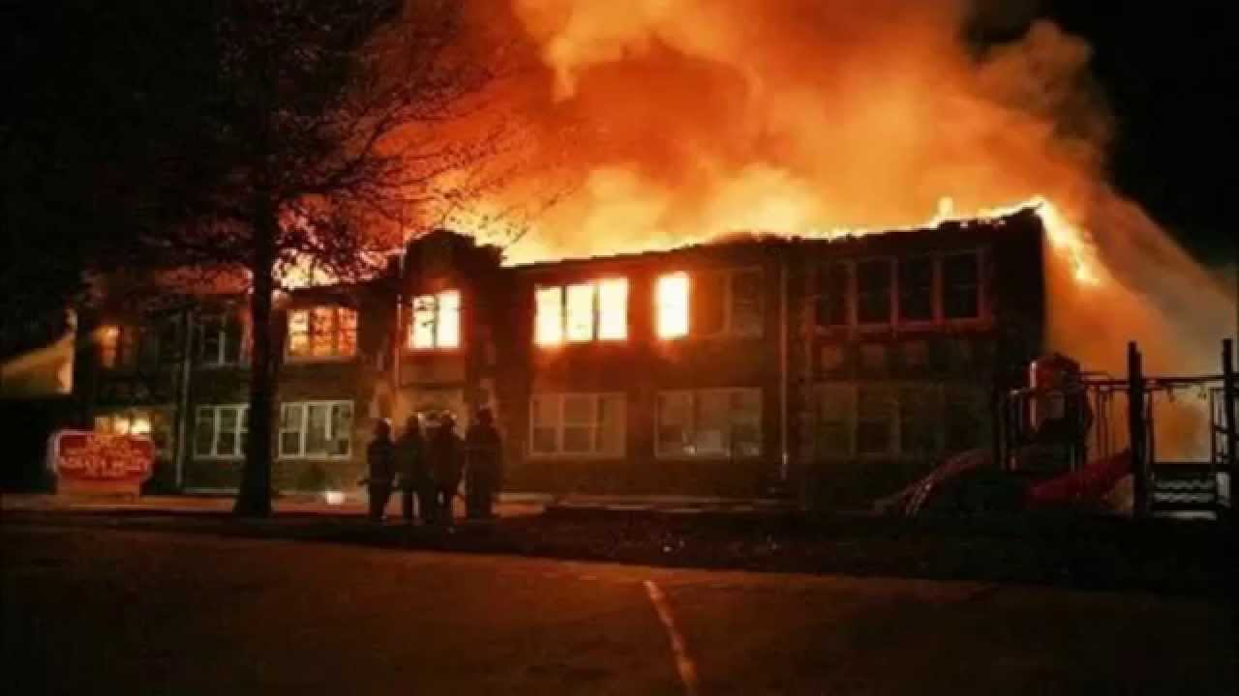
What Makes Schools Safe?

Slide 14
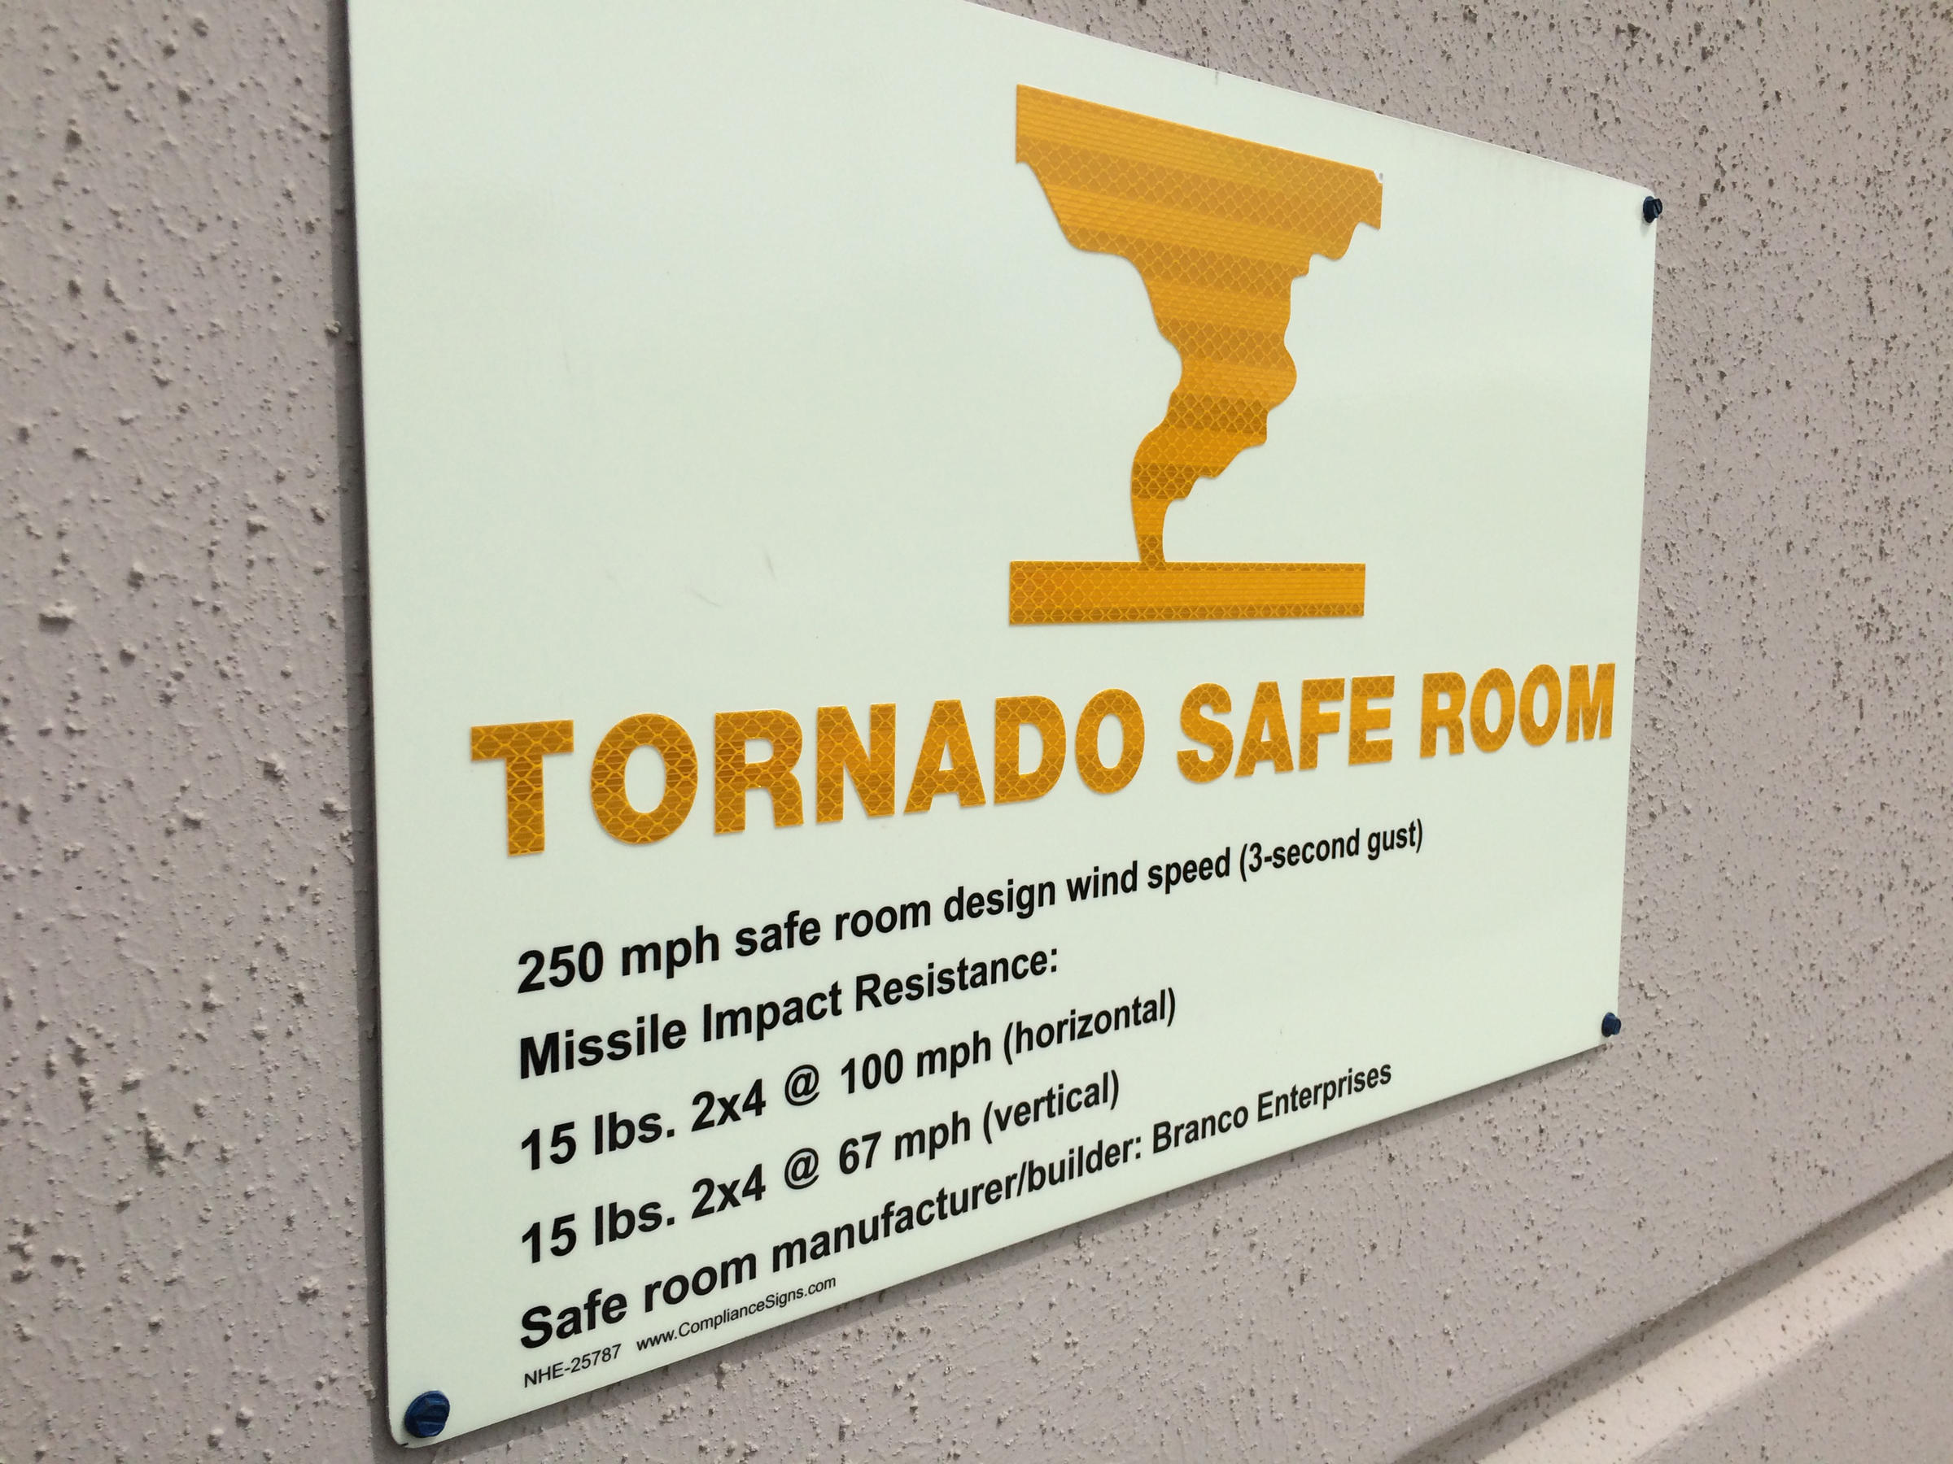
What Makes Schools Safe?

Slide 15
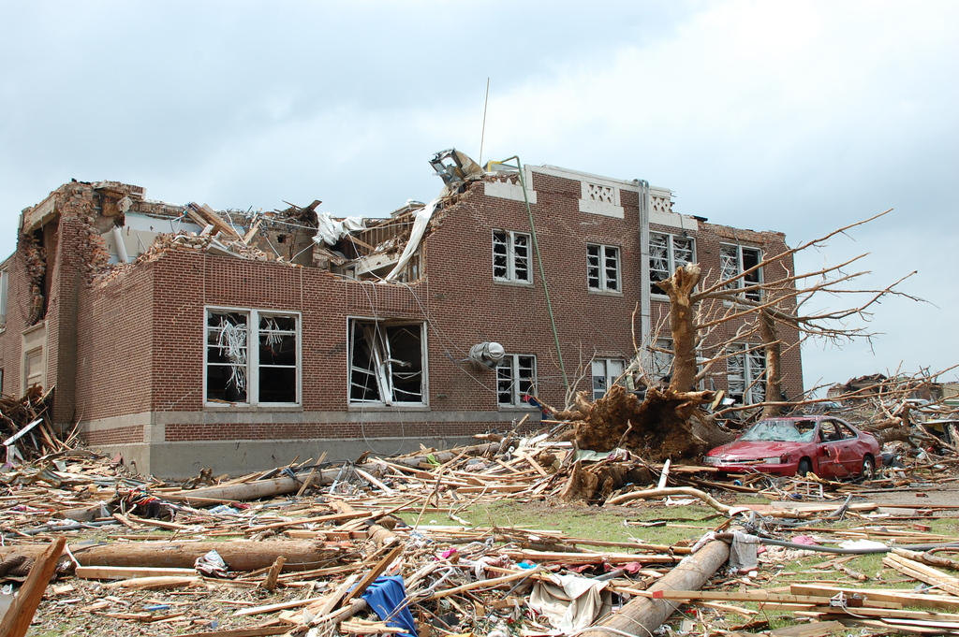
What Makes Schools Safe?
Notes:
April 27, 1923 Johnson City, Kansas^{[1]} 12:15 p.m. 1 student died

Slide 16
What Makes Schools Safe?
Notes:
January 21, 1985 Goddard, Kansas Armed with a rifle and a handgun, 14-year-old James Alan Kearbey, killed principal, James McGee, and wounded two teachers and a student at Goddard Junior High School.^{[147][181][189]}
GODDARD, Kan. (AP) — On the morning of Jan. 21, 1985, 14-year-old James Alan Kearbey walked into Goddard Junior High School armed with an M1A .308-caliber semi-automatic rifle and a .357-caliber Magnum pistol.
He killed one person, principal James McGee, and wounded three others — two teachers and a student.
The Wichita Eagle reports that it is the only fatal school shooting in Kansas history, and it led to a change in the state's judicial process related to prosecuting juveniles.
It preceded similar school shootings in Springfield, Oregon, Paducah, Kentucky, and Littleton, Colorado, by more than a decade, but the striking similarities between what happened in those places and in Goddard — most important the irrevocable damage to the lives of the people involved — can't be denied.
It was cold that morning — about 16 degrees — and Kearbey's car wouldn't start. After several tries, he gave up and began to dig around in the backseat.
He came out with two guns that belonged to his father, Wayne, a Vietnam veteran, and plenty of ammunition for both.
Wearing a long, dark coat and dark glasses, Kearbey tucked the pistol away and held the rifle "port arms" — military style — and began to jog the 200 yards from his house on Walnut Street to the junior high, where he was a ninth-grader.
A neighbor who was watching from his kitchen window called the police; then he called Kearbey's mother.
Minutes later, at 10:55 a.m., Kearbey walked through the front doors of the school. He poked his head in a classroom close to the entrance, didn't see who he was looking for, then started to walk toward the cafeteria, where there were hundreds of students beginning to gather for lunch.
One boy, Matthew Wert, asked him whether the rifle was for a school report.
Kearbey said, "No," paused, then said, "Yes."
He was spotted by a teacher, Dawn Swearingen, when he passed the teacher's lounge and the principal's office, and she went out into the hall. McGee, the principal, walked out after her, followed by athletic director Rick Kilmer.
Calmly, McGee addressed Kearbey.
"Alan, where are you going with that?"
McGee called out to Kearbey again.
Kearbey turned, from around 25 feet, holding the rifle waist-high, and took aim.
"Then, kablooey, he started firing," said Dawn Swearingen's husband, Paul.
One bullet hit McGee in the chest, severing his aorta. More bullets flew into the ceiling and the walls around them. Splinters of plaster and bullet fragments struck Swearingen in the head as both she and McGee fell to the ground.
A call went out to 911 from the school at 10:58 a.m. — two people shot, shooter still in the school.
Kilmer dragged Swearingen and McGee into the principal's office, got on the school's intercom and told the teachers to lock their doors, pull their blinds and stay in their classrooms.
Kilmer wrapped a towel around Swearingen's head; she was conscious and talking.
Kilmer ripped open McGee's shirt. There was a small hole in his chest, where the bullet entered. He began to administer first aid with the help of a nurse.
At the same time, Kearbey was stopped farther down the hallway by Don Harris, a teacher, and a student, Daniel Williams, who both heard the first shots. Harris, like McGee, hailed Kearbey twice.
This time, Kearbey turned and crouched, aiming again from less than 30 feet away. The first shot missed, but the next two shots were on target — both Harris and Williams were hit in their legs.
Kearbey started to run, toward the Goddard Intermediate Learning Center, which was connected to the junior high via a long hallway and housed fourth- through sixth-graders, then exited the building and headed north, away from the school.
By 11:05, Goddard police officers were in the school. By 11:12, the building was declared secure and the hunt for Kearbey, which now included nearly 75 law enforcement officers, began.
About an hour later, Wichita police officer Terry Morrow saw Kearbey walking through a frozen field about a mile and a half from the school. Morrow stopped his car, pulled out his shotgun and asked Kearbey to stop.
Kearbey surrendered peacefully. Police found his pockets jammed full of bullets.
McGee, 35, died several hours later. In the hours and days after the shooting, he and the other three victims were hailed as heroes, their actions having saved the lives of countless students — there were 430 students enrolled in the junior high.
The night of the shooting, at Goddard's City Hall, Wichita police Capt. B.Q. Price sat in a room with Kearbey's father, who was at the point of breaking down.
Price told him that his son wouldn't be hurt, that he was under arrest and that everything would be all right.
"No," Wayne Kearbey said. "Everything won't be all right. Nothing will ever be the same again."
Authorities said there was a list of three people Kearbey went to school to kill that Monday.
One, it was assumed, was McGee.
Sedgwick County District Attorney Marc Bennett, a ninth-grader at the school, said he was another.
The first classroom Kearbey went to when he entered the school was Bennett's. He wasn't there.
"I was in Hawaii, of all places," said Bennett, who was elected in 2012 and has been a prosecutor in Sedgwick County for 18 years.
His father, a Pizza Hut franchisee, had taken the family to the company's national convention in Hawaii.
"I remember the Friday before, there had been a conflict with Alan, which was kind of a constant problem. . Let's just put it this way: He couldn't get along with people," Bennett said.
"There was some pushing and shoving in gym class, and he had kind of stomped off and made threats like, 'I'll kill you guys,' and it was like, 'Yeah, OK.'"
Bennett's father, Bill, came into his son's room in Hawaii the morning of the shooting and told him what happened.
"Who's Alan Kearbey?" his father asked.
Over the ensuing years, investigations and lawsuits revealed Kearbey as a loner — a tough-acting teenager who liked to play Dungeons and Dragons and was obsessed with guns.
Like Michael Carneal, who killed three people at Heath High School in Paducah, Kentucky, on Dec. 1, 1997, Kearbey claimed to have been bullied.
Like Eric Harris and Dylan Klebold, who killed 13 at Columbine High School on April 20, 1999, Kearbey had threatened other students at the school multiple times. Harris and Klebold were even dressed like Kearbey — long coat and dark glasses.
When Don Harris and Williams filed suit against the Goddard school district and Kearbey's parents, it was revealed that in 1982, as a sixth-grader, Kearbey told a school counselor that he had loaded one of his father's guns and went to his grade school with the intention of shooting another student, then changed his mind. The school counselor told the principal. Kearbey's parents were never informed.
The jury awarded $111,000 in damages to Harris and Williams, with Kearbey responsible for $89,000 and the school district responsible for the rest.
Bennett stood out because he was an athlete and big for his age — 6 feet and almost 170 pounds — and he ended up talking to the police a lot when he returned home.
"Let's put it this way, I had understood there was a list, and understood my name was on it," Bennett said. "But I was never called to testify. It was handled, and (Kearbey) went away."
It's part of what set him on his career path, but he's quick to point out that he wasn't the only person affected.
"There were a lot of people out of that school that went into public service," Bennett said. "A lot of lives changed by that day."
The shooting changed the path of Swearingen's life, the teacher wounded by Kearbey.
She quit teaching learning-disabled students, earned her master's degree in counseling from Wichita State University and became a counselor for the Judge Riddel Boys Ranch — which worked with juvenile offenders — and then USD 259 for almost a decade. She moved to Missouri with her family in 1997, where she worked as a school counselor. She died in 2000, on Christmas Day, at age 48.
Harris taught in Goddard for six years after the shooting, changed careers in 1991 and followed his wife into real estate. He died in February 1998 from a heart attack while jogging. In the years after the shooting, he said he had forgiven Kearbey.
Williams, the wounded student, entered the military. After his service he moved his family to a small town in Missouri.
Kilmer retired several years ago.
"I struggled with this for a long time, with what happened to Jim. . But I ultimately came to the point where I could handle it, where I could handle what happened in that hallway and how he died because he was protecting his kids," Kilmer said.
"I taught Sunday school for years, and we always talked about forgiveness . and I want to say that I've forgiven (Kearbey), but I haven't been tested. I definitely know I haven't forgotten him."
McGee's wife, Crystal, was three months pregnant with the couple's fourth child, Jordan, when her husband was killed. She later moved her family to Oklahoma, where she still lives, to be closer to relatives.
The morning of the shooting, Crystal was sick. So were their three children — Jeannie, 10; Joseph, 7; and Jamison, 5 — all with ear infections. All would've been part of the school's lockdown that day.
"To this day, I'm thankful they didn't have to be there," Crystal said.
After the shooting, in her lowest moment, she says she reached out to God.
"I brought the kids to my sister's house in Oklahoma, to get away from everything that was going on," Crystal said. "She put me in my own room that first night, and I had this moment where I knew that this was where I could go on without God, or with him . and I decided that it didn't matter what happened to me. I was with him. Whatever he chose to do, I needed him in my life.
"Thirty years later, all four of my kids are in beautiful places. God fulfilled his promise. I know that he could've reached down and stopped those bullets that day, but I think that he decided to take my husband because (Jim) always just got it, he always just understood a little more than anybody else."
Jeannie is a dentist and was just appointed director of a dental ministry. Joseph is a pastor in southwest Texas.
Jameson, who shared the same birthday of March 2 with his father, went into the Marines, just like his dad. After 11 years as an officer, he now works for the U.S. Naval Research Laboratory.
"He's like his dad's clone," Crystal said. "They're just alike."
Jordan is in the oil and gas industry in Oklahoma.
Crystal said she's past the point of anger at Kearbey.
"From the start, from the day it happened, my hope for Alan and his family was that they would find God's forgiveness," Crystal said. "I think you could see the trouble that was in their lives, you could see that the path they were on wasn't the right one."
In March 1985, Kearbey pleaded no contest and was found guilty of murder and three counts of aggravated assault. Because he was a juvenile, he could not be held in state custody past his 21st birthday and was released in 1991.
Public outrage over McGee's murder and another case involving the shooting deaths of four family members outside of Sterling in July 1989 by Elbert Hurd Jr. and Corey Carlisle, both 15, prompted a change to Kansas law in 1990 that lowered the age when a juvenile can be prosecuted as an adult from 16 to 14.
"The case itself, in those days, was very unusual," said Clark Owens, who was the Sedgwick County District Attorney from 1981 to 1989. "Now, a school shooting, as terrible as it sounds, isn't something that surprises people. At the time, we were trying to get the statute changed for automatic referrals, but this case went automatically to juvenile court.
"It just seemed to me, from what I recall, that (Kearbey) was rather cold-hearted about the whole thing. He wasn't real emotional like you think somebody would be after doing something like that."
Kearbey came back to the Wichita area after he was released in 1991, but trouble would find him once again.
In the early morning hours of Oct. 31, 2001, Wichita police found Kearbey sitting inside his truck in a church parking lot, with a shotgun against his chin. Upset after a night of heavy drinking and arguing with his girlfriend, he said he was going to kill himself "or someone else" during a standoff.
He was eventually talked out of his car and charged with aggravated assault on a law enforcement officer, assault and battery against his girlfriend and criminal possession of a firearm. In April 2002, he was found guilty of the firearm charge, which carried a sentence of up to 23 months, and not guilty of assault and battery on his girlfriend; the aggravated assault charge resulted in a hung jury.
Kearbey was paroled in April 2003.
When contacted last week, Kearbey wouldn't talk, answering questions by saying "Good day."
He has spoken to reporters just once, in December 1997, after a school shooting in Paducah, Kentucky, stirred up memories of what happened in Goddard.
"I have to live with this every day," Kearbey said then. "I've done my time. I want this whole thing to be forgotten."

Slide 17
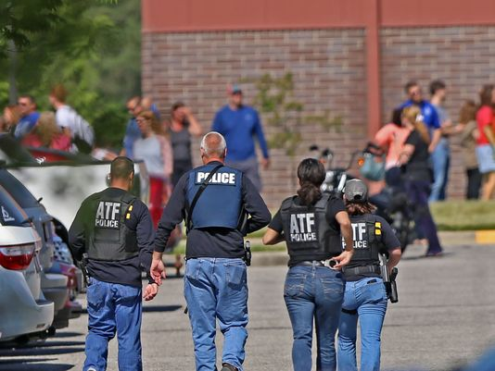
What Makes Schools Safe?

Slide 18
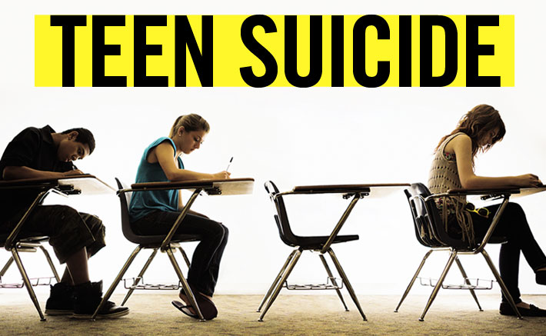
What Makes Schools Safe?
Notes:
16th in nation in youth suicide rates ages 15-24.
Suicide was the 2nd leading cause of death for 15-24-year-olds in 2016. Suicide was also the 2nd leading cause of death for youth aged 10-14 years old.

Slide 19
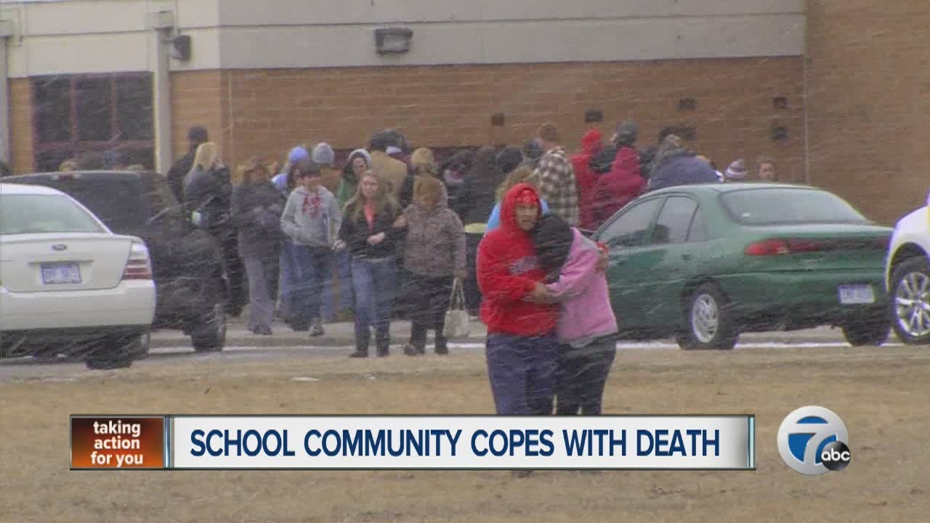
What Makes Schools Safe?

Slide 20
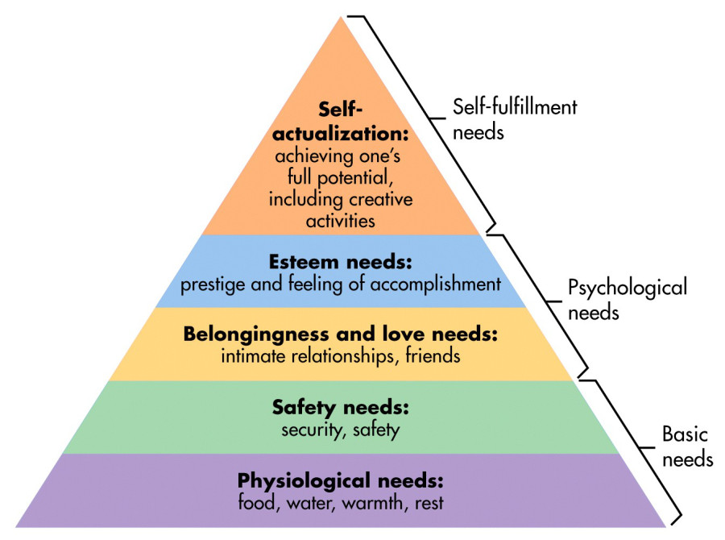
What Students Need ?

Slide 21
What we all want…
“At the end of the day, all I want is when I drop my child off at school in the morning that she returns home safely that night, having had a wonderful day in school learning and growing.” – Anonymous Parent

Slide 22
Notes:
Today’s students are the future workforce and future leaders of Kansas. Kansans Can achieve anything and, together, Kansans Can lead the world in the success of each student.

