Slide 1
Kansas Leads the World in the Success of Each Student.
Dr. Randy Watson, Kansas Commissioner of Education

Slide 2
A NEW Vision for Kansas ...
Kansas leads the world in the success of each student
KANSAS STATE DEPARTMENT OF EDUCATION | www.ksde.org

Slide 3
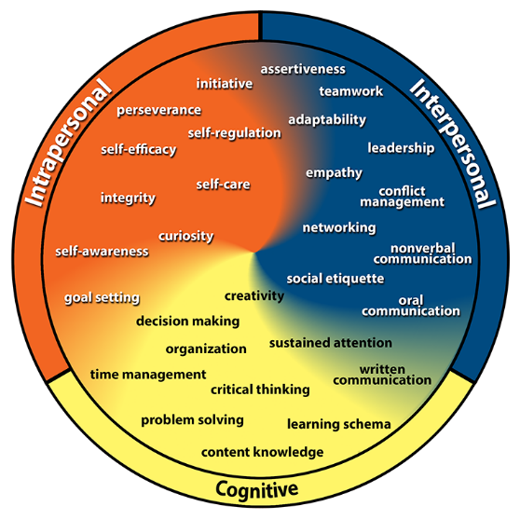
Kansans Can Competencies
Gaumer Erickson, A.S., Soukup, J.H., & Noonan, P. (2013). College & Career Competency Wheel. Lawrence, KS: University of Kansas, Center for Research on Learning. Derived in part from Pellegrino, J.W., & Hilton, M.L. (Eds.). (2012). Education for Life and Work: Developing Transferable Knowledge and Skills in the 21st Century. Washington, DC: National Academies Press.

Slide 4
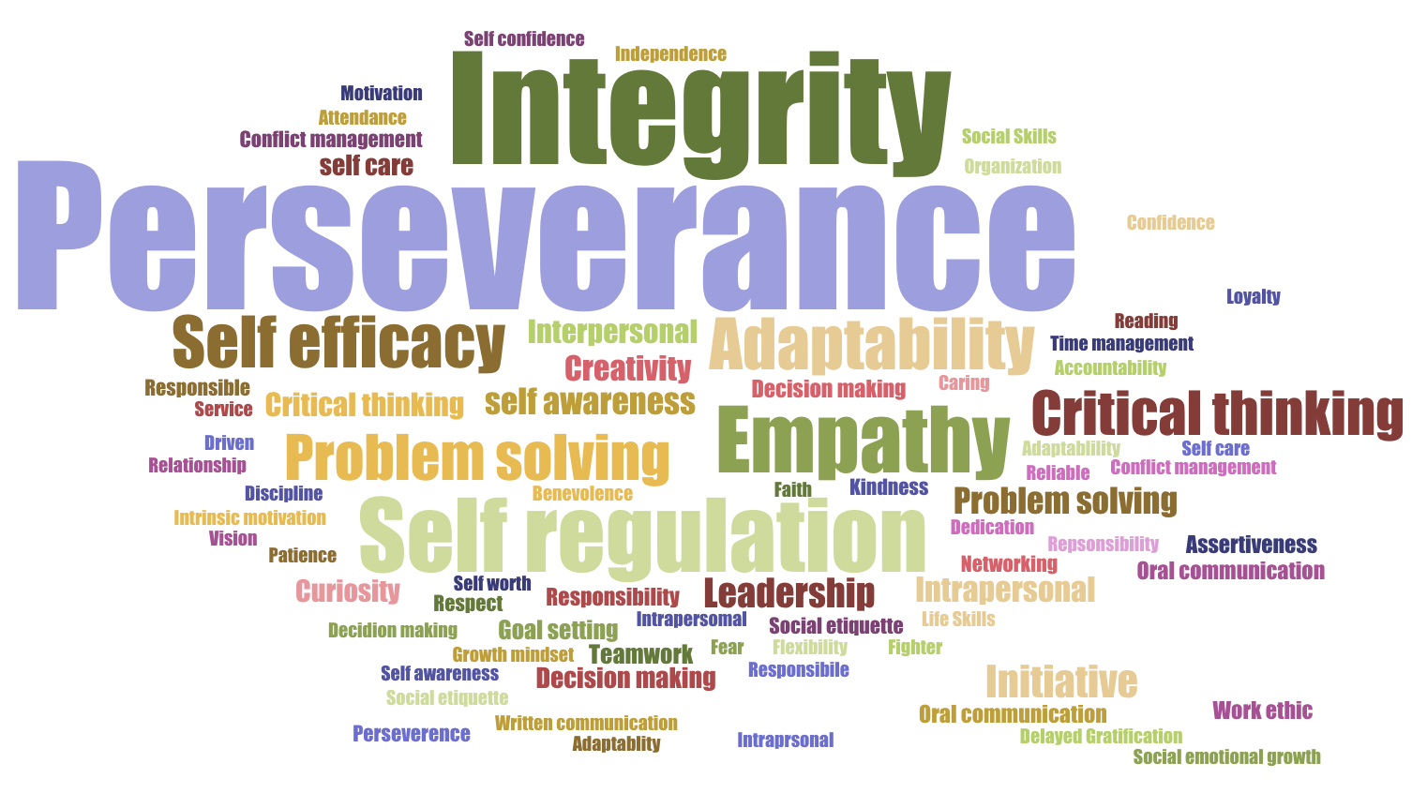
Kansans said…

Slide 5
Recognition

Slide 6
Commissioner Award
Districts that outperform their predictive rate above .40 effect size.

Slide 7
Size 2018
Which District do you want to be?
2017
Predictive Rate
426 | 50.6
354 | 50.5
1,492 | 50.4
392 | 50.3
365 | 50.3
367 | 50.0
205 | 50.0
106 | 50.0
1,323 | 50.0
53.2
54.8 - 58.1 |  | -0.88
58.4 - 64.5 |  | -1.65
49.7 - 51.9 |  | -0.06
45.9 - 50.0 |  | 0.36
48.6 - 51.5 |  | 0.03
45.1 - 48.2 |  | 0.50
45.4 - 52.0 |  | 0.19
33.9 - 38.6 |  | 2.06
53.8 - 56.8 |  | -0.79
38.4
49.2
49.7
47.7
50.4
45.8
63.3
48.8

Slide 8
KANSAN CAN RECOGNITION
Diamond
Gold
Silver
Bronze
Copper

Slide 9
SOCIAL-EMOTIONAL
GOLD
Gold
KINDERGARTEN READINESS
Gold
INDIVIDUAL PLANS OF STUDY
Gold
PREPARED FOR HIGH SCHOOL GRADUATION
Gold
State Assessments 75% at Levels 3/4
CIVIC ENGAGEMENT
Gold
POSTSECONDARY
Effective Rate 70%+
ACT
Employability - WorkKeys
Technical Skills
GRADUATION RATE
95%+

Slide 10
SOCIAL-EMOTIONAL
KINDERGARTEN READINESS
INDIVIDUAL PLANS OF STUDY
Not recognized
PREPARED FOR HIGH SCHOOL GRADUATION
COPPER
COPPER
CIVIC ENGAGEMENT
Not recognized
POSTSECONDARY
EFFECTIVENESS
BRONZE
SILVER
GRADUATION RATE
SILVER
Sample District
GOLD
GOLD
SILVER
SILVER

Slide 11
Prepared for High School Graduation
GOLD
75%+ Levels 3/4
SILVER
60 – 74% Levels 3/4
BRONZE
50 – 59% Levels 3/4
COPPER
35.5 – 49% Levels 3/4

Slide 12
High School Graduation
GOLD
95%+
SILVER
93 – 94.9%
BRONZE
90 – 92.9%
COPPER
87.5 – 89%

Slide 13
Post Secondary Effectiveness
GOLD
70%+
SILVER
60 – 69.9%
BRONZE
50 – 59.9%
COPPER
46.2 – 49%

Slide 14
Diamond Status
Achieves all outcomes
at Gold Levels

Slide 15
Notes:
Today’s students are the future workforce and future leaders of Kansas. Kansans Can achieve anything and, together, Kansans Can lead the world in the success of each student.

