Slide 1
Kansas Leads the World in the Success of Each Student.
Dr. Randy Watson, Kansas Commissioner of Education

Slide 2
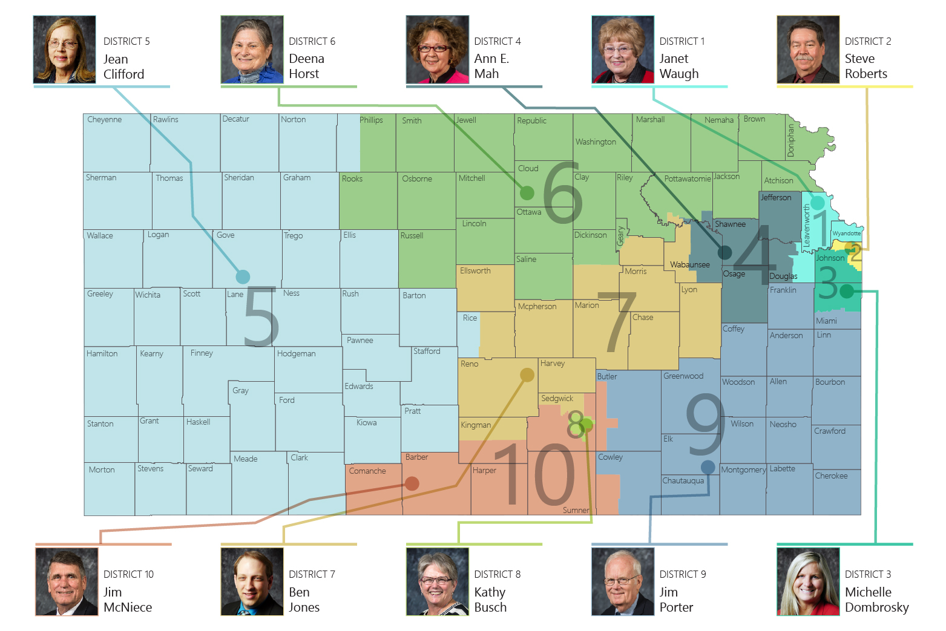

Slide 3
A NEW Vision for Kansas ...
Kansas leads the world in the success of each student
KANSAS STATE DEPARTMENT OF EDUCATION | www.ksde.org

Slide 7
Apollo Application Process
We would love to have the entire district involved in redesign! At at minimum, agree to redesign one elementary and/or one secondary school.
Each district and school must provide evidence and have approval by school board with vote; faculty with a vote of 80 percent; and local Kansas-National Education Association or other professional organization support.
Be able and willing to completely redesign at least one school around the vision, outcomes and definition of a successful high school graduate.
Be able and willing to launch a new school design in the 2020-2021 school year.

Slide 8
Apollo Application Process
Kansas has a Kansas Redesign Flight Manual that will help guide Apollo schools in the redesign process.
Beginning in April, 2019, Mission Inception will provide the schools and districts necessary information for the planning year.
Individualized regional support will be provided to Apollo schools and districts beginning the Fall of 2019.

Slide 9
Apollo Commitment
Redesign takes a community commitment!
Teachers and parents learn to lead along side administration and staff
It is YOUR redesign of YOUR school. We lead you through an intensive process.

Slide 10
Apollo Commitment
Weekly staff member time devoted to working on redesign. This includes both the biweekly, all-day regional workshops the school redesign team attends, as well as work done by the rest of the staff during the weeks between the workshops.
Costs for substitutes and transportation for staff attending the biweekly regional workshops and also for staff to visit other Redesign demonstration schools in Kansas and across the US.

Slide 11
Announcing the Apollo Phase!
Key Dates:
Application window opens – Monday, Feb. 4, 2019
Application window closes – April 5, 2019
Apollo Districts announced at State Board Meeting April 16, 2019
Kansans Can and Do Symposium – Manhattan, March 4-5, 2019

Slide 12
Notes:
Today’s students are the future workforce and future leaders of Kansas. Kansans Can achieve anything and, together, Kansans Can lead the world in the success of each student.

