Slide 1
Building the Launchpad
Meeting 1
August/September

Slide 2
Agenda
9:00-9:30 Welcome, Meet Schools, Meet Coaches
9:30-9:45 Introduce Timeline, Phase Objectives, Meeting Objectives
9:45-10:00 State Why for Redesign
10:00-10:20 Share Your Why
10:20-10:30 Break
10:30-10:50 Introduce Redesign Principles, Process, and Conditions
10:50-12:00 Rotations: Communication, Leadership, and Stakeholder Engagement
12:00-12:30 Lunch
12:30-2:00 Data Rotations & Community Values (15 minutes with a break built in)
2:00-2:45 Planning Time
2:45-3:00 Closing

Slide 3
Links
Slides -

Slide 4
Meet Your Schools
Add slides featuring schools in your region

Slide 5
Meet Your Leaders
Add slides for each Training Team Member

Slide 6
Building the Launchpad
Day 1
Meeting Content

Slide 7
Notes:
https://www.ksde.org/Portals/0/Communications/KC_School_Redesign/Kansans%20Can%20School%20Redesign%20Project%20Plan%20Year%20Timeline.pdf?ver=2020-09-24-144333-290

Slide 8
Objectives
01
“Why” and Shared Vision
Why is Kansas Redesigning?
Review Personal, School, and Community Why
Create a Shared Vision (School + Stakeholders)
Determine values and beliefs
02
Determine Need & Analyze Data
Examine current data for strengths, weaknesses, opportunities, and threats
03
What is the ‘turnkey’ process? How will you train the rest of your school?
How will you continue to inform and engage all stakeholders?
Who is responsible?
Develop an Engagement Plan
04
Communicate with Stakeholders
Why, Who, How, and When
Continue developing your plan
Over communicate

Slide 9
Building the Launchpad
FOCUS
LEVERAGE
ENGAGEMENT
ACCOUNTABILITY
State Vision for Education
Establish a Collective Why Determine Current Engage Stakeholders And Shared Vision for Redesign & Future State & Communicate
-School Why -Examine Current -Build a Purposeful
-School Vision Data Community
-School Values -Examine System -Mobilize Others Data -Communication Plan
-Business Plan
Notes:
Focus on the wildly important.
Act on lead measures.
Keep a compelling scoreboard.
Create a cadence of accountability.

Slide 10
Why Redesign? What’s Redesign?
How will you build a purposeful community?
Where are we currently?
Where are we going?
Turnkey Planning & Closing

Slide 11
Kansas Vision for Redesign
Kansas leads the world in the success of each student.

Slide 12
Notes:
Need to find a better image here.

Slide 13
Creating a Vision for Kansas -- State Outcomes
Notes:
When the Board set out for Kansas to Lead the World in the Success of Each Student, they knew that our focus would need to change. Thus, the Board established 5 key outcomes, that when targeted would assist us in help each student achieve success. Those five key outcomes are…
Read the outcomes.

Slide 14
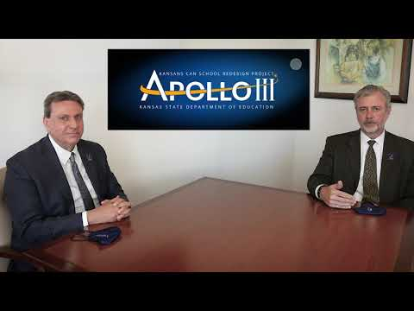
Why Redesign?

Slide 15
Why Redesign?
It’s what Kansans told us they wanted in their schools
It’s what the Kansas job market trends were telling us​
It’s what our K-12 student outcomes were telling us

Slide 16
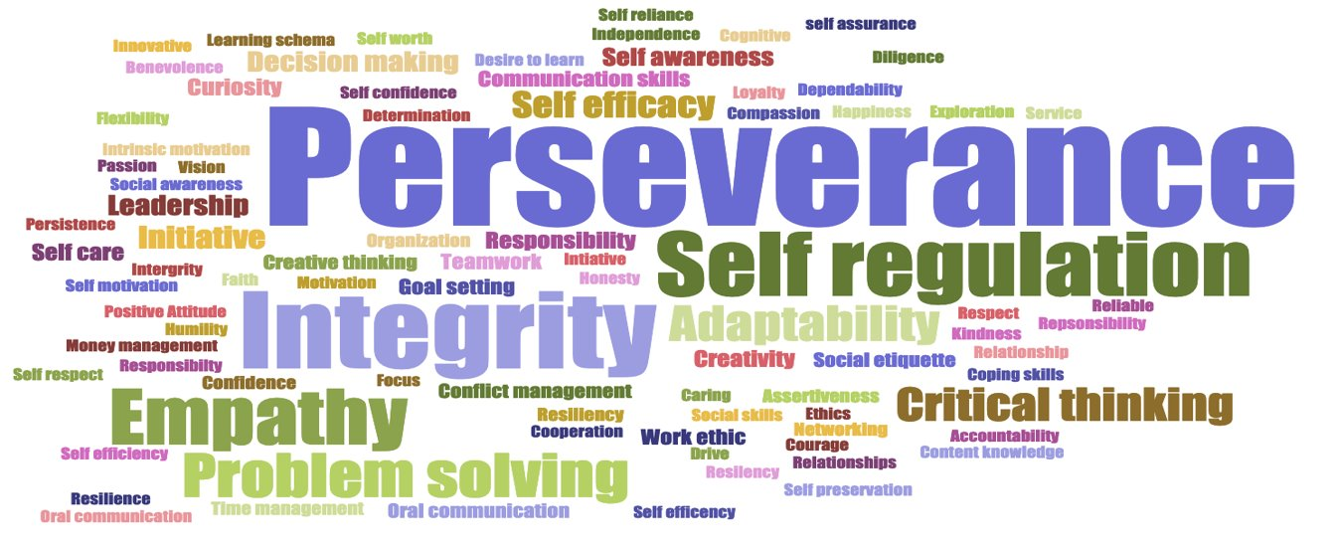
Kansans said, and are still staying...

Slide 17
Percentage of jobs in Kansas that require a credential in addition to a diploma
71%
Data Compiled by the Georgetown Center on Education & the Workforce

Slide 18
Starting with a class of 100 HS Freshman, in Kansas, on average…
88.3% will graduate (2020, 5 year cohort)
54% will, two years after graduation, have earned a certificate or an associate’s or have completed 2 years of college
Putting our Effectiveness Rating for 2019 at 48%
Notes:
2020 Graduation Rate was 88.3%
Double check data in the fall. (Kathi G. will have it soon.)
Check Here- https://ksreportcard.ksde.org/home.aspx?org_no=State&rptType=3

Slide 19
Kansas Vision for Redesign
Kansas leads the world in the success of each student
It’s what Kansans said they wanted. It’s what the job trends and our current K-12 outcomes are telling us.

Slide 20
Revisit & Share Your ‘Why’
Optional Documentation Sheet
Notes:
https://www.ksde.org/LinkClick.aspx?fileticket=9W-j1mTSpkQ%3d&tabid=1509&portalid=0&mid=6016
All Apollo III schools were asked to create their why during the application process. If a school does not have a ‘why’ for redesign, coach them through the process to turnkey after this meeting.

Slide 21
BREAK

Slide 22
Why Redesign? What’s Redesign?
How will you build a purposeful community?
Where are we currently?
Where are we going?
Turnkey Planning & Closing

Slide 23
Kansans Can School Redesign Principles
Student Success Skills | Family, Business, and Community Partnerships
There is an integrated approach to develop student social-emotional learning. | Partnerships are based on mutually beneficial relationships and collaboration.
Personalizing Learning | Real World Application
Personalized learning places the whole child at the center of instruction. It is informed by strong educator/student/family/community relationships to provide equity and choice in time, place, path, pace and demonstration of learning. | Project-based learning, internships, and civic engagement makes learning relevant.

Slide 24
BLENDING DESIGN THINKING & 4DX
EMPATHIZE
with our students and staff
TEST
models and strategies with students
DEFINE
their needs
Create a Cadence of Accountability
Iterations
PROTOTYPE
models and strategies
IDEATE
solutions to these needs
Focus on the Wildly Important (Goal Areas & Lag Measures)
Keep a Compelling Scoreboard
(Liang, Mitchell, & Scott, 2020)
Act on Lead Measures (Strategies)
Notes:
The HOW of Redesign - process
Blending of the two models - unique to school improvement
Start with Empathize and roll through
Design Thinking - student-focused solutions, lends itself to creativity and innovation (Navigating Next) Ex. Michelangelo
4DX - narrowing down to what’s most important for student, executing well with strategies that leverage student-centered goals Ex. Tom Osborne drawing up the split back veer play
Blending creativity & innovation with a focus on executing well = strong process to Redesign
Schools learn this process in the Plan Year and then continually replicate and cycle through in a perpetual loop

Slide 25
Conditions for a Learning Culture
Sh
Principals
Model Learning Leadership
Motivate Teachers
Support Inquiry, Innovation, and Exploration
Shared Leadership
Shared Leadership
-Shared Vision
-Psychological Safety
-Communication & Feedback
-Growth Mindset
Teachers
Collective Efficacy
Change Agents
Collegial Collaboration and Practices
Additional Stakeholders
Input in Goals and Strategies
Communicate about and Invest in the Work
Shared Leadership
Notes:
Conditions = Learning Culture & Shared Leadership

Slide 26
Launch Readiness Rubric
Show & Launch Readiness Expectations:
All four Redesign Principles are addressed in your Redesign Plan
There is documentation of your work throughout the Plan Year (i.e. blueprint, action plans, and gap analyses for each strategy)
Evidence supports that you have regularly updated your Local Board of Education
Your School Vision & Goals align with your District Vision & Goals
Your School Vision & Goals are aligned to the State Vision, Definition of a Successful High School Graduate, and the State Board Outcomes
Category |  | Low | Medium | High
Strategy Selection, Prototyping, and Testing |  | Strategies are missing multiple components: Researched by the GAIT Supported with an Action Plan Connected to the Gap Analysis Measured through data-tracking and monitoring (scoreboards) Adjusted based on accountability meetings and reflection | Some strategies were... Researched by the GAIT Supported with an Action Plan Connected to the Gap Analysis Measured through data-tracking and monitoring (scoreboards) Adjusted based on accountability meetings and reflection | All strategies were... Researched by the GAIT Supported with an Action Plan Connected to the Gap Analysis Measured through data-tracking and monitoring (scoreboards) Adjusted based on accountability meetings and reflection
Process for Continuous Improvement | Plan to Scale | Resource implications have not been determined for strategies selected for scale and support plans have not been created. | For some strategies selected for scale, the resource implications have not been determined OR a complete support plan has not yet been created. | For each strategy selected for scale, the resource implications have been determined and a support plan has been created.
 | Sustainability & Growth | Strategy support through professional development and GAIT team maintenance has not been incorporated into the plan for scale. | Some plans exist regarding professional development for strategies selected for scale, but there is no designated GAIT time set aside for accountability meetings. | There is a plan for ongoing professional development, GAIT time, and accountability meetings so that strategies can be evaluated, monitored, and adjusted in a timely manner.
 | Process for Ongoing Improvement | The district and school have not worked to align improvement plans. It is unclear how school goals and strategies connect with district goals and strategies. Plans exist in multiple places, and they are not aligned. | The district and school improvement plans overlap, but direct alignment and connection is missing in areas.The district supports the school plans for improvement, but there is little alignment across buildings and plans. | The district and school have aligned the school Redesign Plan with the district’s plan for continuous improvement, and support is in place to continue work within the defined Goal Areas.
Internal & External Stakeholder Engagement and Communication |  | The school has not engaged both internal and external stakeholders in the Redesign process. Two-way communication is not developed and feedback loops are not in place. | The school has engaged all stakeholders, but two-way communication has not always been ensured. Feedback loops might exist for some stakeholder groups but not all. | The school has authentically and meaningfully engaged all stakeholders (students, staff, parents, community, business) in the Redesign work and has established two-way communication, opportunities for input, and feedback loops.
Notes:
Rubric- https://www.ksde.org/LinkClick.aspx?fileticket=vnD9-j4k9No%3d&tabid=1207&portalid=0&mid=3630

Slide 27
Why Redesign? What’s Redesign?
How will you build a purposeful community?
Where are we currently?
Where are we going?
Turnkey Planning & Closing

Slide 28
Leadership

Slide 29
Leadership Competencies

Slide 30
Leadership Focus- Principal
Give staff responsibility to lead activities/projects
Facilitate or create the conditions for group learning
Co-create an agenda with the School Redesign Team and have members take the lead.
Coach teacher leaders through the challenges of leading their colleagues.
Plan, Review, and Reflect with teachers on their leadership within activities/projects.
Anticipate and address barriers to group learning.
Intervene skillfully when the conversation ‘heats up’.
Create time and space in the weekly schedule for teachers to learn together about Redesign.

Slide 31
Leadership Focus- Teachers
Understand adult learning
Create an environment of Inquiry, Innovation, and Exploration
Set clear goals
Revisit your ‘Why’
Review information regularly
Utilize training experiences to facilitate interactive learning
Encourage experimentation and innovation
Encourage staff to take initiative
Provide time for problem solving before taking action
Engage in inquiry
Be open to doing things differently
Openly discuss failures as an opportunity for growth
Notes:
Topics came from our Leadership Competencies- https://www.ksde.org/Portals/0/Communications/KC_School_Redesign/Fact%20Sheet%20KCSRP%20How%20do%20Leadership%20Roles%20of%20Redesign%20Fit%20Together.pdf?ver=2020-09-30-132651-717
https://www.wgu.edu/blog/adult-learning-theories-principles2004.html
http://www.ascd.org/publications/educational-leadership/apr15/vol72/num07/The-Juggler's-Guide-to-Collegiality.aspx

Slide 32
Grow Collective Efficacy
How are you intentionally developing the four ways teachers gain power and confidence to make a difference?
Learning together - Interdependence
Cause-and effect relationships - Deep reflection on what causes results and improving those causes (strategies)
Goal-directed behavior - Focus on mastery of teaching skills to improve their practice
Purposeful practice with feedback from a variety of sources (peer, credible expert, instructional coach - even students)
Donahoo and Katz July 2019
Notes:
http://www.ascd.org/publications/educational-leadership/jul19/vol76/num09/What-Drives-Collective-Efficacy%C2%A2.aspx
The process that we teach in Redesign will facilitate growth in collective efficacy. Developing leadership capacities of all involved will support the growth of collective efficacy. These four practices will assist you in creating the conditions for collective efficacy and growth.

Slide 33
Communication

Slide 34
TURNKEY PROCESS
Regional Training Team will experience workshop + modify turnkey materials to train the School Redesign Teams in their service centers
RTT
School Redesign Team receives training from RTT and makes key decisions to modify expectations for their district and school context
SRT
School teams receive training from their School redesign team and engage staff through participation in investigation teams
FULL SCHOOL
Notes:
Two Things:
While you are at these trainings, we are giving you content and walking you through activities to assist you in engaging in design thinking to plan your school redesign. As you participate, you should always be thinking about what you will take back to your staff and how you will deliver it.
To assist you with planning your ‘turnkey’, we have a communication log that you were asked to create in the beginning of our time together. You are not obligated to use this, but it is highly encouraged. Use this communication log to help you plan, to track your progress, and to implement a system of accountability.

Slide 35
WHAT
Determine what is the essential learning for all.
WHY
Establish a clear purpose for the learning.
Turnkey Considerations
HOW
Determine the best time, place, and delivery model for the learning.

Slide 36
Stakeholder Engagement

Slide 37
Who are your stakeholders?
Notes:
Maybe this would be a good place for a discussion - where schools identify their stakeholders.
We could also build in equity - who is easy to engage? Who is more challenging to engage? Who never engages? What efforts might schools take to ensure they have made every effort to engage ALL stakeholders?

Slide 38
Notes:
https://ncsi-library.wested.org/resources/203

Slide 40
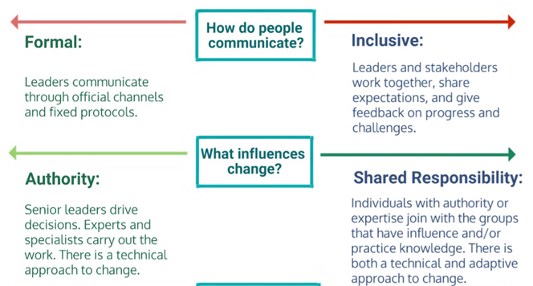

Slide 41
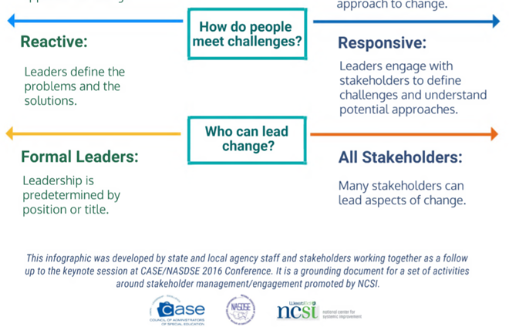

Slide 42
Communication Plan
Begin working on and/or updating your Communication Plan.
PDF Version/ Word Version
Other Communication Materials:
8 Steps to Effective Communication
Creating a Robust Communication Plan (9 Steps)
Developing a Message Map (pages 81-89)

Slide 43
LUNCH

Slide 44
Why Redesign? What’s Redesign?
How will you build a purposeful community?
Where are we currently?
Where are we going?
Turnkey Planning & Closing
Notes:
This section of the day will be 3 rotations. Each of the following slides will be a ~20 minute station.

Slide 45
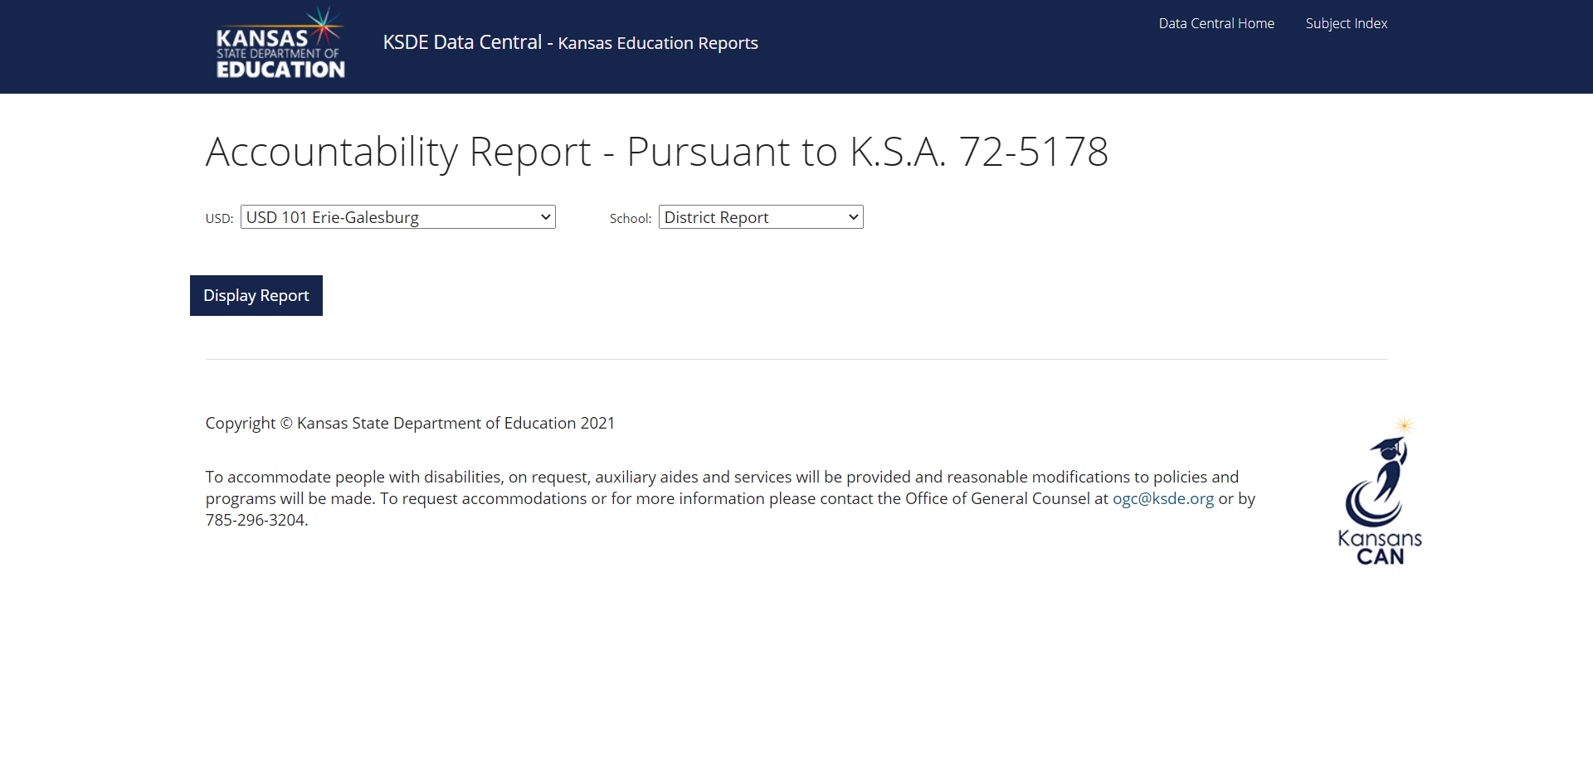
Data Dive- Building & System Report Card
Open your system and building accountability report.
https://datacentral.ksde.org/acct_rpt.aspx
With your team, complete the 15 minute Data Dive using your Accountability Reports.
Notes:
Another protocol to use to examine data:
https://achieve.lausd.net/cms/lib/CA01000043/Centricity/domain/244/secondary%20sbac%20resources/Protocol%20for%20Examining%20Data.pdf

Slide 46
Culture Survey
Use the Redesign School Culture Survey completed during the application period (spring 2021) to do a needs assessment.
Obtain your school’s copy of the Building Culture Survey. You can view the questions here.
With your team, complete the 15 minute Data Dive using your Accountability Reports.
Notes:
Schools can email redesign@ksde.org to gain access to our culture survey. You are also welcome to use whatever culture survey you wish.

Slide 47
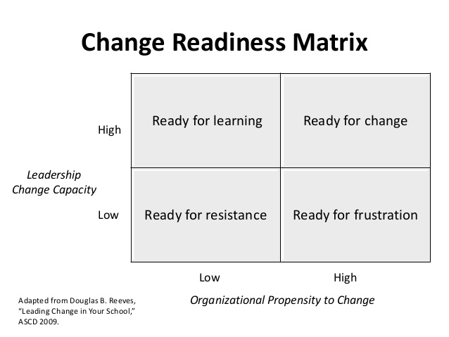
Readiness Assessment
Work through the Organizational Change Readiness Assessment
Read the chapter on change readiness.
Consider a change that you have experienced in education.
How did it go?
Why did it succeed/fail?
Discuss- What will you need to do, remember, etc. to ensure the changes made through redesign are supported and successful?
Notes:
This one can be cut to allow for more time with the other two and values.

Slide 48
Why Redesign? What’s Redesign?
How will you build a purposeful community?
Where are we currently?
Where are we going?
Turnkey Planning & Closing

Slide 49
In order to know where you are going, you have to first establish your values and beliefs. All decisions should be based on who you are as a school and school community.

Slide 50
In this meeting, we are establishing core values and beliefs. In the next meeting, you will use these values and your newfound community insights to create a shared vision.

Slide 51
Analyzing Community Values

Slide 52
Think: How will you engage your stakeholders in determining your values?

Slide 53
Why Redesign? What’s Redesign?
How will you build a purposeful community?
Where are we currently?
Where are we going?
Turnkey Planning & Closing

Slide 54
Turnkey & School Planning Time
Look at data with all school staff
Report card data
Culture Survey data
Organizational Readiness
Bring LOCAL Data to the next meeting
Identify Core Values and Beliefs
Staff
Community
Feedback & Communication
Communication Plan
WHY
WHAT
Turnkey Considerations
HOW
Notes:
Consider using a protocol to discuss the data together.
Observations are about the data.
Identify possible problems of practice - it isn’t personal.
How might your system need to change to support improvement efforts toward the problem of practice?
https://achieve.lausd.net/cms/lib/CA01000043/Centricity/domain/244/secondary%20sbac%20resources/Protocol%20for%20Examining%20Data.pdf

Slide 55
Share your commitments between now and the next Regional Training.
Each school will share out loud.
Notes:
Note- This is like an ‘accountability meeting’. Reporting on last time’s commitments, giving a status update based on data (i.e. checklist), and talking about what’s next...that’s discipline 4 ‘create a cadence of accountability’!

Slide 56
Talk about...

Slide 57
Upcoming Meeting Dates & Reminders

Slide 58
SURVEY
Please take the survey at the end of each regional training. Your feedback is incredibly valuable.

Slide 59
Follow us on Twitter
@KSDEredesign
#kstothemoon

