Slide 1
Why we need to change education in Kansas
Dr. Randy Watson, Kansas Commissioner of Education

Slide 2
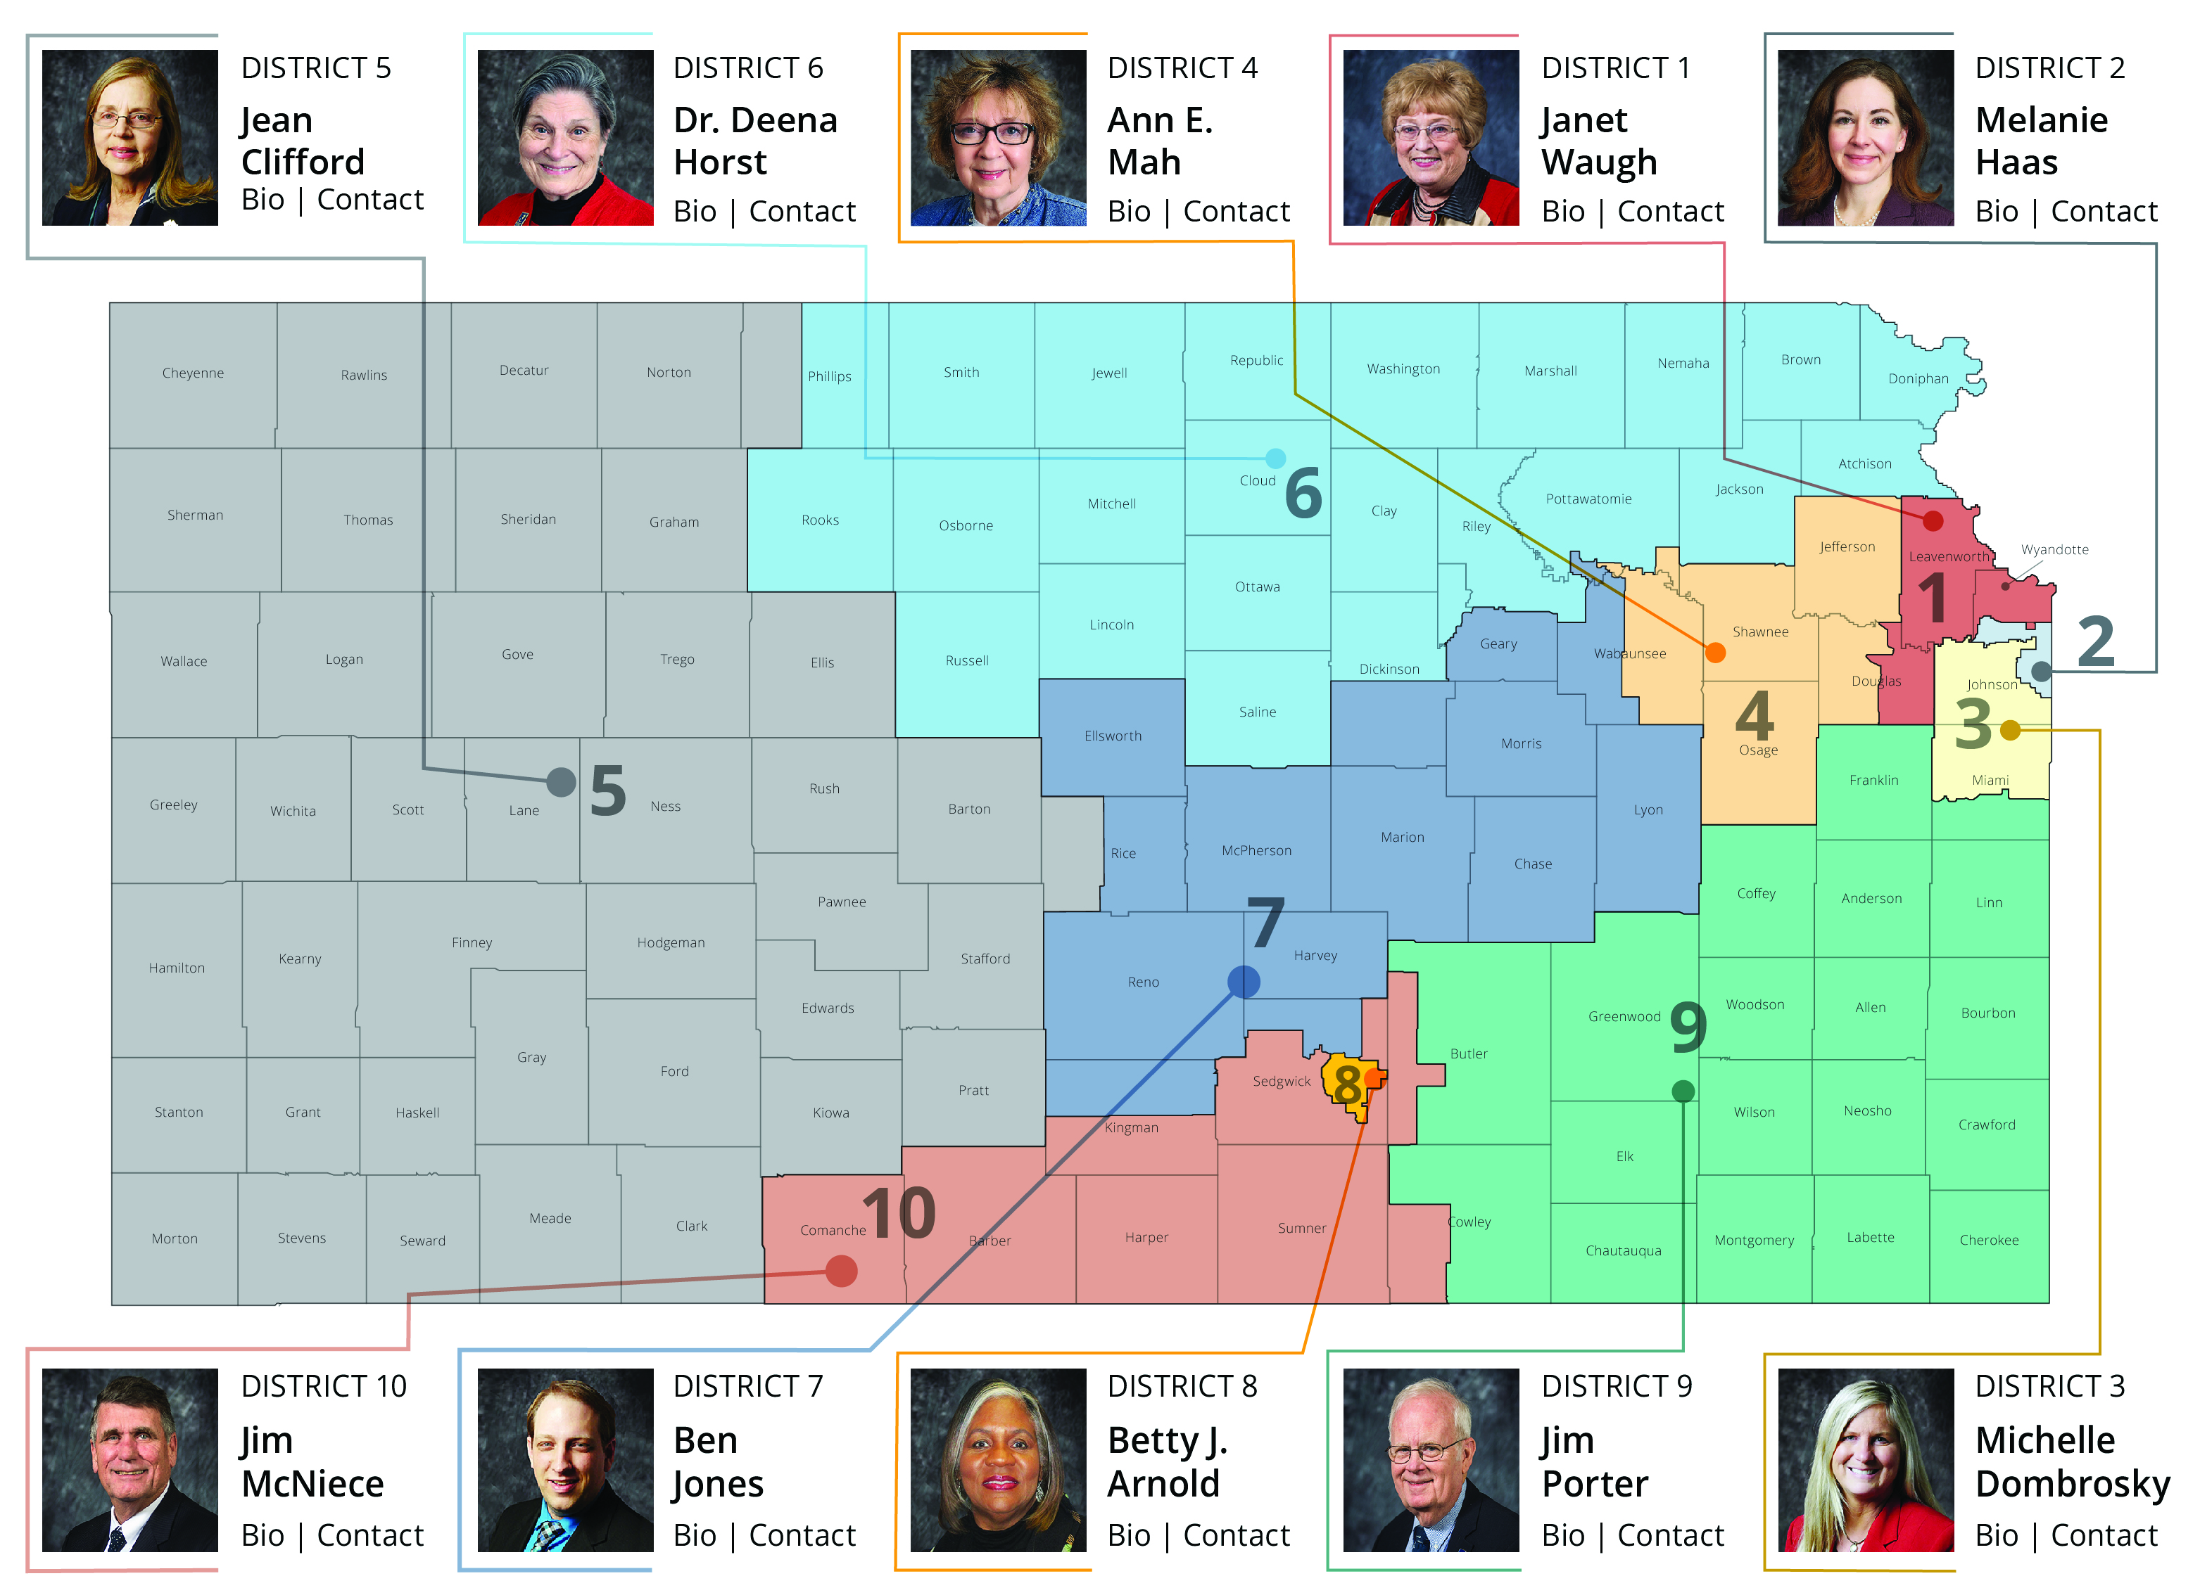

Slide 3
KANSAS CHILDREN KANSAS’ FUTURE Tour

Slide 4
From the first set of focus group responses, what characteristics of success were most frequently cited?

Slide 5
The business and industry focal groups cited non-academic skills with greater frequency than the community groups:

Slide 6
Time to Redesign Schools!
WHAT SKILLS DO BUSINESS & INDUSTRY SAY ARE LACKING IN HIGH SCHOOL, TWO-YEAR and FOUR-YEAR COLLEGE PROGRAM GRADUATES?

Slide 7
HIGH SCHOOL GRADUATES LACKING…
Professionalism/Work Ethic . . . . . . . . . 80.3%
Teamwork/Collaboration . . . . . . . . . . . 75.7%
Verbal Communication. . . . . . . . . . . . . 70.8%
Ethics/Social Responsibility. . . . . . . . . . 63.4%
Critical Thinking/Problem Solving. . . . . 57.5%
Information Technology Applications. 53.0%
Written Communication. . . . . . . . . . . . 52.7%
Diversity. . . . . . . . . . . . . . . . . . . . . . . . 52.1%
Lifelong Learning/Self-Direction. . . . … 42.5%
Creativity/Innovation. . . . . . . . . . . . . . . 36.3%
Consolidated Survey of Corporate America

Slide 8
TWO YEAR COLLEGE GRADUATES LACKING…
Professionalism/Work Ethic. . . . . . . . . . . 83.4%
Teamwork/Collaboration. . . . . . . . . . . . 82.7%
Verbal Communication. . . . . . . . . . . . . 82.0%
Critical Thinking/Problem Solving. . . . . . 72.2%
Written Communication. . . . . . . . . . . . . 71.5%
Ethics/Social Responsibility. . . . . . . . . . . 70.6%
Information Technology Applications. . 68.6%
Lifelong Learning/Self-Direction. . . . . . . 58.3%
Diversity. . . . . . . . . . . . . . . . . . . . . . . . . 56.9%
Creativity/Innovation. . . . . . . . . . . . . . . 45.5%
Consolidated Survey of Corporate America

Slide 9
FOUR YEAR COLLEGE GRADUATES LACKING…
Verbal Communication. . . . . . . . . . . . . 95.4%
Teamwork/Collaboration. . . . . . . . . . . . 94.4%
Professionalism/Work Ethic. . . . . . . . . . . 93.8%
Written Communication. . . . . . . . . . . . . 93.1%
Critical Thinking/Problem Solving. . . . . 92.1%
Ethics/Social Responsibility. . . . . . . . . . 85.6%
Leadership . . . . . . . . . . . . . . . . . . . . . . . 81.8%
Information Technology Applications. 81.0%
Creativity/Innovation. . . . . . . . . . . . . . . 81.0%
Lifelong Learning/Self-Direction. . . . . . 78.3%
Consolidated Survey of Corporate America

Slide 10
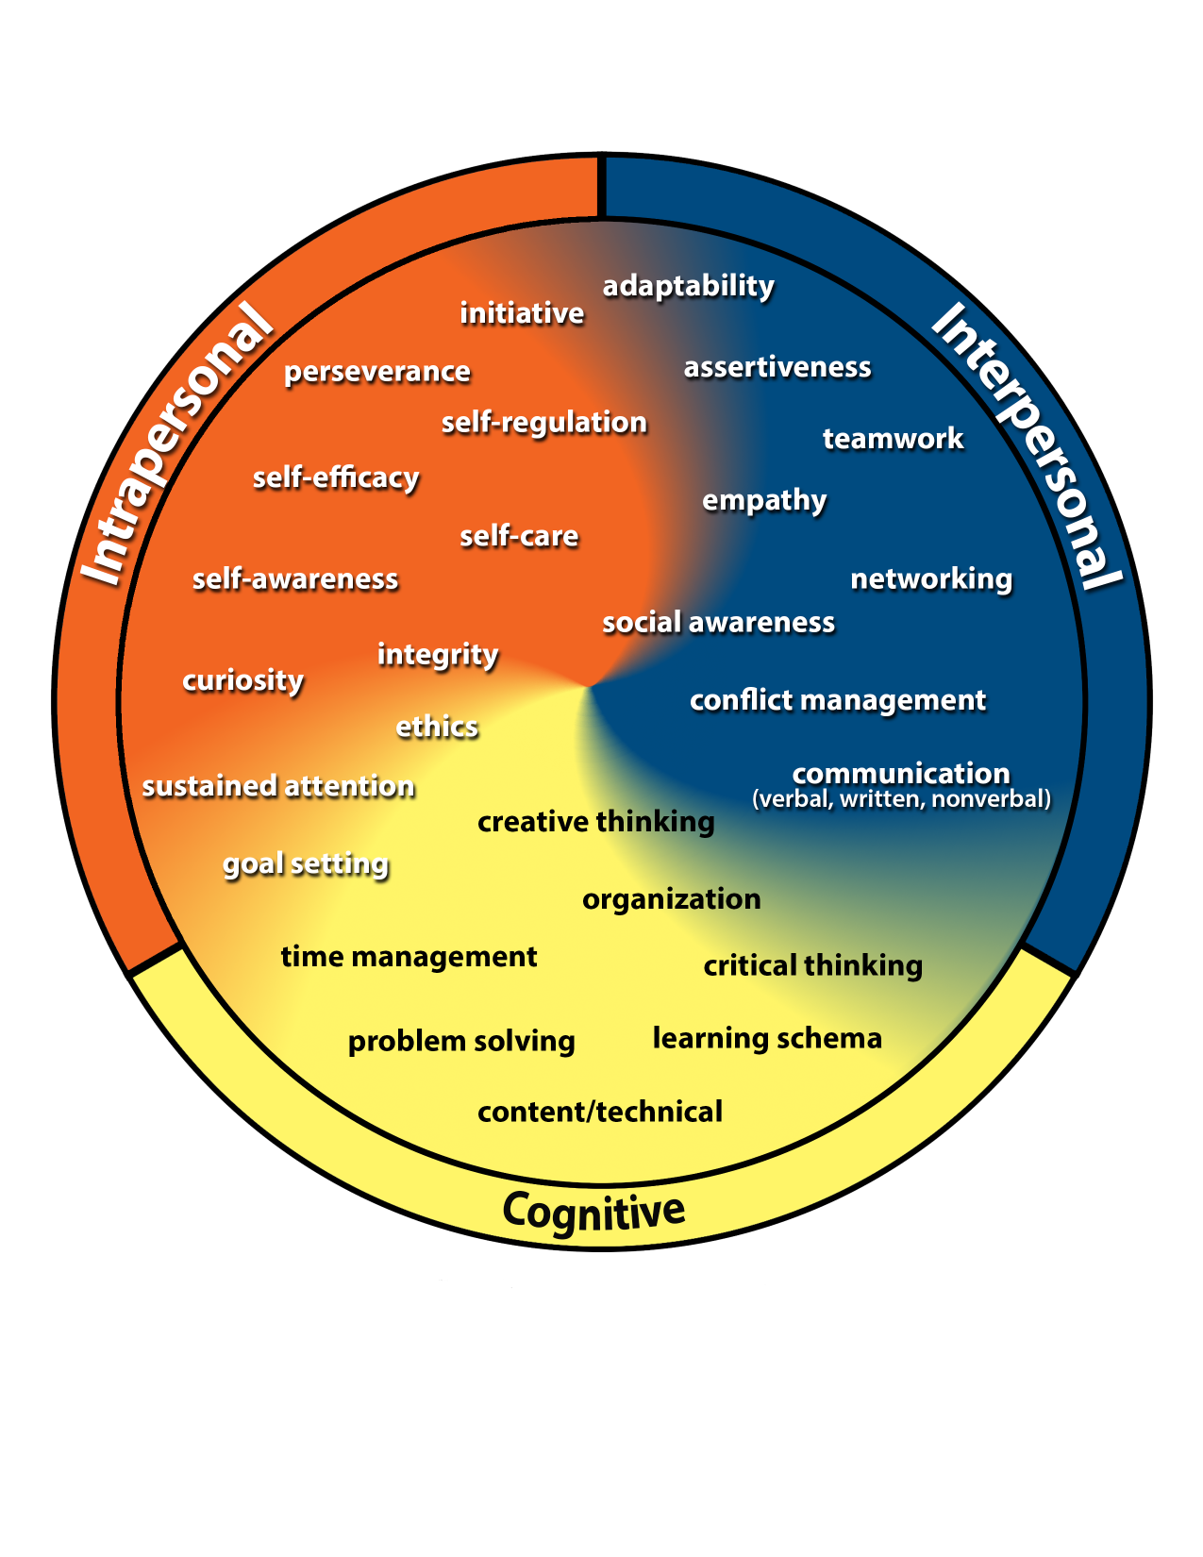
Kansans Can
Competencies

Slide 11
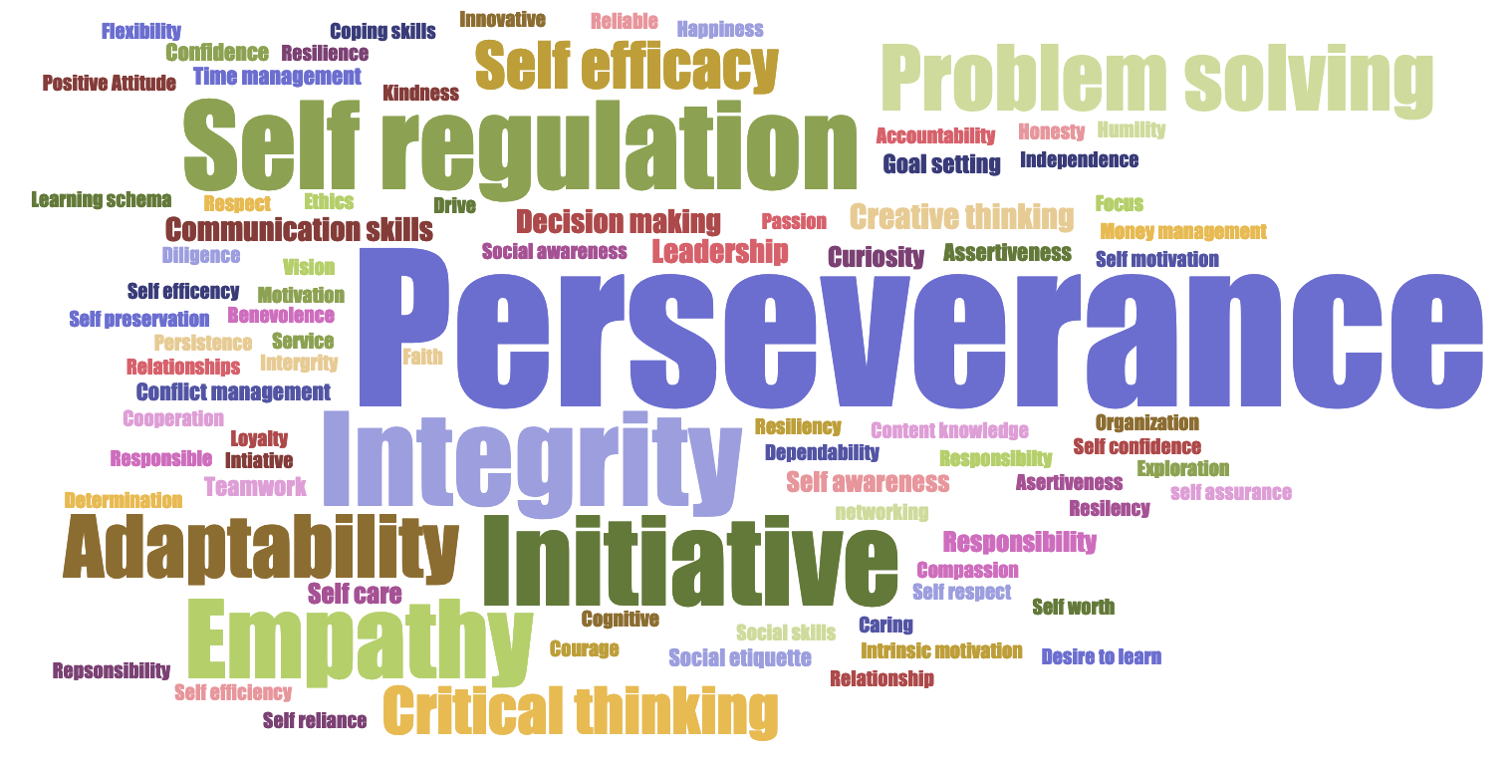
Over 10,000 Kansans said…

Slide 12
Our Vision for Kansas ...
Kansas leads the world in the success of each student

Slide 13
A Successful Kansas High School Graduate has the
Academic preparation,
Cognitive preparation,
Technical skills,
Employability skills and
Civic engagement
to be successful in postsecondary education, in the attainment of an industry recognized certification or in the workforce, without the need for remediation.

Slide 14
What Kansans want from their schools
Changes need to be made to address school culture
New dynamic roles for counselor and social workers
Collaboration between schools and businesses
Reorganize schools around students, not the system
Community service needs to play a bigger role
Kansas children need quality preschool including all day kindergarten
Notes:
We also learned that Kansans believe
Every child needs access to quality preschool education
School culture needs to be addressed – we must value the student going to a two-year or certification program as much as a student attending a four-year institution.
Counselors need to be able to help students identify and explore career interests
Must be collaboration between schools and businesses to prepare students for postsecondary pursuits
Schools must be reorganized around the student, not the system to meet unique needs
Community service is an important part of preparing students for life after high school.

Slide 15
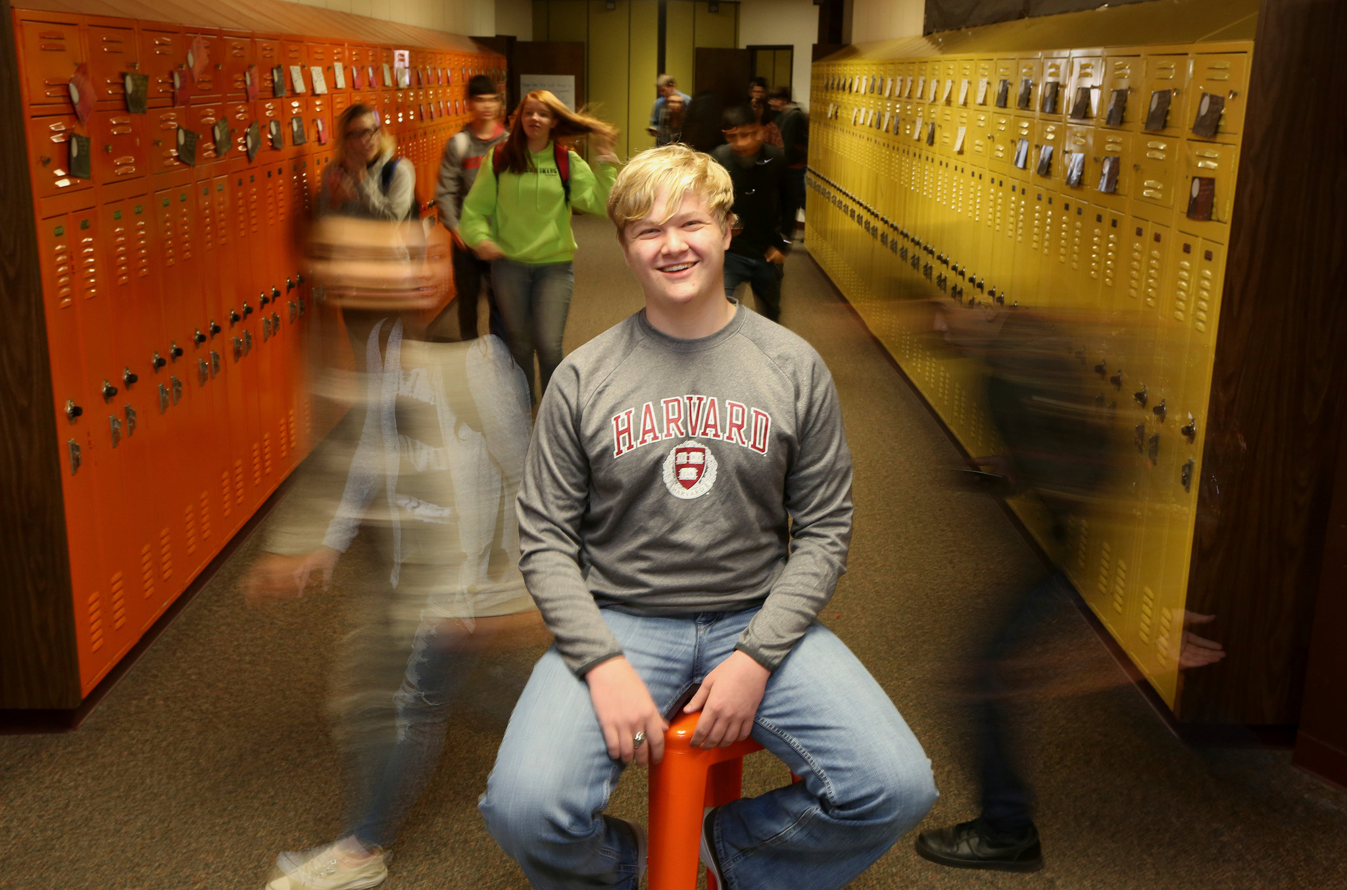

Slide 17
Kansas School Redesign Principles
Student Success Skills | Family, Business, and Community Partnerships
There is an integrated approach to develop student social-emotional learning. | Partnerships are based on mutually beneficial relationships and collaboration.
Personalized Learning | Real World Application
Teachers support students to have choice over their time, place, pace and path. | Project-based learning, internships, and civic engagement makes learning relevant.

Slide 20
Notes:
Today’s students are the future workforce and future leaders of Kansas. Kansans Can achieve anything and, together, Kansans Can lead the world in the success of each student.

