Slide 1
2022 KTOY Team – Defining Success in KS
Dr. Randy Watson, Kansas Commissioner of Education

Slide 2
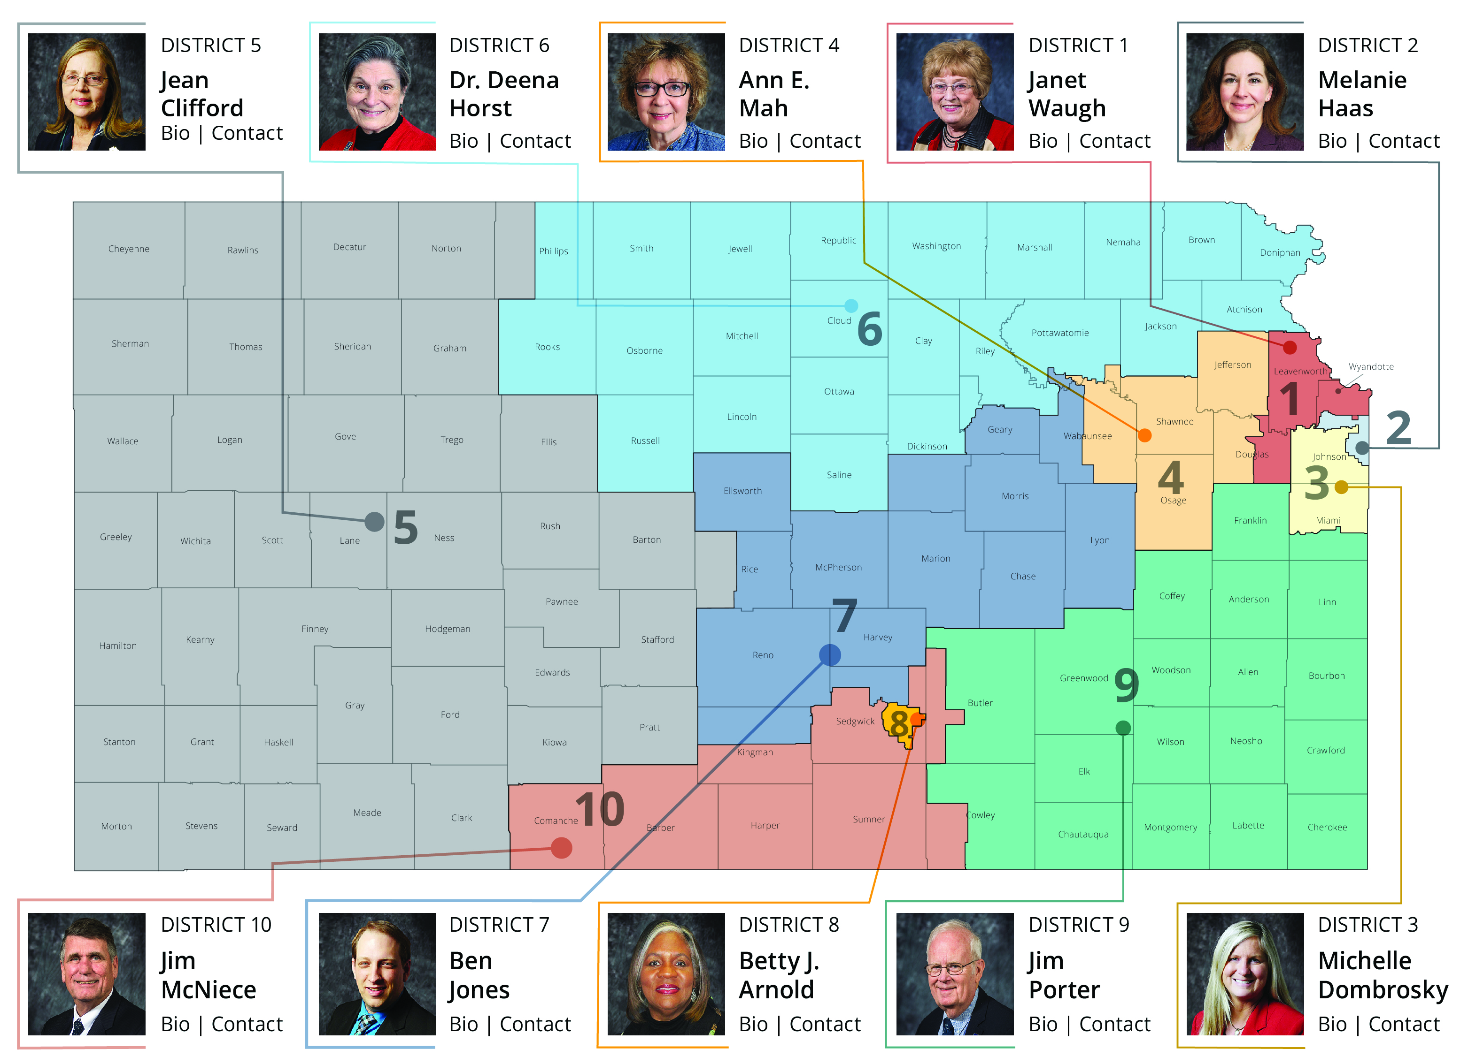

Slide 5
Our Vision for Kansas ...
Kansas leads the world in the success of each student

Slide 6
A Successful Kansas High School Graduate has the
Academic preparation,
Cognitive preparation,
Technical skills,
Employability skills and
Civic engagement
to be successful in postsecondary education, in the attainment of an industry recognized certification or in the workforce, without the need for remediation.

Slide 7
Creating a Vision for Kansas
State Outcomes
Social Emotional Growth
Kindergarten Readiness
Individual Plan of Study
High School Graduation Rates
Post Secondary Completion

Slide 8
Kansas School Redesign Principles
Student Success Skills | Family, Business, and Community Partnerships
There is an integrated approach to develop student social-emotional learning. | Partnerships are based on mutually beneficial relationships and collaboration.
Personalized Learning | Real World Application
Teachers support students to have choice over their time, place, pace and path. | Project-based learning, internships, and civic engagement makes learning relevant.

Slide 9
Quantitative Measures: Automatically calculated by KSDE based on collected district data.
Academically prepared for postsecondary
High school graduation
Postsecondary success
Commissioner Award

Slide 10
Qualitative Measures: Districts must apply to be recognized in the following areas:
Social-emotional growth
Kindergarten readiness
Individual Plans of Study
Civic engagement

Slide 11
KANSAS CHILDREN KANSAS’ FUTURE Tour

Slide 12
From the first set of focus group responses, what characteristics of success were most frequently cited?

Slide 13
The business and industry focal groups cited non-academic skills with greater frequency than the community groups:

Slide 14
What Kansans want from their schools
Changes need to be made to address school culture
New dynamic roles for counselor and social workers
Collaboration between schools and businesses
Reorganize schools around students, not the system
Community service needs to play a bigger role
Kansas children need quality preschool including all day kindergarten
Notes:
We also learned that Kansans believe
Every child needs access to quality preschool education
School culture needs to be addressed – we must value the student going to a two-year or certification program as much as a student attending a four-year institution.
Counselors need to be able to help students identify and explore career interests
Must be collaboration between schools and businesses to prepare students for postsecondary pursuits
Schools must be reorganized around the student, not the system to meet unique needs
Community service is an important part of preparing students for life after high school.

Slide 17
Examining the 2021 Success Tour Data R12 Comprehensive Center - McRel Kansas State University Kansas State Department of Education

Slide 18
Statewide glance
How many people responded to the survey questions?
3,455 respondents
3,213 online Menti respondents
242 paper question cards completed
50 in-person sessions across the state and 1 online session
Notes:
General information about session attendees.
3,455 total survey respondents. 3,213 responded to the online Menti during the session and an additional 242 individuals completed the question cards or paper survey.
**It should be noted that the Menti items and the paper Question Cards did phrase the scale items in different ways. The Menti asked them to rate on a scale of 1 – 5 with 1 being the lowest and 5 being the highest. The Question card however, asked respondents to select from strongly agree to strongly disagree. The data has been interpreted with the strongly agree to strongly disagree scale.

Slide 19
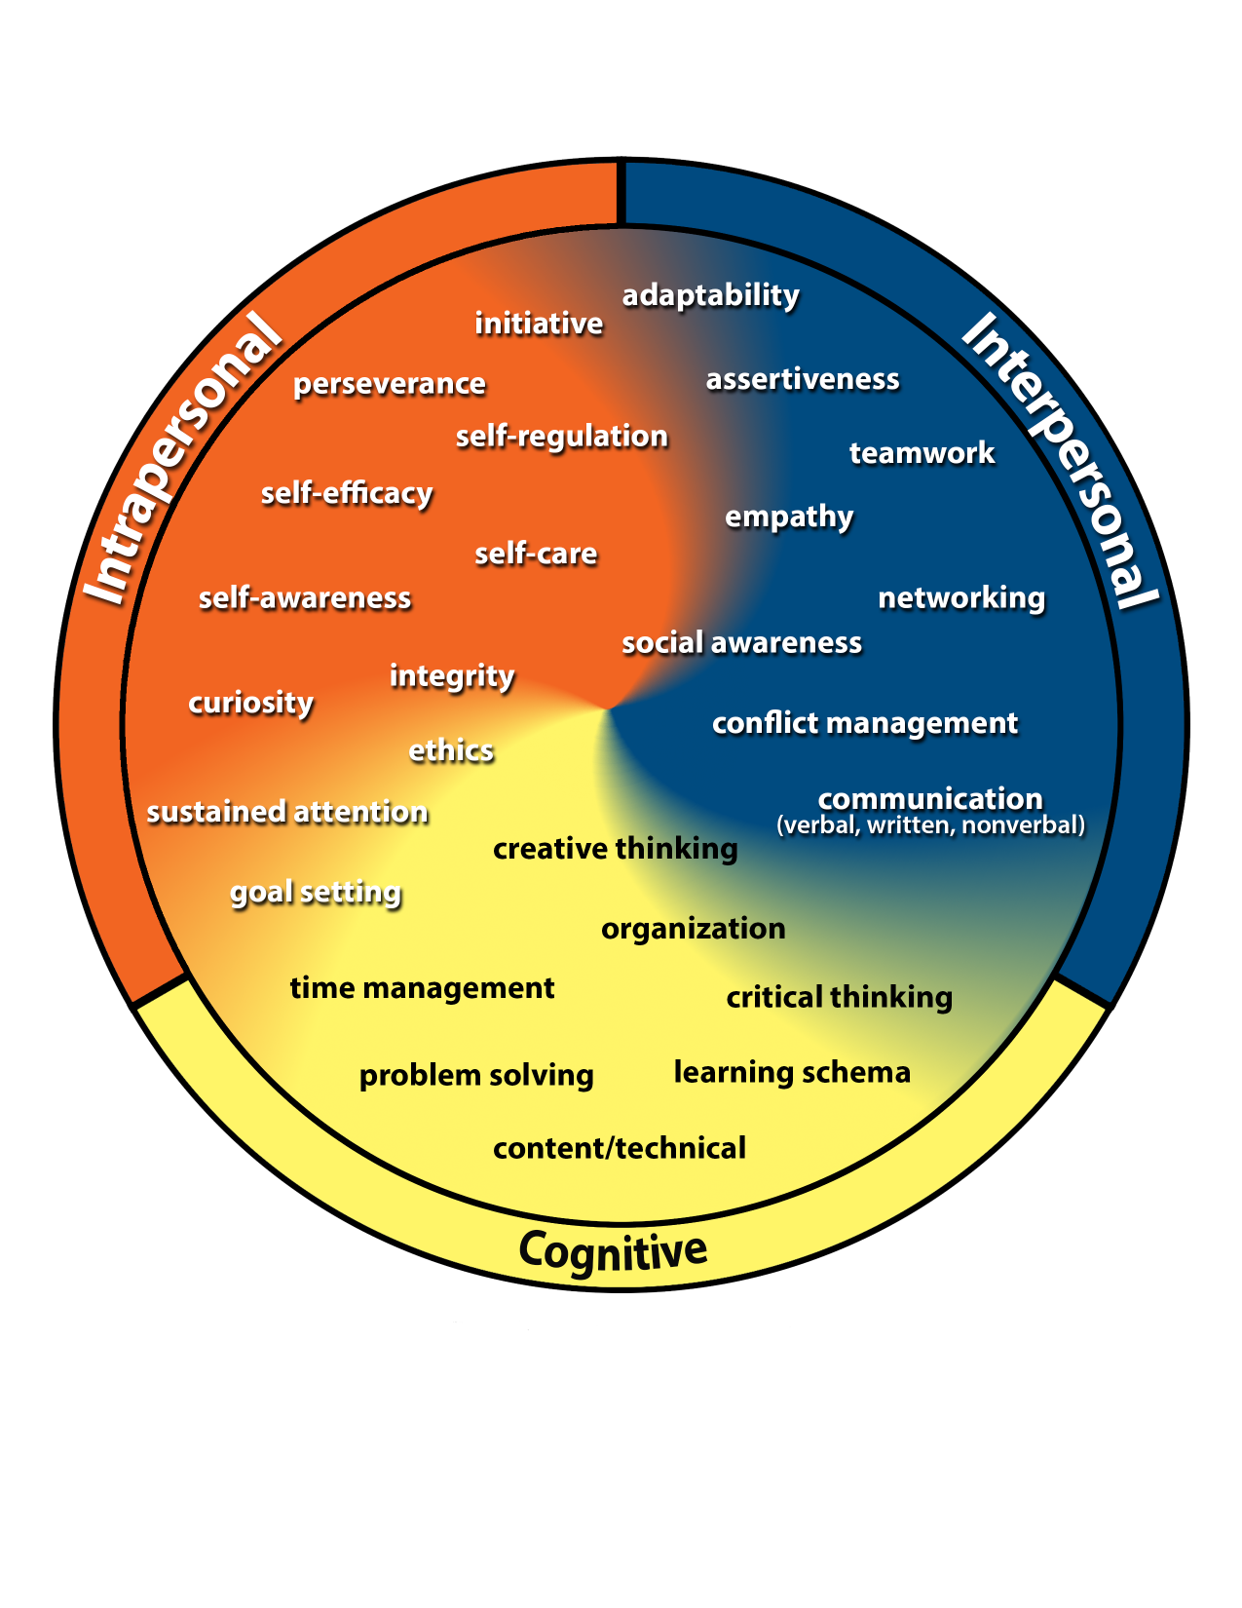
Kansans Can
Competencies
Notes:
Added the Kansans Can Competency Wheel here as a reminder of the skills included prior to viewing the responses to the following survey item.

Slide 20
The skills represented on the Kansans Can Competency Wheel are the skills students need to be successful as an adult.
5%
2% Disagree or Strongly Disagree
Neutral
Notes:
This provides the same data as the previous slide. Here we have combined the top and bottom two categories into a single grouping.
**We are also interpreting the ratings of 1 – 5 as strongly disagree to strongly agree.**
93% of individuals agree or strongly agree that the KCCW skills are needed for students to be successful adults. Whereas 2% of respondents reported disagreement or strong disagreement with the statement. 5% of respondents selected 3, which could be interpreted as a neutral response.

Slide 21
These strategies Kansans expressed are still a priority to accomplish the goal of producing successful high school students.
8%
3% Disagree or Strongly Disagree
Neutral
Notes:
This provides the same data as the previous slide. Here we have combined the top and bottom two categories into a single grouping.
**We are also interpreting the ratings of 1 – 5 as strongly disagree to strongly agree.**
89% of respondents agree or strongly agree that the strategies expressed are still a priority to accomplish the goal of producing successful high school students. Whereas 3% of respondents reported disagreement or strong disagreement with the statement. 8 % of respondents selected 3, which could be interpreted as a neutral response.

Slide 22
Across the state, Kansans overwhelming agree that we are prioritizing the right skills and strategies to produce successful high school students and adults.
Notes:
Most survey respondents rated the statements high which can be interpreted as agreement with the Kansans Can Competency Wheel skills (93%) and the strategies (89%) used to accomplish the goal of producing successful adults.
…but there is more work to be done to support schools in achieving these goals…

Slide 23
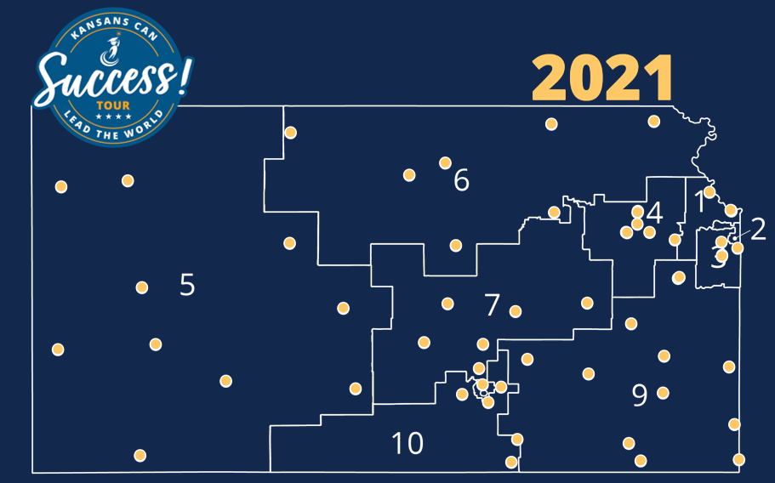
Though there were some unique needs shared, overall Kansans reported clear and consistent needs for supporting schools regardless of geographic location, board region and district size.
Notes:
Final Summary points:
Validation of the current work of the agency
Consistency in needs across the state regardless of location, board region, district size
There were specific needs identified unique to certain locations (particularly rural session locations)
Regional and district comparison data can be provided if requested (however, the data was analyzed with themes and codes unique to KSDE/KSU/R12CC)
Many of these supports intersect the five core themes
Funding touches student learning, system wide needs, educator centered supports and is impacted by leadership and policy
Some supports may lead to action whereas others are out of the control of the districts/KSDE

Slide 24
Notes:
Today’s students are the future workforce and future leaders of Kansas. Kansans Can achieve anything and, together, Kansans Can lead the world in the success of each student.

