Slide 1
Council of Superintendents November 2020
Dr. Randy Watson, Kansas Commissioner of Education

Slide 2
Our Vision for Kansas ...
Kansas leads the world in the success of each student

Slide 3
What has been done to date to assist?
State Assessments
Monitoring State Assessments. Decision after first of year
Interim Assessments may be taken remotely
HGSS Assessment delayed one year
Carl Perkins (Federal) The following deadlines were extended:
Spring FY20 Perkins Progress Report
KACTE Perkins Reserve Application deadline
FY 21 Perkins Application
Final FY20 Perkins Report
Fall FY Perkins Progress Report

Slide 4
What has been done to date to assist?
Early Childhood
Replaced competitive grants for 2020-2021 Kansas Parents as Teachers funding with renewal of 2019-2020 award levels.
Extended the deadline to apply for Kansas Preschool Pilot grants for the 2020-2021 school year.

Slide 5
What has been done to date to assist?
KESA
Extended OVT onsite visit timelines
Allowed for virtual visits 2020-2021
Any system who did not have their 2019-2020 visit was allowed to not conduct an OVT visit.
Provided systems to voluntarily pause their KESA activities per State Board action.
Systems pausing do not need to complete in totality their System Yearly Update.

Slide 6
What has been done to date to assist?
Kansas Volunteer Commission
Provided a match waiver to AmeriCorps and Volunteer Generation Fund subgrantees, as well as all mini-grant recipients, which waived their regulatory match for FY19 and FY20.
Provided additional grant funds to Volunteer Generation Fund subgrantees to continue grant activities in Oct, Nov and Dec 2020.
Redistributed funds to provide two separate COVID-19 Recovery and Response mini-grants to the field.

Slide 7
What has been done to date to assist?
Redesign
Adjusted all levels of expectations for schools.
Special Education and Title Services
The reporting requirements that SETS oversees are nearly entirely driven by federal and state statutes, regulations, and reporting requirements. As a result, SETS had very little flexibility to offer reporting flexibility without changes to statute, regulation, or U.S. Department of Education reporting requirements. Where SETS had flexibility, while still meeting requirements, we offered global timeline extensions or worked individually with districts who need an extension.

Slide 8
What has happened already this year
62% of all Professional Development days were scheduled before 9/15/20 this year.
26 School Districts used all of their Professional Development days before 9/15/20.
60 School Districts used 80% of their Professional Development days before 9/15/20.

Slide 9
What is being planned for the rest of the year
87% are taking 3 days for Thanksgiving.
87% are taking 8-10 days for Christmas/Holiday Break.
40% have MLK Day as a holiday for both students and teachers, while 35% have it as PD for teachers.
58% have President’s Day as a holiday for both students and teachers.
87% have at least 5 days off for Spring Break.
84% have 1 or 2 days off around Easter.

Slide 10
Next Steps?
The SBOE charged the Commissioner with bringing back an option to take off limited hours for districts during the winter months.
Monitor through March and revisit this topic in the winter at State Board Meetings.

Slide 11
Notes:
Today’s students are the future workforce and future leaders of Kansas. Kansans Can achieve anything and, together, Kansans Can lead the world in the success of each student.

Slide 12
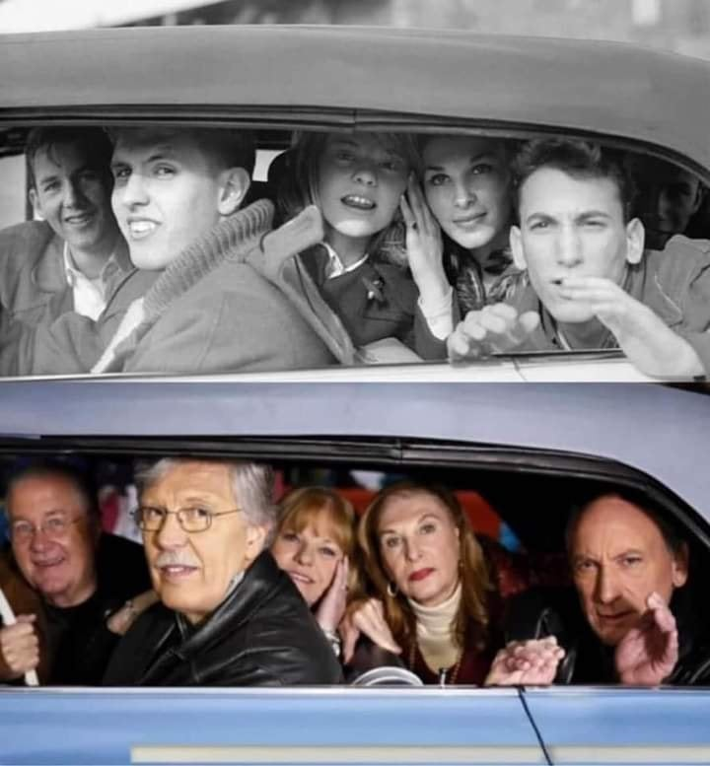

Slide 14
Partners who contribute to Navigating Change

