Slide 1
Stakeholder Blitz
Student and Staff Engagement Workshop adapted from the Think Wrong Institute

Slide 2
Student Blitz
Done with 30 students per school in grades 3-5

Slide 3
Materials
3 pieces of post-it paper per group of 4 (have them stacked on top of one another)
On paper 1, each student will take 1 corner to construct their lists.
On paper 2, students will create their school.
On paper 3, students will create their classroom.
Markers or other colored writing utensils

Slide 4
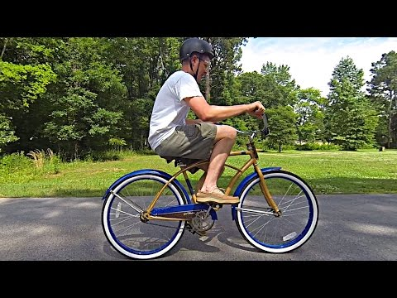
How can we go from the way things are to the way they need to/should be?
Knowledge = Understanding
It’s hard to change our thinking.
But once we do, it’s hard to go back to the old way of thinking.
Notes:
This video can be heavy for the young audience. However, encourage students to think about the notes on the right hand side of the slide.

Slide 5
We are all victims of our pre-existing way of thinking (our old ideas).
A Bold Idea
Be bold
Get out
Let go
Make stuff
Bet Small
Move Fast
The Way Things Are

Slide 6
How might we design the school of the future?
Lead students through these next few slides to solicit their feedback and creative ideas for moving forward.
Student Blitz

Slide 7
Write down 10 things you love about school.
Step 1

Slide 8
Write down 10 things that drive you crazy about school.
Step 2

Slide 9
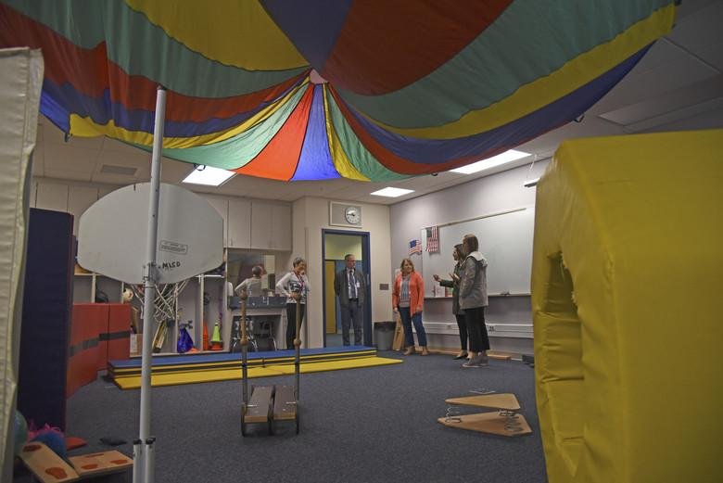
Write down 10 things you wish your school had and draw 1 thing that would make school fun!
Step 3 & 4

Slide 10
Design a school from scratch:
Come up with:
School Name
Motto
Mascot
Draw your school
Draw a classroom within your new school
Steps 5-7

Slide 11
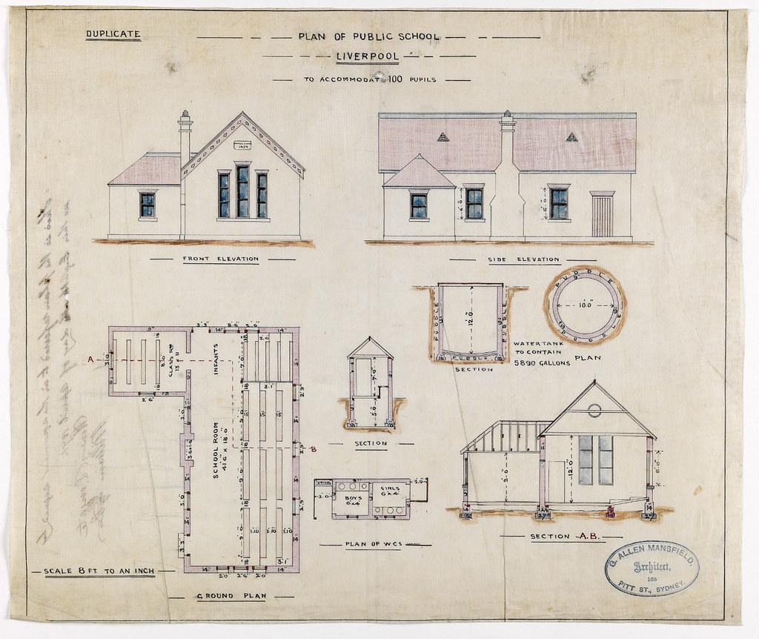
Share your plan for your dream school!

Slide 12
High School Student & Staff Blitz
The same protocol was used for high school students and staff.

Slide 13
Materials
2 pieces of post it paper per group of 4 (paper can be stacked one on top of the other)
Paper 1- steps 1-5
Paper 2- steps 7 & 8
Post-Its (steps 9 & 10)
Markers or other colored utensils

Slide 14
How can we go from the way things are to the way they need to/should be?
Knowledge = Understanding
It’s hard to change our thinking.
But once we do, it’s hard to go back to the old way of thinking.
Notes:
This video can be heavy for the young audience. However, encourage students to think about the notes on the right hand side of the slide.

Slide 15
We are all victims of our pre-existing way of thinking (our old ideas).
A Bold Idea
Be bold
Get out
Let go
Make stuff
Bet Small
Move Fast
The Way Things Are

Slide 16
How might we redesign education in Kansas to accelerate student success?
Lead students/staff through these next few slides to solicit their feedback and ideas for moving forward.
Student (MS/HS)/Staff Blitz

Slide 17
Write down 10 things that define success for you.
Step 1
Notes:
Divide a large piece of post it paper into four quadrants. 4 people sit around the paper and will make 3 lists in their quadrant (steps 1, 2 and 3). The paper will then be rotated in step 4.

Slide 18
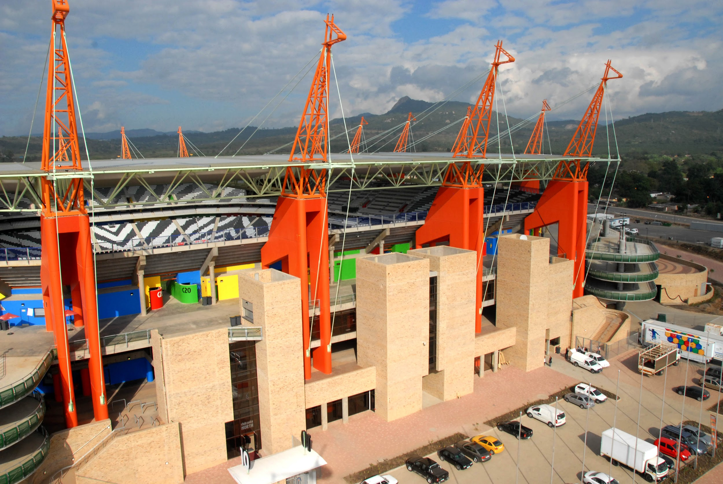
Write down 10 assets at your school that support student success. (Resources, people, things, etc)
Step 2

Slide 19
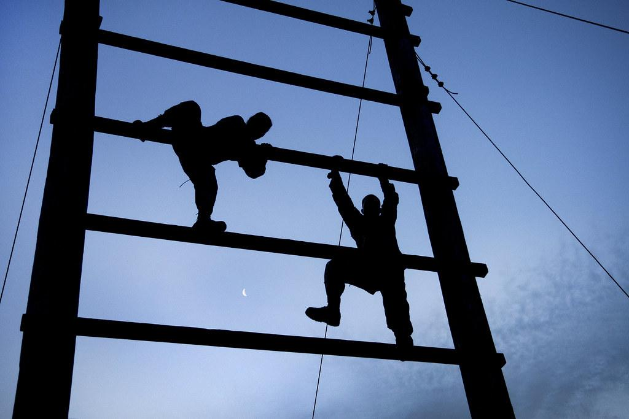
Write down 10 challenges to your success.
Step 3

Slide 20
Turn your paper and read the lists that others at your table have written down.
Circle 3 things that stand out/trends/should be addressed.
Step 4
Notes:
Steps 4 and 5 can be combined. Simply eliminate switching papers, and only circle key challenges that stand out to you.

Slide 21
Swap papers with another group of 4 and circle the 3 biggest challenges.
Step 5
Notes:
Steps 4 and 5 can be combined. Simply eliminate switching papers, and only circle key challenges that stand out to you.

Slide 22
Talk with your group and select the Biggest Challenge you want to talk about today. (Lens)
Step 6
Notes:
Example- Time, Workload, Connection to the Material, Student Trauma

Slide 23
Share Out your Lens

Slide 24
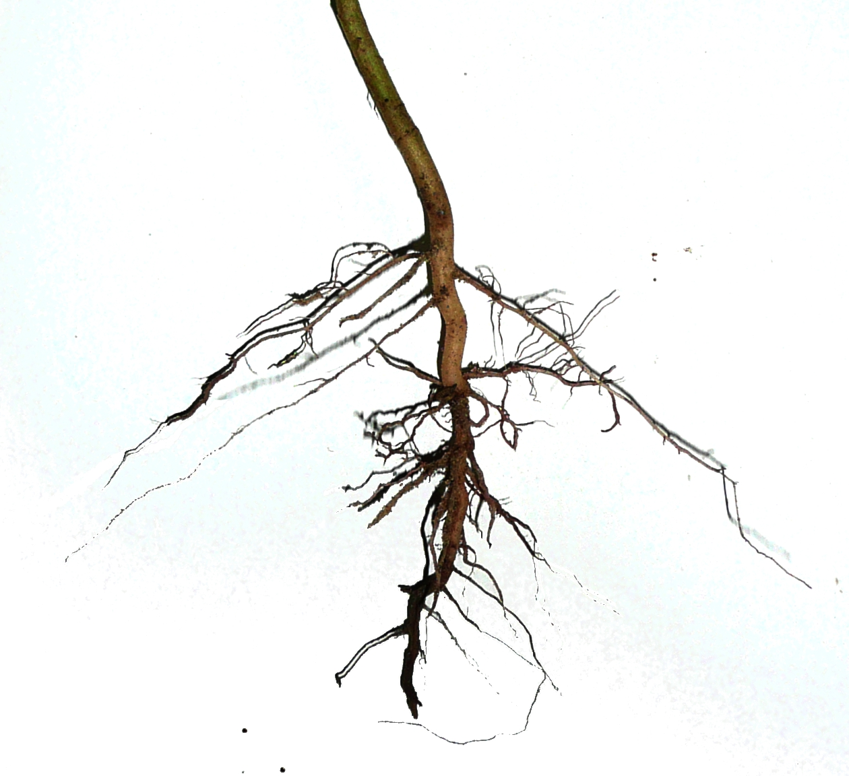
Address the root cause of the challenge. Ask ‘why’ 5 times when discussing your lens/challenge.
Step 6.5
For Staff
Notes:
Get a new piece of post it paper and put your ‘lens’ at the top. Then continue the steps.
A lot of times, the challenge we identify is the symptom of something larger. As we redesign, we want to think about the root cause of our issue and tackle that, not just treat a symptom. It would be like taking tylenol to quiet a fever but without actually addressing what is causing the fever in the first place.

Slide 25
Write down 10 ways to address the challenge (your lens).
Step 7

Slide 26
Turn paper over. This time, THINK WRONG.
What’s the craziest way to accelerate student success?
What’s the craziest way to address your challenge?
Step 8
Notes:
Try writing these as ‘what if’ statements. What if we gave a student a desk that could transform into multiple types of workspace? What if we allowed every student time to talk with an adult during the week? What if… THINK BIG!

Slide 27
Turn your craziest idea into a 6 word pitch.
Put your lens and 6 word pitch on a post-it note.
Step 9

Slide 28
Share Out your Lens and Pitch.

Slide 29
Pass your post it.
With a new lens and pitch, amplify their idea. How can you make it crazier?
Create a Moonshot Haiku (5:7:5)
Write down one small bet for the next year.
Step 10
Notes:
Think of your moonshot as a ‘dog in a hat’ idea. What is something big and crazy you could do that would make people stop and go ‘what’?!

Slide 30
Share Out your Lens, Moonshot Haiku, and Small Bet for quick implementation and success.

