Slide 1
Navigating Change 2020
Dr. Randy Watson, Kansas Commissioner of Education

Slide 4
Our dilemma as Educational Leaders
Ensure maximum opportunities for student success skills to be learned
Ensure maximum safety for all students and staff
Custodial Care and Economic Engine
Students will be a remote learning environment
Students will be a ”normal” school environment

Slide 5
Notes:
Today’s students are the future workforce and future leaders of Kansas. Kansans Can achieve anything and, together, Kansans Can lead the world in the success of each student.

Slide 6
Learning Environments
Understanding the need to be flexible during the 2020-21 school year, three different learning environments were defined.
On-Site
Used when community restrictions for COVID-19 are low.
Schools can operate at 100% capacity with precautions.
Social distancing should be practiced where feasible.
Group sizes and spectator events will meet local guidelines.
Hybrid
Used when community restrictions for COVID-19 are moderate.
Schools will operate at reduced capacity (50%) with students alternating between on-site and remote learning.
Social distancing should be enforced.
Group sizes will meet local guidelines (15)
Spectator events not allowed.
Remote
Used when community restrictions for COVID-19 are high.
School capacity restricted to essential staff and activities.
Social distancing should be strictly enforced.
Group sizes will meet local guidelines (10 or fewer).
Spectator events not allowed.

Slide 7
Please consider this…
We will be with this virus in some capacity throughout the rest of this school year. We must plan to have models of learning that will sustain the support of staff, students and parents, while ensuring safety, throughout the entire year.

Slide 8
What districts are currently facing
Remote and Hybrid work well for control of the virus. Cases are low and going down in these districts.
These districts are primarily large 4A to 6A districts.
Learning is not as effective as on-site. Parents are growing increasingly upset with remote and Hybrid.
This model is most likely NOT sustainable all school year.
On-site works for learning and activities well. Staff, students and parents are generally happy.
These districts are primarily 1A to small 4A districts.
School and activities are being disrupted at a high rate because of virus and quarantine.
This model, as being implemented currently, is most likely NOT sustainable all school year.

Slide 9
Kansas Schools Gating Criteria
Green
Yellow
Orange
Red
PK-12
PK-5
6-12
PK-5
6-12
PK-12
Learning
+
On-Site
On-Site**/
Hybrid
Hybrid
On-Site**/
Hybrid
Remote Only
Remote Only
School Activities
On-Site following Navigating Change guidelines. Facilities should limit capacity to allow for 6’ social distancing.
No all school activities. Small group activities limited; masks and social distancing required; stable groups with limited group numbers. No high risk activities. No group travel. Conditioning/ practice may continue with modifications
Remote Only
Remote Only
Spectators - audience
On-Site following Navigating Change guidelines. Facilities should limit capacity to allow for 6’ social distancing.
Allowed: Distancing by household groups; masked if indoors. 6’ social distancing required; total group numbers limited per guidelines
Remote Only
Remote Only
Visitor Access
On-Site following Navigating Change guidelines. Facilities should limit capacity to allow for 6’ social distancing.
Limited: by appointment; masks and social distancing required; building access requirements must be met
Extremely limited: by appointment; masks and social distancing required; building access requirements must be met
None Allowed
Playgrounds
On-Site following Navigating Change guidelines. Facilities should limit capacity to allow for 6’ social distancing.
Open: Capacity to allow for 6’ social distancing; total group numbers limited per guidelines
Open: Capacity to allow for 6’ social distancing; masks required if less than 6’ social distance maintained; total group numbers limited per guidelines
Closed
NOTE:
The following recommendations are subject to change by actions of federal, state, county, or local authorities.

Slide 11
What to do now?
Students should be grouped together in cohorts of less than 15 students per group.
Either have class sizes with <15 students per class
OR have separate cohorts within classes of <15 students per cohort with adequate physical distancing between cohorts and no mixing of groups other than the teacher
Safe but unused facilities within the district and community should be utilized to spread out students.

Slide 12
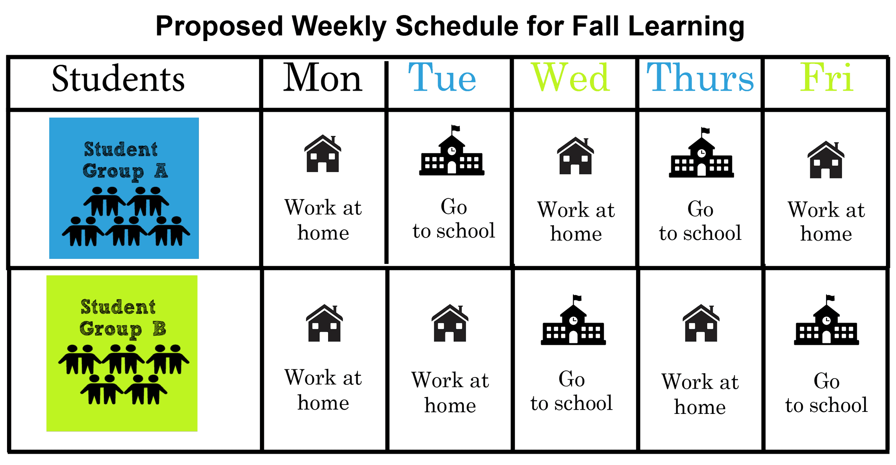

Slide 13
Three Major Problems
Lack of good facilities in your community to ensure proper safety of students.
Lack of qualified staff to lower class sizes to 15 or less across district.
Lack of financial resources to accomplish safe facilities and adequate staff.

Slide 14
Lack of Good Facilities
Sports, gyms, libraries and recreation facilities should be utilized when otherwise not in use.
Outside areas should be utilized weather permitting.
Schools should work with their community to utilize additional community locations to space out students for on-site education. This includes community buildings, churches, restaurants, etc.
Locations should be consistent between classes/cohorts.
Plan for and consider internet connections and possibly of tying classrooms together virtually.

Slide 15
Lack of qualified staff to lower class size
Use certified staff differently: Instructional coaches, substitutes, aides, paras, principals, central office staff, reading specialists, librarians, retired teachers as teachers for this year.
Mischel Miller, Director of Teacher Licensure & Accreditation will assist districts in this area.

Slide 16
Lack of financial resources
Partnerships with your community, city/county commissioners and chambers will be important to find educational space that might be inexpensive.
Will need to use CARES and SPARK money to rent new facilities, hire additional staff where needed.
Use contingency funds for one year to accomplish task.

Slide 17
Issues not Resolved
This is REALLY hard to execute.
As long as high risk activities are being played, virus spread and quarantines are very likely.
Large middle and high schools will not be able to do this model. Might consider a daily Hybrid, instead of 2-3 days a week.

