Slide 1
Kansas Leads the World in the Success of Each Student.
Dr. Randy Watson, Kansas Commissioner of Education

Slide 2
A NEW Vision for Kansas ...
Kansas leads the world in the success of each student
KANSAS STATE DEPARTMENT OF EDUCATION | www.ksde.org

Slide 3
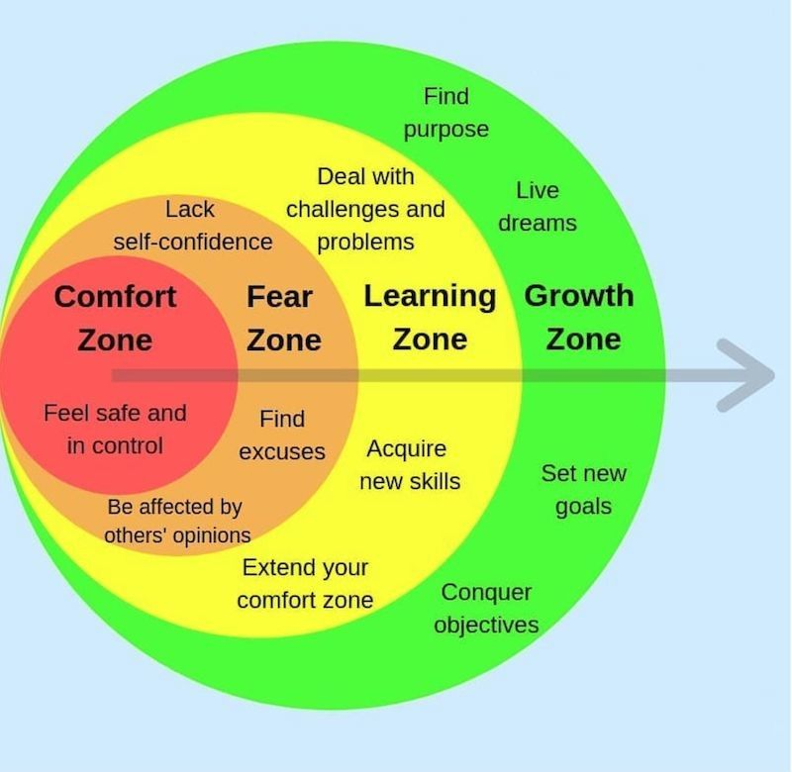
The Challenge of Change

Slide 5
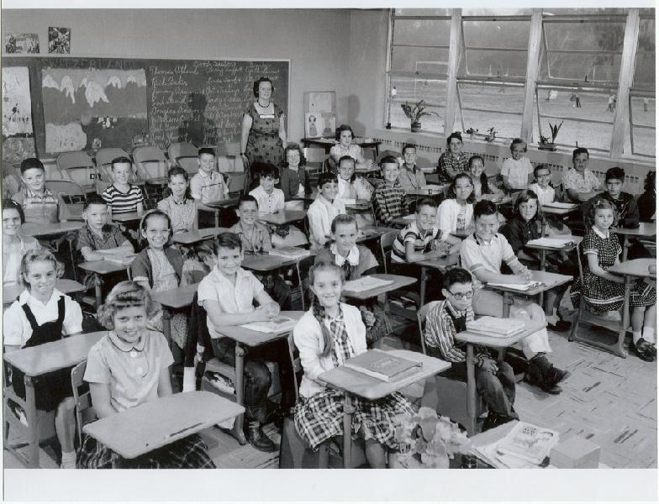
Classroom of the Past

Slide 6
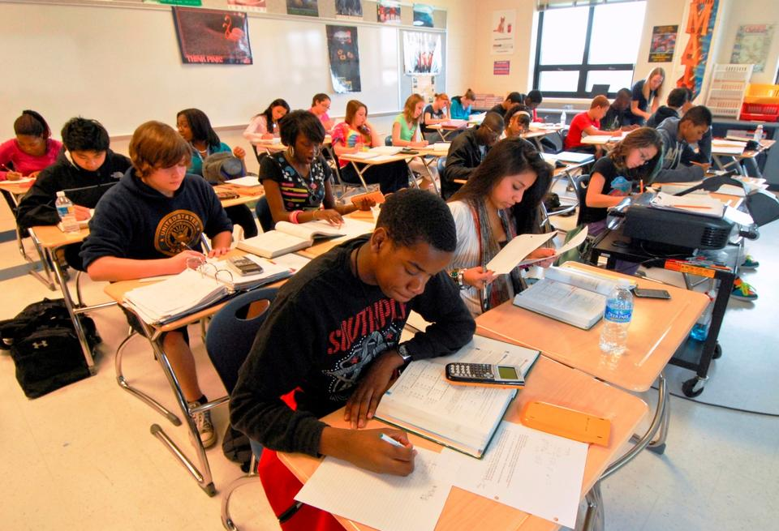
Classroom of today

Slide 7
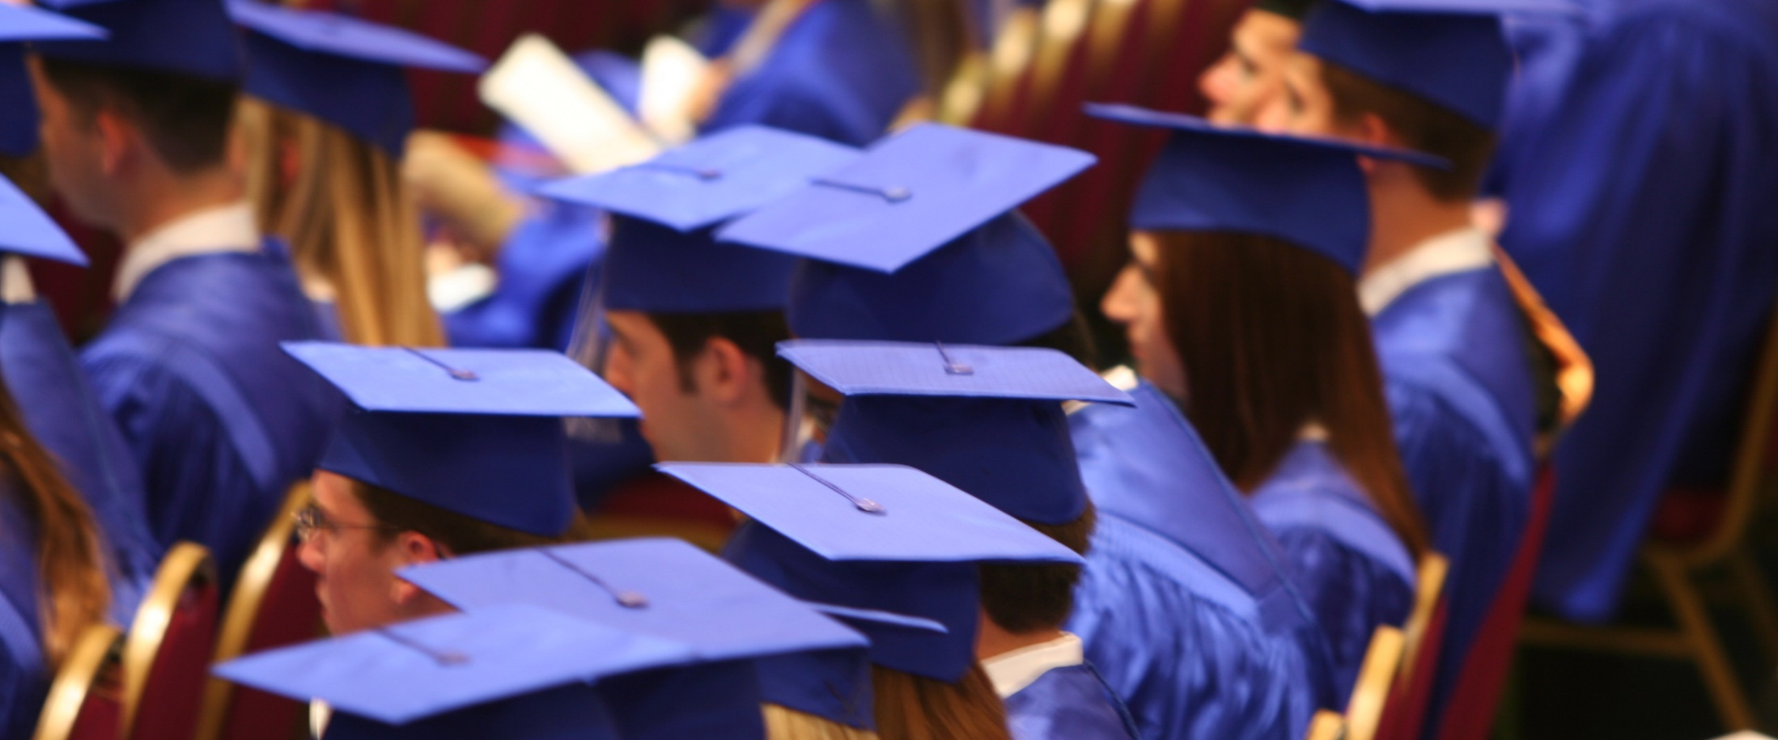
Defining Success
A Successful Kansas High School Graduate has the
Academic preparation,
Cognitive preparation,
Technical skills,
Employability skills and
Civic engagement
to be successful in postsecondary education, in the attainment of an industry recognized certification or in the workforce, without the need for remediation.

Slide 8
Creating a Vision for Kansas – State Outcomes
Social Emotional Growth
Kindergarten Readiness
Individual Plan of Study
High School Graduation Rates
Post Secondary Completion
Notes:
Among the outcomes being considered by the state board are:
High School Graduation Rates
Post Secondary Completion/Attendance
Remedial Rate of Students Attending Post-Secondary
Kindergarten Readiness
Individual Plan of Study Focused on Career Interest
Social/Emotional Growth Measured Locally
Education Commissioner Randy Watson and members of the State Board of Education will meet with business, education and state leaders to build agreement on how we will work together to achieve this vision for Kansas education.
Kansas schools are already doing tremendous work to address the needs of individual students, but in order to achieve this new vision we cannot expect schools to go it alone. This requires a unified effort with businesses, communities, parents, higher education, and elected officials working with educators to help provide the supports and experiences Kansas students need for their future success.

Slide 9
Kansas School Redesign Principles
Student Success Skills | Family, Business, and Community Partnerships
There is an integrated approach to develop student social-emotional learning. | Partnerships are based on mutually beneficial relationships and collaboration.
Personalized Learning | Real World Application
Teachers support students to have choice over their time, place, pace and path. | Project-based learning, internships, and civic engagement makes learning relevant.

Slide 10
Stages of Development – What we look for
Birth – Age 4
Ages 5 - 9
Ages 10-16
Ages 17-20

Slide 11
Our Big Rocks…Our Overall Goal
100% of Students Graduate High School
100% of Students execute a Post Secondary Plan
45% attend a four year college
45% attend a two year college and/or have multiple certificates
5% are in apprentice programs
4% enlist in the military
1% attend 18-21 year old program

Slide 12
Stages of Development – What we look for
Birth – Age 4
Ages 5 - 9

Slide 13
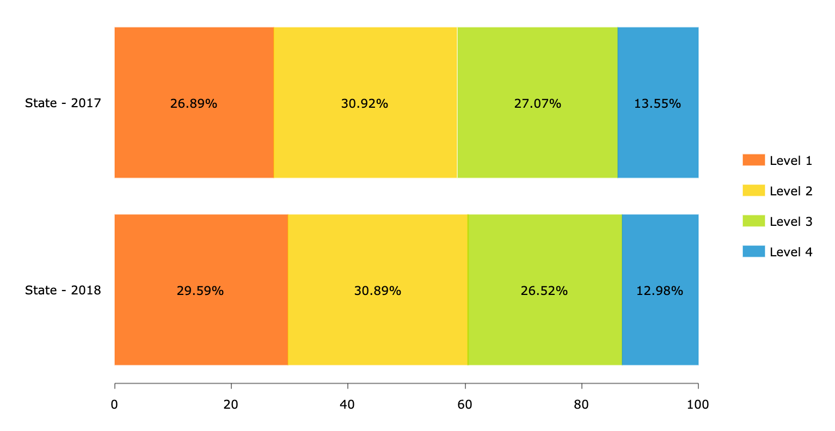
The Challenge of Change - LA

Slide 14
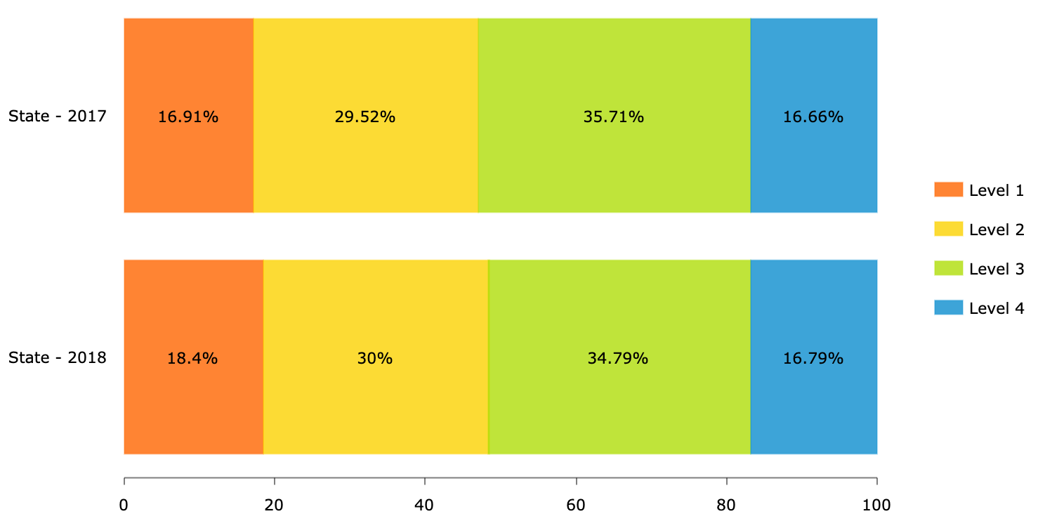
The Challenge of Change - Math

Slide 15
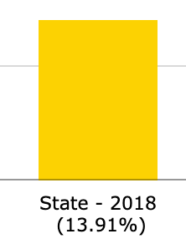
The Challenge of Change - ???

Slide 16
Notes:
Today’s students are the future workforce and future leaders of Kansas. Kansans Can achieve anything and, together, Kansans Can lead the world in the success of each student.

