Slide 1
Kansas Leads the World in the Success of Each Student.
Dr. Randy Watson, Kansas Commissioner of Education

Slide 2
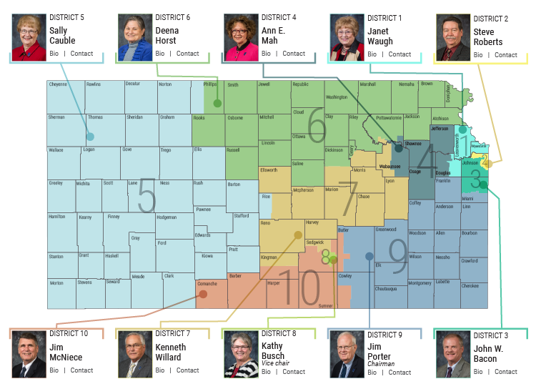

Slide 3
A NEW Vision for Kansas ...
Kansas leads the world in the success of each student
KANSAS STATE DEPARTMENT OF EDUCATION | www.ksde.org
Notes:
Jay - This is the vision for education in Kansas and the redesign initiative is all about aligning school systems to this vision.
“Each” – personalizing learning for each student.
What do you want success to mean for your students?

Slide 4
From the first set of focus group responses, what characteristics of success were most frequently cited?
Notes:
This result is a little surprising since about 66% of the respondents were educators, education administrators, or former educators—people who mostly teach, or used to teach, academic skills. Nevertheless, the soft skills—social-emotional, personality skills, or 21st century skills—they have lots of names—were cited 70% of the time.

Slide 5
The business and industry focal groups cited non-academic skills with greater frequency than the community groups:
Notes:
Recall that the community groups cited non-academic skills 70% of the time and academic skills 23% of the time. These frequencies are remarkably similar to those expressed by the community groups. If volume can be equated with importance, the business and industry groups are saying that the non-academic characteristics are more important than academic skills, including applied skills, and that non-academic skills are at least as important to them as to the community groups, maybe more so.
One cited experience as a characteristic of the ideally prepared 24 year old (the tiny yellow line).

Slide 6
What Kansans want from their schools
Changes need to be made to address school culture
New dynamic roles for counselor and social workers
Collaboration between schools and businesses
Reorganize schools around students, not the system
Community service needs to play a bigger role
Kansas children need quality preschool including all day kindergarten
Notes:
We also learned that Kansans believe
Every child needs access to quality preschool education
School culture needs to be addressed – we must value the student going to a two-year or certification program as much as a student attending a four-year institution.
Counselors need to be able to help students identify and explore career interests
Must be collaboration between schools and businesses to prepare students for postsecondary pursuits
Schools must be reorganized around the student, not the system to meet unique needs
Community service is an important part of preparing students for life after high school.

Slide 7
Redesign?
Personalized
Project Based
Intense focus on social and emotional development
Immersion with parents and the community
Notes:
Personalized Learning
What is Personalized Learning?
A personalized learning environment includes the following elements:
Personal learning paths for each student
Personalized learning time
Project-based learning
Student mentor program
Flexible learning environment
Mastery-based education
Performance-based assessments (project-based learning, portfolios, etc.)
What do teacher and student roles look like in Personalized Learning?
Teachers Students Personalize instruction by providing opportunities for students to practice skills, give real-time feedback and support students to make their own plans to reach academic goals.
Provide small group workshops based on individual student needs.
Mentors students to become self-directed learners who can set and achieve goals and maximize opportunities.
Demonstrate student agency by having choice in when, where, and how they learn.
Select content that best meets their learning style.
Establish weekly obtainable academic goals.
Establish long term college goals. Work collaboratively with small groups
What is Connect? Connect is Pasadena ISD’s personalized learning initiative.
Personalized Every Connect student has a digital Personalized Learning Plan and is able to access all of the learning tools and resources they need at any time.
Empowering Connect students are self-directed learners. Connect students are encouraged and coached to develop in the elements of self-directed learning - Challenge Seeking, Persistence, Strategy-shifting, Response to Setbacks and Appropriate Help Seeking are key habits that are invaluable for college and life success.
Relevant Connect students receive consistent, relevant, and personalized support seamlessly integrated into their school day as they drive towards their academic and personal goals.
College and Career Readiness Student success in college and career must extend far beyond college acceptance. We focus on helping students to develop in four areas that form the foundation for a lifetime of success.
Mentor Support ​​Student-teacher bond is the heart of learning. Students meet weekly with their mentor teacher to set academic goals and discuss their progress.
Empowering students to engage in self-directed learning and develop key habits that are invaluable for college and life success.

Slide 8
Notes:
Today’s students are the future workforce and future leaders of Kansas. Kansans Can achieve anything and, together, Kansans Can lead the world in the success of each student.

