Slide 1
Kansas Leads the World in the Success of Each Student.
Dr. Randy Watson, Kansas Commissioner of Education

Slide 2
A NEW Vision for Kansas ...
Kansas leads the world in the success of each student
KANSAS STATE DEPARTMENT OF EDUCATION | www.ksde.org

Slide 3
Defining Success
A Successful Kansas High School Graduate has the
Academic preparation,
Cognitive preparation,
Technical skills,
Employability skills and
Civic engagement
to be successful in postsecondary education, in the attainment of an industry recognized certification or in the workforce, without the need for remediation.

Slide 4
Time to Redesign Schools!
WHAT SKILLS DO BUSINESS & INDUSTRY SAY ARE LACKING IN HIGH SCHOOL, TWO-YEAR and FOUR-YEAR COLLEGE PROGRAM GRADUATES?

Slide 5
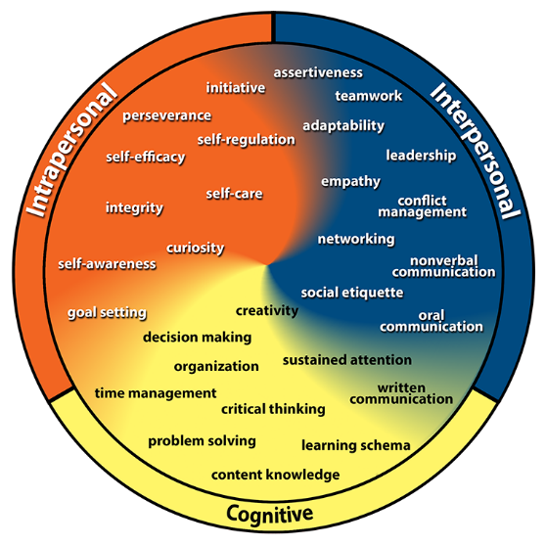
Kansans Can Competencies

Slide 6
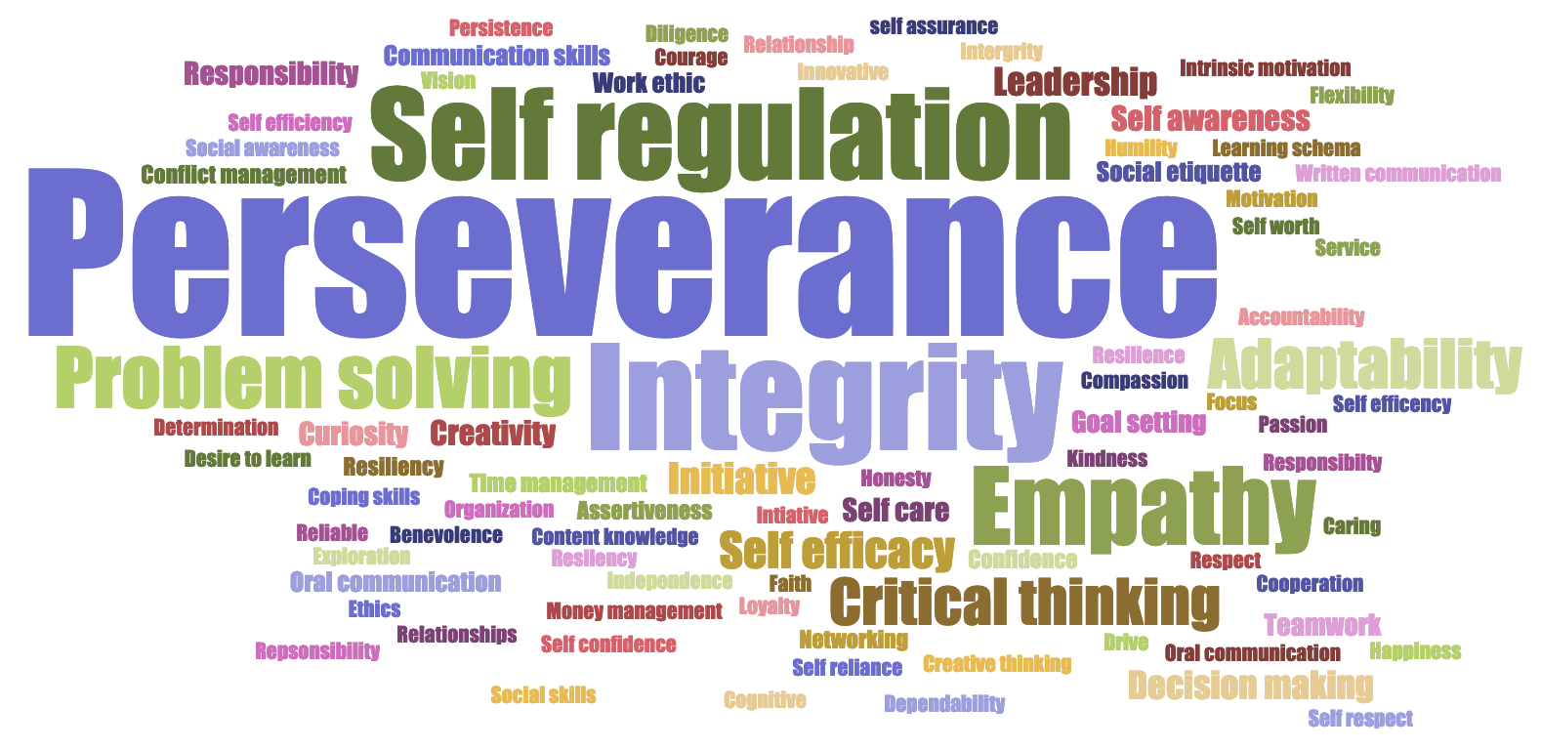
Kansans said…

Slide 7
HIGH SCHOOL GRADUATES LACKING…
Professionalism/Work Ethic . . . . . . . . . 80.3%
Teamwork/Collaboration . . . . . . . . . . . 75.7%
Verbal Communication. . . . . . . . . . . . . 70.8%
Ethics/Social Responsibility. . . . . . . . . . 63.4%
Critical Thinking/Problem Solving. . . . . 57.5%
Information Technology Applications. 53.0%
Written Communication. . . . . . . . . . . . 52.7%
Diversity. . . . . . . . . . . . . . . . . . . . . . . . 52.1%
Lifelong Learning/Self-Direction. . . . … 42.5%
Creativity/Innovation. . . . . . . . . . . . . . . 36.3%
Consolidated Survey of Corporate America

Slide 8
TWO YEAR COLLEGE GRADUATES LACKING…
Professionalism/Work Ethic. . . . . . . . . . . 83.4%
Teamwork/Collaboration. . . . . . . . . . . . 82.7%
Verbal Communication. . . . . . . . . . . . . 82.0%
Critical Thinking/Problem Solving. . . . . . 72.2%
Written Communication. . . . . . . . . . . . . 71.5%
Ethics/Social Responsibility. . . . . . . . . . . 70.6%
Information Technology Applications. . 68.6%
Lifelong Learning/Self-Direction. . . . . . . 58.3%
Diversity. . . . . . . . . . . . . . . . . . . . . . . . . 56.9%
Creativity/Innovation. . . . . . . . . . . . . . . 45.5%
Consolidated Survey of Corporate America

Slide 9
FOUR YEAR COLLEGE GRADUATES LACKING…
Verbal Communication. . . . . . . . . . . . . 95.4%
Teamwork/Collaboration. . . . . . . . . . . . 94.4%
Professionalism/Work Ethic. . . . . . . . . . . 93.8%
Written Communication. . . . . . . . . . . . . 93.1%
Critical Thinking/Problem Solving. . . . . 92.1%
Ethics/Social Responsibility. . . . . . . . . . 85.6%
Leadership . . . . . . . . . . . . . . . . . . . . . . . 81.8%
Information Technology Applications. 81.0%
Creativity/Innovation. . . . . . . . . . . . . . . 81.0%
Lifelong Learning/Self-Direction. . . . . . 78.3%
Consolidated Survey of Corporate America

Slide 10
Time to Redesign Schools!
The most important skills are the hardest to teach -
until now.

Slide 12
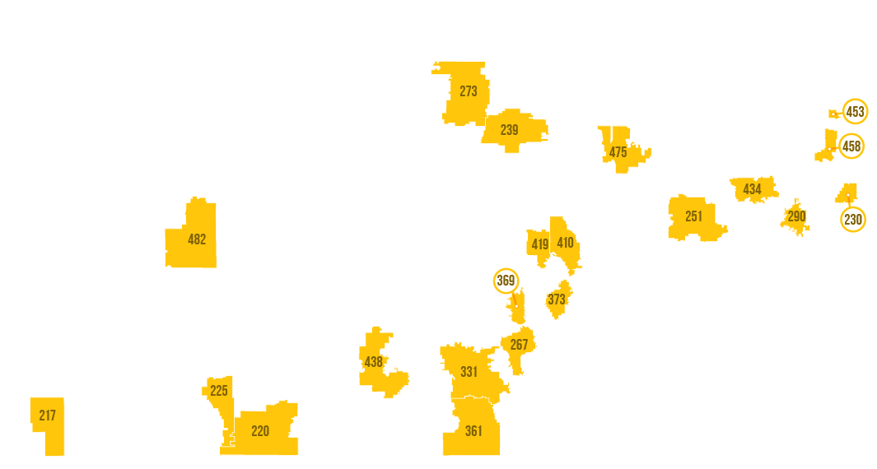
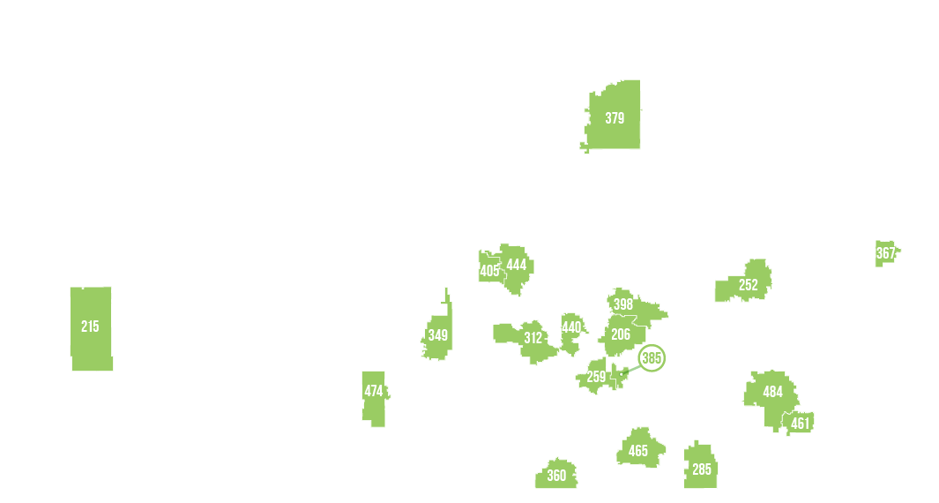
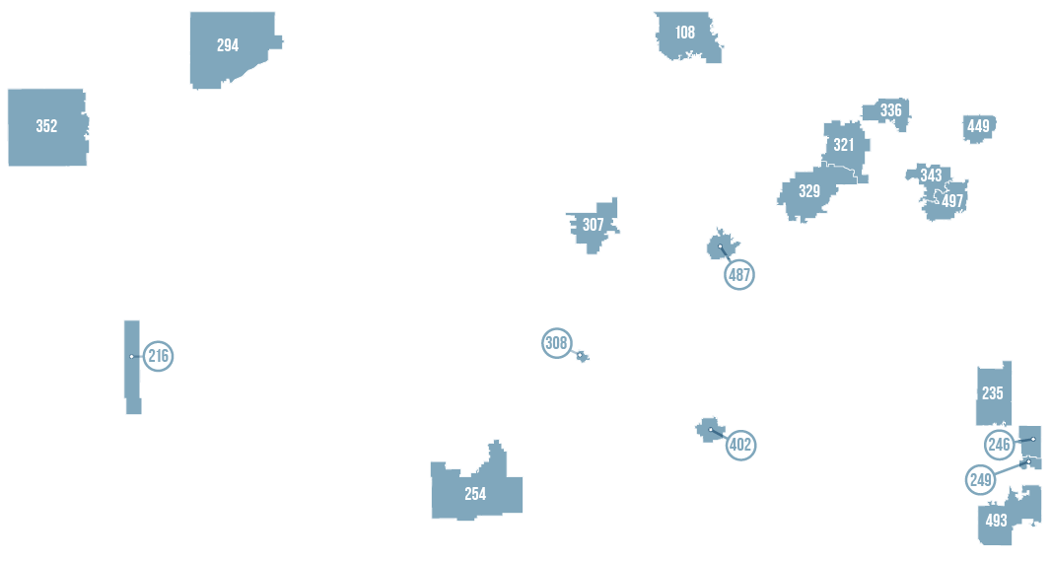

Slide 13
Kansas School Redesign Principles
Student Success Skills | Family, Business, and Community Partnerships
There is an integrated approach to develop student social-emotional learning. | Partnerships are based on mutually beneficial relationships and collaboration.
Personalized Learning | Real World Application
Teachers support students to have choice over their time, place, pace and path. | Project-based learning, internships, and civic engagement makes learning relevant.

Slide 14
Do the best you can until you know better. Then when you know better, do better. – Maya Angelou

Slide 15
Notes:
Today’s students are the future workforce and future leaders of Kansas. Kansans Can achieve anything and, together, Kansans Can lead the world in the success of each student.

