Slide 1
Kansas Leads the World in the Success of Each Student.
Dr. Randy Watson, Kansas Commissioner of Education

Slide 2
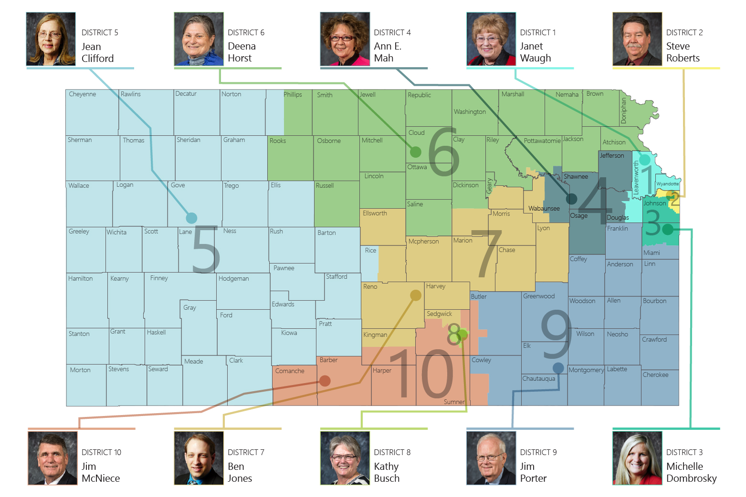

Slide 3
A NEW Vision for Kansas ...
Kansas leads the world in the success of each student
KANSAS STATE DEPARTMENT OF EDUCATION | www.ksde.org

Slide 4
Future Teachers from the University of Kansas…
When KU freshman are asked to give the ONE word to describe their senior year in high school, it is…..
BORING
When asked what in high school prepared them most for success in life, KU students said…
Extra-Curricular Activities
When future teachers from KU are asked if they learned more about teaching from student teaching or from 4 years of college, they say…
Of course they said STUDENT TEACHING!

Slide 5
What could be done better in High School?
Go to www.menti.com
Type73 43 42

Slide 6
Notes:
LiveSlide Site
https://www.mentimeter.com/s/df652e81addc2a6dfbab29171ebd66cc/053e1d28429f/edit

Slide 7
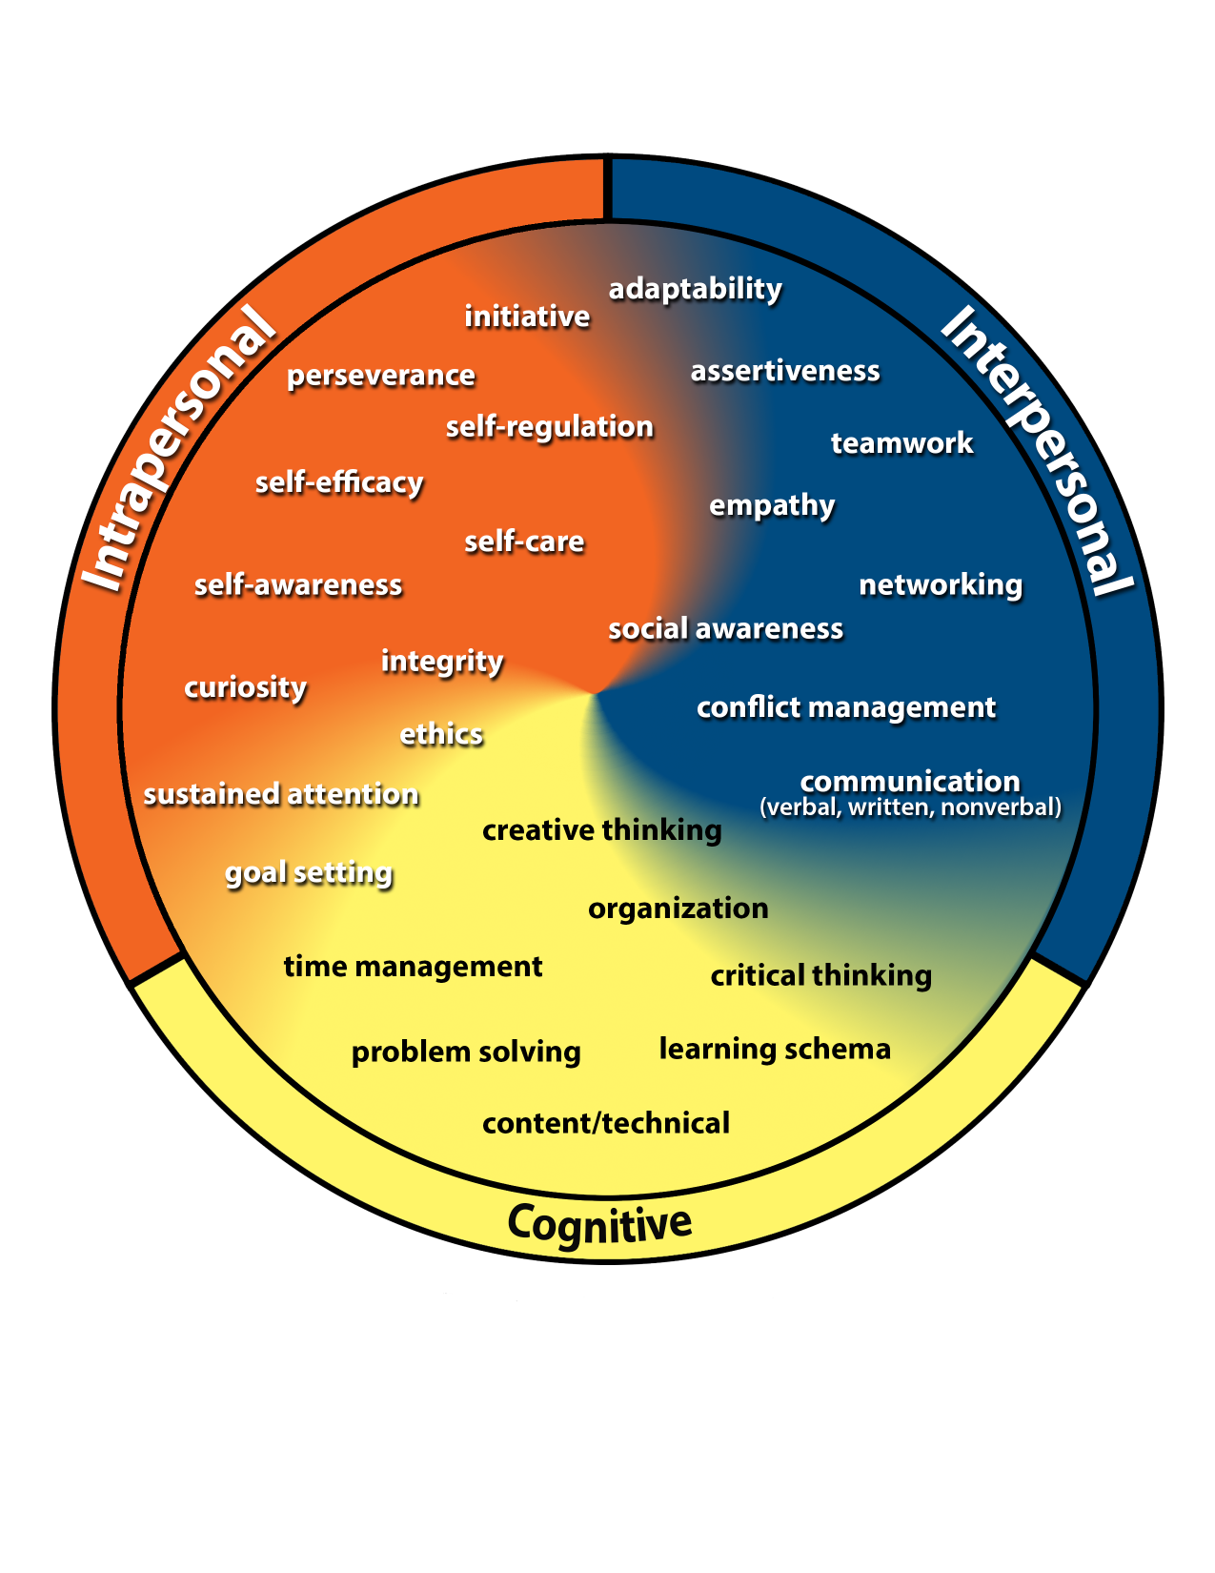
Kansans Can Competencies
Go to www.menti.com
Type73 43 42

Slide 8
Notes:
LiveSlide Site
https://www.mentimeter.com/s/df652e81addc2a6dfbab29171ebd66cc/4f24dd70786a/edit

Slide 9
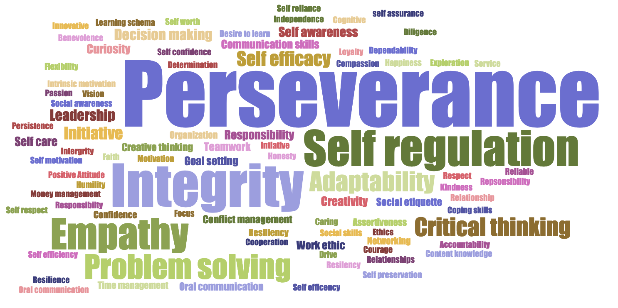
Kansans said…

Slide 10
Time to Redesign Schools!
WHAT SKILLS DO BUSINESS & INDUSTRY SAY ARE LACKING IN HIGH SCHOOL, TWO-YEAR and FOUR-YEAR COLLEGE PROGRAM GRADUATES?

Slide 11
HIGH SCHOOL GRADUATES LACKING…
Professionalism/Work Ethic . . . . . . . . . 80.3%
Teamwork/Collaboration . . . . . . . . . . . 75.7%
Verbal Communication. . . . . . . . . . . . . 70.8%
Ethics/Social Responsibility. . . . . . . . . . 63.4%
Critical Thinking/Problem Solving. . . . . 57.5%
Information Technology Applications. 53.0%
Written Communication. . . . . . . . . . . . 52.7%
Diversity. . . . . . . . . . . . . . . . . . . . . . . . 52.1%
Lifelong Learning/Self-Direction. . . . … 42.5%
Creativity/Innovation. . . . . . . . . . . . . . . 36.3%
Consolidated Survey of Corporate America

Slide 12
TWO YEAR COLLEGE GRADUATES LACKING…
Professionalism/Work Ethic. . . . . . . . . . . 83.4%
Teamwork/Collaboration. . . . . . . . . . . . 82.7%
Verbal Communication. . . . . . . . . . . . . 82.0%
Critical Thinking/Problem Solving. . . . . . 72.2%
Written Communication. . . . . . . . . . . . . 71.5%
Ethics/Social Responsibility. . . . . . . . . . . 70.6%
Information Technology Applications. . 68.6%
Lifelong Learning/Self-Direction. . . . . . . 58.3%
Diversity. . . . . . . . . . . . . . . . . . . . . . . . . 56.9%
Creativity/Innovation. . . . . . . . . . . . . . . 45.5%
Consolidated Survey of Corporate America

Slide 13
FOUR YEAR COLLEGE GRADUATES LACKING…
Verbal Communication. . . . . . . . . . . . . 95.4%
Teamwork/Collaboration. . . . . . . . . . . . 94.4%
Professionalism/Work Ethic. . . . . . . . . . . 93.8%
Written Communication. . . . . . . . . . . . . 93.1%
Critical Thinking/Problem Solving. . . . . 92.1%
Ethics/Social Responsibility. . . . . . . . . . 85.6%
Leadership . . . . . . . . . . . . . . . . . . . . . . . 81.8%
Information Technology Applications. 81.0%
Creativity/Innovation. . . . . . . . . . . . . . . 81.0%
Lifelong Learning/Self-Direction. . . . . . 78.3%
Consolidated Survey of Corporate America

Slide 14
Stages of Development – What we look for
Birth – Age 4
Ages 5 - 9
Ages 10-16
Ages 17-20

Slide 15
Notes:
LiveSlide Site
https://www.mentimeter.com/s/df652e81addc2a6dfbab29171ebd66cc/b98c0d6972b6/edit

Slide 17
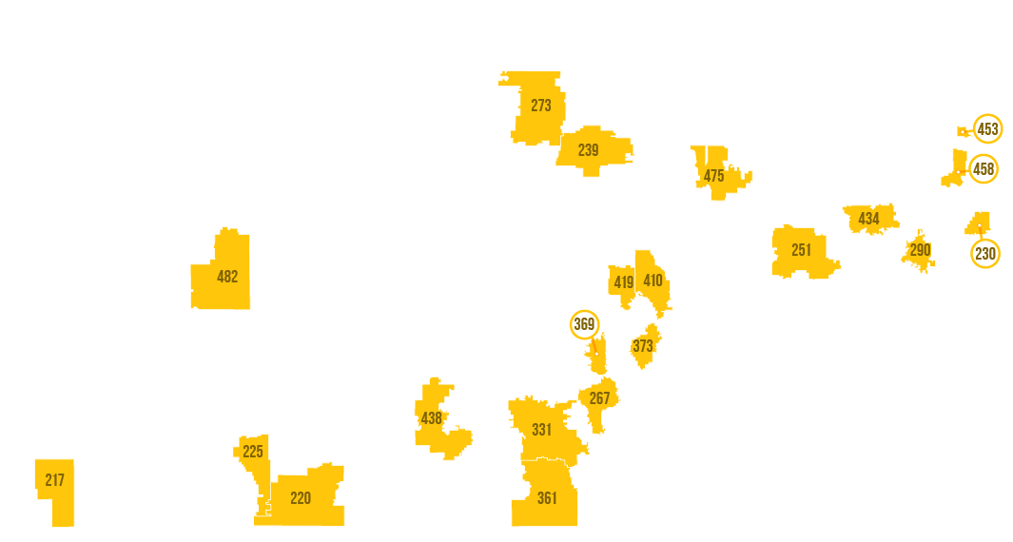
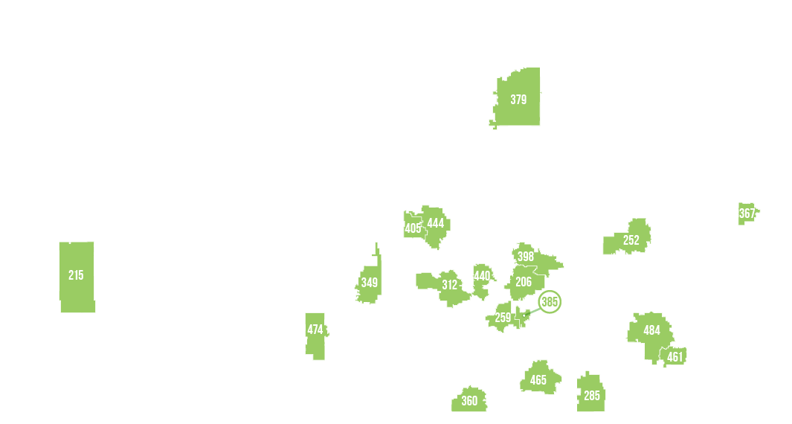
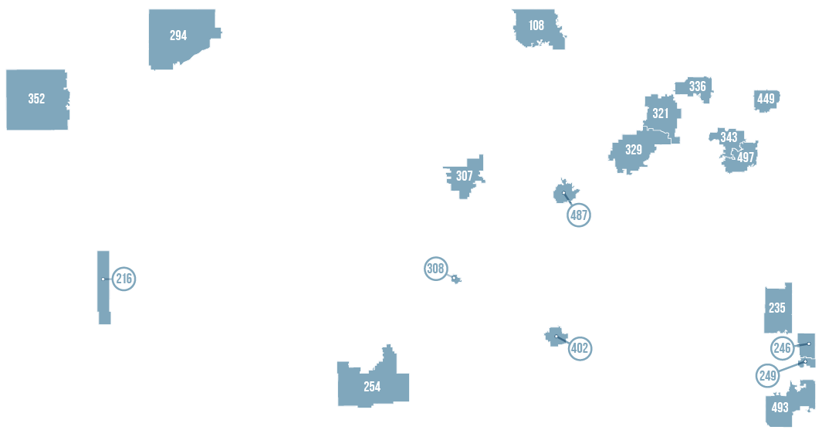

Slide 18
Kansas School Redesign Principles
Student Success Skills | Family, Business, and Community Partnerships
There is an integrated approach to develop student social-emotional learning. | Partnerships are based on mutually beneficial relationships and collaboration.
Personalized Learning | Real World Application
Teachers support students to have choice over their time, place, pace and path. | Project-based learning, internships, and civic engagement makes learning relevant.

Slide 19
Notes:
Today’s students are the future workforce and future leaders of Kansas. Kansans Can achieve anything and, together, Kansans Can lead the world in the success of each student.

