Slide 1
Student Profiles
Designing the Rocket: Empathize

Slide 2
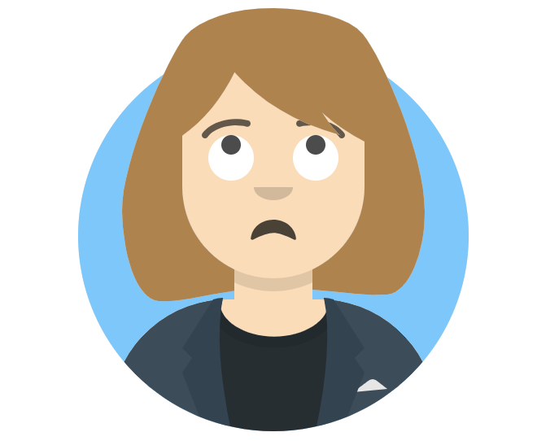
Helen A- 10th Grade
My teachers welcome me in class and are happy when I’m present.
I follow all directions to the best of my ability and don’t ask many questions even if I don’t fully understand what I’m doing.
Most of my classes are boring and I feel like they go through everything too fast.
My parents are glad I joined the soccer team; I did it for the PE credit at first, but am having fun.
I’m struggling to keep up with all of my work, but really want to stay eligible so I can play in the game.
My therapist believes that teetering on eligibility has started to drain my motivation to try my hardest.

Slide 3
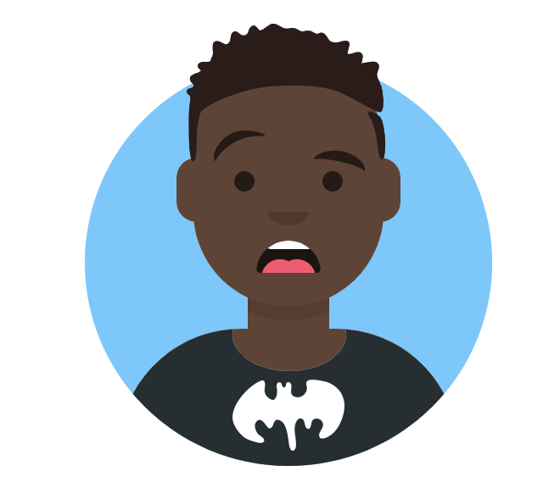
Marcel L- 4th Grade
“What did you say? I have a hard time paying attention. My mother says it’s “selective hearing”.
I try my hardest to do what the teacher says, I feel good when I make them happy.
My math teacher learned from my band teacher that I focus better when I get to stand up. Now I like doing math more!
My band instructor wants me to stay after school for lessons, but I can’t because my mom has to pick me and my little sister up before her second job.
School is fun when we get to do projects and move around the room, but that only happens on Fridays.

Slide 4
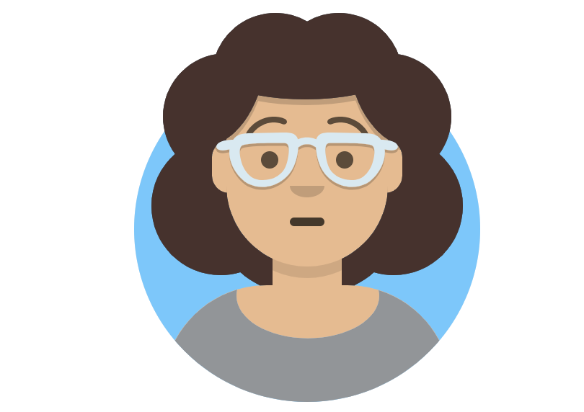
Deanna T- 5th Grade
I really like school!
I have lots of best friends and get good grades.
My teachers would never describe me as shy or someone who needs to speak up more.
I follow the same routine almost every day and this helps me be successful.
Reading class is boring; we read books that are too easy for me, and the teacher has to go so slow to make sure everyone is on the same page.
I like when we work in math stations because I get to work with a partner and talk out how to solve the problems.

Slide 5
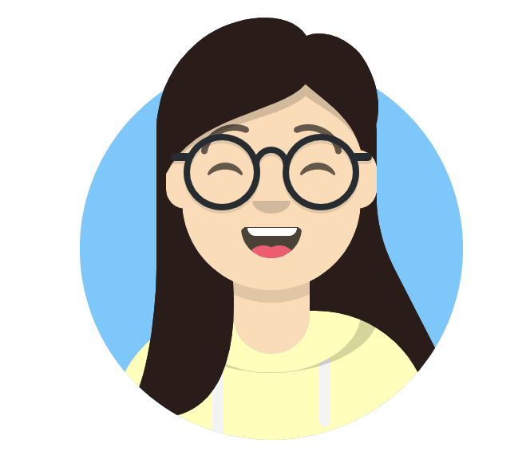
Mora M- 12th Grade
It feels so good to almost be done with high school!
Overall, I had a good experience in school and felt like I was recognized for my success and accomplishments.
I’ve always done my best in smaller classes and rely on my teachers for validation when my confidence is low.
Being recognized as Gifted gave me access to more rigorous classes and engaging extracurricular opportunities.
I’m confident that I’ll be accepted into a 4-year university, but am nervous that I won’t be as prepared as my peers who came from larger districts/schools.

Slide 6
Daniel E- 6th Grade
School is okay, I guess.
I have one friend, but we aren’t in any of the same classes.
I like my teachers, but I don’t want to bother them with my questions when they are busy dealing with behavior problems.
I often have missing, incomplete, or late work, so I can’t play sports.
I get nervous easily so I don’t like to raise my hand, read out loud, or present.
When my teacher calls on me, I get frustrated and put my head down.
I live with my grandparents and they are too tired to come to conferences or meet with my teachers.

Slide 7
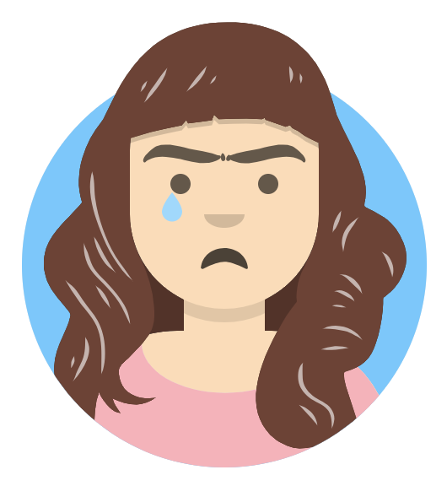
Alma R- Kindergarten
I arrived at school midway through the year.
I don’t feel ready for school.
My parents fight at home and it makes me sad and I don’t want to leave them.
English is my second language so I struggle to make friends with everyone.
I feel better when I get to sit with the teacher and read a story.
When I understand, I do a good job of following directions.
My last school said I might need an IEP to help me learn better, but my family doesn’t know what that is.

Slide 8
Christopher M- 2nd Grade
Sometimes I like school and sometimes I don’t.
I like playing math games on the computer and writing my spelling words.
My favorite thing to do is win, because our teacher gives us candy.
Art and lunch are my favorite classes.
I feel smart when we fill out our mastery trackers and it shows I’m getting closer to meeting my goal.
I want to be a baseball player and a racecar engineer when I grow up!
My teachers won’t let me to sit next to my friend in class, even though I was just trying to help him!

Slide 9
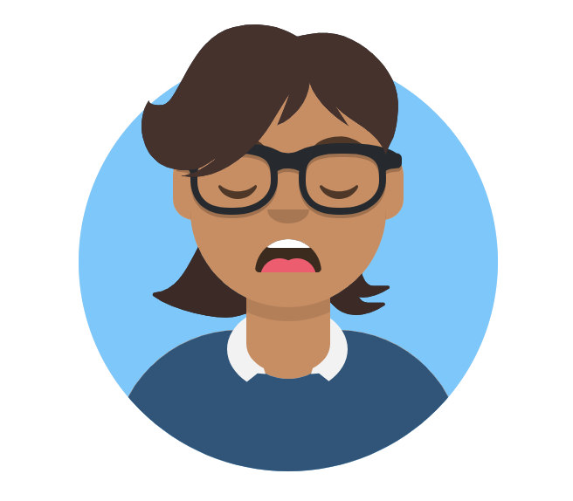
Ephraim L- 9th Grade
Both of my parents work multiple jobs, so I take care of myself and my younger sister.
When I’m at home, we speak Spanish.
My parents work hard, so they motivate me to work hard because I want to go to college.
I put my best effort into everything I do, but still only get B’s and C’s.
At the end of the day I’m always tired and drained.
But I still do my homework right after school so I can play sports.
I have 2-3 hours of homework per night which is a lot compared to middle school.

