Slide 1
Show and Launch: Meeting 1

Slide 2
Agenda
9:00-9:30 Welcome, Share Out, Phase Overview
9:30-10:15 Telling Your Story
10:15-10:30 Break
10:30-11:15 Required Artifacts
11:15-11:30 Break
11:30-12:00 Readiness Reflection
12:00-12:30 Lunch
12:30-1:15 On-Site Visit
1:15-1:30 Break
1:30-2:45 Plan Time
2:45-3:00 Closing & Survey

Slide 3
Links
Slides -

Slide 4
Kansas Vision for Redesign
Kansas leads the world in the success of each student
It’s what Kansans said they wanted. It’s what the job trends and our current K-12 outcomes are telling us.

Slide 6
Launch Readiness Rubric
Show & Launch Readiness Expectations:
All four Redesign Principles are addressed in your Redesign Plan
There is documentation of your work throughout the Plan Year (i.e. blueprint, action plans, and gap analyses for each strategy)
Evidence supports that you have regularly updated your Local Board of Education
Your School Vision & Goals align with your District Vision & Goals
Your School Vision & Goals are aligned to the State Vision, Definition of a Successful High School Graduate, and the State Board Outcomes
Category |  | Low | Medium | High
Strategy Selection, Prototyping, and Testing |  | Strategies are missing multiple components: Researched by the GAIT Supported with an Action Plan Connected to the Gap Analysis Measured through data-tracking and monitoring (scoreboards) Adjusted based on accountability meetings and reflection | Some strategies were... Researched by the GAIT Supported with an Action Plan Connected to the Gap Analysis Measured through data-tracking and monitoring (scoreboards) Adjusted based on accountability meetings and reflection | All strategies were... Researched by the GAIT Supported with an Action Plan Connected to the Gap Analysis Measured through data-tracking and monitoring (scoreboards) Adjusted based on accountability meetings and reflection
Process for Continuous Improvement | Plan to Scale | Resource implications have not been determined for strategies selected for scale and support plans have not been created. | For some strategies selected for scale, the resource implications have not been determined OR a complete support plan has not yet been created. | For each strategy selected for scale, the resource implications have been determined and a support plan has been created.
 | Sustainability & Growth | Strategy support through professional development and GAIT team maintenance has not been incorporated into the plan for scale. | Some plans exist regarding professional development for strategies selected for scale, but there is no designated GAIT time set aside for accountability meetings. | There is a plan for ongoing professional development, GAIT time, and accountability meetings so that strategies can be evaluated, monitored, and adjusted in a timely manner.
 | Process for Ongoing Improvement | The district and school have not worked to align improvement plans. It is unclear how school goals and strategies connect with district goals and strategies. Plans exist in multiple places, and they are not aligned. | The district and school improvement plans overlap, but direct alignment and connection is missing in areas.The district supports the school plans for improvement, but there is little alignment across buildings and plans. | The district and school have aligned the school Redesign Plan with the district’s plan for continuous improvement, and support is in place to continue work within the defined Goal Areas.
Internal & External Stakeholder Engagement and Communication |  | The school has not engaged both internal and external stakeholders in the Redesign process. Two-way communication is not developed and feedback loops are not in place. | The school has engaged all stakeholders, but two-way communication has not always been ensured. Feedback loops might exist for some stakeholder groups but not all. | The school has authentically and meaningfully engaged all stakeholders (students, staff, parents, community, business) in the Redesign work and has established two-way communication, opportunities for input, and feedback loops.
Notes:
Rubric- https://www.ksde.org/LinkClick.aspx?fileticket=vnD9-j4k9No%3d&tabid=1207&portalid=0&mid=3630

Slide 7
Share-Out
Discuss- What have your GAITs done? What have they learned? What are their next steps?

Slide 8
Show & Launch Objectives
01
Telling Your Story
Why are you Redesigning?
What is your Shared Vision?
Design Thinking Process & Your School
02
Evaluating your Redesign
Were all four Redesign Principles met?
What did your data tell you?
What do you want to scale?
03
What strategies will you scale next year? Following years?
What will you need in order to scale?
How will you continue to inform stakeholders?
Who is responsible?
Planning to Scale
04
Communicate with Stakeholders
Why, Who, How, and When
Continue developing your plan
Over communicate

Slide 9
Show & Launch
FOCUS
LEVERAGE
ENGAGEMENT
ACCOUNTABILITY
Your Vision for Education
Complete the Redesign On-Site Visit & Evidence Tell Your Story Workbook Collection
For every goal area… -Complete pre-visit -Create presentation
-Gap Analysis planning -Involve stakeholders
For every strategy… -Document on-site -Include multiple mediums
-Action Plan evidence -Present to LRC and Local
-Scoreboard -Debrief Board of Education
-Analysis & Plan to
scale
Notes:
Focus on the wildly important.
Act on lead measures.
Keep a compelling scoreboard.
Create a cadence of accountability.

Slide 10
TURNKEY PROCESS
Regional Training Team will experience workshop + modify turnkey materials to train the School redesign Teams in their service centers
RTT
School Redesign Team receives training from RTT and makes key decisions to modify expectations for their district and school context
SRT
School teams receive training from their School redesign team and engage staff through participation in investigation teams
FULL SCHOOL
Notes:
Two Things:
While you are at these trainings, we are giving you content and walking you through activities to assist you in engaging in design thinking to plan your school redesign. As you participate, you should always be thinking about what you will take back to your staff and how you will deliver it.
To assist you with planning your ‘turnkey’, we have a communication log that you were asked to create in the beginning of our time together. You are not obligated to use this, but it is highly encouraged. Use this communication log to help you plan, to track your progress, and to implement a system of accountability.

Slide 11
WHAT
Determine what is the essential learning for all.
WHY
Establish a clear purpose for the learning.
Turnkey Considerations
HOW
Determine the best time, place, and delivery model for the learning.

Slide 12
Review and provide feedback on comprehensive redesign plan components, format and SRT readiness
Align on next steps for RTT and SRT toward ‘Show and Launch’
Review evidence collection for on-site visit
Turnkey Planning & Closing

Slide 13
2 Parts of Comprehensive Redesign Plan
Presentation (45 min)
Collection of Artifacts

Slide 14
Story Time
In 15 seconds or less, share one thing you’ve learned how to do recently.
What would you have liked to have heard more about?
What would have made their story more compelling?
Notes:
Have participants get with a partner (or two). Be sure to really only give each person 15 seconds to share. If given more time, people will elaborate and the two questions on the slide won’t have as much meaning. Have them popcorn out answers to the two questions.
Telling your school story in a compelling way:
As schools progress through the redesign process, there are many bumps along the way and being able to ground people in why your school is redesigning is critically important. One way to do that is to create a story based on:
§ Normal (what was school like before Redesign)
§ Explosion (going through the initial stages of Redesign)
§ New Normal (what school is like now that your Redesign has been launched)

Slide 15
Telling the “Redesign Story”
Notes:
https://www.ksde.org/LinkClick.aspx?fileticket=0SdvPTr7b1E%3d&tabid=1509&portalid=0&mid=6022

Slide 16
Elements of Storytelling
(8 minutes)
Review the Elements of Effective Storytelling
Rewrite your story (~2-minutes long) and include as many components as you can.
Notes:
Have participants take the time to read through the linked document independently, noting any parts that resonate with them. If time permits, have them discuss these resonate points with other members of their SRT.
Keep the expansion of their story to 2 minutes and highlight the importance of telling a compelling and succinct story.

Slide 17
Elements of Storytelling
Share your story with a partner
What did your partner do to make their story compelling?
What components did they include that made this story effective?

Slide 18
Storytelling as a Tool
Stories help us...
Reflect on our experiences
Synthesize our thoughts
Share our learnings and insights
Think about what’s next

Slide 19
What are the parameters for your presentation?
Who are you?
What is in your Redesign plan?
How did you execute and test the ‘what’?
Do- What will you do to scale? Continuously improve?
Approximately 45 minutes
Should be teacher led
Should include…
Your Redesign Story (Who, What, How, Do)
Why
Shared Vision
Empathize Information
How Might We questions
Goal Areas with Lag Measures
Strategies Selected, Tested, and Outcome Data (Lead Data)
Lessons Learned
Establishing a Process of Continuous Improvement
Plan to Scale
Sustainability & Growth
Stakeholder Engagement
Notes:
For planning purposes, each of these presentations should last no more
than 45 minutes:
a. 30-35 minute presentation from the school using whatever
medium/format they choose (Slides, document, video, combination)
b. 5-10 minutes for questions/comments from the committee, ending the
school’s time with next steps (the committee will send their
determination to the school within one week)
c. 3-5 minutes for the committee to confer, add feedback, and make a
determination or plan for further deliberation at another time.
There will be a common document all Launch Readiness Committee
members will use to make notes and a Go/No Go determination

Slide 20
Optional Template for Show and Launch Presentation is included at the end of your ‘Redesign Workbook’

Slide 21
Break
15 Minutes

Slide 22
Review and provide feedback on comprehensive redesign plan components, format and SRT readiness
Align on next steps for RTT and SRT toward ‘Show and Launch’
Review evidence collection for on-site visit
Turnkey Planning & Closing

Slide 23
2 Parts of Comprehensive Redesign Plan
Presentation (45 min)
Collection of Artifacts

Slide 24
Required Artifacts
Complete Redesign Workbook
→ You can preview all tasks on the simple document.

Slide 25
Key Considerations
Consider the following questions to help guide your planning:
Stakeholders | Who should provide feedback to your plan? Who should review your plan prior to presenting to your board? Who should present the plan?
Format/Medium | What is the best format and medium for you to share each component of your redesign plan?
Communication | What is the best way to present this plan (Slides, document, presentation, combination)? Who should be present for this presentation? How can you simplify your messages to highlight your priorities? How can you best communicate your story? How did priorities shift or change?
Timeline | Is there a group of people who would benefit from receiving this information prior to presenting to the board?
Notes:
Please familiarize yourself with the Comprehensive Redesign Planner.

Slide 26
Approval Timeline and Criteria
GO OR NO GO PROCESS
1 | RTT coach reviews- April onsite | April Onsite
2 | SRT Presents to Launch Readiness Committee Approved and move on to local school board Denied and given feedback | Early May
3 | Local school board for approval | May-June as determined by school

Slide 27
You are ‘Ready for Launch’ when…
You have completed your Comprehensive Redesign Planner
You self-evaluate using the Launch Readiness Rubric
You have presented to a Launch Readiness Committee
You receive your ‘Go for Launch’ letter from your local board!

Slide 28
Break
15 Minutes

Slide 29
Review and provide feedback on comprehensive redesign plan components, format and SRT readiness
Align on next steps for RTT and SRT toward ‘Show and Launch’
Review evidence collection for on-site visit
Turnkey Planning & Closing

Slide 30
2 Parts of Comprehensive Redesign Plan
Collection of Artifacts
Presentation (45 min)

Slide 31
Progress Check
What should be done:
What should be in motion/wrapping up:
Collective Why
Shared Vision
Stakeholder Engagement
Communication & Feedback Loops
Redesign Workbook
HMW
Goal Areas
Strategy Action Plans
Prototyping and Testing
Action Plans for each GAIT should be completed
Scoreboards should exist for each strategy being tested
Feedback and Accountability loops should exist

Slide 32
Launch Ready means...
You have completed the key tasks for each Redesign Phase:
Building the Launchpad
Collective Why
Shared Vision
Designing the Rocket
Goal Areas
Gap Analysis for each Goal Area
Action Plans for Strategies
Building the Rocket
Implementation of Strategies
Scoreboards & Accountability Protocols
You have established relationships with key stakeholders.
You have established strong communication and feedback loops.
You have learned the process (and language) of Design Thinking and know how to execute your plans using 4DX!

Slide 33
Strategy Report
Optional tool for evaluating tested strategies for scaling across your launch and ascent years.

Slide 34
Launch Readiness Rubric
Show & Launch Readiness Expectations:
All four Redesign Principles are addressed in your Redesign Plan
There is documentation of your work throughout the Plan Year (i.e. blueprint, action plans, and gap analyses for each strategy)
Evidence supports that you have regularly updated your Local Board of Education
Your School Vision & Goals align with your District Vision & Goals
Your School Vision & Goals are aligned to the State Vision, Definition of a Successful High School Graduate, and the State Board Outcomes
Category |  | Low | Medium | High
Strategy Selection, Prototyping, and Testing |  | Strategies are missing multiple components: Researched by the GAIT Supported with an Action Plan Connected to the Gap Analysis Measured through data-tracking and monitoring (scoreboards) Adjusted based on accountability meetings and reflection | Some strategies were... Researched by the GAIT Supported with an Action Plan Connected to the Gap Analysis Measured through data-tracking and monitoring (scoreboards) Adjusted based on accountability meetings and reflection | All strategies were... Researched by the GAIT Supported with an Action Plan Connected to the Gap Analysis Measured through data-tracking and monitoring (scoreboards) Adjusted based on accountability meetings and reflection
Process for Continuous Improvement | Plan to Scale | Resource implications have not been determined for strategies selected for scale and support plans have not been created. | For some strategies selected for scale, the resource implications have not been determined OR a complete support plan has not yet been created. | For each strategy selected for scale, the resource implications have been determined and a support plan has been created.
 | Sustainability & Growth | Strategy support through professional development and GAIT team maintenance has not been incorporated into the plan for scale. | Some plans exist regarding professional development for strategies selected for scale, but there is no designated GAIT time set aside for accountability meetings. | There is a plan for ongoing professional development, GAIT time, and accountability meetings so that strategies can be evaluated, monitored, and adjusted in a timely manner.
 | Process for Ongoing Improvement | The district and school have not worked to align improvement plans. It is unclear how school goals and strategies connect with district goals and strategies. Plans exist in multiple places, and they are not aligned. | The district and school improvement plans overlap, but direct alignment and connection is missing in areas.The district supports the school plans for improvement, but there is little alignment across buildings and plans. | The district and school have aligned the school Redesign Plan with the district’s plan for continuous improvement, and support is in place to continue work within the defined Goal Areas.
Internal & External Stakeholder Engagement and Communication |  | The school has not engaged both internal and external stakeholders in the Redesign process. Two-way communication is not developed and feedback loops are not in place. | The school has engaged all stakeholders, but two-way communication has not always been ensured. Feedback loops might exist for some stakeholder groups but not all. | The school has authentically and meaningfully engaged all stakeholders (students, staff, parents, community, business) in the Redesign work and has established two-way communication, opportunities for input, and feedback loops.

Slide 35
Lunch Break
12-12:30

Slide 36
Review and provide feedback on comprehensive redesign plan components, format and SRT readiness
Align on next steps for RTT and SRT toward ‘Show and Launch’
Review evidence collection for on-site visit
Turnkey Planning & Closing

Slide 37
Goal of Onsite Visits (Day 2)
Support schools in collecting evidence and stakeholder input, and developing narrative
Review progress of comprehensive redesign plan
Witness Redesign strategies in action
Determine next steps before final presentation

Slide 38
Onsite Visit Components
OBSERVATION What did you see?
FEEDBACK What did you hear?
DEBRIEF What are next steps?
Look-fors for prototype Questions to ask students/teachers in the moment Scoreboard evidence
Audience/participants for feedback delivery Format for feedback Questions, themes and trends to explore with stakeholders
Identify trends in observation and feedback Assess progress toward redesign goal(s) Plan clear next steps to address obstacles
Notes:
There are three components to the onsite visit: Observation, Feedback, Debrief. We will examine each of these sections. Then you will have team time to begin planning your onsite visit.

Slide 39
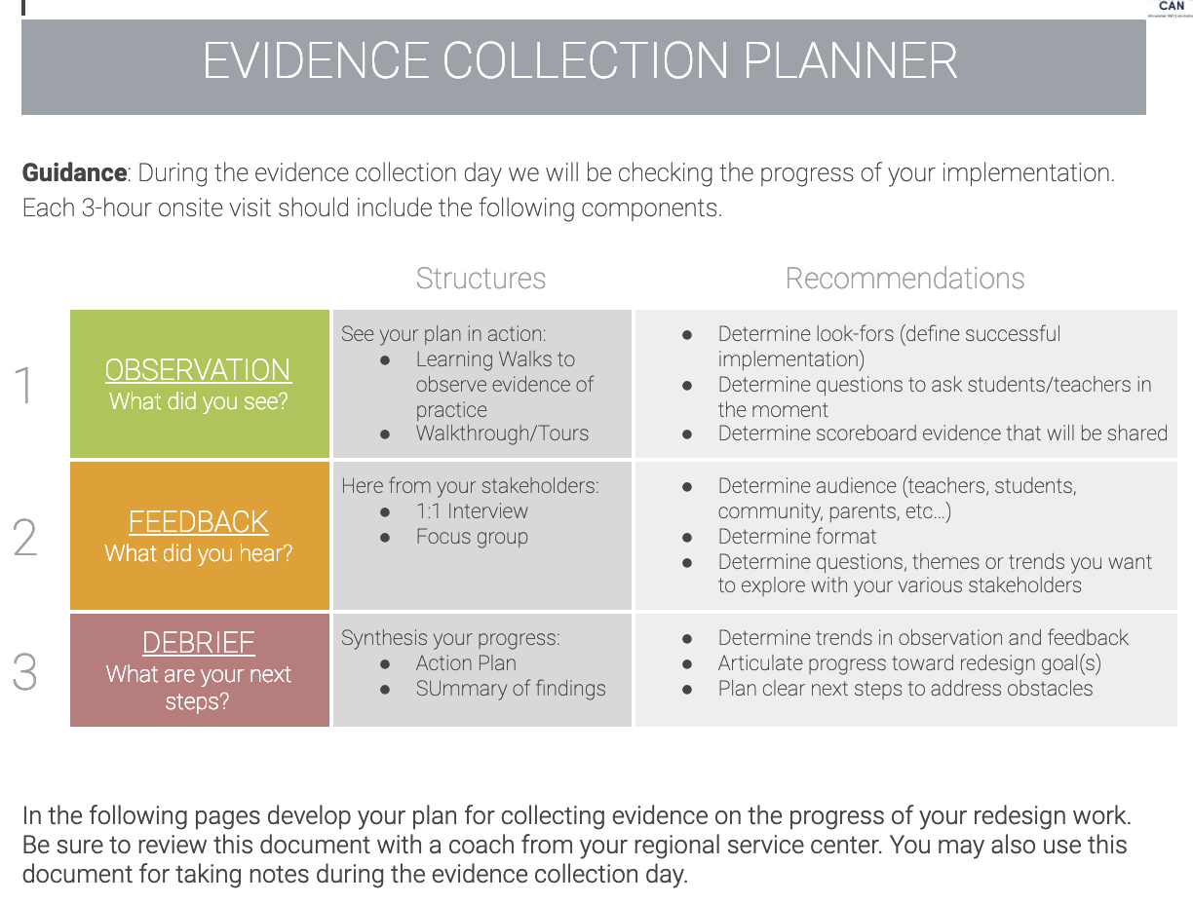
KSDE Evidence Collection Planning Document
Open and make a copy of the KSDE Evidence Collection Planning Document
SRTs will make individual copies of this document
Used to plan for visits, as well as capture notes during visits. (Note Template)
Notes:
Familiarize yourself with the KSDE Evidence Collection Planning Document (prior to the presentation).

Slide 40
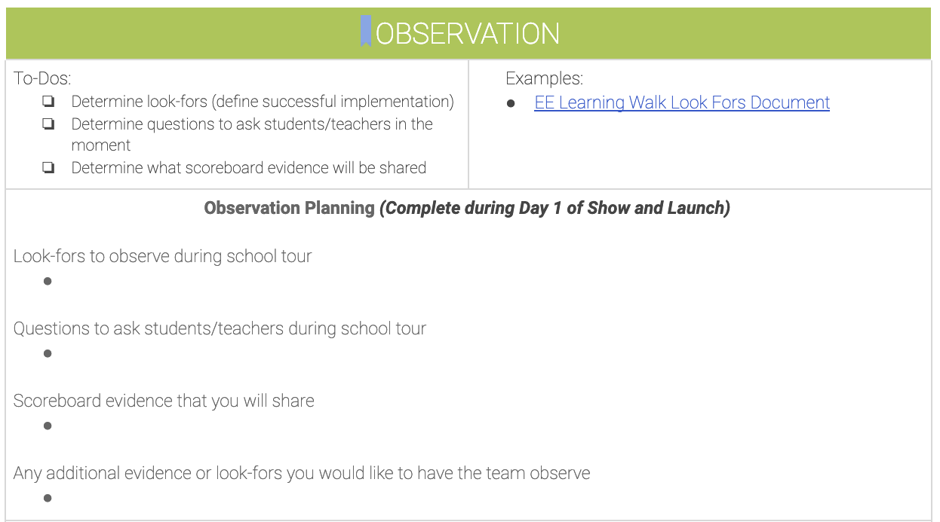
Review Planner-
Observation
Review the guide for ‘Observation’
(5 min) Silently reflect
How could you apply this to your prototypes?
What kinds of look-fors might be appropriate?
How will we capture this data/information?

Slide 41
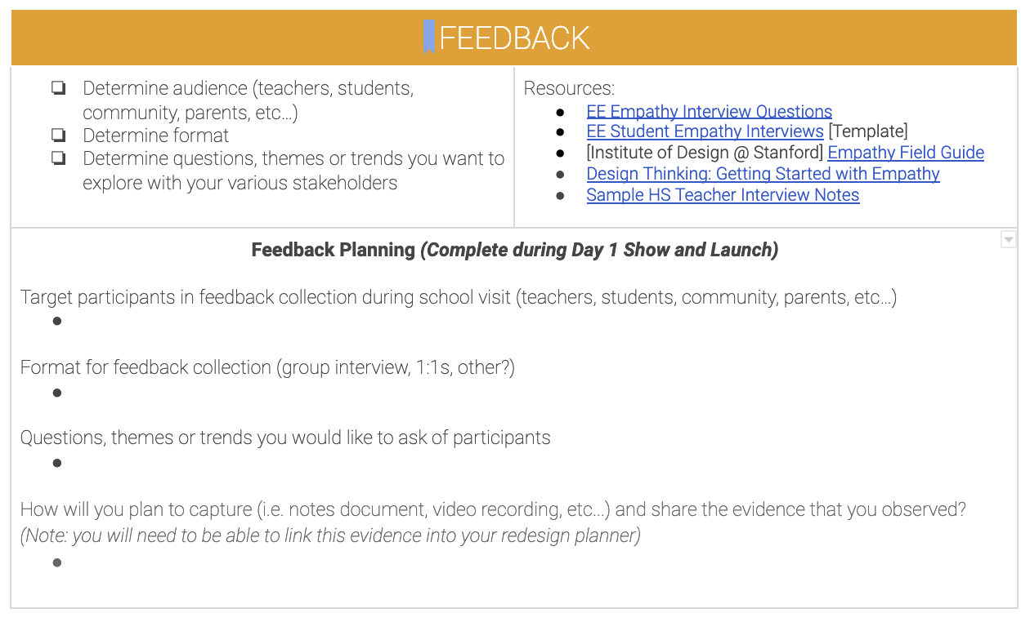
Review Planner-
Feedback
Review the guide for ‘Feedback’
Jot down on a post-it:
How would apply this to your prototypes?
How can you align your ‘Look Fors’ to what is being asked during your feedback conversations?
Who might be the right stakeholders for feedback?

Slide 42
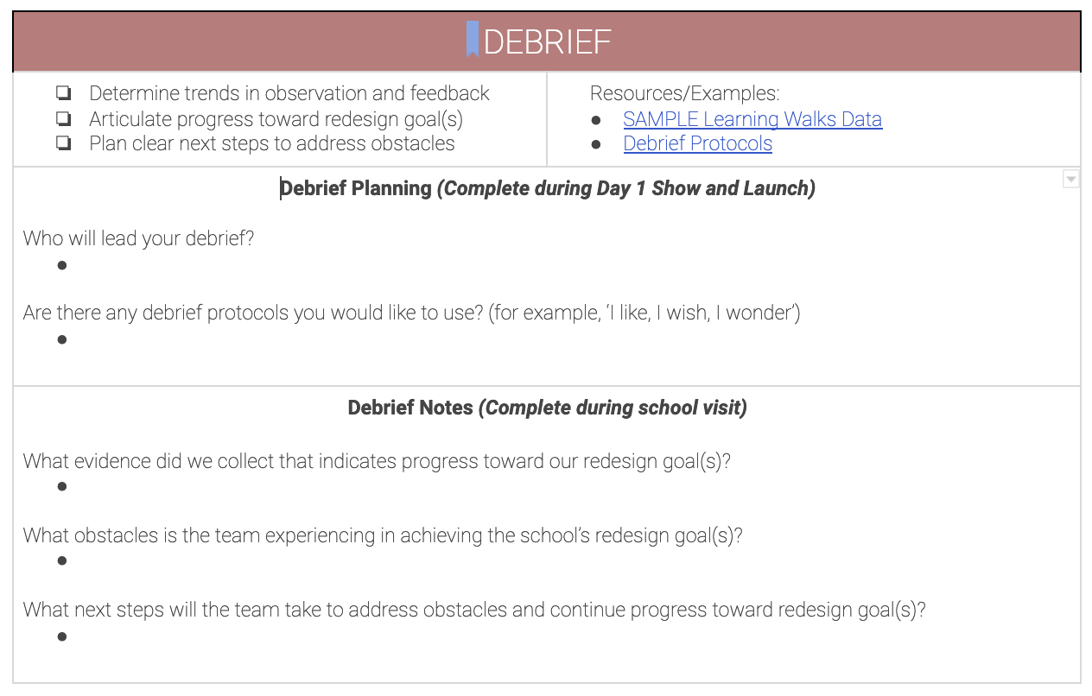
Review Planner- Debrief
Review the guide for Debrief
Jot down on a post-it:
Who should be involved in this debrief?
What would you need in order to ensure a successful debrief?

Slide 43
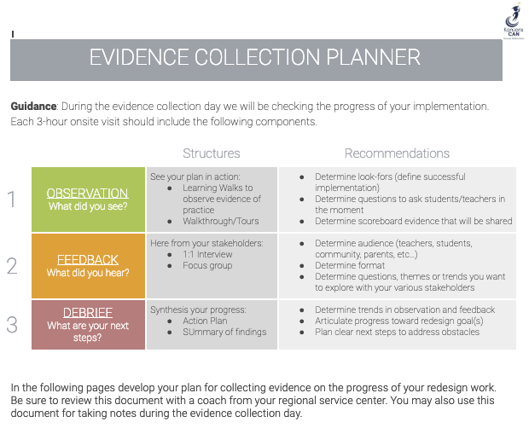
Planning Time
Work time to begin assembling Evidence Collection Planner
Review Evidence Collection Document and Identify
1 Question
1 Observation

Slide 44
Planning Time
Work time to begin assembling Evidence Collection Planner

Slide 45
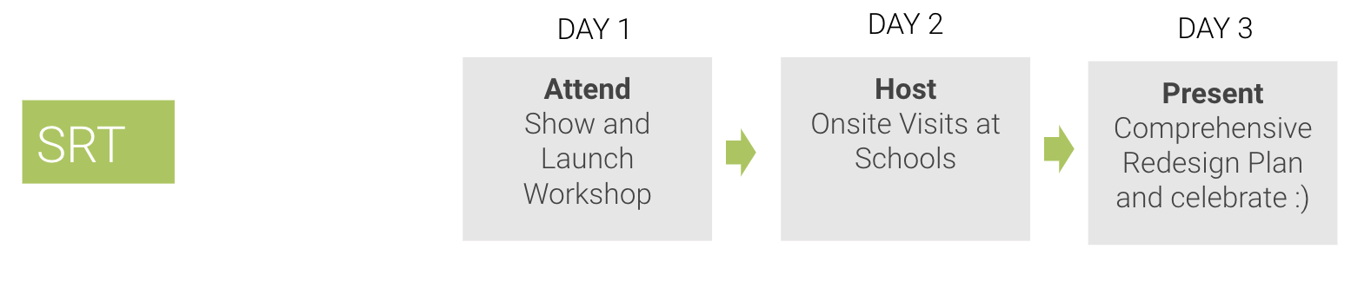
At the end of Day 1 Show and Launch...
Begin to complete their Comprehensive Redesign Plan
Develop a plan for Evidence Collection onsite day

Slide 46
Break
15 Minutes

Slide 47
Review and provide feedback on comprehensive redesign plan components, format and SRT readiness
Align on next steps for RTT and SRT toward ‘Show and Launch’
Review evidence collection for on-site visit
Turnkey Planning & Closing

Slide 48
Turnkey & School Planning Time
Redesign Workbook
On-Site Visit & Evidence Collection
Show & Launch Presentation
Feedback & Communication
Communication Plan
Business/Community Engagement Plan
WHY
WHAT
Turnkey Considerations
HOW

Slide 49
Check Out with Your Team
How you are feeling coming out of today’s session?
30 seconds or less

Slide 50
Survey
Please take this survey after each training. Your feedback is incredibly valuable.

Slide 51
Follow us on Twitter
@KSDEredesign
#kstothemoon
Notes:
Remind participants to take pictures of their team and/or their work, tweet it and tag @KSDEredesign.

