Slide 1
Developmental Stages of Children to Lead the World in the Success of Each Student
Dr. Randy Watson, Kansas Commissioner of Education

Slide 2
Our Vision for Kansas ...
Kansas leads the world in the success of each student
Notes:
Our business cards will stand out as innovative and memorable with a vertical or portrait orientation. Bonus it has a back side!
a portrait or vertical design. It’s also two-sided!
Another fundamental change you may notice (if not you will after I tell you) is that the main address for our agency has been simplified to the main desk in Suite 102. As all our mail is sorted in the print shop having everything labeled by a different team name and suite only made sense to us as we're used to it. It is less confusing and complex for those we serve.

Slide 3
One of the biggest reasons most of us don't set out to achieve a huge goal is that we think we first need to develop a comprehensively detailed grand plan, one where every step is charted, every milestone identified—where success is pre-ordained.
But because we don't have that kind of plan—because creating that kind of plan is basically impossible—we hesitate. We need to see an end before we see a beginning.
And so we never start.
Notes:
Our business cards will stand out as innovative and memorable with a vertical or portrait orientation. Bonus it has a back side!
a portrait or vertical design. It’s also two-sided!
Another fundamental change you may notice (if not you will after I tell you) is that the main address for our agency has been simplified to the main desk in Suite 102. As all our mail is sorted in the print shop having everything labeled by a different team name and suite only made sense to us as we're used to it. It is less confusing and complex for those we serve.

Slide 4
Leadership Matters…
Effective leadership puts first things first (your big rocks). Effective management is scheduling that leadership and having the discipline to stick with it to carry it out.

Slide 5
Our Big Rocks…Our Wildly Important Goal
100% of Students Graduate High School
100% of Students execute their Post Secondary Plan
45% attend a four year college
45% attend a two year college and/or have multiple certificates
5% are in apprentice programs
4% enlist in the military
1% attend 18-21 year old program

Slide 6
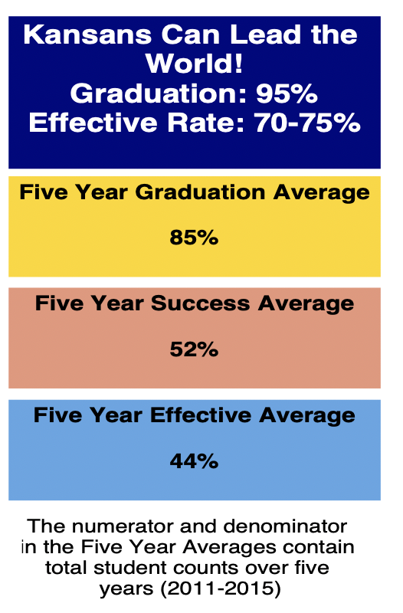
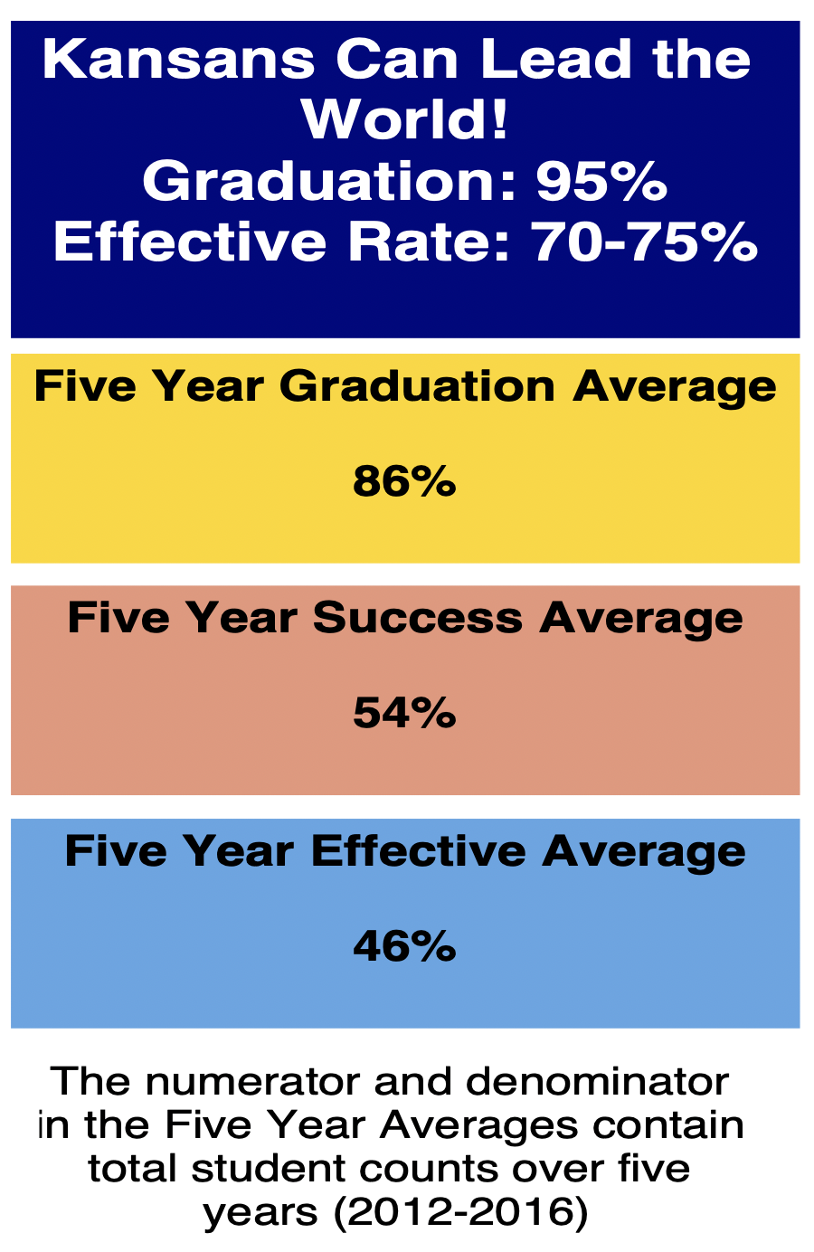
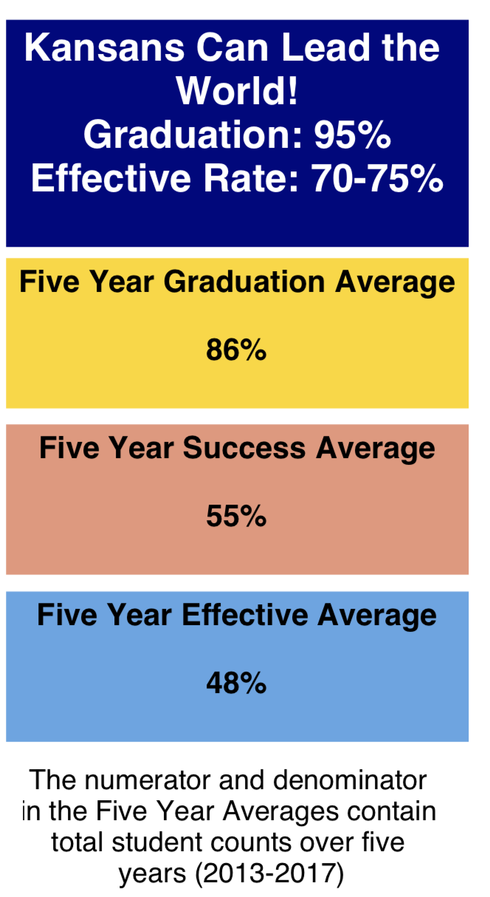
Notes:
Our business cards will stand out as innovative and memorable with a vertical or portrait orientation. Bonus it has a back side!
a portrait or vertical design. It’s also two-sided!
Another fundamental change you may notice (if not you will after I tell you) is that the main address for our agency has been simplified to the main desk in Suite 102. As all our mail is sorted in the print shop having everything labeled by a different team name and suite only made sense to us as we're used to it. It is less confusing and complex for those we serve.

Slide 7
Birth – Age 4
Ages 5 - 9
Ages 10-15
Ages 16-20
Oversight and
Influence
Oversight
Oversight
Oversight and
Influence

Slide 8
Birth – Age 4
What are my lag measures for this developmental stage?
Notes:
Our business cards will stand out as innovative and memorable with a vertical or portrait orientation. Bonus it has a back side!
a portrait or vertical design. It’s also two-sided!
Another fundamental change you may notice (if not you will after I tell you) is that the main address for our agency has been simplified to the main desk in Suite 102. As all our mail is sorted in the print shop having everything labeled by a different team name and suite only made sense to us as we're used to it. It is less confusing and complex for those we serve.

Slide 9
Birth – Age 4
95% academically ready on ASQ
95% socially emotionally ready on ASQ
Other local measures on readiness
Notes:
Our business cards will stand out as innovative and memorable with a vertical or portrait orientation. Bonus it has a back side!
a portrait or vertical design. It’s also two-sided!
Another fundamental change you may notice (if not you will after I tell you) is that the main address for our agency has been simplified to the main desk in Suite 102. As all our mail is sorted in the print shop having everything labeled by a different team name and suite only made sense to us as we're used to it. It is less confusing and complex for those we serve.

Slide 10
Ages 5 - 9
Oversight
Notes:
Our business cards will stand out as innovative and memorable with a vertical or portrait orientation. Bonus it has a back side!
a portrait or vertical design. It’s also two-sided!
Another fundamental change you may notice (if not you will after I tell you) is that the main address for our agency has been simplified to the main desk in Suite 102. As all our mail is sorted in the print shop having everything labeled by a different team name and suite only made sense to us as we're used to it. It is less confusing and complex for those we serve.

Slide 11
Ages 5 - 9
What are my lag measures for this developmental stage?
Notes:
Our business cards will stand out as innovative and memorable with a vertical or portrait orientation. Bonus it has a back side!
a portrait or vertical design. It’s also two-sided!
Another fundamental change you may notice (if not you will after I tell you) is that the main address for our agency has been simplified to the main desk in Suite 102. As all our mail is sorted in the print shop having everything labeled by a different team name and suite only made sense to us as we're used to it. It is less confusing and complex for those we serve.

Slide 12
Ages 5 - 9
Chronic Absenteeism is less than 5%.
75% of students score 3 or 4 on science, mathematics, language arts and social studies state assessments.
No more than 5% of students score in level 1 on state assessments.
Local Social-Emotional measurement.
Survey of students and parents on satisfaction with school.
Notes:
Our business cards will stand out as innovative and memorable with a vertical or portrait orientation. Bonus it has a back side!
a portrait or vertical design. It’s also two-sided!
Another fundamental change you may notice (if not you will after I tell you) is that the main address for our agency has been simplified to the main desk in Suite 102. As all our mail is sorted in the print shop having everything labeled by a different team name and suite only made sense to us as we're used to it. It is less confusing and complex for those we serve.

Slide 13
Ages 10-15
Oversight
Notes:
Our business cards will stand out as innovative and memorable with a vertical or portrait orientation. Bonus it has a back side!
a portrait or vertical design. It’s also two-sided!
Another fundamental change you may notice (if not you will after I tell you) is that the main address for our agency has been simplified to the main desk in Suite 102. As all our mail is sorted in the print shop having everything labeled by a different team name and suite only made sense to us as we're used to it. It is less confusing and complex for those we serve.

Slide 14
Ages 10-15
What are my lag measures for this developmental stage?
Notes:
Our business cards will stand out as innovative and memorable with a vertical or portrait orientation. Bonus it has a back side!
a portrait or vertical design. It’s also two-sided!
Another fundamental change you may notice (if not you will after I tell you) is that the main address for our agency has been simplified to the main desk in Suite 102. As all our mail is sorted in the print shop having everything labeled by a different team name and suite only made sense to us as we're used to it. It is less confusing and complex for those we serve.

Slide 15
Ages 10-15
Chronic Absenteeism is less than 5%.
95% of students involved in 2-5 extra curricular activities in or out of school.
100% of students have an IPS.
75% of students score 3 or 4 on science, mathematics, language arts and social studies state assessments.
No more than 5% of students score in level 1 on state assessments.
Suspension and Expulsion rates and procedures.
Local Social-Emotional measurement.
Survey of students and parents on satisfaction with school.
Notes:
Our business cards will stand out as innovative and memorable with a vertical or portrait orientation. Bonus it has a back side!
a portrait or vertical design. It’s also two-sided!
Another fundamental change you may notice (if not you will after I tell you) is that the main address for our agency has been simplified to the main desk in Suite 102. As all our mail is sorted in the print shop having everything labeled by a different team name and suite only made sense to us as we're used to it. It is less confusing and complex for those we serve.

Slide 16
Ages 16-20
Oversight and
Influence
Notes:
Our business cards will stand out as innovative and memorable with a vertical or portrait orientation. Bonus it has a back side!
a portrait or vertical design. It’s also two-sided!
Another fundamental change you may notice (if not you will after I tell you) is that the main address for our agency has been simplified to the main desk in Suite 102. As all our mail is sorted in the print shop having everything labeled by a different team name and suite only made sense to us as we're used to it. It is less confusing and complex for those we serve.

Slide 17
Ages 16-20
What are my lag measures for this developmental stage?
Notes:
Our business cards will stand out as innovative and memorable with a vertical or portrait orientation. Bonus it has a back side!
a portrait or vertical design. It’s also two-sided!
Another fundamental change you may notice (if not you will after I tell you) is that the main address for our agency has been simplified to the main desk in Suite 102. As all our mail is sorted in the print shop having everything labeled by a different team name and suite only made sense to us as we're used to it. It is less confusing and complex for those we serve.

Slide 18
Ages 16-20
Chronic Absenteeism is less than 5%.
95% of students involved in 2-5 extra curricular activities in or out of school.
100% of students execute their IPS
95% of students score Silver level or above on ACT WorkKeys
75% of students score college ready on ACT exam.
Local Social-Emotional measurement.
Survey of students and parents on satisfaction with school.
Notes:
Our business cards will stand out as innovative and memorable with a vertical or portrait orientation. Bonus it has a back side!
a portrait or vertical design. It’s also two-sided!
Another fundamental change you may notice (if not you will after I tell you) is that the main address for our agency has been simplified to the main desk in Suite 102. As all our mail is sorted in the print shop having everything labeled by a different team name and suite only made sense to us as we're used to it. It is less confusing and complex for those we serve.

Slide 19
Notes:
Today’s students are the future workforce and future leaders of Kansas. Kansans Can achieve anything and, together, Kansans Can lead the world in the success of each student.

Slide 20
Notes:
Our business cards will stand out as innovative and memorable with a vertical or portrait orientation. Bonus it has a back side!
a portrait or vertical design. It’s also two-sided!
Another fundamental change you may notice (if not you will after I tell you) is that the main address for our agency has been simplified to the main desk in Suite 102. As all our mail is sorted in the print shop having everything labeled by a different team name and suite only made sense to us as we're used to it. It is less confusing and complex for those we serve.

Slide 21
Kansas School Redesign Principles
Student Success Skills | Family, Business, and Community Partnerships
There is an integrated approach to develop student social-emotional learning. | Partnerships are based on mutually beneficial relationships and collaboration.
Personalized Learning | Real World Application
Teachers support students to have choice over their time, place, pace and path. | Project-based learning, internships, and civic engagement makes learning relevant.
Notes:
Our business cards will stand out as innovative and memorable with a vertical or portrait orientation. Bonus it has a back side!
a portrait or vertical design. It’s also two-sided!
Another fundamental change you may notice (if not you will after I tell you) is that the main address for our agency has been simplified to the main desk in Suite 102. As all our mail is sorted in the print shop having everything labeled by a different team name and suite only made sense to us as we're used to it. It is less confusing and complex for those we serve.

