Slide 1
KANAAE Back to School Update 2020
Dr. Randy Watson, Kansas Commissioner of Education

Slide 2
Our Vision for Kansas ...
Kansas leads the world in the success of each student
Notes:
Our business cards will stand out as innovative and memorable with a vertical or portrait orientation. Bonus it has a back side!
a portrait or vertical design. It’s also two-sided!
Another fundamental change you may notice (if not you will after I tell you) is that the main address for our agency has been simplified to the main desk in Suite 102. As all our mail is sorted in the print shop having everything labeled by a different team name and suite only made sense to us as we're used to it. It is less confusing and complex for those we serve.

Slide 3
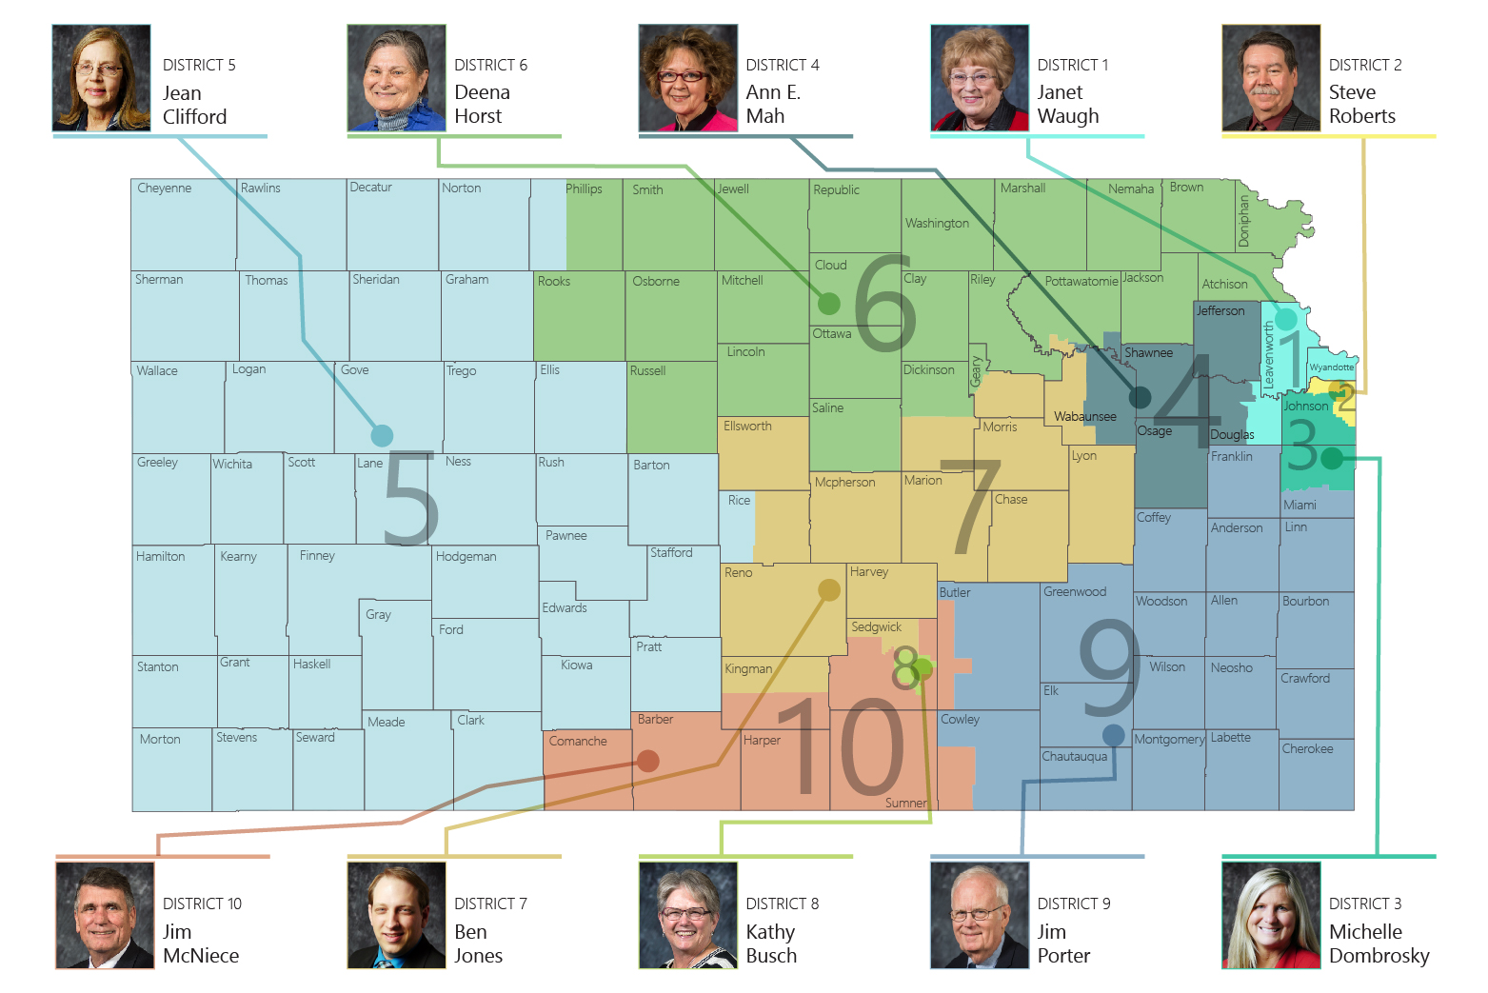

Slide 5
Goals for all Stages
Have Strong Learning Environments
Keep Students and
Staff Safe
Academic rigor needs to be high and students need to be engaged on a daily basis.
Social-Emotional support and learning must be a high priority and a part of any plan.
Equity and Access is essential for families.
No environment can guarantee safety, but strong precautions can be taken to ensure the environment is as safe as possible.
Schools should enable families to maximize their learning options.

Slide 6
Learning Environments
Understanding the need to be flexible during the 2020-21 school year, three different learning environments were defined.
On-Site
Used when community restrictions for COVID-19 are low.
Schools can operate at 100% capacity with precautions.
Social distancing should be practiced where feasible.
Group sizes and spectator events will meet local guidelines.
Hybrid
Used when community restrictions for COVID-19 are moderate.
Schools will operate at reduced capacity (50%) with students alternating between on-site and remote learning.
Social distancing should be enforced.
Group sizes will meet local guidelines (15)
Spectator events not allowed.
Remote
Used when community restrictions for COVID-19 are high.
School capacity restricted to essential staff and activities.
Social distancing should be strictly enforced.
Group sizes will meet local guidelines (10 or fewer).
Spectator events not allowed.

Slide 7
Considerations for Learning Environments
Schools should consult with their local health department to identify what learning environment should be considered using case counts.
Low Restrictions
Disease spread, as represented by the daily case rate of new cases by onset date should be low or a steady decline - utilize on-site learning
Moderate Restrictions
Disease spread, as represented by the daily case rate of new cases by onset date should be flat - utilize hybrid learning
High Restrictions
Disease spread, as represented by the daily case rate of new cases by onset date would be increasing over 4 – 6 weeks or less if determined by the health department - utilize remote learning

Slide 9
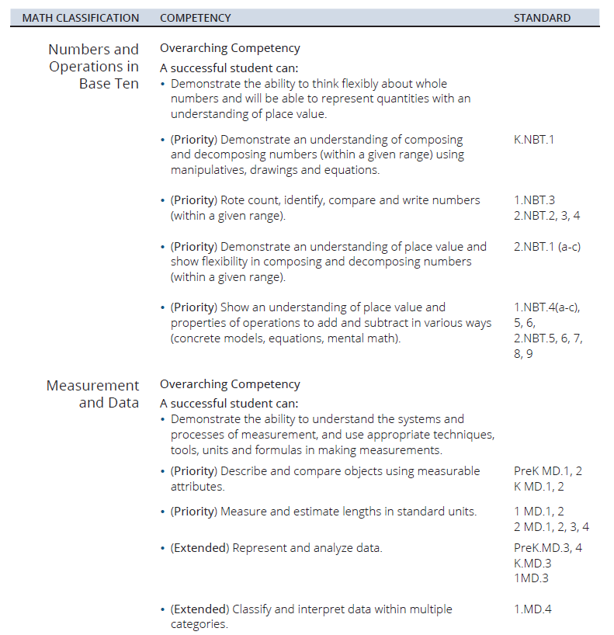

Slide 10
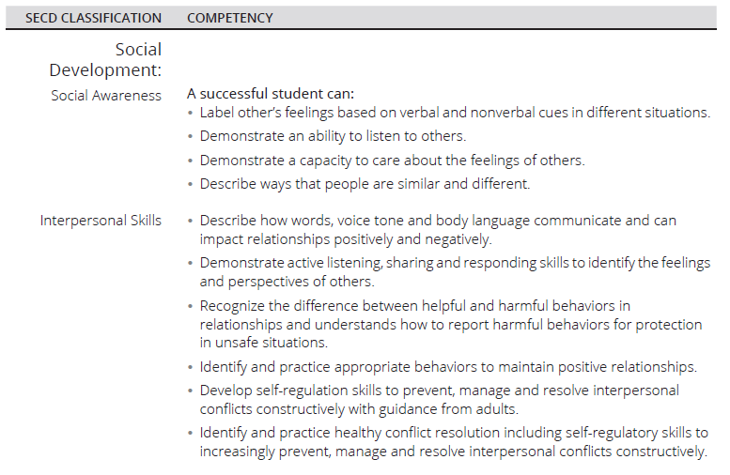

Slide 11
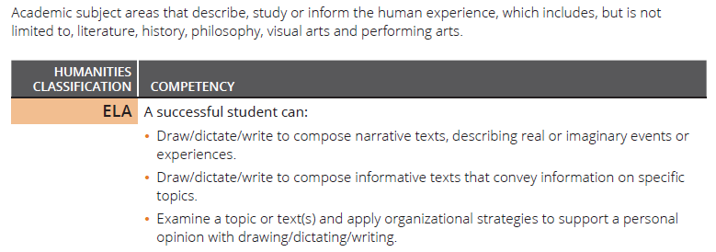

Slide 13
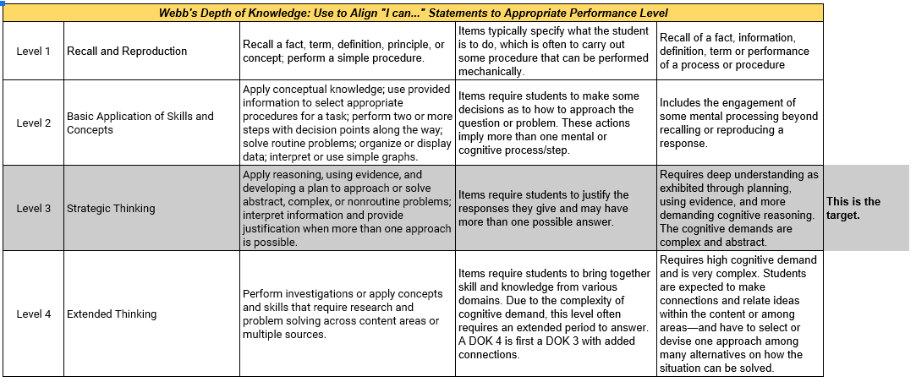
Measuring Student Learning

Slide 16
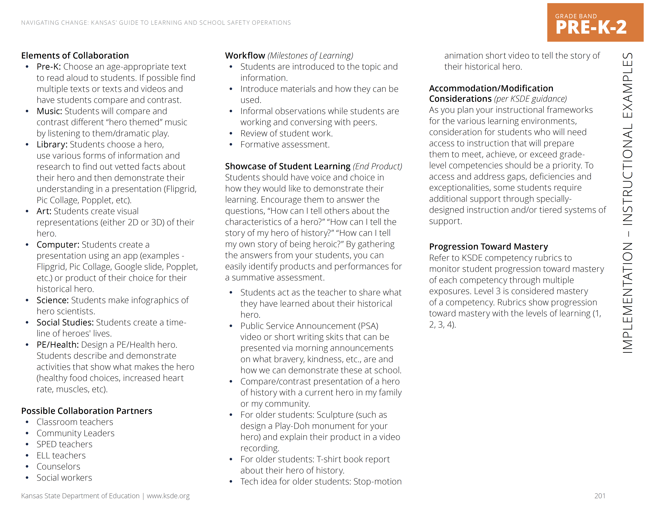

Slide 17
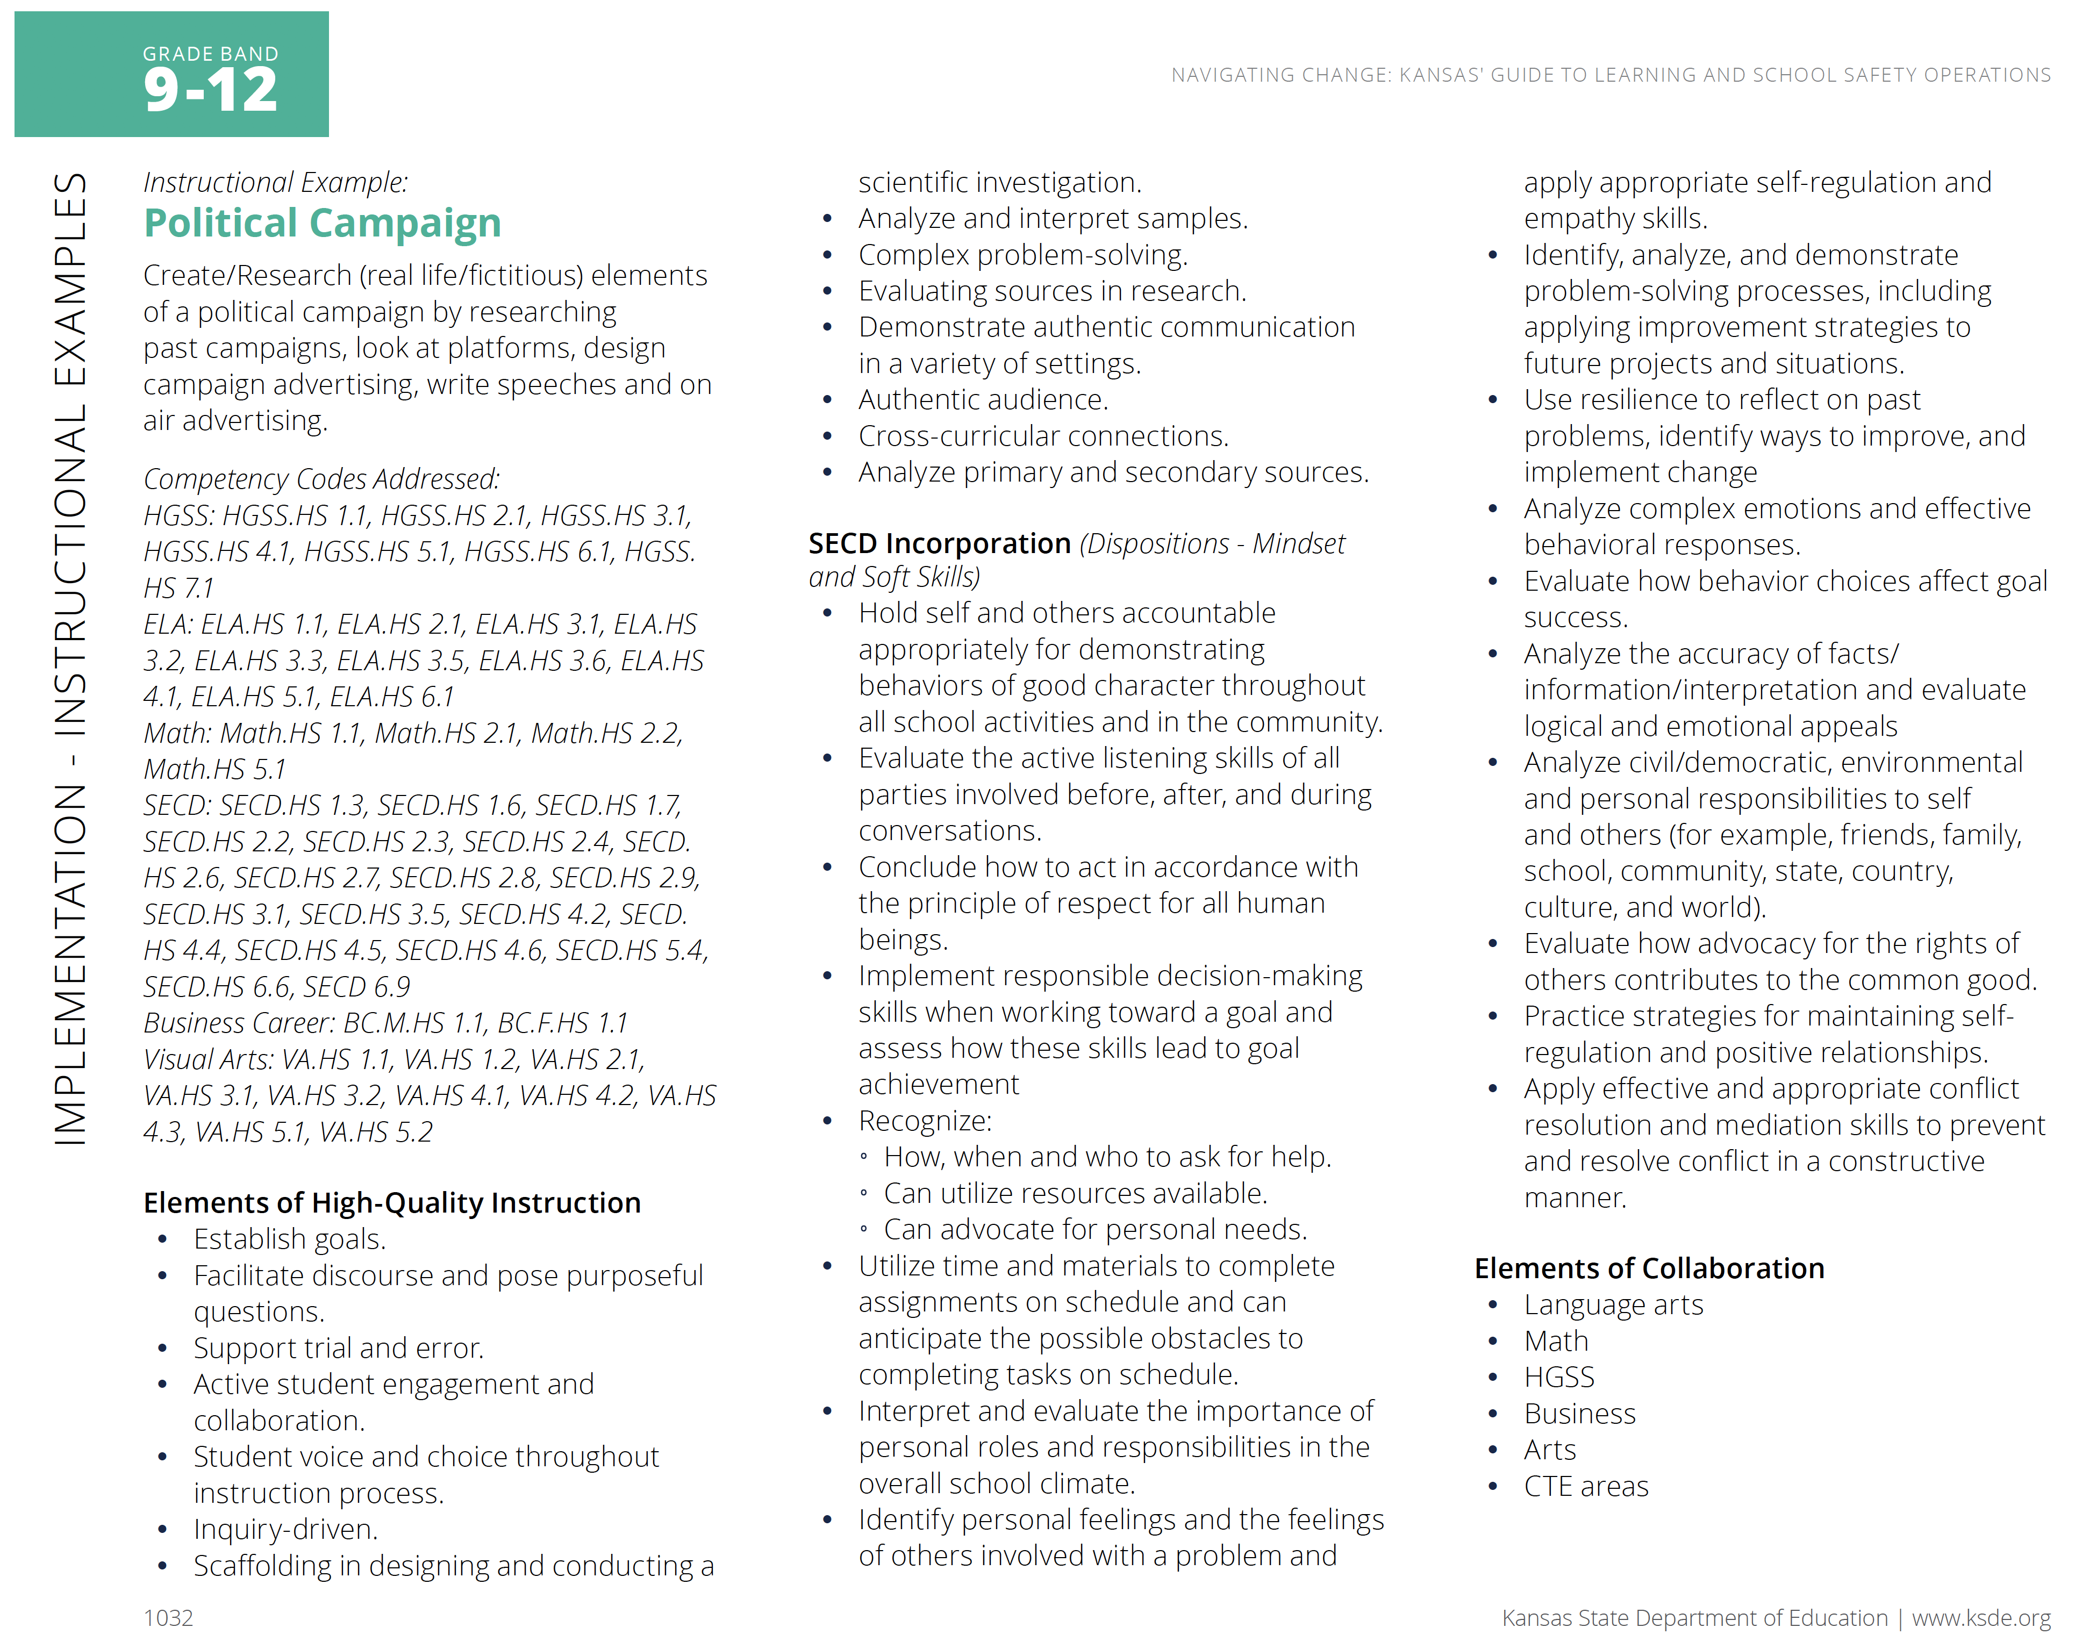

Slide 18
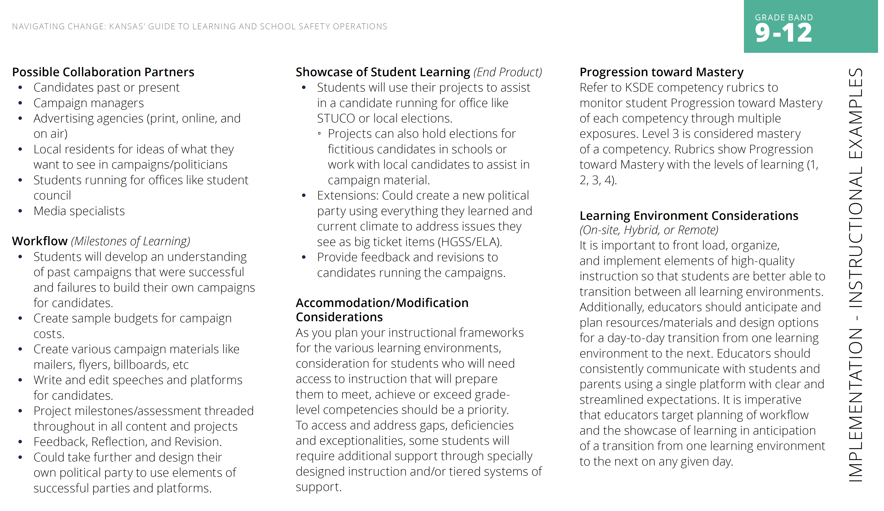

Slide 19
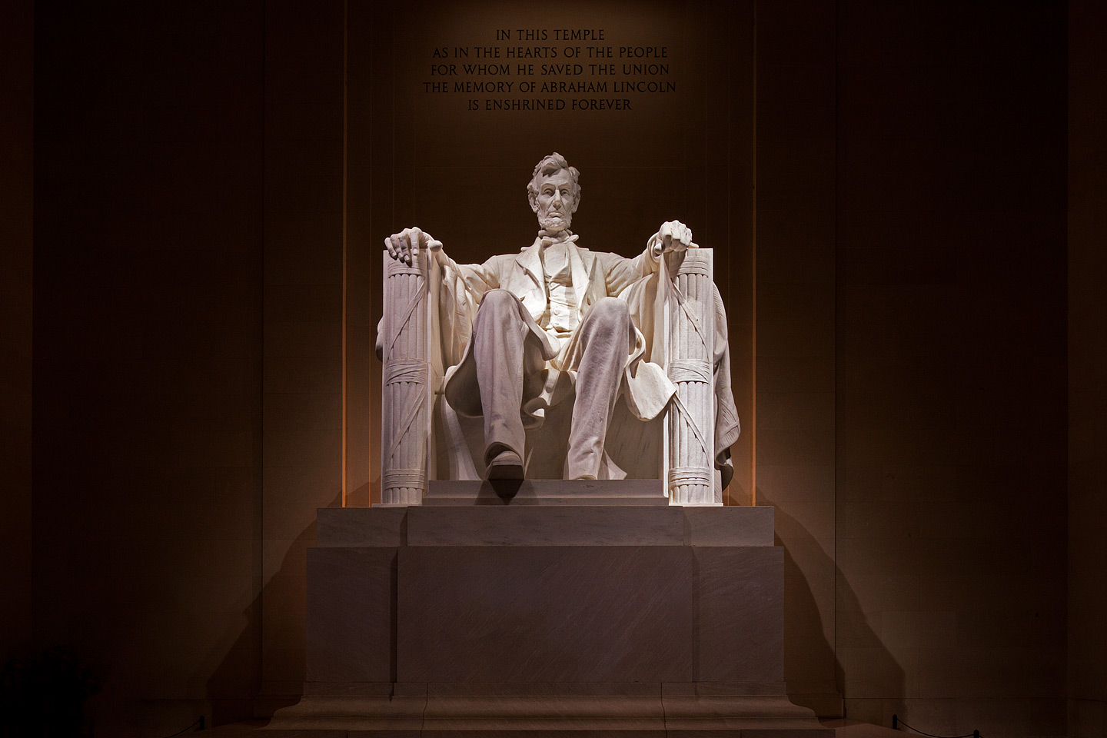
Our Leadership Challenge
“The dogmas of the quiet past, are inadequate to the stormy present. The occasion is piled high with difficulty, and we must rise -- with the occasion.” Annual Message to Congress - December 1, 1862

Slide 20
Notes:
Today’s students are the future workforce and future leaders of Kansas. Kansans Can achieve anything and, together, Kansans Can lead the world in the success of each student.

