Slide 1
Building the
Rocket
Meeting 1

Slide 2
Agenda
9:00-9:30 Welcome, Share Out, Phase Overview
9:30-9:50 Strategy Alignment- Begin the ‘What’
9:50-10:45 Strategy Selection & Gap Analysis
10:45-11:00 Break
11:00-12:00 Keeping Score
12:00-12:45 Lunch
12:45-1:30 Wrap Up/Debrief Scoreboards
1:30-1:45 Break
1:45-2:45 Plan Time
2:45-3:00 Wrap Up and Closing

Slide 3
Links
Slides -

Slide 4
Kansas Vision for Redesign
Kansas leads the world in the success of each student
It’s what Kansans said they wanted. It’s what the job trends and our current K-12 outcomes are telling us.

Slide 6
Launch Readiness Rubric
Show & Launch Readiness Expectations:
All four Redesign Principles are addressed in your Redesign Plan
There is documentation of your work throughout the Plan Year (i.e. blueprint, action plans, and gap analyses for each strategy)
Evidence supports that you have regularly updated your Local Board of Education
Your School Vision & Goals align with your District Vision & Goals
Your School Vision & Goals are aligned to the State Vision, Definition of a Successful High School Graduate, and the State Board Outcomes
Category |  | Low | Medium | High
Strategy Selection, Prototyping, and Testing |  | Strategies are missing multiple components: Researched by the GAIT Supported with an Action Plan Connected to the Gap Analysis Measured through data-tracking and monitoring (scoreboards) Adjusted based on accountability meetings and reflection | Some strategies were... Researched by the GAIT Supported with an Action Plan Connected to the Gap Analysis Measured through data-tracking and monitoring (scoreboards) Adjusted based on accountability meetings and reflection | All strategies were... Researched by the GAIT Supported with an Action Plan Connected to the Gap Analysis Measured through data-tracking and monitoring (scoreboards) Adjusted based on accountability meetings and reflection
Process for Continuous Improvement | Plan to Scale | Resource implications have not been determined for strategies selected for scale and support plans have not been created. | For some strategies selected for scale, the resource implications have not been determined OR a complete support plan has not yet been created. | For each strategy selected for scale, the resource implications have been determined and a support plan has been created.
 | Sustainability & Growth | Strategy support through professional development and GAIT team maintenance has not been incorporated into the plan for scale. | Some plans exist regarding professional development for strategies selected for scale, but there is no designated GAIT time set aside for accountability meetings. | There is a plan for ongoing professional development, GAIT time, and accountability meetings so that strategies can be evaluated, monitored, and adjusted in a timely manner.
 | Process for Ongoing Improvement | The district and school have not worked to align improvement plans. It is unclear how school goals and strategies connect with district goals and strategies. Plans exist in multiple places, and they are not aligned. | The district and school improvement plans overlap, but direct alignment and connection is missing in areas.The district supports the school plans for improvement, but there is little alignment across buildings and plans. | The district and school have aligned the school Redesign Plan with the district’s plan for continuous improvement, and support is in place to continue work within the defined Goal Areas.
Internal & External Stakeholder Engagement and Communication |  | The school has not engaged both internal and external stakeholders in the Redesign process. Two-way communication is not developed and feedback loops are not in place. | The school has engaged all stakeholders, but two-way communication has not always been ensured. Feedback loops might exist for some stakeholder groups but not all. | The school has authentically and meaningfully engaged all stakeholders (students, staff, parents, community, business) in the Redesign work and has established two-way communication, opportunities for input, and feedback loops.
Notes:
Rubric- https://www.ksde.org/LinkClick.aspx?fileticket=vnD9-j4k9No%3d&tabid=1207&portalid=0&mid=3630

Slide 7
Share-Out
Discuss- What have your GAITs done? What have they learned? What are their next steps?

Slide 8
Objectives
01
Develop & Implement a Prototype Plan
Create Gap Analysis and Action Plan for each strategy
Create timeline for implementation
Create success criterion for implementation
02
Keep Score and Stay Accountable
Create scoreboards for every strategy
Establish cadence of accountability for each GAIT
Create team roles and responsibilities for meeting
03
Identify Scaling Needs
Create Gap Analysis around each strategy for scaling
Create project plan and needs statement
Generate PD/Budget/Resource Plan for scaling
04
Conduct School Visits
Goal Areas, Investigation Teams, and Capacity
In State, Out of State, and/or Virtual
Set up a Why and Goals before each visit
05
Communicate with Stakeholders
Why, Who, How, and When
Continue developing your plan
Over communicate
Notes:
We have already done 1 and 2. If you have not done those in your school, then that should be your priority. 5 is ongoing and should be happening all of the time. This phase really focuses on 3 and 4.

Slide 9
Building the Rocket
FOCUS
LEVERAGE
ENGAGEMENT
ACCOUNTABILITY
Your Vision for Education
Engage in Disciplines 3 & 4 Prototype and Test Engage Stakeholders Strategies & Communicate
-Define Lead & Lag -Prioritize Strategies to -Document and Share Measures Prototype Progress
-Create Scoreboards -Complete Gap Analysis -Update Communication
-Establish Cadence -Create Action Plans and Business Plan
of Accountability -Create Plan for Scale -Share Resource
and Sustainability Implications with System
Notes:
Focus on the wildly important.
Act on lead measures.
Keep a compelling scoreboard.
Create a cadence of accountability.

Slide 10
TURNKEY PROCESS
Regional Training Team will experience workshop + modify turnkey materials to train the School redesign Teams in their service centers
RTT
School Redesign Team receives training from RTT and makes key decisions to modify expectations for their district and school context
SRT
School teams receive training from their School redesign team and engage staff through participation in investigation teams
FULL SCHOOL
Notes:
Two Things:
While you are at these trainings, we are giving you content and walking you through activities to assist you in engaging in design thinking to plan your school redesign. As you participate, you should always be thinking about what you will take back to your staff and how you will deliver it.
To assist you with planning your ‘turnkey’, we have a communication log that you were asked to create in the beginning of our time together. You are not obligated to use this, but it is highly encouraged. Use this communication log to help you plan, to track your progress, and to implement a system of accountability.

Slide 11
WHAT
Determine what is the essential learning for all.
WHY
Establish a clear purpose for the learning.
Turnkey Considerations
HOW
Determine the best time, place, and delivery model for the learning.

Slide 12
Selecting Strategies Part 1- Ensuring Alignment
Selecting Strategies Part 2- Prioritizing for Impact
4 Disciplines of Execution- What does it mean to keep score?
Leadership & Culture
Turnkey Planning & Closing

Slide 13
Current State:
Why →
Vision →
Goals (How) →
Strategies (What)
Completed-
Vision Statement
Goal Areas
Goal Area Investigation Teams
Researched Strategies
Possible Visits
In Progress-
Lag Measures for Goal Areas
Target Areas

Slide 14
VISION: Kansas leads the world in the success of each student.
Kindergarten Readiness
Social Emotional Growth
Individual Plan of Study
Graduation Rate
Post Secondary Effective Rate
System VISION:
Note-
All of the work that happens in buildings is meant to move us closer toward achieving our state vision and reaching our state board outcomes. Additionally, the work of systems should also work to support buildings and reflect their priorities, while also moving us closer to our state vision and outcomes. These relationships should flow up and down.
System Values
KESA Goal Area:
KESA Goal Area:
Lag Measure(s):
Lag Measure(s):
School VISION:
Student Success Skills
Real World Applications
Personalized Learning
Family/Business/Community Engagement
Goal Area:
Goal Area:
Goal Area:
Lag Measure(s):
Lag Measure(s):
Lag Measure(s)
Strategies:
Strategies:
Strategies:
Notes:
The 4 Redesign Principles and the schools’ shared vision are foundational.
Schools, with the leadership of the SRT, will explore their student profiles, determine their HMW statements (or problems of practice). These could align with their KESA goal areas.
Schools do not need to have 4 goal areas, they could have fewer, depending on their student profiles.
The work of the investigation teams and the prototype results will inform the strategies that will be put in place. These strategies need to address the goal areas AND align to the 4 Redesign Principles.

Slide 15
Future Work:
Selecting the Right Strategy
The right strategy…
High Impact (Effort/Impact)
Measurable
Predictive of future success
Influenceable by the team
Aligns with one or more Redesign Principle
Aligned to your school Vision, Goal Areas, and Lag Measures
Aligned to system Vision, Goals, and Lag Measures
Aligned to state Vision, Board Outcomes, and Definition of a Successful High School Graduate

Slide 16
Kansans Can: Redesign Principles
Student Success Skills | Family, Business, and Community Partnerships
There is an integrated approach to develop student social-emotional learning. | Partnerships are based on mutually beneficial relationships and collaboration.
Personalizing Learning | Real World Application
Personalized learning places the whole child at the center of instruction. It is informed by strong educator/student/family/community relationships to provide equity and choice in time, place, path, pace and demonstration of learning. | Project-based learning, internships, and civic engagement makes learning relevant.

Slide 17
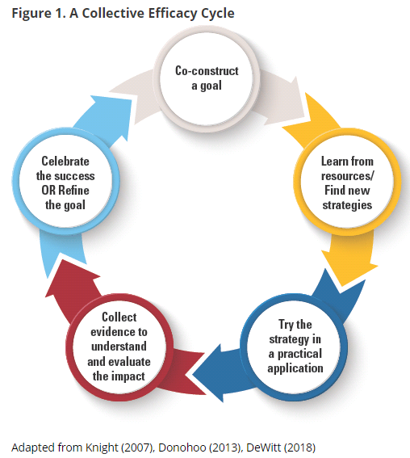
Grow Collective Efficacy
(Liang, Mitchell, & Scott, 2020)
Notes:
The graphic on the left walks through the steps necessary for growing collective efficacy in your organization. In order to grow and build collective efficacy, you must allow all staff an opportunity to co-construct the goal; learn from resources and investigate strategies; staff must have a chance to ‘try a strategy on’ while collecting evidence to understand impact; and lastly, staff must have a collective opportunity to celebrate and reflect.
If you compare that to the process used in Redesign of design thinking and the four disciplines of execution, you see that there is quite a significant alignment between them. In redesign, you use design thinking and 4dx to empathize with students and define your wildly important goals. You ideate and investigate strategies that become your lead measures. Your build prototypes the you test in small groups and while doing so, you create data scoreboards and you hold accountability meetings where ‘pivots’ or ‘adjustments’ are determined. And at the end of your test window, you reflect, celebrate and create a plan for scale or revise and begin again.
To put it simply, using the redesign process with fidelity and integrity will allow you to grow teacher collective efficacy. Let’s move on to learn a little bit more!
Donohoo, Jenni, and Steven Katz. “What Drives Collective Efficacy?” What Drives Collective Efficacy? - Educational Leadership, ASCD, July 2019, www.ascd.org/publications/educational-leadership/jul19/vol76/num09/What-Drives-Collective-Efficacy%C2%A2.aspx.
Liang, J. “Grace,” Mitchell, T., & Scott, J. (2020). Statewide School Redesign: Integrating Design Thinking and the Four Disciplines of Execution as a Continuous School Improvement Process. Journal of Case Studies in Educational Leadership, 1(13). Retrieved from https://journals.sagepub.com/doi/10.1177/1555458920975462

Slide 18
Selecting Strategies Part 1- Ensuring Alignment
Selecting Strategies Part 2- Prioritizing for Impact
4 Disciplines of Execution- What does it mean to keep score?
Leadership & Culture
Turnkey Planning & Closing

Slide 19
VISION:
Foundations
Student Success Skills
Real World Applications
Personalized Learning
Family/Business/Community Engagement
How might we ...?
Goal Area:
Goal Area:
Goal Area:
Note-
It is recommended that you select 2-3 goal areas to intensely focus on in working to achieve your vision. Your goal areas should not be the Redesign Principles, but should connect back to the Principles through the execution of strategies. Also consider: what does your data tell you? What are your stakeholders telling you? What areas of need exist and need to be specifically addressed?
Lag Measure(s):
Lag Measure(s):
Lag Measure(s)
Strategies:
Strategies:
Strategies:
Goal Areas and Strategies
Notes:
The 4 Redesign Principles and the schools’ shared vision are foundational.
Schools, with the leadership of the SRT, will explore their student profiles, determine their HMW statements (or problems of practice). These could align with their KESA goal areas.
Schools do not need to have 4 goal areas, they could have fewer, depending on their student profiles.
The work of the investigation teams and the prototype results will inform the strategies that will be put in place. These strategies need to address the goal areas AND align to the 4 Redesign Principles.

Slide 20
VISION:
Foundations
Student Success Skills
Real World Applications
Personalized Learning
Family/Business/Community Engagement
How might we ...?
Goal Area:
Goal Area:
Goal Area:
Note-
For each Goal Area, it is important that you determine your Lag Measure. By addressing this goal area, what Lag Measure do you intend to impact? What is the ‘big rock’ that will be moved by executing on this wildly important goal?
Lag Measure(s):
(From x to y by when)
Lag Measure(s):
(From x to y by when)
Lag Measure(s):
(From x to y by when)
Strategies:
Strategies:
Strategies:
Goal Areas and Strategies
Notes:
NOTE- Building the Rocket with dive into lag and lead measures. This is introductory, it is not expected to be done!
The 4 Redesign Principles and the schools’ shared vision are foundational.
Schools, with the leadership of the SRT, will explore their student profiles, determine their HMW statements (or problems of practice). These could align with their KESA goal areas.
Schools do not need to have 4 goal areas, they could have fewer, depending on their student profiles.
The work of the investigation teams and the prototype results will inform the strategies that will be put in place. These strategies need to address the goal areas AND align to the 4 Redesign Principles.

Slide 21
Present vs Future State
On a poster, draw the present and future state of the Goal Area strategy(ies) you’ve selected.
Once complete, discuss:
What are the gaps/barriers that exist between these two states?
What would the outcome be if you achieved the future state?
What are you currently trying? What is working? What isn’t? | What do you want it look like? What will people be doing?
Notes:
As you are thinking through the present state and the desire future state you may naturally discover the gaps between the two. Note those as we will use the gaps in the next step.

Slide 22
VISION- KSDE will lead the world in the success of each student.
Student Success Skills
Real World Applications
Foundations
Personalized Learning
Family/Business/Community Engagement
How might we ensure students have structures and systems in place that ensure that they stay on track throughout the school year?
Goal Area: Engaging Learning Opportunities
Goal Area: Real World Connections
Goal Area: Social Emotional Learning
Goal Area: Community Connections
Lag Measure:
Post-Secondary Effect Rate; Assessment Data
Lag Measure:
Post-Secondary Effect Rate; Graduation
Lag Measure:
Social Emotional; Culture Data; IPS
Lag Measure:
Graduation; Post-Secondary; Culture Data
Strategies:
Personalized Learning Time
Choice Activities
Project-based Learning
Strategies:
Student internships with community partners
Career fair
Strategies:
Mentoring time
Incorporate learner profiles
Partner with Families on IPS
Strategies:
Student-directed community service projects
School/community garden
Goal Areas and Strategies

Slide 23
Prototype Gap Analysis
Academic Preparation
What strategy(ies) will you test? What is the purpose? As a school, we would like to devote Personalized Learning Time each week for students to engage in goal-setting, reflection and have time to work toward content based on their needs.
Present State |  |  | Gaps/Barriers |  |  | Future State
PLT does not exist school-wide. In the past, we have had ‘advisory’ periods for some students which may be similar, but not as a school-wide component. We have a general idea of what PLT time could include (goal-setting, reflection, time to complete assignments) but need to gain a better common definition of what it will mean for our school |  |  | Common vision or definition of PLT at our school Defined components of PLT time (what students should complete) Scheduling logistics - what adjustments do we need to make to our scheduling? Training for teachers on how to facilitate PLT |  |  | All students have PLT time twice a week on days with modified schedules Students will have assigned location for PLT, but can sign up for time with teachers as needed. There will be a common approach across the school for teachers facilitating PLT.
Outcomes (What will outcome be if future state is achieved? What LAG Data will be moved?)
Increased development of academic literacy skills and habits of success, More incoming students staying on track throughout the course of the year. Increased engagement in core content classes, which will lead to improvements in student behavior

Slide 24
Present vs Future State
On a poster, draw the present and future state of the Goal Area strategy(ies) you’ve selected.
Once complete, discuss:
What are the gaps/barriers that exist between these two states?
What would the outcome be if you achieved the future state?
What are you currently trying? What is working? What isn’t? | What do you want it look like? What will people be doing?
Notes:
As you are thinking through the present state and the desire future state you may naturally discover the gaps between the two. Note those as we will use the gaps in the next step.

Slide 25
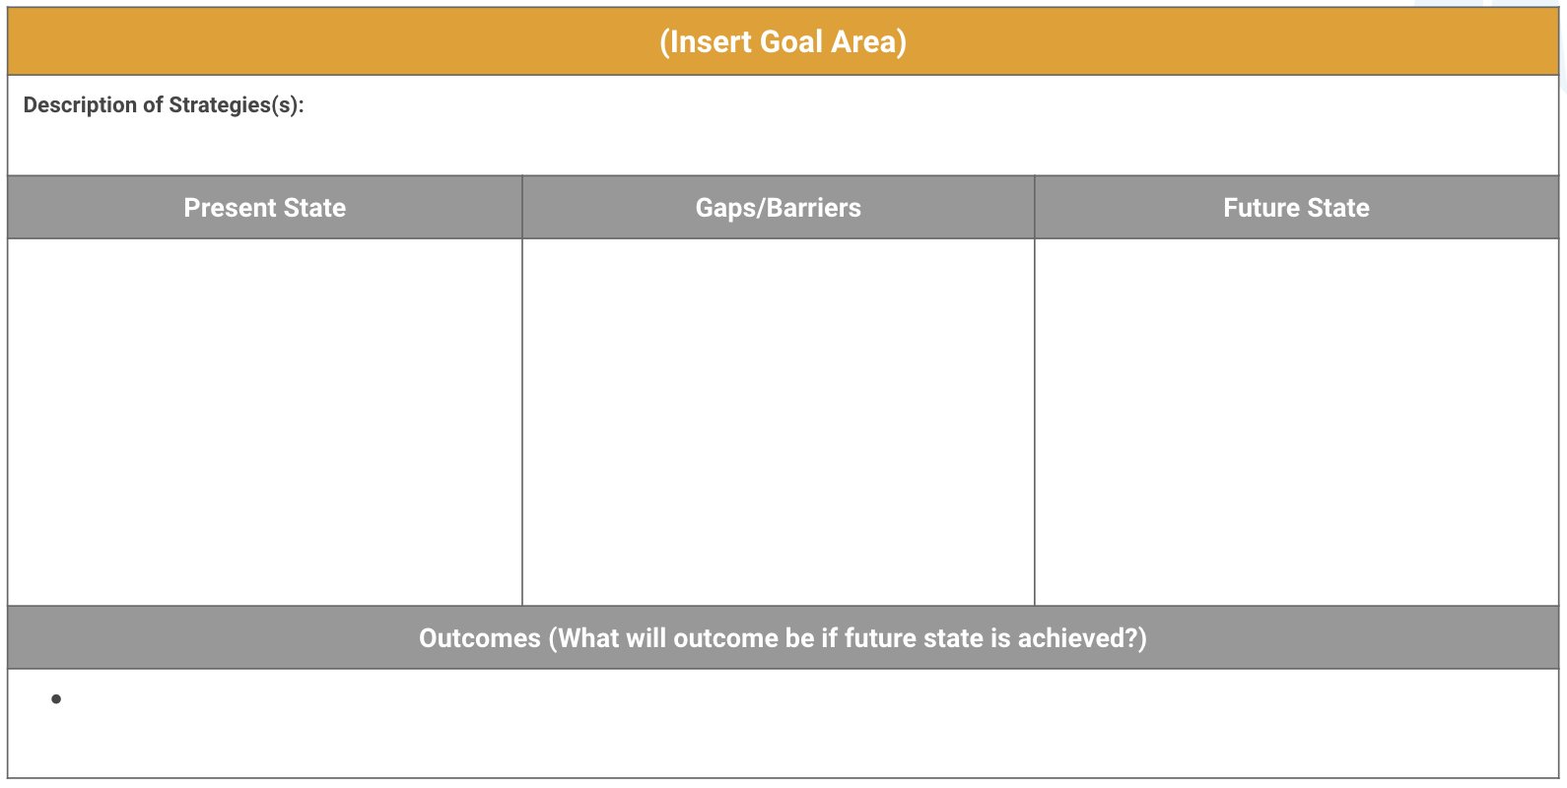
Complete Present and Future State in Workbook
On the next slide of your redesign workbooks, complete the following steps:
Add a description of the strategy(ies) your team will be focusing on
Document the Present State, Gaps/Barriers, and Future State of these strategies
Document what outcomes will occur if future state is achieved
Notes:
School should bring these to their investigation teams come back with them at Day 2. Like always, we do one in the workshop, and then this is an activity they will turnkey and have GAITs complete.

Slide 26
Prioritizing Strategies for Prototyping and Testing
Start by addressing your barriers.
Are these technical issues that can easily be addressed?
Are these adaptive issues that will need time, planning, attention, and revision?
If barriers are technical, address them.
If barriers are adaptive, they will most likely require an intentional focus (i.e. measurement, action plan, and accountability meetings).
Then examine your future state. Consider,
What desired state element should come first?
Which element, if done well, would allow me to establish other elements?

Slide 27
Technical Problem vs Adaptive Challenge
Technical Problem | Adaptive Challenge
It is easy to identify. | It is difficult to identify.
Most of the time has quick and easy solutions (tried and tested). | It requires changes in the way things are done (changes in approach to work).
Requires small changes that are within organizational boundaries. | Requires changes in a lot of places which may cross organizational boundaries.
People are receptive to technical solutions. | People resist to acknowledge adaptive challenges.
Solutions can be implemented face and by authority. | Solutions emerge from experimentation and discovery; take a long time to implement.

Slide 28
Strategies that you might be able to simply just go for it
We know all issues we will need to address
Known
Strategies to Prototype
Obstacles/ Issues to address
Unknown
We don’t know what issues there might be
Unknown
Known
Solutions
We don’t know if it will work
We know it will work
Notes:
Created by Jennifer Hanni at Greenbush

Slide 29
Quick Wins | Projects to Prototype
Safe Confidence Builders | Rethink and Repurpose
Low Impact High Impact
Low Effort High Effort
Notes:
Created by ESSDACK

Slide 30
Goal Area #1:
Note-
Once a Goal Area has been identified, narrow the Goal Area down into 1 to 3 Target Areas.
For each Target Area, determine a lag measure that will ultimately let you know once you reach the desired level in that particular Target Area.
Your Lag Measure should be a statement using the format ‘from x to y by when’. Your Lag Measure should in turn be a SMART Goal.
Target Area:
Target Area:
Target Area:
Goal Area, Target Areas, and Strategies
Lag Measure:
(From x to y by when)
Lag Measure:
Lag Measure:
Strategy:
Strategy:
Strategy:
Notes:
NOTE- Building the Rocket with dive into lag and lead measures. This is introductory, it is not expected to be done!
The 4 Redesign Principles and the schools’ shared vision are foundational.
Schools, with the leadership of the SRT, will explore their student profiles, determine their HMW statements (or problems of practice). These could align with their KESA goal areas.
Schools do not need to have 4 goal areas, they could have fewer, depending on their student profiles.
The work of the investigation teams and the prototype results will inform the strategies that will be put in place. These strategies need to address the goal areas AND align to the 4 Redesign Principles.

Slide 31
Goal Area #1:
Note-
The strategies you choose are your Lead Measures. They will lead you to success in your target area and goal area.
When writing your strategy, consider four things:
Verb: sets action orientation
Focus: states explicit outcome
Consistency: how often
Quality: criteria for success
Lead Measures should set you up to impact your Lag Measure.
Target Area:
Target Area:
Target Area:
Goal Area, Target Areas, and Strategies
Lag Measure:
(From x to y by when)
Lag Measure:
Lag Measure:
Strategy:
Implement soft starts according to blueprint five days a week beginning February 10, 2021.
Strategy:
Strategy:
Notes:
NOTE- Building the Rocket with dive into lag and lead measures. This is introductory, it is not expected to be done!

Slide 32
VISION:
Foundations
Student Success Skills
Real World Applications
Personalized Learning
Family/Business/Community Engagement
How might we ...?
Goal Area #1: Student Engagement
Target Area: Personalized Learning Time
Target Area:
Target Area:
Goal Area, Target Areas, and Strategies
Lag Measure: 100% of students will utilize PL time to improve academic performance by 2023.
Lag Measure:
Lag Measure:
Strategy:
PL Time- All students will have PL Time built into their daily schedule by fall 2022.
Strategy:
Strategy:
Notes:
The 4 Redesign Principles and the schools’ shared vision are foundational.
Schools, with the leadership of the SRT, will explore their student profiles, determine their HMW statements (or problems of practice). These could align with their KESA goal areas.
Schools do not need to have 4 goal areas, they could have fewer, depending on their student profiles.
The work of the investigation teams and the prototype results will inform the strategies that will be put in place. These strategies need to address the goal areas AND align to the 4 Redesign Principles.

Slide 33
Prototype Action Plan
Description of Strategy(ies): As a school, we would like to devote Personalized Learning Time each week for students to engage in goal-setting, reflection and have time to work toward content based on their needs.
Scoreboard- Student and Teacher feedback on new schedule
Accountability- Meet every other week
Actions to Address Barriers | Tasks | Owners | Timeline
Define components of Personalized Learning Time and collect stakeholder input | Research PLT time in other schools; conduct reach out as needed Develop common expectations for PLT and scoreboard to measure success Share vision for PLT with stakeholders to collect feedback | School Leadership Team | By January 2022
Develop master schedule that incorporates PLT time | Determine how PLT will fit within master schedule (# of days per week, teachers involved) Pilot PLT time with single grade level | Principal + AP | By February 2022
Develop professional development plan for training staff on facilitation of PLT. | Determine necessary training opportunities for PLT Incorporate PLT training in professional development calendar | Academic Coach | By March 2022
Launch PLT time in pilot grades | Launch PLT with designated grade | Staff | April 2022
Monitor and support PLT time | Host accountability talks for teachers to share out on PLT time Collect metrics and update scoreboard based on defined metrics | Grade Level PLCs Academic Coach | April - June 2022
Reflect and update PLT time based on early wins and challenges | Review scoreboard and early indicators of success Determine updates to PLT time for whole-school launch in August 2019 | School Leadership Team | June - August 2022
Notes:
Resources to Support
Creating a scoreboard
Accountability Talks
Deepen knowledge on 4 Principles of Redesign

Slide 34
Option 2: Create Your Strategic Action Plans
Name the Goal Area & Redesign Principles that a particular strategy will address.
List the strategy name.
Identify the name of the Strategy Leader.
Name the team members who will be responsible for planning and implementing this strategy.
Describe the strategy.
Describe what success will look like at the end of next school year, as this will determine your key activities and milestones.
Identify your key points for measurement.
Map out key project milestones.
Notes:
This is another way to summarize the work of each GAIT. Instead of seeing the ‘weeds’ of the action plan in the workbook, it might be helpful to keep a summary of what each GAIT is hoping to do. This can also be used by leaders as a way of ‘checking in’ with GAITs. While they are responsible for managing their action plan and accomplishing tasks and creating new tasks, leaders can use this (and the next slide) as a way of checking the progress of each group.
Pages 50-53
https://www.fourpointeducation.com/wp-content/uploads/2017/10/Playbook-for-Redesigning-Schools-for-the-21st-Century.pdf
Google Doc- https://docs.google.com/document/d/1l82DY3GJKaIaNlcPLSOxfwTixAdDfZ6WZwanaW-Rw40/edit?usp=sharing

Slide 35
BREAK

Slide 36
Selecting Strategies Part 1- Ensuring Alignment
Selecting Strategies Part 2- Prioritizing for Impact
4 Disciplines of Execution- What does it mean to keep score?
Leadership & Culture
Turnkey Planning & Closing

Slide 37
Grow Collective Efficacy
(Liang, Mitchell, & Scott, 2020)
Notes:
The graphic on the left walks through the steps necessary for growing collective efficacy in your organization. In order to grow and build collective efficacy, you must allow all staff an opportunity to co-construct the goal; learn from resources and investigate strategies; staff must have a chance to ‘try a strategy on’ while collecting evidence to understand impact; and lastly, staff must have a collective opportunity to celebrate and reflect.
If you compare that to the process used in Redesign of design thinking and the four disciplines of execution, you see that there is quite a significant alignment between them. In redesign, you use design thinking and 4dx to empathize with students and define your wildly important goals. You ideate and investigate strategies that become your lead measures. Your build prototypes the you test in small groups and while doing so, you create data scoreboards and you hold accountability meetings where ‘pivots’ or ‘adjustments’ are determined. And at the end of your test window, you reflect, celebrate and create a plan for scale or revise and begin again.
To put it simply, using the redesign process with fidelity and integrity will allow you to grow teacher collective efficacy. Let’s move on to learn a little bit more!
Donohoo, Jenni, and Steven Katz. “What Drives Collective Efficacy?” What Drives Collective Efficacy? - Educational Leadership, ASCD, July 2019, www.ascd.org/publications/educational-leadership/jul19/vol76/num09/What-Drives-Collective-Efficacy%C2%A2.aspx.
Liang, J. “Grace,” Mitchell, T., & Scott, J. (2020). Statewide School Redesign: Integrating Design Thinking and the Four Disciplines of Execution as a Continuous School Improvement Process. Journal of Case Studies in Educational Leadership, 1(13). Retrieved from https://journals.sagepub.com/doi/10.1177/1555458920975462

Slide 38
FOCUS
LEVERAGE
ENGAGEMENT
ACCOUNTABILITY
4 Disciplines of Execution
Focus on the wildly important.
Act on lead measures (strategies).
Keep a compelling scoreboard.
Create a cadence of accountability.

Slide 39
FOCUS
LEVERAGE
ENGAGEMENT
ACCOUNTABILITY
FOCUS
Focus on the Wildly Important
Identifies starting line, finish line, and deadline.
Narrows the gap
Think WHAT not HOW
Creates behavior change
Tests:
Aligned
Measureable now
Ownership
Performance based

Slide 40
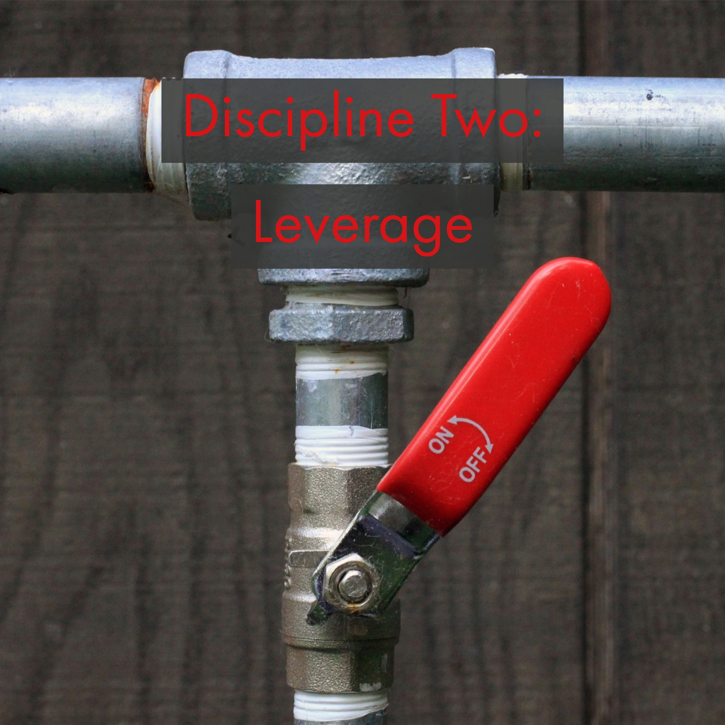
FOCUS
LEVERAGE
ENGAGEMENT
ACCOUNTABILITY
LEVERAGE
Act on the Lead Measures (Strategies)
Moves the needle toward the wildly important goal
High impact ideas
Influenceable by the team
Tests:
Predictive
Measurable
Ownership
Ongoing
Team Game

Slide 41
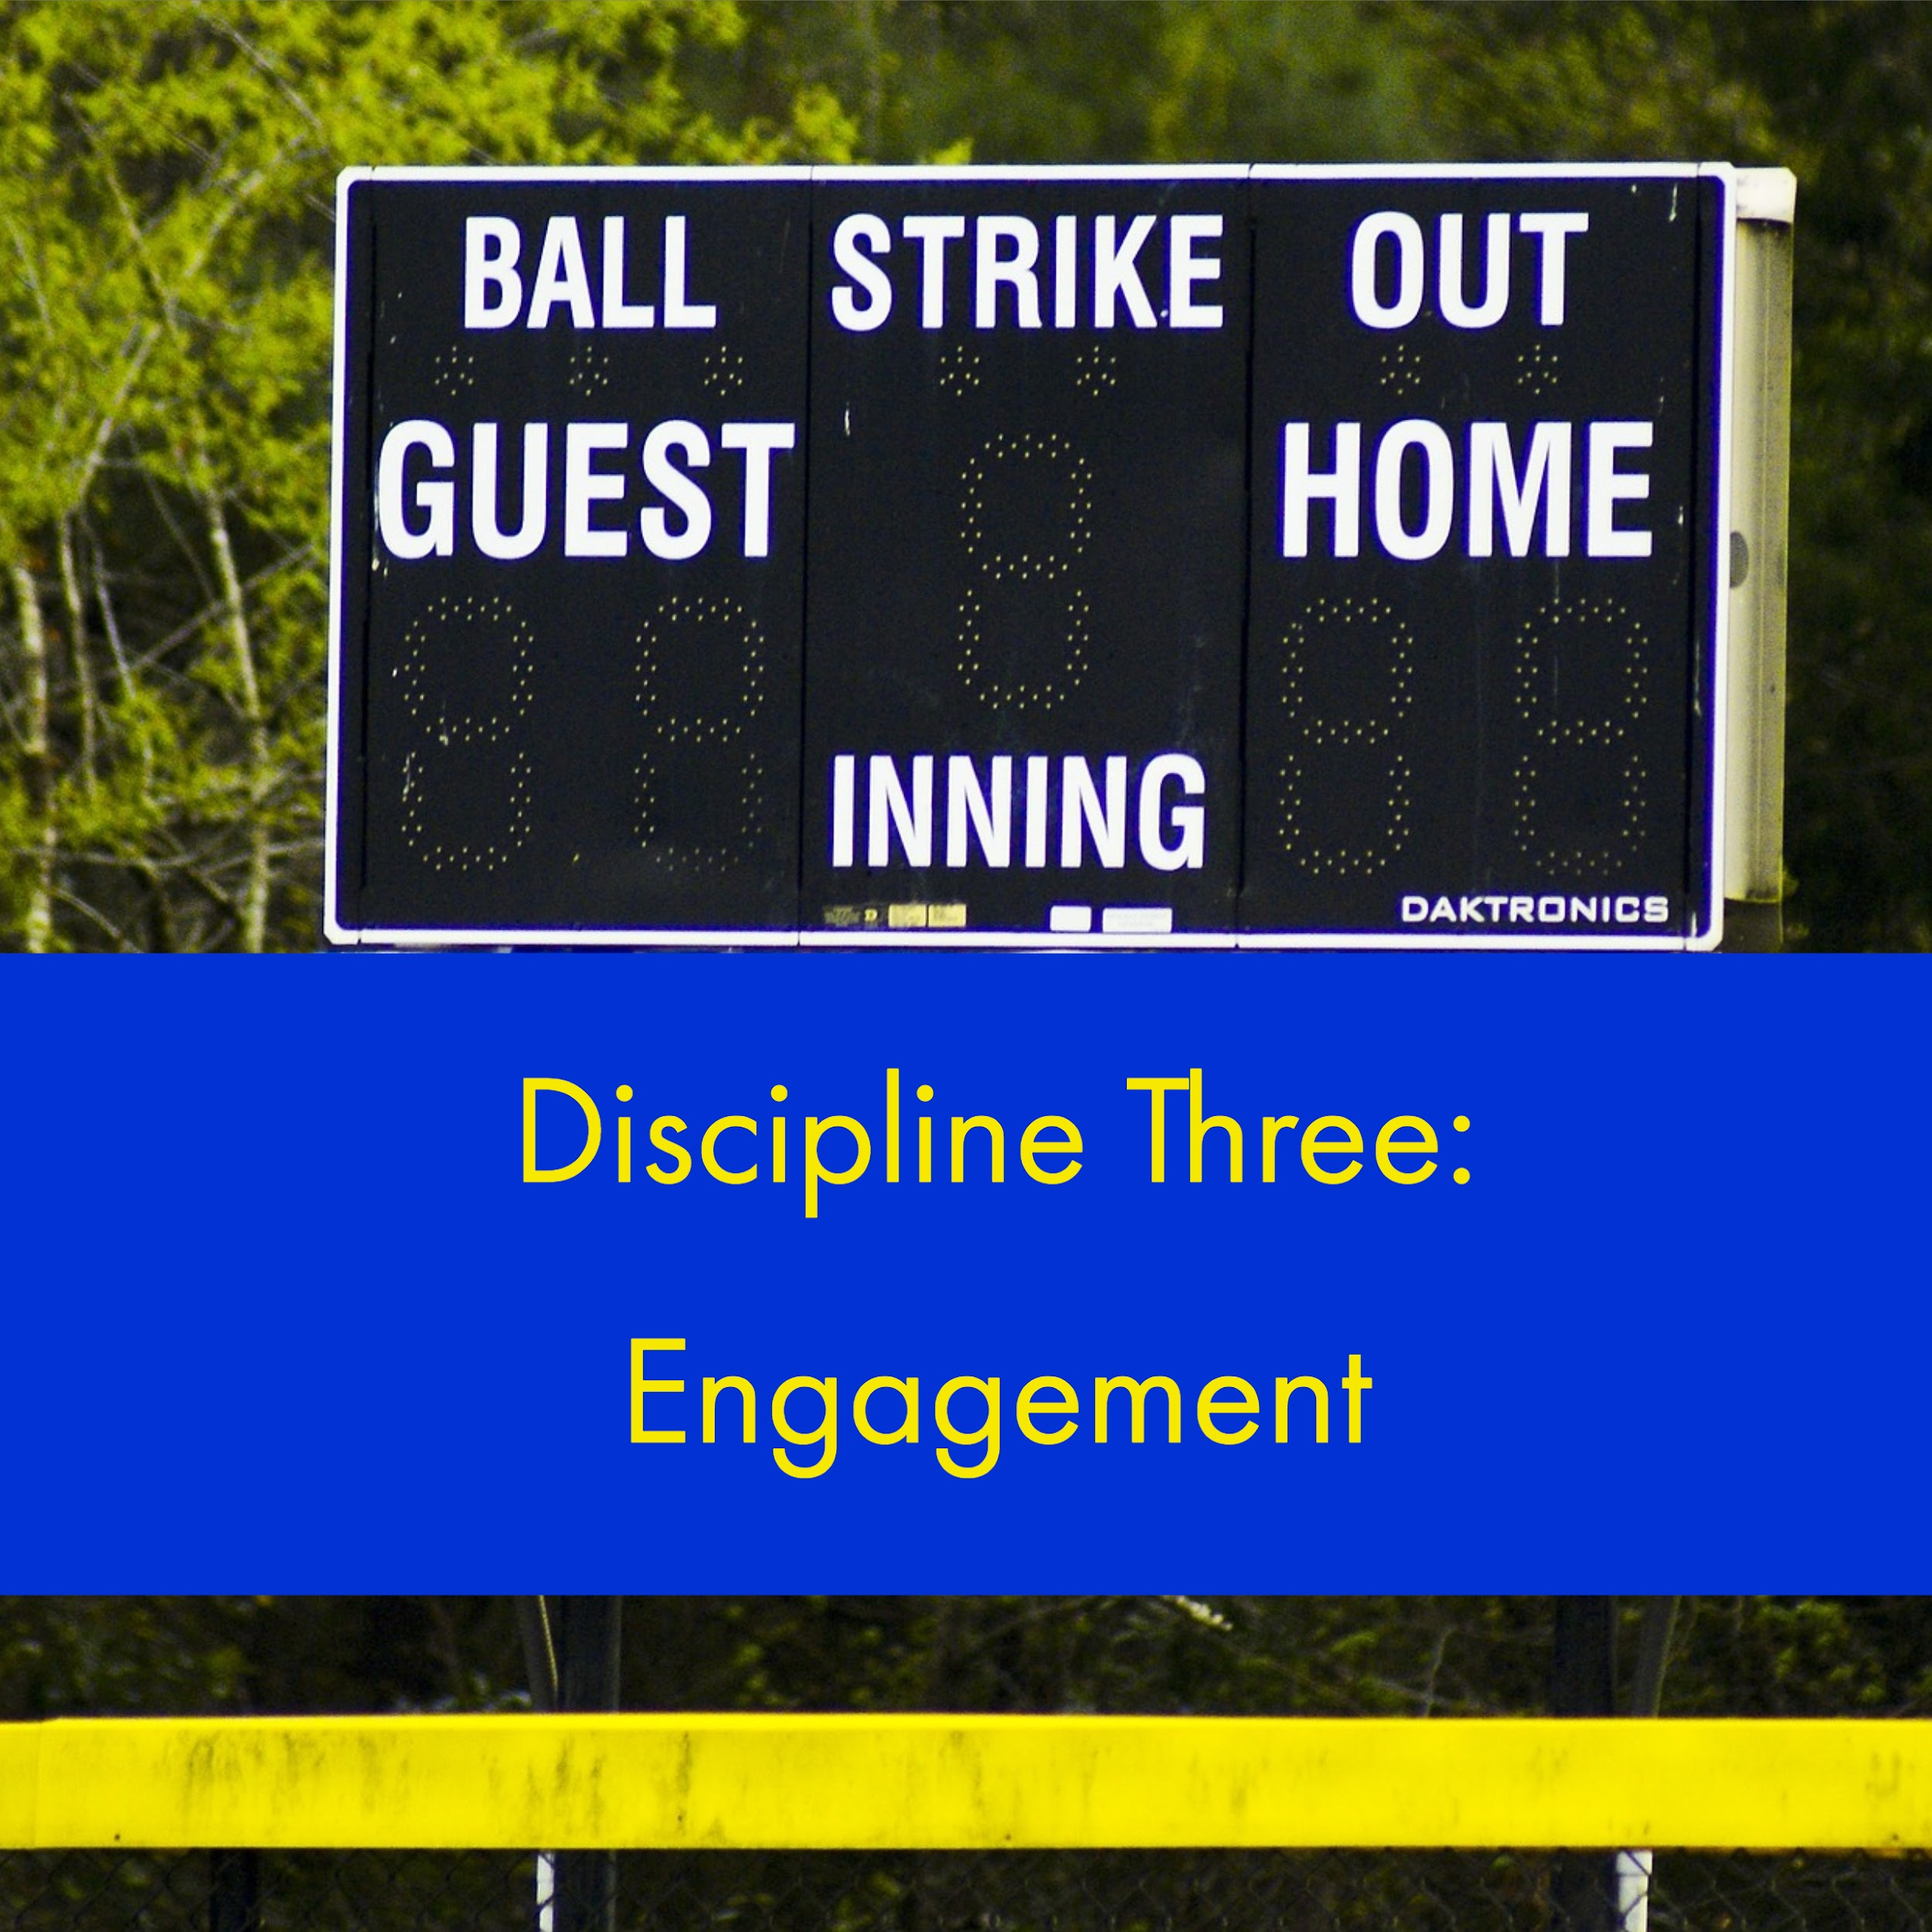
FOCUS
LEVERAGE
ENGAGEMENT
ACCOUNTABILITY
ENGAGEMENT
Keep a Compelling Scoreboard
Stakeholders remain emotionally engaged by knowing the score
Designed by and for the players
Tests:
Visible
Simple
Shows lead and lag measures
Shows if we are winning or losing

Slide 42
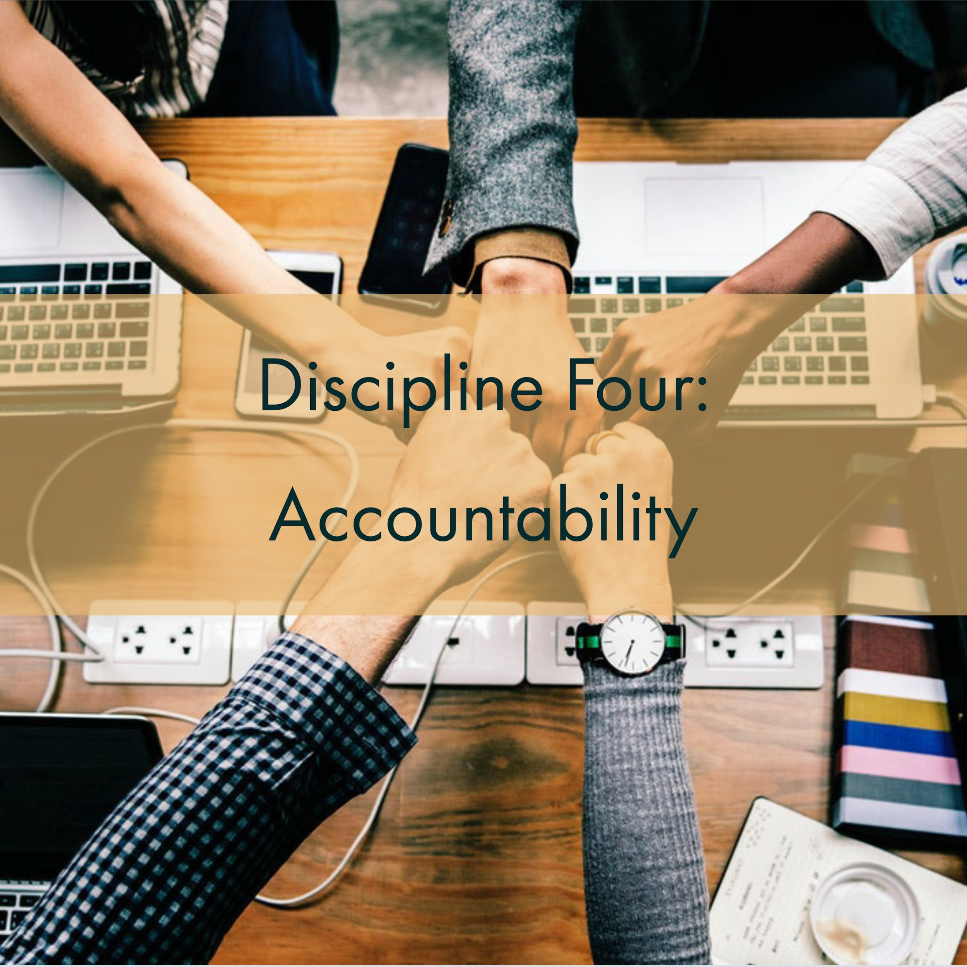
FOCUS
LEVERAGE
ENGAGEMENT
ACCOUNTABILITY
ACCOUNTABILITY
Create a Cadence of Accountability
Weekly commitments made by team
WIG meetings held weekly to report and commit
Tests:
Specific
Aligned
Timely

Slide 43
Define Lead & Lag

Slide 44
Definitions
Lead Strategy = leads you to the result, outcome; leading measure/indicator of success; ‘formative’
Tied to implementation data or impact data
Lag Measure = end result, outcome; they lag behind the work; ‘summative’
Tied to outcome data (impact)
IF
THEN

Slide 45
Definitions
Implementation -
Are you doing the thing you said you would do?
Impact -
Is your data the same along the way? (i.e. reading scores)
Is the data a measure of growth? Performance? Results?

Slide 46
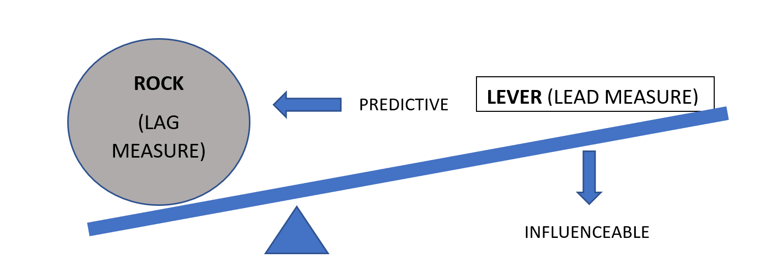
The 2nd Discipline of Execution
Act on Lead Measures (Strategies)
(IDEATE, PROTOTYPE)
From The 4 Disciplines of Execution, McChesney, Covey, Huling 2012
Notes:
Ex. Rock - Astronauts can survive 7 days in space, including walking on the moon (LAG)
Lever - Incrementally, increase length of time in simulated weightless environment (LEAD)

Slide 47
Selecting the Right Lead Measure

Slide 48
Selecting the Right Lead Strategy
‘Good to do’
High Impact Strategy
Strategies that indirectly lead to growth in your goal area.
Positive in nature; will not cause harm.
Could be done at any time...not necessarily a result of your data analysis.
Strategies that can be directly connected to your goal area and its respective data.
Measurable connection
Require planning, prototyping, testing, and evaluation.

Slide 49
Quality Strategies
Safe enough to try (Research Based) vs Evidenced Based
In Redesign, we encourage you to test strategies that are ‘Safe enough to try’. That means you have done research, looked closely at your stakeholders, data, and resources, and determined that testing this strategy would be ‘safe’ and possibly highly impactful.
That does not mean you can try anything. It means you try things that have been researched formally, or informally by your Goal Area Investigation Team, and demonstrate a potential for impact in your setting.
Evidence Based means that the strategy has been validated to be effective through numerous studies. You can learn more about evidence based practices by exploring ‘Wise Ways’, ‘What Works Clearinghouse’ or other academic research bases.

Slide 50
What’s meant by ‘safe enough to try’?
Clear purpose for the strategy
Direct connect to a ‘problem’ made evident through data analysis.
Supported by educational research
Benefits, possibilities, and downfalls have been identified
Clear prototype, or plan exists for the strategy
Data, expertise, resources or advice will be available to support the decision making process
It is measurable!
Notes:
Safe enough to try (Research Based) vs Evidenced Based
In Redesign, we encourage you to test strategies that are ‘Safe enough to try’. That means you have done research, looked closely at your stakeholders, data, and resources, and determined that testing this strategy would be ‘safe’ and possibly highly impactful.
That does not mean you can try anything. It means you try things that have been researched formally, or informally by your Goal Area Investigation Team, and demonstrate a potential for impact in your setting.
Evidence Based means that the strategy has been validated to be effective through numerous studies. You can learn more about evidence based practices by exploring ‘Wise Ways’, ‘What Works Clearinghouse’ or other academic research bases.
When you can use a promising practice, and collect your own action research on it.
Clear purpose for the strategy. What are the issues and who is being affected by the decision?
Does current educational research support this? If not, why not? Has the investigation team had time to thoroughly investigate the possibilities, benefits, and downfalls?
Clear prototype, or plan. What is being tried? How often? How long?
Exactly what data, expertise, resources or advice will be needed to make a decision?
How will you know that the strategy has the possibility of positively impacting student outcomes?

Slide 51
Getting Started- Examples
(More Examples)

Slide 52
Role of Baseline Data
In order to measure progress, you must have a starting line, or ‘baseline data’.
Sometimes, the data we want to move by employing a strategy doesn’t exist! However, oftentimes, we do have data related to our strategies that we can use as a foundational starting point for gauging progress.
Ask:
What baseline data might we have for that?
What data might we want to move by using this strategy?

Slide 53
Lead and Lag within a System
Implementation & Impact
Lead- Teachers using the advisory time lessons
Lag- Student completion of IPS
Lead- Student completion of IPS
Lag- Star Recognition for IPS
Lag- Post-Secondary Success Rate is 5% above predicted
SCHOOL
SYSTEM

Slide 54
High School Example
In this example, we have two lead/lag examples.
In the first, they measure completion of weekly BRAGG Conferences.
This leads to IPS Benchmark Completion (lag).
In the next example, they measure scheduling conferences.
This leads to attendance (lag).

Slide 55
Lead & Lag within a System
Impact Only
Lead = student scores on formative assessments (Lexia)
Lag = student performance on interim assessments
Lead = student performance on interim assessments
Lag = student performance on summative assessments (KAP)
SCHOOL
SYSTEM

Slide 56
Elementary Example
In this school, they are tracking three things:
Social Emotional Learning-
Did teachers complete the lessons? (lead)
Are students staying ‘green’ throughout the day? (lag)
Reading-
Are students advancing along: Mobymax & AR? (lead)
Are kids meeting benchmarks? (lag)
Math-
For each grade, how well are students scoring on the introductory & end of chapter exams? (pre/post)

Slide 57
Practice- Keeping Score

Slide 58
The 3rd Discipline of Execution
Keep a Compelling (and Public) Scoreboard
(TEST)
-People play differently when keeping score
-Create a Player’s scoreboard, not a Coach’s
Is it simple?
Can I see it easily?
Does it show both lead and lag measures?
Can I tell at a glance if I’m winning?
Notes:
Ex. Track the length of time astronauts can function in a simulated weightless environment

Slide 59
Tips for determining what to measure
For Lag, ask...
For Lead, ask...
What outcome data do I ultimately want to move?
What is the greatest need my data is highlighting?
What high impact strategy will lead me to the impact I am seeking?
How do you know?
For measurement, start by asking:
What is the simplest piece of data I could collect?
If we used that in discussion, what other questions would I have?
What data steps could I take to answer the questions?

Slide 60
Example
Lag- Increase time on task & decrease behavior referrals
Lead Strategy- Movement Hallway
Lead Measure- __?__
What is the simplest thing I could measure?
# of times kids use the hallway
If we reviewed that data what questions might we ask:
How was their behavior before/after?
Why are some kids using it more than others?
Is it helping?
__?__
What additions/adjustments could I make to my simple scoreboard to answer some of these questions?

Slide 61
Considerations for Scoreboards
Quality Criteria
Getting Started
Is it easy to understand?
Can it be seen easily by the team? Who is the audience?
Does it show data related to the effectiveness of the strategy?
Is it easy to update?
Choose a theme: Trend lines, Bar chart, Speedometer, Andon (colored signals or lights showing progress, ex. stoplight), etc…
Design your scoreboard
Build it
Keep it updated

Slide 62
Prototype a Scoreboard for One of Your Strategies

Slide 63
Why start this habit?
“Execution doesn’t like complexity. The two best friends of execution are simplicity and transparency.” ~ Chris McChesney
The lag and lead measures won’t have much meaning to the team unless they can see the progress in real time.
Bowling through a curtain is not that much fun.
Discipline 3 is the discipline of engagement.
People perform best when they are emotionally engaged, and the highest level of engagement comes when people know the score: whether they are winning or losing the game. It’s that simple.
https://www.franklincovey.com/the-4-disciplines/discipline-3-scoreboard/

Slide 64
LUNCH

Slide 65
Selecting Strategies Part 1- Ensuring Alignment
Selecting Strategies Part 2- Prioritizing for Impact
4 Disciplines of Execution- What does it mean to keep score?
Leadership & Culture
Turnkey Planning & Closing

Slide 66
Leadership Focus- Principals
Coach those you lead: Give Constructive Feedback
Maintain Accountability Meetings
Focus on the needs of the receiver
Be specific with descriptive facts
Tough on the performance (data)
Focus on the future and suggest positive alternatives
(McBride, 2019)
Ensure staff have time to hold weekly accountability meetings within their Goal Area Investigation Teams.
Provide technical support to teams when called upon.
Assist in facilitating tough conversations.
Notes:
KLC Guidebook, by Julia Fabris McBride, Kansas Leadership Center, 2020
Criticism:
A way of unloading anger or disappointment
Focused on the needs of the giver
Angry, dismissive, emotional
Ignore positive
Tough on the person
Vague, generalized, evaluative
Attributes opinions to others
Looks backward; laments missed opportunities
One-way pronouncements

Slide 67
Leadership Focus- Teachers
Giving and Receiving Constructive Feedback
Analyzing Data in Objective Conversations
Focus on the needs of the receiver
Be specific with descriptive facts
Tough on the performance (data)
Focus on the future and suggest positive alternatives
(McBride, 2019)
Focus on the facts and not the feelings
Establish and stick to conversation outcomes
Ex- Strategies are evaluated to determine if they should be continued, revised, or stopped.
Notes:
KLC Guidebook, by Julia Fabris McBride, Kansas Leadership Center, 2020
Criticism:
A way of unloading anger or disappointment
Focused on the needs of the giver
Angry, dismissive, emotional
Ignore positive
Tough on the person
Vague, generalized, evaluative
Attributes opinions to others
Looks backward; laments missed opportunities
One-way pronouncements

Slide 68
Conditions for a Learning Culture
Sh
Principals
Model Learning Leadership
Motivate Teachers
Support Inquiry, Innovation, and Exploration
Shared Leadership
Shared Leadership
-Shared Vision
-Psychological Safety
-Communication & Feedback
-Growth Mindset
Teachers
Collective Efficacy
Change Agents
Collegial Collaboration and Practices
Additional Stakeholders
Input in Goals and Strategies
Communicate about and Invest in the Work
Shared Leadership

Slide 69
Selecting Strategies Part 1- Ensuring Alignment
Selecting Strategies Part 2- Prioritizing for Impact
4 Disciplines of Execution- What does it mean to keep score?
Leadership & Culture
Turnkey Planning & Closing

Slide 70
Turnkey & School Planning Time
Redesign Blueprint
Blueprint/Overview
Goal Areas & Target Areas
Lag & Lead Measures
Establish Scoreboards
Gap Analysis
Begin Action Planning
Assign Roles & Responsibilities
Bring Baseline Data to Meeting 2
Feedback & Communication
Communication Plan
Business/Community Engagement Plan
WHY
WHAT
Turnkey Considerations
HOW

Slide 71
Share your commitments between now and the next Training.
Each school will share out loud.
Notes:
Note- This is like an ‘accountability meeting’. Reporting on last time’s commitments, giving a status update based on data (i.e. checklist), and talking about what’s next...that’s discipline 4 ‘create a cadence of accountability’!

Slide 72
SURVEY
Please take the survey at the end of each training. Your feedback is incredibly valuable.

Slide 73
Follow us on Twitter
@KSDEredesign
#kstothemoon

Slide 74
Site Visits & Connections
KSDE Redesign Webpage- Videos Tab
Redesign Google Site- School Models Tab

