Slide 1
Kansas Leads the World in the Success of Each Student
Dr. Randy Watson, Kansas Commissioner of Education

Slide 2
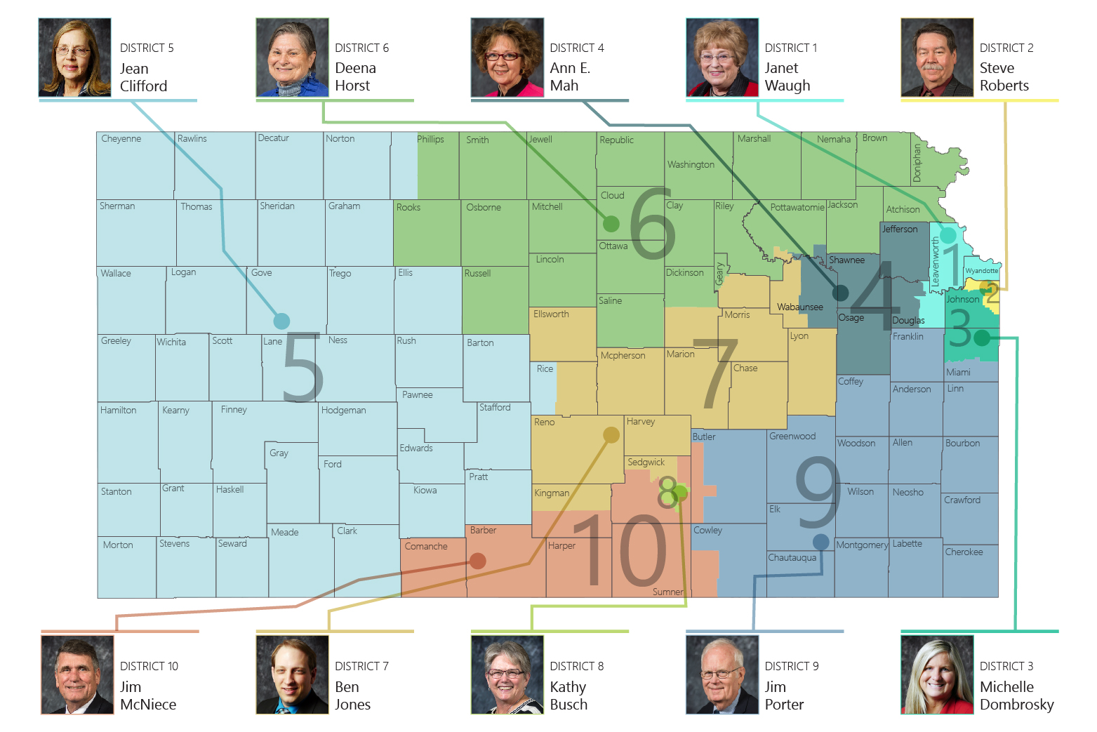

Slide 3
Our Vision for Kansas ...
Kansas leads the world in the success of each student
KANSAS STATE DEPARTMENT OF EDUCATION | www.ksde.org

Slide 5
Do you agree?
The best thing about being a teacher is that it matters…really matters.
The hardest thing about being a teacher is that it matters every day, especially to the students who need us the most.

Slide 6
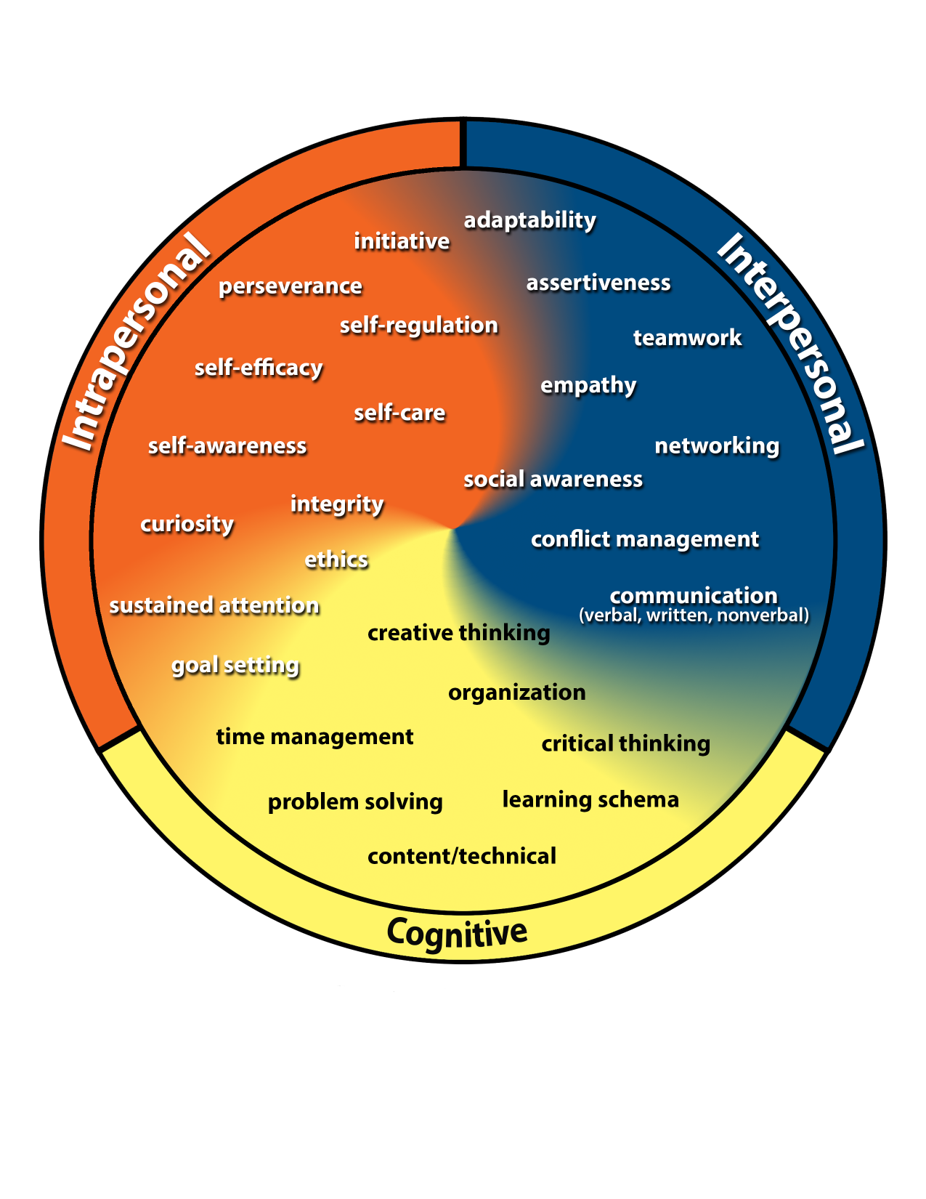
Kansans Can Competencies
Go to www.menti.com
Type 89 27 57

Slide 7
Notes:
LiveSlide Site
https://www.mentimeter.com/s/562bd6c5da2fbe2d4d2dfe4005e6a92f/450fbc50b8e1/edit

Slide 8
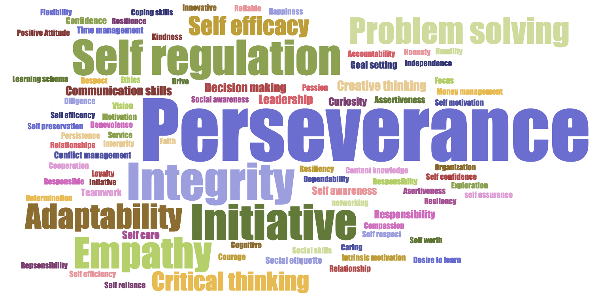
Kansans said…

Slide 9
Highest Need Competencies Identified by Over 7,300 Kansas Students
Overall Rank by Highest Need | Males | Females | 6th Grade | 9th Grade | 12th Grade
Sustained Attention Self-Regulation | Sustained Attention Self-Regulation | Sustained Attention Self-Regulation | Sustained Attention Self-Regulation | Sustained Attention Self-Regulation | Sustained Attention Self-Regulation
Initiative | Initiative | Assertiveness | Initiative | Initiative | Assertiveness
Assertiveness | Conflict Management | Initiative | Conflict Management | Assertiveness | Communication Networking
Self-Efficacy Goal Setting | Communication | Conflict Management | Assertiveness | Communication | Conflict Management
Conflict Management | Assertiveness | Self-Efficacy | Goal Setting | Conflict Management | Self-Efficacy Goal Setting

Slide 10
Kansas School Redesign Principles
Student Success Skills | Family, Business, and Community Partnerships
There is an integrated approach to develop student social-emotional learning. | Partnerships are based on mutually beneficial relationships and collaboration.
Personalized Learning | Real World Application
Teachers support students to have choice over their time, place, pace and path. | Project-based learning, internships, and civic engagement makes learning relevant.

Slide 12
Notes:
Today’s students are the future workforce and future leaders of Kansas. Kansans Can achieve anything and, together, Kansans Can lead the world in the success of each student.

