Slide 1
Graduation
ABC’s of Dropping Out

Slide 2
Who we are…
Branden Johnson
Assistant Director at KSDE
AVID Coordinator
Business Teacher
Ed.D. Student with a focus on Chronic Absenteeism and its effect on Grad Rates
4 years Non-Formal Administrative Roles
John Girodat
Education Program Consultant at KSDE
5 years as JH/HS Principal/AP
12 years JH/HS Social Studies teacher

Slide 4
Successful Kansas graduate
Possess the following in order to be successful in postsecondary education, in the attainment of an industry recognized certification or in the workforce…
Academic Preparation
Cognitive Preparation
Technical Skills
Employability Skills
Civic Engagement

Slide 5
Roadmap to graduation
What is it?
Intended audience?
Where are we in the process?

Slide 6
Graduation goal
Goal is 95% by 2030
Last year’s Kindergarteners
Why… because dropping out is a process, not a single event

Slide 7
Notes:
This is the state aggregate… is this what your district or school looks like? Maybe not.

Slide 8
1349 Homeless Students – 454 did NOT graduate

Slide 9
Why is graduating a big deal?
Dropouts are also more likely than their graduating peers to:
Be in prison
Get divorced
Live in poverty
Be unemployed
Have poor health
Utilize public assistance

Slide 10
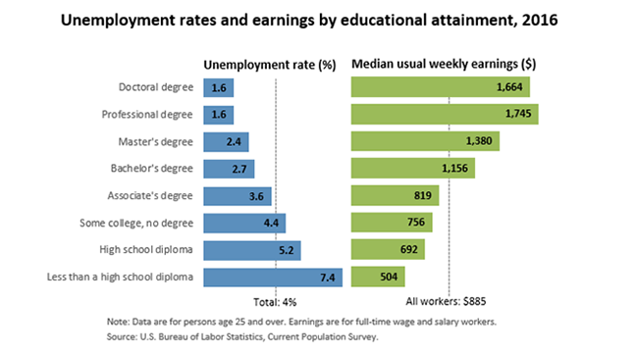
Why is graduating a big deal?

Slide 11
Why is graduating a big deal?
Dropouts aren’t a school or individual problem…
2016-17… 3,500 Kansas dropouts = 19 each school day
Cost society $292,000 in lost earnings, taxes and productivity
Kansas’ 2016-17 dropouts cost us approximately $1Billion!
Notes:
Beyond the economic impact on society, what are the other implications? These are your fellow Kansans, these are your neighbors, these are the people that will be looking after us when we are in the home.

Slide 12
Why do student dropout?
Missed too many days of school
Thought GED was easier
Poor/Failing Grades
Did not like school
Could not keep up with schoolwork
National Dropout Prevention Center: http://dropoutprevention.org/resources/statistics/quick-facts/why-students-drop-out/
Notes:
At tables, have groups brainstorm the top 5 reasons that students drop out of school.

Slide 13
Other dropout factors?
Work
Pregnancy
Didn’t feel like they belonged
Suspension/expulsion
Didn’t feel safe
National Dropout Prevention Center: http://dropoutprevention.org/resources/statistics/quick-facts/why-students-drop-out/

Slide 14
Push/pull/fallout factors
Push: school-consequences on attendance, discipline, coursework; bullying; failing grades
Pull: out-of-school enticements such as jobs/families
Fall: Disengagement due to lack of interest, lack of relationships or no sense of belonging, lack of progress

Slide 15
Abc’s of dropping out
Attendance – Unexcused & Excused = Chronic Absenteeism
Behavior – OSS, ISS, Detentions, ODR, Citizenship Grades
Coursework – Behind in 3rd Grade Reading, Math and ELA Failures in MS, Any Course Failure in 9th Grade

Slide 16
Attendance
#1 reason students drop out of school
Each week of absence = 20% decrease in Grad Rate
Why do absences occur?
  Factors that we can’t control, but can influence
  District Policies and Procedures around attendance that we control
Notes:
Board Outcomes speak directly to addressing absences in many ways… Disengagement (IPoS; Grad Rates; Postsecondary); Aversion (SECD; K Readiness)

Slide 17
Things we can’t control, but can influence
Parent Stressors
Transportation
Neighborhood Safety
Chronic Illness
Sibling Effect
Parental Misunderstandings
  Early Grades aren’t as important
  Students will catch up
  Only consecutive absences matter
  Absences are o.k. as long as the parents sign-off
  Attendance is about legal compliance
BLAME

Slide 18
Things we can directly control
District Policies in place for daily attendance?
Set District procedures in place for daily attendance?
  When teachers take attendance, do they change attendance when a student comes in after its been submitted?
  Who is in charge of contacting teachers when attendance hasn’t been taken?
  What is considered Present? Absent?
Transitions – 5th to 6th (or 6-7); 8th to 9th

Slide 19
Attendance
Essential to track attendance accurately and consistently
What does it mean to be absent?
  Missing a “significant part of the school day” (72-1113-c-2)
  Federal definition of a “significant part of the school day” is 50%
  Need to account for attendance to the minute

Slide 20
Attendance
Average Daily Attendance (ADA) – how many students are attending school
Chronic Absenteeism (students missing 10% or more of school excused or unexcused) – which students are missing school
  10% of possible days… not 10% of 180

Slide 21
ADA vs. chronic Absenteeism
Notes:
ADA – tells us how many students were at school
CA – tells us which students weren’t at school

Slide 22
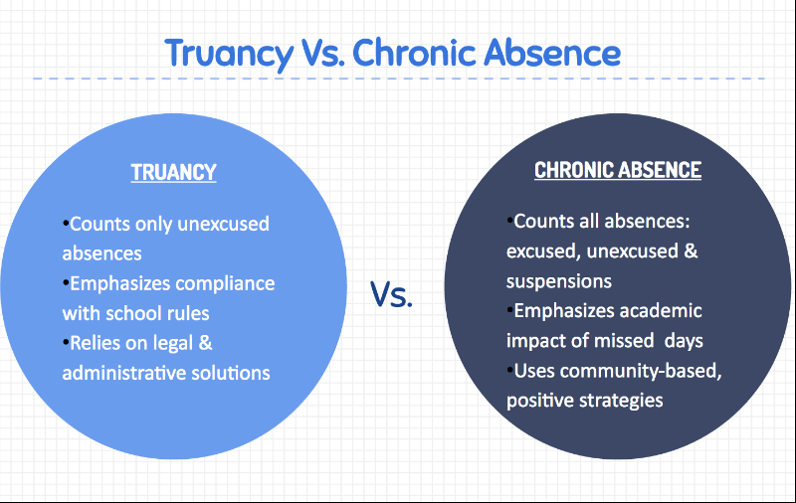
attendance

Slide 23
behavior
Office Discipline Referrals
Detentions
In School Suspensions
Out of School Suspensions
Citizenship Grades
Expulsions
Social Emotional Character Development

Slide 24
Behavior
This can be difficult to generalize across the nation, state, or even district
Having consistent data reporting and consequences can help identify patterns

Slide 25
behavior
Office Discipline Referrals (ODR) – 3+ in a month
Detention – 4+ in a month
ISS – 2+ in a month
OSS – 2+ days in a month
ECI – Restraint and Seclusion
Others?

Slide 26
coursework
Failing any core course in 9th Grade
1 F = 20% decrease in Grad Rate
Appropriate Classes and Supports for students to be successful

Slide 27
Process for addressing the abc’s
Form a team
Look at your data/indicators
Identify your interventions
Implement, Monitor, Adjust, Repeat
Re-evaluate your process annually

Slide 28
1. Student assistance teams (SAT or SIT)
Principal, or AP
Teachers
Counselors
Social Worker
Nurse
Foster Services Liaison
Child Welfare/Juvenile Justice
Attendance Secretary/Clerk
Mentor Program Coordinator
Parent/Family Liaison
Any other caring adult that might add something to the team
Adopt a team approach to looking at data and interventions
MUST HAVE A REGULAR MEETING TIME AND PLACE – HOLD THAT TIME SACRED!
Notes:
Ask tables to brainstorm who you might want on your SAT/SIT team?

Slide 29
2. Analyze data / indicators
What does the data tell us about which students are at-risk of dropping out?
Which attendance indicators, behavior indicators, and coursework indicators are “predictive” of students dropping out?
You can use research data, but if you can find patterns in your own data it is more powerful

Slide 30
3. Interventions
  What do we have?
  What do we need?
  Systems: Focusing on individual solutions will wear you out… what groups would benefit from the same interventions?
  Individual interventions for those students that haven’t responded to group interventions, or are of critical need

Slide 31
4. Implement, monitor, adjust, repeat
Identify early and start interventions
What are the goals of the intervention, who is making sure intervention is implemented with fidelity, who is responsible for providing support, is the student responding to the intervention, how do we know if we met the goal, when do we move on to another intervention

Slide 32
5. Re-evaluate process annually
We must reflect on the process
Are our indicators identifying the right students? Too many? Not enough?
Do we have the interventions that we need?
Are we implementing our interventions with fidelity?
Are we responsive enough within our framework to respond to student needs?

Slide 33
Resources
KSDE Graduation Page
Attendance Works
America’s Promise Alliance
National Dropout Prevention Network
Center on School Turnaround
KSDE TASN

Slide 34

Contact us
Branden Johnson, Assistant Director
KSDE, CSAS – Graduation
785-296-8447
bjohnson@ksde.org
John Girodat, Education Program Consultant
KSDE, CSAS – Graduation, Virtual/Charter
785-296-3444
jgirodat@ksde.org

