Slide 1
Summary of Gap Causes and Where the Most Prominent Gaps Are in Kansas
Tony Moss
Researcher / Data Analyst
Kansas State Dept. of Education
Gap Workgroup Meeting
KSDE, 24 Sept 2014

Slide 2
In our first meeting, we reviewed research and data which confirmed that:
Gaps are leading indicators of the health and competitiveness of a society. The smaller the gaps, the healthier and more economically competitive the society. The rapid growth in the proportion of working and single mothers is a global phenomenon, but countries that have high-quality Early Education and Child Care (EECC), have reduced the gaps associated with poverty and single-parenthood.
Health and academic gaps, because of developmental sensitivities, originate in early child development and social interactions. Once the architecture of developing brains and biological systems is shaped, gradients in health and achievement persist. Plasticity is limited.
Notes:
1. Early child and brain development can affect physical and mental health, learning, and behavior for life. They can also have intergenerational effects.
2. The quality of early childhood, in language immersion, responsive care, play, bonding and attachment, experience, nutrition, and health, predicts the quality of a country’s future population and to a significant degree, a country’s future health, competence, and prosperity.
3. If we want to reduce health and academic gaps, we need to reduce the stresses of maternal and child poverty and improve the quality of parenting, and of early childcare and education.
4. The higher the quality of social interactions, especially the responsiveness of primary caregivers in the early years, the more likely child outcomes will be positive.
5. While the up-front costs of high-quality childcare seem expensive, the savings and social improvements are much, much greater.
6. In an age when the ingenuity of a population is a critical factor in economic competitiveness, effective investments in early childhood investment are a crucial economic development necessity. Future prosperity depends on effective investments in human development, especially early development, now.
7. By making environments as developmentally smart as possible, we can improve the growth trajectories of many, maybe most, children.
8. To monitor progress in reducing gaps, we need to monitor the social, and the contextual measures that shape long-term growth.

Slide 3
The brain is sculpted by experience, especially so from birth through age 5. This foundational architecture shapes some capacities for life.
Notes:
Development is a dynamic process between each individual and the environment in which:
Experiences, especially early social experiences and family environments, shape genetic expression and biological architecture, especially of the brain;
Social, emotional, cognitive, and linguistic competencies are interdependent—optimum growth depends on them all;
Skills are mastered hierarchically so that later attainments are built upon previous ones; and
Growth is sometimes dependent on the right interactions at the right time (critical and sensitive periods).

Slide 4
Review continued:
Sub-optimal architecture increases the probability of lower academic performance, heart disease, diabetes, mental illnesses, and criminal behaviors.
As income and wealth gaps have increased over the last three decades, the upper classes are investing more in their children, increasing academic gaps by 30 to 60 percent.
Social and Economic Status (SES) has become a much stronger predictor of gaps than ethnicity or race. Lower SES is disproportionately greater among African-Americans and Hispanics.
Notes:
We are going to talk about the high, lifetime costs of damaged developmental trajectories later.
In the gap trends, we’ve all seen how the higher income children, on average, move up and the lower income children do, too, but the gaps generally remain pretty similar from year to year. A partial explanation is, that as income inequality grows, competition between individuals and families grows.

Slide 5
The 3 most important early factors for a child’s future academic success are:
Rich language & intellectual stimulation and reciprocity
Warm, positive bonding & attachment & emotional reciprocity
Normal, not chronically stressful or neglectful, social environments
Notes:
The quality of parenting accounts for about one-third of the health and education gaps between rich and poor children.
Richard Reeves and Kimberly Howard, 2013, The Parenting Gap.
Show the Thirty Million Words video? http://tmw.org/tmw-initiative/

Slide 6
Where are the biggest gaps and what solutions might be tested there?
Which ten Kansas districts have the greatest numbers of Hispanics, African-American, and lower SES students?
How well are these 3 overlapping groups performing academically?
Do the descriptive facts of these districts and schools fit with our causal hypotheses? In Kansas, is poverty a stronger predictor of lower academic results than ethnicity?

Slide 7
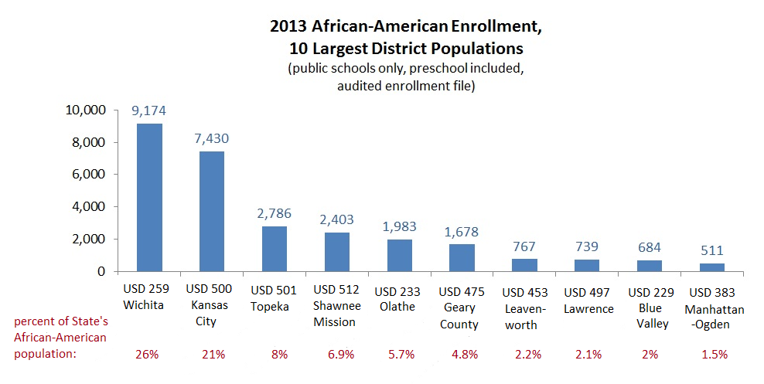
Where are the greatest numbers of each of the 3 groups?
Notes:
Wichita has about 26% of all the African Am students in the state; Kansas City about 21%; Topeka about 8%. African-Americans are more concentrated in urban areas than Hispanics and Whites.
More than 80 percent of all the African Americans in Kansas live in these 10 districts.
“Double segregation” segregation by both ethnicity and poverty. See Gary Orfield’s work.

Slide 8
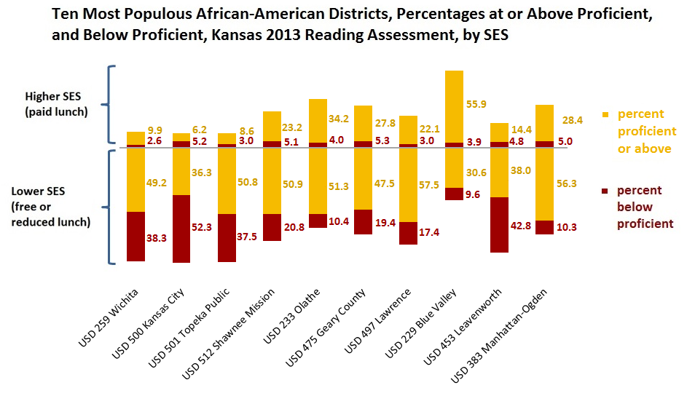
How well do African-American students do on state reading assessments in these 10 districts?
Notes:
In these 10 districts, if a student is African American and middle class, the odds are about 5.5 to 1 that the student will be proficient. If one is African American and lower income, the odds are only 1.8 to one, that’s less than half of the middle class odds, that the student will be proficient or above.

Slide 9
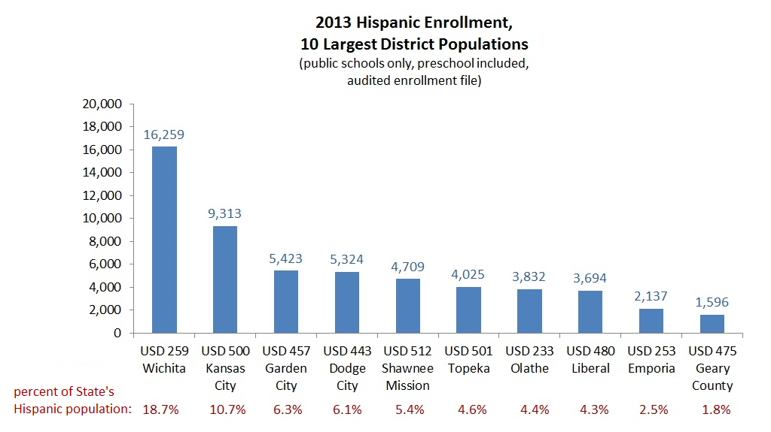
Where are the greatest numbers of Hispanic students?
Notes:
Wichita has about 18 % of the State’s Hispanic students; Kansas City a little less than 11 %; Dodge about 6 %.
About 65 % of all Kansas Hispanic students attend these 10 districts—less concentrated than the African-Americans, but still highly concentrated, especially in Wichita and Kansas City.

Slide 10
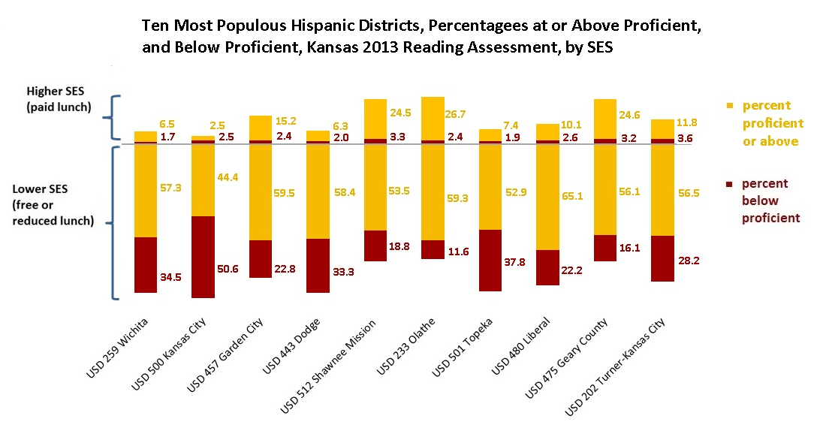
How well do Hispanic students do on state reading assessments in their 10 most populous districts?
Notes:
Notice how comparatively few of the Hispanic students in these districts are middle income.

Slide 11
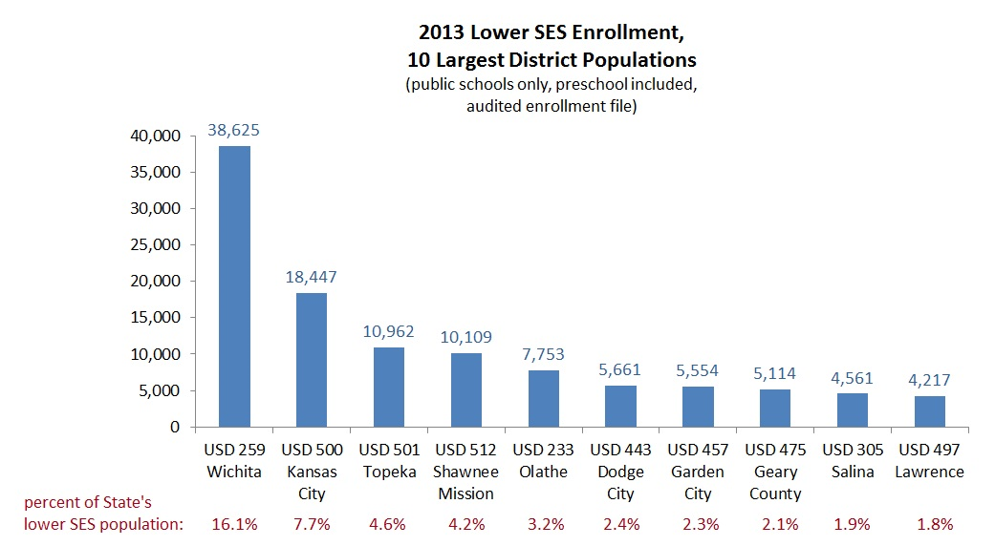
Where are the greatest numbers of lower social & economic status students?
Notes:
So 46.2 percent of Kansas’ lower income students attend these ten districts.

Slide 12
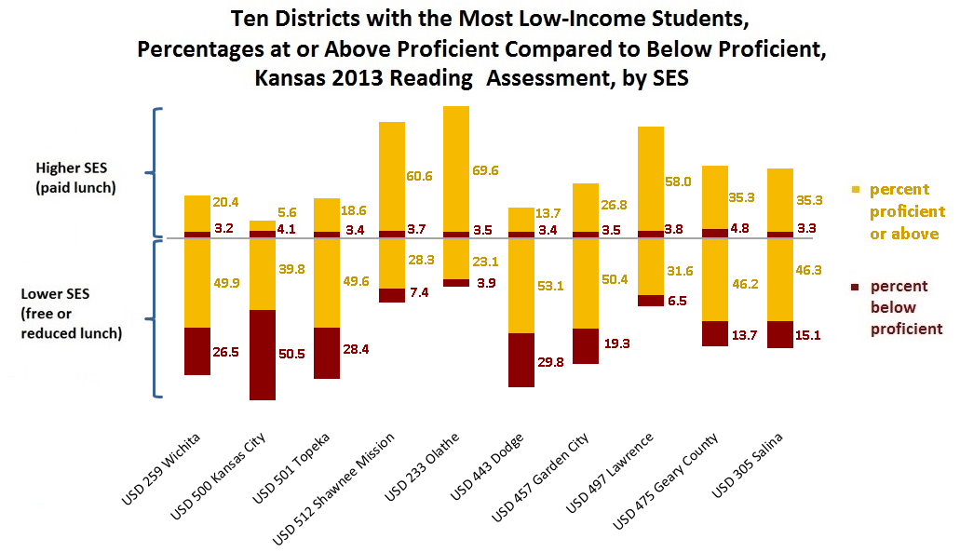
How do the ethnic groups’ relative risks compare to those of lower-income students? Is the pattern the same?
Notes:
Yes. In general, for African Americans, Hispanics, and All Students, the proportions of free and reduced lunch students who are scoring below proficient are much higher than the proportions among higher SES students. This fits with the national data I showed you in my first presentation that showed that class had surpassed race as a predictor of academic achievement.

Slide 14
In Kansas, is lower SES a stronger predictor of academic achievement than ethnicity?
Dependent or Predicted Variable : Cumulative Academic Percentile Rank Based on Available State Assessments
school-level predictors: | environment (urban, suburban, town, rural)
 | size of school (by percentile)
 | local poverty (percent of students receiving free or reduced lunch)
 | percent of student body that is African-American
 | percent of student body that is Hispanic
 | percent of student body classified as English Language Learners
 | percent of student body that are Students with Disabilities
student-level predictors: | current poverty: Is the student classified as free or reduced lunch this year?
 | cumulative poverty: the number of years the student has received free or reduced lunch
 | gender
 | cumulative times the student has been declared with a disability
 | cumulative times the student has been declared an English Language Learner
 | mean rate of absence, all available years
 | number of times student changed schools, current year
 | cumulative times the student has been declared truant
 | the students ethnicity or race (African-American, Hispanic, White, Other)

Slide 15
What variables were significant predictors of students’ average academic growth? (same predictors, reading and math combined)
Notes:
Why Hispanic shows up as a predictor of lower growth, we can’t be sure. We may be missing some variables or there may be something about being Hispanic in Kansas that predicts lower academic growth.
I used was it called a mixed or hierarchical model so that school-level effects could be separated from individual-level influences. We see that poverty shows up as a very strong predictor at both the school level—the percentage of students receiving free or reduced lunch—and at the individual level—the cumulative times that a student has qualified for free or reduced lunch.

Slide 16
If we know that poverty is having a stronger effect than race, our targeting ought to include poverty.
Number of
Below proficient,
Lower-Income
Students

Slide 17
By this targeting criteria, half of the identified African-American and Hispanic districts match, including 3 of the largest.
Number of
Below proficient,
Lower-Income
Students

Slide 18
If we select the districts with the largest numbers of below proficient and low-income students, regardless of race, we get these districts:
Number of
Below proficient,
Lower-Income
Students
Notes:
Notice what happens to the proportions when White and other ethnicities are added: they go way down. That’s because the greatest number of low-income and below proficient students are White, but they are much more evenly distributed around the state, while the African-American and Hispanic students are much more concentrated in a few larger districts.

Slide 19
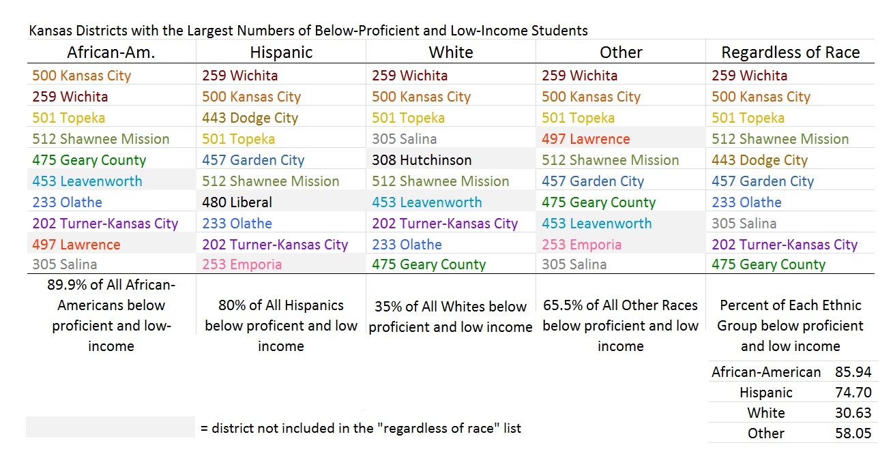
Overlap of Kansas Districts with the Largest Numbers of Below-Proficient & Low-Income Students by Ethnic Group

