Slide 1
According to Kansans, what skills should the ideally-educated youth have? An analysis of community and business focus-group responses.
Tony Moss
Research and Evaluation Workgroup
Kansas State Department of Education
3 Sept 2015

Slide 2
What do we want to know? (research questions)
What skills do Kansans expect their schools—both K-12 and higher ed—to cultivate in young adults?
How do the views of educators, community members, and Kansas employers agree and differ on these skill-goals?
How can these sectors better collaborate to reach these goals?
What are the best measures of progress as we move toward these goals?

Slide 3
We asked Kansans in 20 communities around the State:
What are the characteristics, qualities, abilities, and skills of a successful 24-year old Kansan?
In the first set of 20 community consultations, 287 focus groups, with an average of 6 people each, answered this and two other questions.
Notes:
And we asked how schools should cultivate those ideal characteristics.

Slide 4
Respondents' Occupational Roles
 | number | %
students | 99 | 5.9
parents | 95 | 5.6
education administrators | 199 | 11.8
school board members | 95 | 5.6
higher education professional | 110 | 6.5
business professional | 7 | 0.4
legislator or public official | 77 | 4.6
community member | 69 | 4.1
press, media professional | 12 | 0.7
educators and para-educators | 852 | 50.6
KSDE staff | 69 | 4.1
 | 1,684 | 100.0

Slide 5
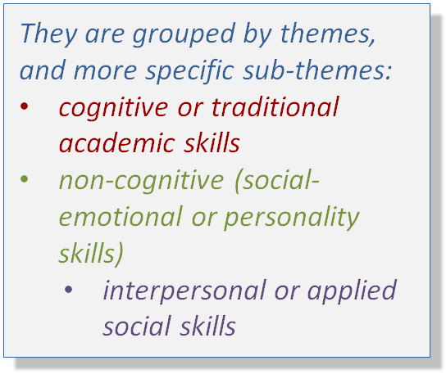
For example, a focus group in Oakley answered:
communication skills
team work
ability to work with all types of people
ability to evaluate and plan
initiative
problem solver
independent thinker
responsible
dependable
reliable
spirituality
strong character
ability to envision their future
literate
respectful
empathy
creative forward thinking
civic responsibility
persistence
determination
adaptable
golden rule

Slide 6
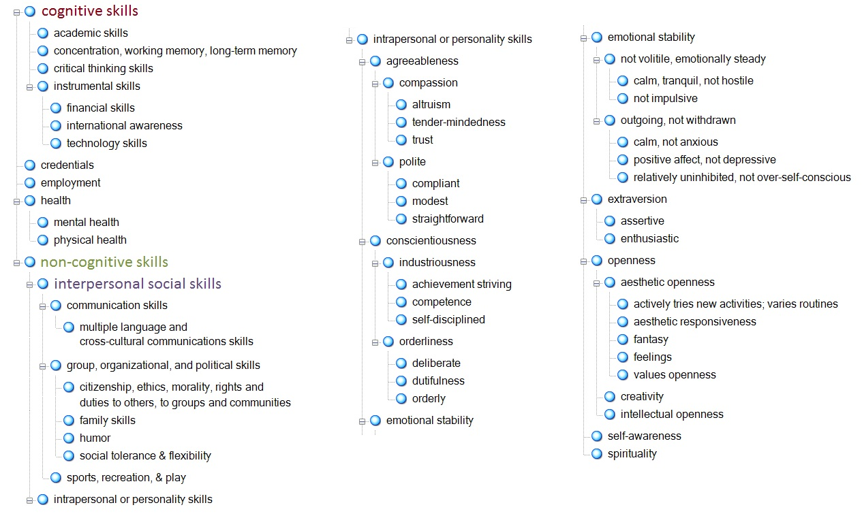
The themes and sub-themes become a conceptual framework:
The number of times different focus groups mention the same themes can be compared. The more frequently different focus groups cite the same themes, the more socially or culturally predominant the theme.
Notes:
Conceptual frameworks can be generated from the themes themselves, or, from established research and theory, when a framework has already been developed.

Slide 7
We are using assumptions like those in The Wisdom of Crowds, that collectively, groups of people, under certain conditions, know more than individual experts, like the “guess the number of jelly beans in the jar” contests.
Notes:
“New Yorker business columnist James Surowiecki explores a deceptively simple idea: Large groups of people are smarter than an elite few, no matter how brilliant–better at solving problems, fostering innovation, coming to wise decisions, even predicting the future.” Any guesses on the number of beans in the jar? 2107

Slide 8
Conceptual frameworks can be generated from the themes themselves, or from established research and theory. We used both methods: validated predictors of career and life success, (the Big 5 personality skills), and themes that emerged from focus groups’ answers.
Conscientiousness
Agreeableness
Emotional Stability or Neuroticism
Openness
Extraversion
Each has subcomponents which we incorporated into the conceptual model.
Notes:
We combined both methods. Labor market economists and institutional psychologists have a well-developed framework of intrapersonal or personality skills called the Big 5. We incorporated the Big 5—conscientiousness, openness, agreeableness, extraversion, and emotional stability—into our framework, and added new themes when focus groups cited characteristics that didn’t fit into the Big 5 model.
It is very important to use known theory and causal models if we decide we want to cultivate these soft skills. Without these links to theory and causes, we could end up just shuffling terms we like and never figure our how to cultivate them.
The other possible theoretical framework is the self-regulation theories associated with Bandura, Zimmerman, with Mischel’s marshmallow test, and Duckworth’s grit. The measures developed within the self-regulation framework have been used to predict academic outcomes and IQ. But they haven’t been used longitudinally to the extent of the Big 5 to predict job, income, and other life outcomes like longevity. The first question—about the ideal characteristics of Kansas youth—is focused on these long-term, large outcome measures, especially employability. Many aspects of the self-regulation framework can fit within the Big 5 framework—for example the goal setting that is part of the self-regulation framework fits with the achievement striving that is a component of conscientiousness; the delayed gratification fits with the self-discipline and the deliberation subcomponent of conscientiousness; time-management within the order component of conscientiousness. But self-regulation does add some things that are missing from the Big 5—for example, the influence of students’ beliefs about their own abilities—think of Dweck’s growth mindset vs. a belief in innate intelligence. We will probably come back to this self-regulation framework when we start considering remedies.

Slide 9
“Validated” means non-academic skills have been shown to predict key outcomes:
For low-skilled work, the return for academic skills is low. For highly skilled work, the return for academic skills is high. But the return for non-academic skills, like conscientiousness, increases constantly across all skill levels.
In addition to predicting higher wages, non-academic skills are also associated with longer lives, lower divorce rates, and higher academic achievement at all levels.
Lindqvist, E. and Westman, R. (2009). The labor market returns to cognitive and noncognitive ability: Evidence from the Swedish enlistment. IFN Working Paper, No. 794.
[academic skills]
[non-academic skills]
Notes:
Another way of saying this is: no matter what your skill level, no matter what the job, non-academic skills matter, while IQ matters little for low-skilled work, but matters a lot more for complex work. For greater clarity, we are using the term “academic skills” instead of “cognitive skills,” and “non-academic skills” instead of “non-cognitive skills.” We use our minds for every skill, so at some level, all skills are cognitive.
The distinctions between “skills” and “knowledge” are similarly confused. Skills and knowledge are not separate, but intertwined, and hierarchically integrated through learning, practice, and experience. See p. 18 of “Education for Life and Work: Developing Transferable Knowledge and Skills in the 21st Century,” 2015, National Academy of Sciences.
For a summary of studies showing the predictive relationship of non-academic skills to academic outcomes, see Poropat, A.E. (2009). A meta-analysis of the five-factor model of personality and academic performance. Psychological bulletin, 135, 322-338. For its association with other life outcomes, see Roberts, B.W. et al (2007, December). The power of personality: The comparative validity of personality traits, socioeconomic status, and cognitive ability for predicting important life outcomes. Perspectives in Psychological Science 2 (4), 33-345.
Heckman and Kautz (2013), “Fostering and measuring skills: Interventions that improve character and congnition,” NBER WORKING PAPER, No. 191656, using a national sample of employers from 1996, found that 69 percent of the employers had rejected applicants because they lacked soft skills—like not missing work, showing up on time, or having a strong work ethic (conscientiousness). Employers rejected less than half as many applicants due to insufficient reading and writing skills.

Slide 10
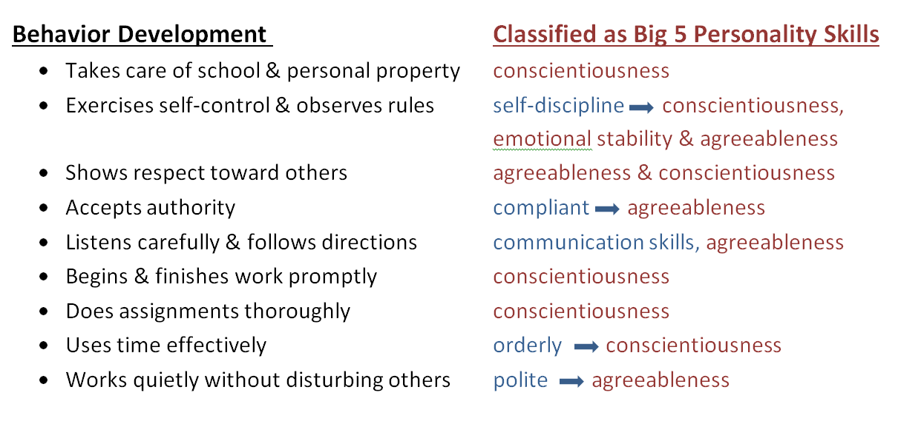
The Big 5 personality skills are a validated and standardized version of the social-emotional skills typically reported on Kansas report cards or lists of employability skills:
Notes:
We’ve always assessed and reported non-academic skills back to parents. I suspect all cultures have children’s stories designed to cultivate social-emotional skills—think of Aesop’s stories, like the Turtle and the Rabbit story about persistence paying off. What’s missing is a systematic identification of what skills are most important for academic, career, and life success. And which are most ripe for cultivation at different points during development. Improving these measures is about optimizing essential skills like persistence, self-control, teamwork, not about high-stakes accountability.
Academics and the testing industry continue to develop a variety of measures that incorporate and emphasize different social-emotional skills that are ingredients to success. Terms are not consistent and tend to vary by discipline. Counselors tend to use social-emotional skills; business people tend to use 21st century skills or employability skills. Reading from different disciplines, one will encounter the terms soft skills, life skills, noncognitive skills, personality traits, character skills, among others. Each has different advantages and disadvantages.
Some of the economists working in this area use the term personality skills. The skills we are talking about evolved in us as responses to the social environments in which we develop. Differing from Freud’s assumption, they are malleable—they change over the life course, generally in response to social environments. [Example, MAOA gene vs. agreeableness]
The economists and the psychologists have probably done the most to standardize these skills—that’s where we get the Big 5—and to test how much they actually contribute to labor-market success, and life successes, like academic achievement, finding a mate, living longer, and staying out of jail. So here we are using the Big 5, their subcomponents, and the term personality skills, and some of the most frequently used terms, like non-cognitive skills, though sometimes we use the other terms interchangeably.

Slide 11
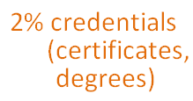
From the first set of focus group responses, what characteristics of success were most frequently cited?
Notes:
This result is a little surprising since about 66% of the respondents were educators, education administrators, or former educators—people who mostly teach, or used to teach, academic skills. Nevertheless, the soft skills—social-emotional, personality skills, or 21st century skills—they have lots of names—were cited 70% of the time.

Slide 12
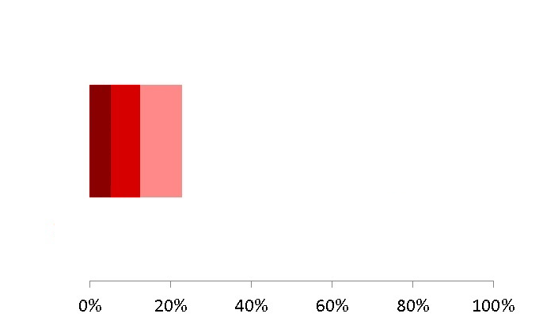
Let’s break those categories down: academic skills first
Notes:
If one of the focus groups described the ideally skilled 24-year-old as “literate,” or “financially literate,” or as having a knowledge set from a traditional subject, like history, those items were counted as academic skills.
If a focus group said the ideally prepared Kansan was an “innovative thinker,” “a critical thinker,” or “a problem solver,” these were counted in the critical thinking skills category.
Anyone who would like to receive an electronic example of how any one of these categories have been coded is welcomed to contact Tony Moss at KSDE and he can send you a file with examples.

Slide 13
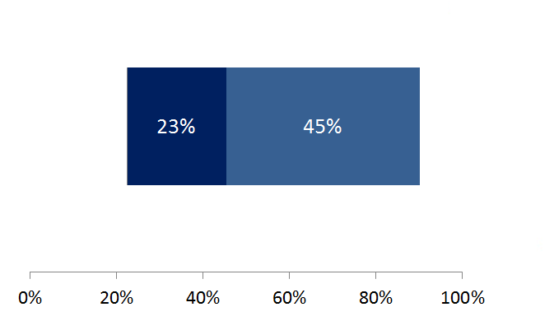
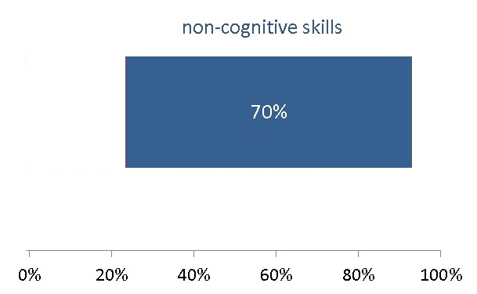
What do non-academic skills include?
Interpersonal skills are applied social skills, like communication skills, citizenship, team skills
Intrapersonal skills are personality skills, like a strong work ethic, perseverance, self-discipline

Slide 14
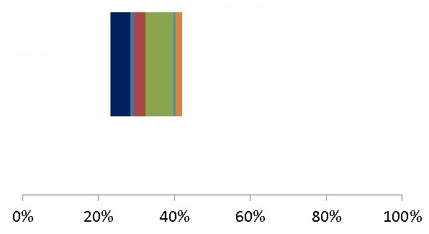
Let’s disaggregate interpersonal social skills first:
Notes:
Interpersonal communication skills were defined as communication skills, oral, written, and language skills, including in multiple languages and cross-cultural social skills and organizational skills. They included ethics, moral integrity, citizenship, moral responsibility; loyalties, rights, and duties to the community, and they included political skills. These percentages are based on the total number of items the focus groups identified. 7 % of the items as being classifiable as citizenship, ethics, duties to others, rights, etc.—is a strong recognition of these skills. So is the 5% devoted to communication skills.
Note that family skills is barely cited. This is striking if we consider where personality skills come from. It is in the crucible of families, especially early nurturance, where language, social skills, and conscience are cultivated. We may be ignoring what may be the most important, foundational step toward the results we want, a highly social and cognitively skilled, motivated 24 year old.
It is surprising how infrequently multiple language and cultural skills were mentioned, since international economies are so integrated and interdependent now and a significant portion of Kansans are Spanish-speakers. As cross-national economies continue to integrate, some business and industry representatives rate multiple language and cultural skills as increasingly important.
The sum of the disaggregations is always smaller than the parent or general category. That’s because there are some classifications that fit into the parent or general category, but not into any of the narrower subcategories.

Slide 15
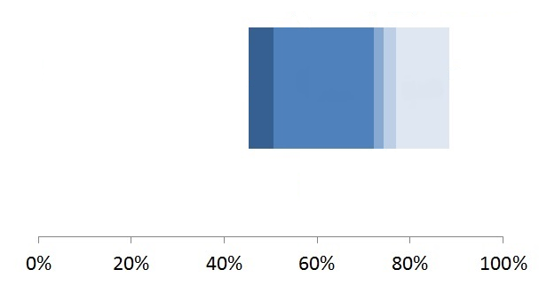
Now let’s disaggregate intrapersonal or personality skills:
Notes:
Conscientiousness is far and away the most cited theme or characteristic of success. This means that the Kansans who came out for the 20 community survey cited some aspect of conscientiousness as an characteristic of success more often than any other characteristic. The definition of conscientiousness was the tendency to be organized, responsible, and hardworking. Integrity is included with conscientiousness rather than at citizenship because we have distinguished between intrapersonal and interpersonal skills.

Slide 16
This emphasis on non-academic skills means the community focus groups are largely in agreement with the national business community. Nationally, of the non-academic skills, employers prefer:
Conscientiousness
(esp. dependability, integrity)
Agreeableness
(esp. cooperation, teamwork)
Emotional Stability
(esp. self control, stress tolerance)
Paul Sackett, Univ. of Minnesota psychologist, combined different national employer data sources and found that employers rated the above non-academic skills above all others, across all educational levels, from dropouts to PhDs.
Notes:
Sackett said the jury is still out on the relative importance of non-academic factors compared to academic, but “the evidence is strong [that] the non-cognitive factors are important.” personal communication Feb 22, 2012 email;
Sackett, P. (2010, December 9). What we know about non-cognitive constructs and workplace outcomes. Slides presented at the conference Building Better Students: Preparation for Life After High School sponsored by the Educational Testing Service and the College Board. Retrieved February 3, 2012, from https://www.ets.org/c/15481/videos.html

Slide 17
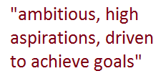
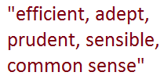
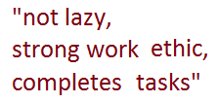
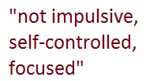
What does conscientiousness include?
Notes:
Conscientiousness is by far the dominant characteristic. The sub-characteristics that are making the biggest contributions are achievement striving, and self-discipline. The percentages are based on the total number of items identified in a randomly selected group of 100 focus groups.
There are some strands of research that have been identifying which facets of conscientiousness are most predictive of academic and work success—dependability and achievement striving, for example. Bandura’s self-regulation model, which includes motivational processes like a student’s belief in their own abilities, seems to complement the Big 5 personality model well [see Kyllonen et al, 2014, Personality, Motivation, and College Readiness . . . ].

Slide 18
What are the take-home lessons from Question 1?
The community focus groups cited non-academic skills at more than a 7:2 ratio over academic skills as characteristics of the ideally prepared young adult.
Conscientiousness, with its inclusion of achievement-striving and self-discipline, was the dominant characteristic, accounting for 22% of all items. Combined national sources of business people also identified conscientiousness as the number one desirable skill.
Among academic skills, the focus groups emphasized applied skills over traditional academic skills at about a 2:1 ratio, with critical thinking skills in between the two.

Slide 19
Question 2 is really two questions:
2A. What is the role of K-12 education in achieving this future?
and
2B. How should K-12 measure indicators toward that success?

Slide 20
Comparing these two questions with the first question, we see a big decline in the volume of responses:
Why the big drop in volume? Was the clock running out? Were the latter questions less interesting? Or are the questions progressively harder, moving from describing the ideal, to describing schools’ role in cultivating that ideal, to measuring progress in achieving it?
Notes:
It’s like the Aesop story about the mice and the cat. The mice all get together and agree they share a problem, the cat. One young mouse proposes a solution: “Put a bell around the cat’s neck so we will all be warned by the tinkle when the cat is near.” All the mice cheer, they finally have a solution. But an old mouse asks, “who is going to bell the cat?” It’s easier to describe an ideal than to make it real.

Slide 21
There are at least 3 or 4 situations that may influence the responses to the second question:
If you believe that what matters should be measured, then the most important roles identified in question 2A will correspond to indicators in 2B.
Every role can imply an indicator.
Some focus groups treated the responses to 2A and 2B as synonymous. Others matched each role with a measure.

Slide 22
Example 1: A focus group from Parsons mostly identified measures:
Example 2: A focus group from Hays matched every K-12 goal to an indicator:
graduation rates; portfolio, multiple measures; problem solving skills; assessment; social skills; real world situation; peer evaluation; self-evaluation
assure that education is enlightening enough to keep kids - I:attendance and graduation rate; be sure school is challenging enough - I: attendance and graduation rate; provide options for career and tech ed/work ready success - I: placement, employment, on to college or post-secondary . . . .
Notes:
The Parsons’ group identified 5 measures, grad rates, portfolio multiple measures, assessments, peer evaluations, and self-evaluations. They identified 2 sets of skills as goals, problem-solving skills and social skills. And a single strategic role, a curriculum with real-world situations.
Notice how they identify specific types of measures, portfolios, peer evaluations, and self-evaluations. We’ll talk more about these later.

Slide 23
2nd possibility: If the focus group believes that identifying measures will lead to high-stakes accountability that will corrupt the process the measures are intended to monitor, then the second part of the question may be ignored.
In perhaps a quarter of the focus groups responses, no indicators or measures were identified.
Notes:
After No Child Left Behind, such a response would be understandable.
Campbell’s observation:
"The more any quantitative social indicator (or even some qualitative indicator) is used for social decision-making, the more subject it will be to corruption pressures and the more apt it will be to distort and corrupt the social processes it is intended to monitor."

Slide 24
Example 1: A Salina focus group doesn’t explicitly identify any measures:
Example 2: From Hays:
teach to locate, synthesize, and validate information; how to research; how to analyze data-interpret language; critical thinking; to prepare students to be future ready; relevant-real world application; keep students motivated to learn/improve; work with post-secondary and early childhood to collaborate at each content area and include B & I also; career exploration even to determination
more trade based opportunities for students; realistic expectations - grades, academics success, behavior; channeling of talents, refocusing misdirected energy
Again, no indicators are explicitly identified.
Notes:
Grades isn’t a measure, an example of where expectations need to be realistic.
This response from Hays avoids directly citing any measure or indicator:

Slide 25
3rd possibility: Accurate measurement of phenomena like conscientiousness can be notoriously difficult—maybe we are asking for answers beyond the expertise of the respondents.
If so, we might expect the focus groups to respond with traditional measures, to ignore the measures part of the question, or maybe pose questions in their response.
Notes:
Measurement of social phenomena is notoriously difficult—psychologists worked for decades to identify the Big 5 personality skills and continue to refine them. Measuring abstractions like school climate or the effectiveness of curriculum design is difficult for measurement experts. The question, in many cases, may be asking for answers beyond the expertise of the respondents. For example, this focus group in Olathe answered Question 2 like this:
higher level thinking skills; real life problem to solve; not a bubble test more project based learning; work as a team to complete a task; measure is the output meeting the needs?; creativity and problem solving tasks; literacy level, especially international; 21st century skills; writing component; assessing tool - rubric but manpower to score is overwhelming- could knowledgeable business experts be part of evaluating?; history connection

Slide 26
Example 1: From an Olathe focus group:
higher level thinking skills; real life problem to solve; not a bubble test more project based learning; work as a team to complete a task; measure is the output meeting the needs?; creativity and problem solving tasks; literacy level, especially international; 21st century skills; writing component; assessing tool - rubric but manpower to score is overwhelming- could knowledgeable business experts be part of evaluating?; history connection
Notes:
You can see in their questions that this focus group struggled to come up with measures for the roles they identified.

Slide 27
4th possibility: The focus group was thinking outside the box. A few focus groups stepped out of the school accountability model. Consider this child-center developmental-stage model from Oakley:

Slide 28
The goals and measures are child-centered and vary by the age and stage of the students.
prek-3 : social; soft skills; not sure how to test self control; cooperative learning;
4-6: academic growth model; hard data to show improvements; rubric on citizenship; career exploration;
6-8: work and respect others;
10-12: project based learning; service leadership; work study programs; link drivers license to diploma; attendance data

Slide 29
Now let’s analyze the responses to 2A:
What is the role of K-12 education in achieving this future?

Slide 30
Coding from what the respondents said, yielded this conceptual framework:
Notes:
As foreshadowing, a few things are worth noting with the themes the 20 communities itemized:
Curriculum design—like project-based learning, or integration of real-world problems with the curriculum, or individualized instruction—was the most frequently mentioned strategic activity.
Under applied skills there was an emphasis on experiential learning—learning through realistic, concrete practice of skills, learning through internships, job shadowing and other experiences.
In the non-academic or social emotional skills, under conscientiousness, perseverance, teaching kids to overcome failure, was identified with more frequency than the other themes that make up conscientiousness.

Slide 31
What is the role of K-12 education in achieving this future? The responses fell into two broad themes: Skill training and Strategic activities.
Notes:
The responses fit into two broad themes:
skill training: the direct training of skills--academic, applied or job skills, and non-academic, social-emotional skills--that respondents say schools should be cultivating.
strategic activities: defined as “all the activities suggested as steps, building blocks or scaffolding to support the characteristics, abilities, and skills being cultivated in the students (family engagement, community collaboration, specialized staffing and training, particular curriculum design, etc.)”

Slide 32
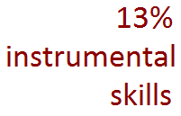
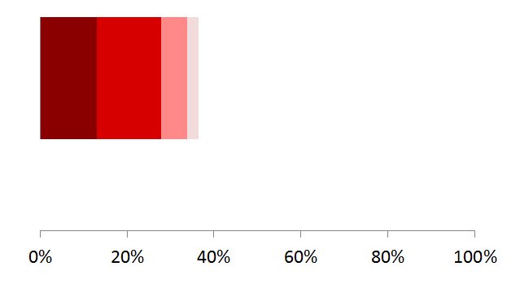
What does skill training include?
defined as all traditional academic skills, like math, reading, writing; all subject-
specific, content-focused, knowledge-based skills, like geography
defined as all training aimed at cultivating personality, social-emotional skills, 21st century
and other non-traditional skills, including perseverance over failure . . .
defined as skills that are instrumental in employment, or preparing for employment, or
generally used for living, like financial skills . . .
defined as innovative problem-solving skills; problem-solving that incorporates
solutions from divergent subjects, experiences, or sources . . .
Notes:
The rank of non-academic skills is still number one, with instrumental skills followed by academic skills. Critical thinking has fallen in rank behind academic skills. Notice how the non-academic skills shrunk in volume when the focus groups were asked to identify their role in cultivating them. Is it because the respondents know less about how to cultivate them? There is more evidence about this in the focus group responses.
Instrumental or applied skills include experiential learning.

Slide 33
Within instrumental skills, the community focus groups identified a notable subcategory: skills gained from experience.
concrete, realistic practice of skills
internships, work-study, apprenticeships
job shadowing
work experience
service or volunteer experiential learning
mentoring or coaching
job exposures
intercultural and bilingual experience
Notes:
Among the instrumental skills identified, the majority were skills gained from experiences. The largest proportion were from the concrete, realistic practice of instrumental skills. This implies a re-design of the curriculum to incorporate more “hands-on training” and “real-world experiences.” The second, third, and four most cited experiences--internships, work-study, and apprenticeships—and then job shadowing and work experience—imply closer ties to and coordination with businesses.

Slide 34
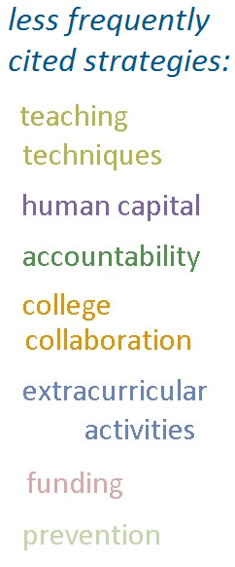
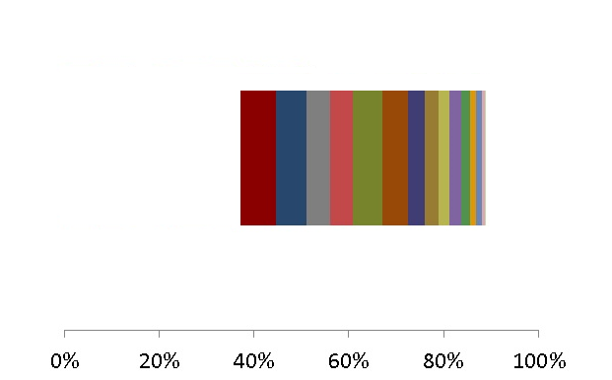
What themes made up the strategic activities?
Career planning items called for individual goals and planning, of classes, pathways, further education, transitions, and careers. Some items included the family in the planning. When career planning should begin—middle school? 8th grade?--wasn’t clear.
Family engagement items complemented the career planning items, but the partnership between schools and families started early—birth through preK in some items. Some advocate joint planning for the child’s future, and others, opportunities for family participation and family education.
School climate activities were diverse and sometimes conflicting. Some advocate creating an environment of high expectations, while others recommend realistic expectations, or a positive supportive culture.
Individualized instruction and experience varied in intensity, from career interest diagnostics to universally required individual plans that the student must personally defend. The timing varied from beginning in Kindergarten, to middle school, to 8th grade.
Real-world instruction items advocate for concrete, real-life, relevant problems to solve, sometimes including their social dimensions. Some suggest integrating academics with applied skills, to improve motivation. Timing? As early as preK.
Community collaboration items emphasized mutual obligations between students and the community and better social networking. Some advocate student community service, sometimes as a requirement; others, partnerships with local businesses and social agencies, especially early childhood agencies.
Project-based learning items emphasize the learning and demonstration of applied skills, sometimes in contrast to standardized curricula and assessments. Some suggest projects as part of community service, a qualification for graduation, or a better way to teach or measure personality skills.
Early childhood strategies include strengthening the foundations of language and social skills at this sensitive stage, and the early establishment of parental collaboration.
Notes:
About the less frequently cited strategies:
Teaching techniques as strategies included integrated, collaborative teaching; teacher as facilitator; engaging students; teaching teachers how to teach soft skills, among others.
Investments in human capital suggested increasing the number of counselors (which fits with the suggestion for more individual career planning), and more professional development for elementary math teachers.
The more striking suggestions in the accountability recommendations included more autonomy for teachers, aiming to meet the Rose Standards, linking drivers’ licenses to graduation, and allowing for greater individual differences in student development.
College collaboration and extracurricular activities were relatively few, which is surprising with the larger initiatives to prepare students to be college and career ready, and the ideal of teaching more social-emotional skills.

Slide 35
A few take-home lessons from question 2A:
Re-designing the curriculum—around individualized goals, planning, instruction, and experience, around incorporating real-life problems and projects into the curriculum, and experiential learning—is heavily suggested.
New roles are suggested for school counselors—in deeper individual career planning, and perhaps in coordinating internships and work experiences with business and community organizations.
The large proportion of instrumental skill training that included some experiential training, e.g. internships; concrete, realistic practice, job shadowing, etc.—suggests much more integrated coordination with businesses and community organizations.
School climate is important but not well-defined.
Notes:
There is a suggestion of a structure of social opportunities—opportunities for experience, particularly real-world experiences—that students need to practice applied skills, both practical and social.

Slide 36
On to the responses to 2B:
How should K-12 measure indicators toward that success?

Slide 37
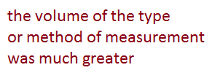
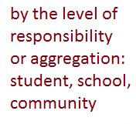
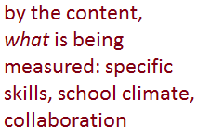
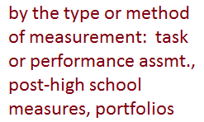
There are at least 3 ways to classify the measures or indicators:

Slide 38
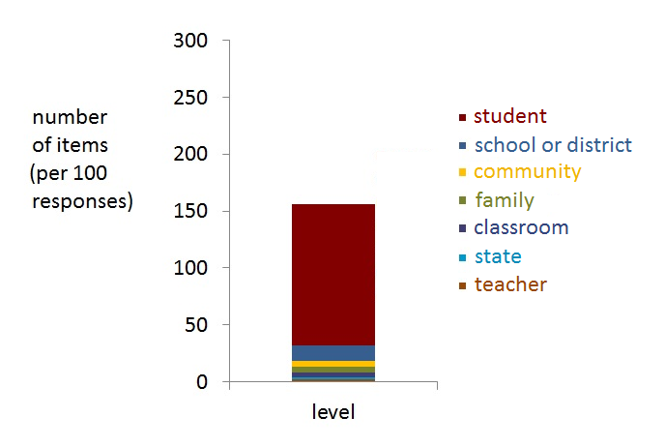
Details of level of responsibility:
Most of the suggested indicators were at the student level, and most of these were for non-academic, social-emotional measures like citizenship, perseverance, social skills, and self-control.
At the community level, suggestions included indicators based on the quality of collaborative education with business and industry and post-secondary.
Notes:
One suggestion at the community level was for a measure of collective responsibility.

Slide 39
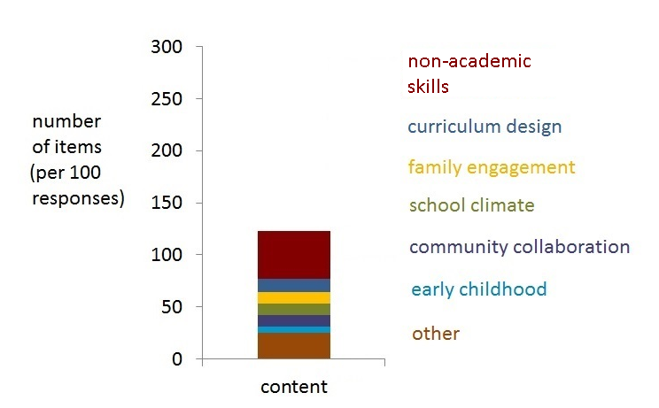
Details of content-specific indicators:
While the non-academic skills are the most frequent within this category, they are often very general, like “employability skills” rather than something specific like “strong work ethic.”
Notes:
While the non-cognitive skills are the most frequent of items within this category, the are often very general terms, like “employability skills” rather than something specific like “strong work ethic.”

Slide 40
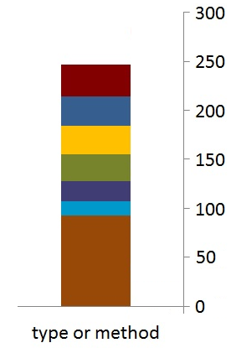
The most frequently cited indicators were identified by type or method:
The other category includes 93 items divided across 14 types or methods. Traditional subject and even applied skill assessments were cited less often than task or project performance assessments, post-high school measures, or individual plans of study, so they were included in the “other” category. Self-evaluations—where the student sets individual performance goals and reflects on her or his results—and integrated assessments—were also among these less-frequently identified indicators.
Post high-school measures include the typical ones—percentage continuing their education—and some non-typical ones—improved SES, and improved well-being.
Project or performance-
based tasks, and skill demonstrations were the most frequently cited indicators.
Credentials include industry-recognized certifications, ACT’s Aspire, pathways certifications, and 2 or 4-year degrees.
Individual career plans were defined as any individual plans of study or individual education plans designed to guide and motivate individual students toward career, further education, or the next milestone in their development.
Observations, rubrics, and portfolios include any observational reports, diagnostic instruments like Dibels, subjective judgments, or rubric-guided judgments, and portfolios.
Experiential includes any measures of formative experiences, like student participation in sports, internships, community service, employment, business ventures, or summer camps.

Slide 41
What are community focus groups saying about measures?
Non-cognitive, social-emotional measures, like conscientiousness and school climate, are important, but how they can be measured isn’t clear.
Project & task performance, individual planning, curriculum designed for realistic experiences, internships and work experiences—are more important measures than traditional assessments.
Post high-school measures—credentials, employment, well-being—are also important measures of K-12 success.

Slide 42
Like question 2, question 3 is really two questions:
3A. What is the role of higher education in achieving this future?
and
3B. How should higher education measure indicators toward that success?

Slide 43
Grouping items by themes for Q3A, on higher ed roles, yielded this conceptual framework:
Notes:
Institutional collaboration—especially between K-12 and higher education, and between business and industry—is the most frequently cited theme.
Student services are also emphasized.
Compared to the roles emphasized for K-12 schools, skills training, including critical thinking, non-academic or social-emotional skills training, are cited less frequently.

Slide 44
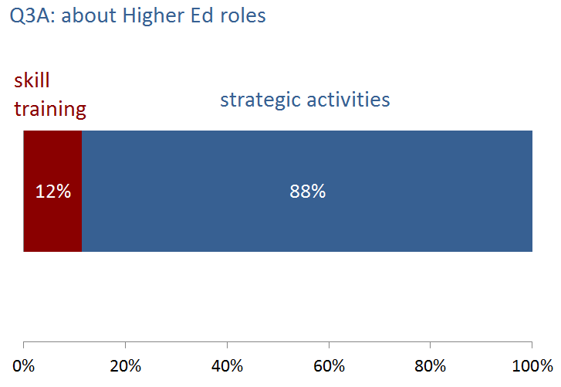
What is the role of higher education in achieving this future? Applying the same broad categories of Q2A, skill training and strategic activities, we see a strong shift in items to the latter.

Slide 45
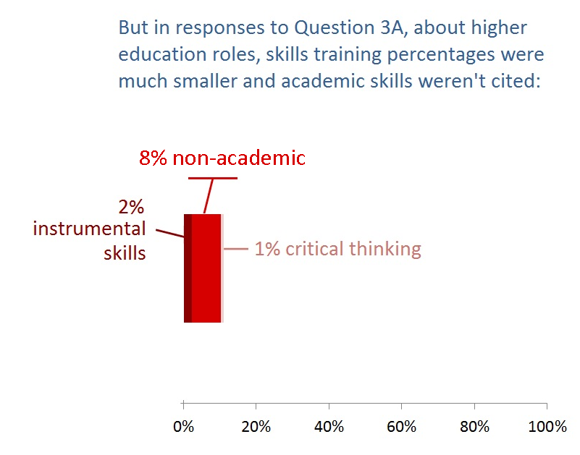
Why the diminished emphasis on skills training?
Notes:
Focus groups might see the specific applied skills, of majors and minors and continued pathways, and critical thinking skills, as the substance of post-secondary education. Specific, applied skills don’t need to be mentioned—that’s what higher education does. It could be that respondents see social emotional skills as foundational to K-12, as skills already mostly fixed. The social-emotional skills identified are very general—”employability” as opposed to specifics like “strong study habits.” It could also be that the community focus groups wanted to emphasize other roles for higher education.

Slide 46
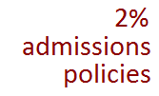
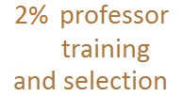
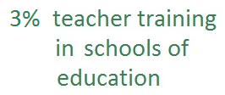
What themes were classified as strategic activities?
After institutional collaboration, the suggestions for students services—especially for individual career planning, for social and academic supports, and for affordable access—were the strongest theme.
With 39% of all responses to question 3, institutional collaboration was the strongest theme. Among these, the predominant suggestion was for collaboration between K-12 and higher education. The next most frequent theme was for collaboration between business and industry and higher education.
School climate items were very general—for high expectations, against high expectations—and for more engagement, social and curricular.
This theme—labor market responsiveness—includes calls for accurate forecasting of labor market demands so that higher education and business can successfully plan and collaborate, for adaptiveness and specialization of the curricula to fit new labor market demands, and for continuing career planning and training, again to fit career paths to changing labor market demands.
About half of the curriculum design suggestions favored more realistic, experiential learning, and two suggested less emphasis on general ed. courses, especially in the freshman year.
The few admission policy items were split, with a majority favoring stricter or more selective higher education admissions. But there were also some who favored looser or different admission policies.
The few items about teacher training in schools of education advocated more creativity in teaching, higher-quality training and mentoring, and more integration with emerging technologies and opportunities for students.
The few professor training and selection items advocated for improved training of teaching techniques, and mentoring.
The institutional design items included suggestions for systemic changes, large and small: integrate high school with community college, elevate the quality of technical schools to that of universities, redesign the teaching incentives for university professors, replace 15-week semesters with 8-week quarters, replace grades with pass/fails, among others.
Notes:
The few items about teacher training in schools of education advocated more creativity in teaching, higher-quality training and mentoring, and more integration with emerging technologies and opportunities for students.
The grey ‘other’ category has a few items about teaching technique and single-mention items.

Slide 47
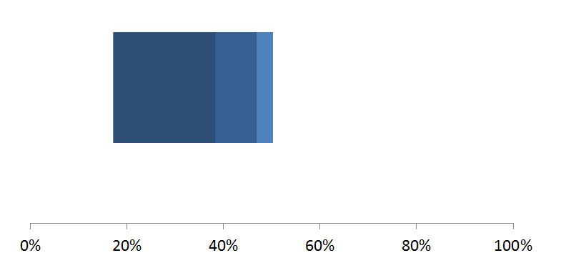
Let’s disaggregate the biggest category, institutional collaboration:
Notes:
Suggestions for K-12 and higher education collaboration made up 21% of all suggestions about the role of higher ed in cultivating the ideal students.
The curriculum planning and coordination items suggested the K-12 and higher ed collaborate on aligning curricula, designing requirements, sequence and content of courses, crediting, arranging experiential learning outside the classroom, and in communicating with students. Feedback loops could reduce remediation. What is taught to future teachers in schools of education could also be better coordinated.
Some suggested transition planning for all students. Items suggested seamless, easier transitions to whatever was the next, best-fitting higher education institution.
Some suggest assessing student readiness, strengths and weaknesses, and deliberately teaching the skills to succeed in the higher ed institution of choice. Suggestions include feedback loops between high schools supplying students, post-secondary institutions, and graduates out in the work world.

Slide 48
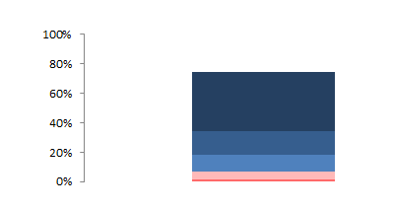
Now let’s drill down one more level. First, let’s disaggregate K-12 & higher ed collaboration:
Some suggest assessing student readiness, strengths and weaknesses, and deliberately teaching the skills to succeed in the higher ed institution of choice. Suggestions include feedback loops between high schools supplying students, post-secondary institutions, and graduates out in the work world.
The curriculum planning and coordination items suggested that K-12 and higher ed collaborate on:
aligning curricula
sequence and articulation of courses
credits for courses
arranging experiential learning outside the classroom and
in communicating with students.
Coordinated feedback loops could reduce remediation. What is taught to future teachers in schools of education could also be better coordinated with the field.
A handful of items suggested that counselors need to be better connected to community colleges, better informed of college costs, and of experiential opportunities with employers, particularly local employers.
Some suggested transition planning for all students; others seamless, easier transitions to whatever was the next, best-fitting higher education institution.
Notes:
Suggestions for K-12 and higher education collaboration made up 21% of all suggestions about the role of higher ed in cultivating the ideal students.
The curriculum planning and coordination items suggested the K-12 and higher ed collaborate on aligning curricula, designing requirements, sequence and content of courses, crediting, arranging experiential learning outside the classroom, and in communicating with students. Feedback loops could reduce remediation. What is taught to future teachers in schools of education could also be better coordinated.
Some suggested transition planning for all students. Items suggested seamless, easier transitions to whatever was the next, best-fitting higher education institution.
Some suggest assessing student readiness, strengths and weaknesses, and deliberately teaching the skills to succeed in the higher ed institution of choice. Suggestions include feedback loops between high schools supplying students, post-secondary institutions, and graduates out in the work world.
A handful of items suggested that counselors need to be better connected to community colleges, better informed of college costs, and experiential opportunities with employers, particularly local employers.

Slide 49
Now let’s disaggregate business & industry collaboration with higher ed:
The call for experiential opportunities—for internships, work-study, real-life experiences—was by far the most frequent suggestion for collaboration between business & industry, and higher ed.
There were also some suggestions for communication, coordination and alignment between businesses and higher ed, and for mentors from business & industry.
Notes:
The call for experiential opportunities—for internships, work-study, real-life experiences—was by far the most frequent suggestion for collaboration between business & industry, and higher ed.
There were also some suggestions for communication, coordination and alignment between businesses and higher ed, and for mentorships for students, from business & industry.

Slide 50
Suggested by the responses to Q3A:
Collaborative partnerships between K-12 and higher ed, and between higher ed and business & industry, to provide internships and real-life learning, aligned training, and smooth transitions, is strongly recommended.
Student services, especially for individual career planning, for social and academic support, and for affordable access to higher ed, are also suggested.
Labor market demands should be coordinated with business & industry, and accurately forecast. Curricula should be quickly adaptive to changing demands.

Slide 51
Q3B. How should higher education measure indicators toward that success?

Slide 52
With 25 indicators, higher ed measures were diverse, but the most frequent were:
Employment status of former students
Graduation rates
Continuity or retention rates
Credentials (certification, degree, etc.)
Earnings, income, and post-graduation SES

Slide 53
How did Kansas business & industry answer the question:
What are the characteristics, qualities, abilities, and skills of a successful 24-year old Kansan?

Slide 54
Who participated in the business and industry focus groups? 127 people from 110 organizations
sector | number | %
Agriculture | 2 | 1.8
Construction | 4 | 3.6
Education, pre-K, K-12, & Higher | 33 | 29.7
Financial Activities | 17 | 15.3
Government Services | 5 | 4.5
Information | 6 | 5.4
Leisure and Hospitality | 2 | 1.8
Manufacturing | 2 | 1.8
Mining, Quarrying, and Oil and Gas | 1 | 0.9
Other Services | 7 | 6.3
Professional and Business Services | 20 | 18.0
Retail Trade | 2 | 1.8
Transportation and Warehousing | 2 | 1.8
Utilities | 3 | 2.7
Wholesale Trade | 2 | 1.8
Notes:
Note: Each business or organization is counted once, even if more than one employee participated in the focus groups. There was one participant who did not identify any business or organizational affiliation.

Slide 56
Business & Industry Focus Group Participants by City
city | number | %
Dodge City | 12 | 9.4
Great Bend | 8 | 6.3
Highland | 1 | .8
Hillsboro | 1 | .8
Kansas City | 2 | 1.6
Lawrence | 14 | 11.0
Manhattan | 21 | 16.5
McPherson | 18 | 14.2
Pittsburg | 6 | 4.7
Seneca | 1 | .8
Topeka | 8 | 6.3
Wichita | 35 | 27.6
total: | 127 | 100.0
Notes:
Note: Each business or organization is counted once, even if more than one employee participated in the focus groups

Slide 57
Business & Industry Focus Group Participants by City
Each of the 127 participants are included in the percentages.

Slide 58
Business & Industry Focus Groups by Organizational Size (number of employees)
number of employees | number of businesses at this level | %
0 | 2 | 1.8
1 - 10 | 28 | 25.2
11 - 50 | 28 | 25.2
51 - 100 | 8 | 7.2
101 - 150 | 6 | 5.4
151 - 200 | 6 | 5.4
201 - 500 | 14 | 12.6
> 500 | 19 | 17.1
Each organization is counted only once, even if more than one employee attended.
Notes:
Note: Each business or organization is counted once, even if more than one employee participated in the focus groups

Slide 59
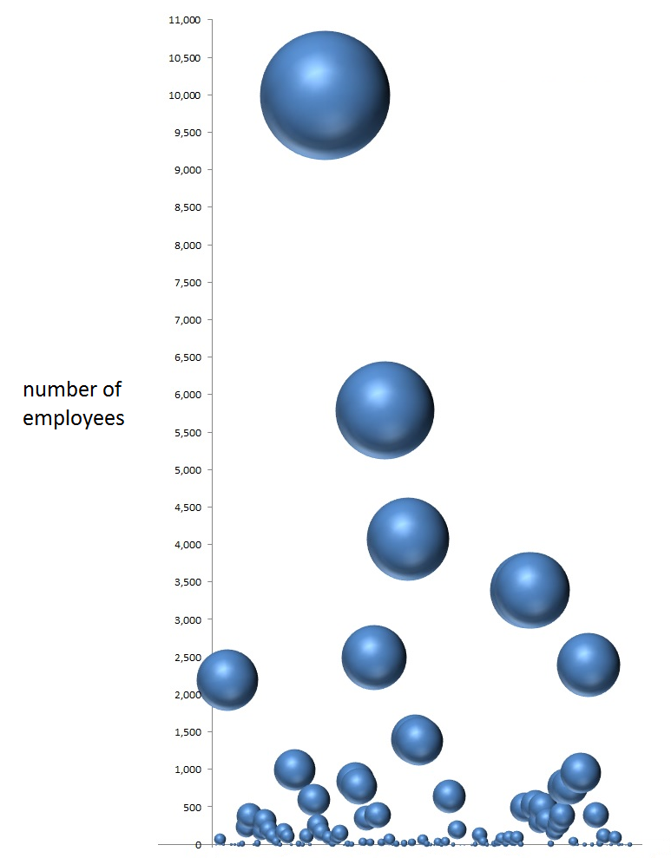
Another way to look at the relative size of the participating businesses and organizations is with a bubble chart. The size of the bubbles indicate the number of employees, including those outside of Kansas.

Slide 60
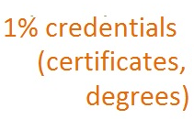
The business and industry focal groups cited non-academic skills with greater frequency than the community groups:
Notes:
Recall that the community groups cited non-academic skills 70% of the time and academic skills 23% of the time. These frequencies are remarkably similar to those expressed by the community groups. If volume can be equated with importance, the business and industry groups are saying that the non-academic characteristics are more important than academic skills, including applied skills, and that non-academic skills are at least as important to them as to the community groups, maybe more so.
One cited experience as a characteristic of the ideally prepared 24 year old (the tiny yellow line).

Slide 61
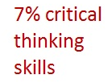
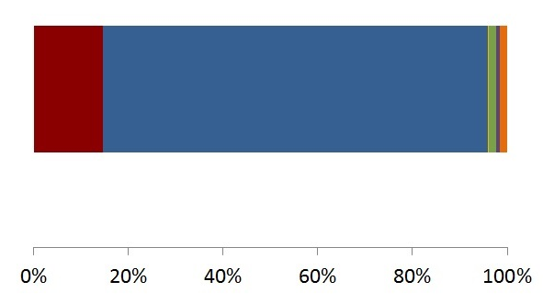
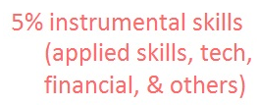
Let’s go down a level and decompose academic skills:
Notes:
For the community groups, traditional academic skills accounted for about 5% of all the items. For the business and industry focus groups, it’s about half or less that rate.
The two groups identified critical thinking skills at the same 7% rate, so both agree about the relative importance of these skills.
Instrumental skills were also identified at about half the rate of the community focus groups (10% versus 5%). We might have expected a greater emphasis on instrumental and applied skills with employers, but it was notably less.

Slide 62
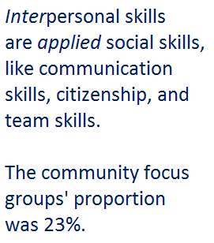
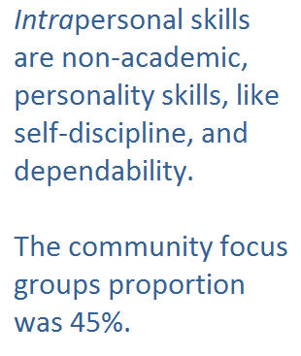
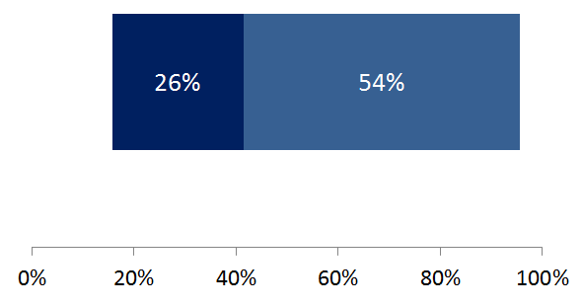
Now let’s disaggregate non-academic skills:
Notes:
Comparing the community focus groups and the business and industry groups, the frequencies and proportions of interpersonal and intrapersonal skills are very similar, though we can say the business and industry groups put a greater emphasis on non-academic, intrapersonal skills than the community groups.

Slide 63
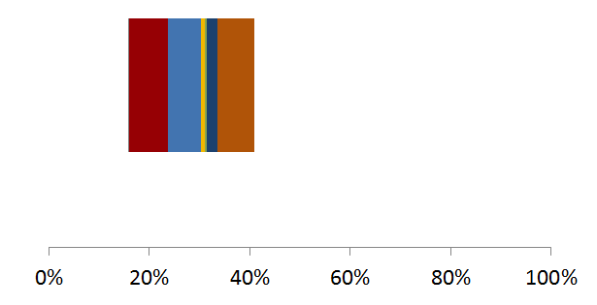
Let’s disaggregate interpersonal skills:
Notes:
About 5% of the community focus groups’ items were communication skills, so the business & industry groups increased this percentage 3 points, but the two groups seem roughly in agreement about the relative importance of communication skills.
Citizenship and duties to others were about 7% of the community groups’ items, about the same as the 6% of the business & industry groups’.
Conflict resolution skills were not part of the skill set mentioned by the community groups, but a few of the business focus groups identified these as desirable skills.
Family skills were mentioned once by the a business & industry group, and then not clearly so, but were identified by the community focus groups.
Both the community groups and the business & industry groups named about the same proportion of items identifying social tolerance and flexibility as ideal skills.
But the business & industry group about doubled its proportion of group skills like teamwork.

Slide 64
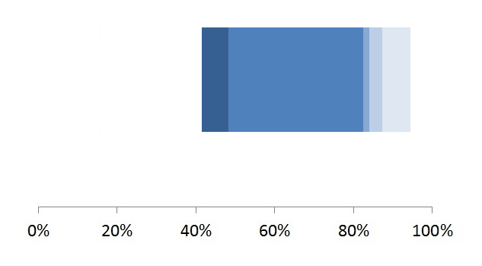
What were the intrapersonal skills that business & industry groups identified?
At around 1%, emotional stability accounted for a smaller proportion than the 2% of the community groups. Sackett’s study combining national business sources found that elements of emotional stability, like self-control and stress tolerance, were rated as highly important by national business professionals. A meta-analysis by Roberts et al also found strong correlations between low emotional stability and life outcomes like divorce.
At 34%, the business groups’ proportion of conscientiousness items was 12 points above the community groups’ proportion. Conscientiousness includes achievement-striving—having goals—self-discipline—having a work ethic—and dutifulness—being dependable, and honest.
3% of the community groups’ items also identified extraversion. Extraversion includes assertiveness, confidence, and a willingness to take risks.
The proportions of items in the openness theme were about the same in both the community and the business groups. Openness includes characteristics like adaptability, independence, intellectual and experiential openness, and creativity.
About 5% of the community focus group items were for agreeableness—
a lower but similar proportion. Agreeableness includes politeness and compliance—characteristics needed for customer service and organizational effectiveness.
Notes:
See Roberts, B.W. et al, (2007). The power of personality: The comparative validity of personality traits, socioeconomic status, and cognitive ability for predicting important life outcomes. Perspectives on psychological science, vol. 2, 4, December, 313-345.
Sackett, P. (2010, December 9). What we know about non-cognitive constructs and workplace outcomes. Slides presented at the conference Building Better Students: Preparation for Life After High School sponsored by the Educational Testing Service and the College Board. Retrieved February 3, 2012, from https://www.ets.org/c/15481/videos.html
Available from ETS site at https://www.google.com/url?sa=t&rct=j&q=&esrc=s&source=web&cd=1&ved=0CCMQFjAAahUKEwjRu4nphe_GAhUSOIgKHTiRA2Q&url=https%3A%2F%2Fwww.ets.org%2Fc%2F15481%2Fppt%2Fsackett_sessionII.ppt&ei=oLWvVdHrBpLwoAS4oo6gBg&usg=AFQjCNGD-AJukwh2HINAjfBKGlX5wC6HcQ&bvm=bv.98197061,bs.1,d.aWw

Slide 65
We can begin to answer our original research questions:
What skills do Kansans expect their schools—both K-12 and higher ed—to cultivate in young adults?
How do the views of educators, community members, and Kansas employers agree and differ on these skill-goals?

Slide 66
At about a 7:2 ratio, greater for the business and industry focus groups, non-academic skills are cited over traditional academic skills as characteristics of the ideally-educated Kansas youth.
Conscientiousness and its components, especially
dutifulness (dependability),
achievement striving (pursuing goals),
self-discipline (persistence, a strong work ethic)
are highly-cited ideal characteristics by both community and business focus groups.

Slide 67
Other mutually agreed upon characteristics are:
Critical thinking
Openness (adaptability, independence, creativity)
Communication skills
Group skills like teamwork and
Citizenship and moral obligations to others.
Traditional academic skills and applied skills are important, but less frequently cited than the non-academic skills listed above.

Slide 68
Here’s the next question that was put to the business and industry focus groups:
What are the needs of business and industry
and
what skills and abilities are lacking in the 24-year old?

Slide 69
Comparing the volume of responses of different questions, the responses to the needs and lacks question is relatively small:
Because there were a smaller number of business focus groups—27—the smaller volume of responses made the comparison of themes less precise.

Slide 70
The employer focus groups treated both the needs and lacks as characteristics of youth. For example, here’s a response from Manhattan:
Needs: being professional, personal, marketing plan (ability to sell yourself), work specialization (we want to have employees that already have certificates and training before they come)
Lacking: soft skills, communicate - written and oral, dressing & presenting oneself professionally; confidence (they have always been taught to succeed), they have been beaten down, a result of all this competition is a hyper-competitive culture
Because both the needs and lacks were treated like characteristics of youth, we could combine them in the same conceptual framework. This helped solve the problem of low-volume.

Slide 71
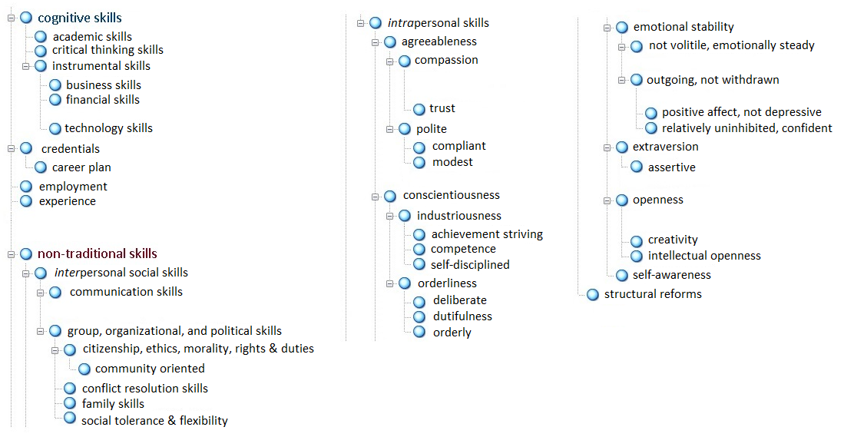
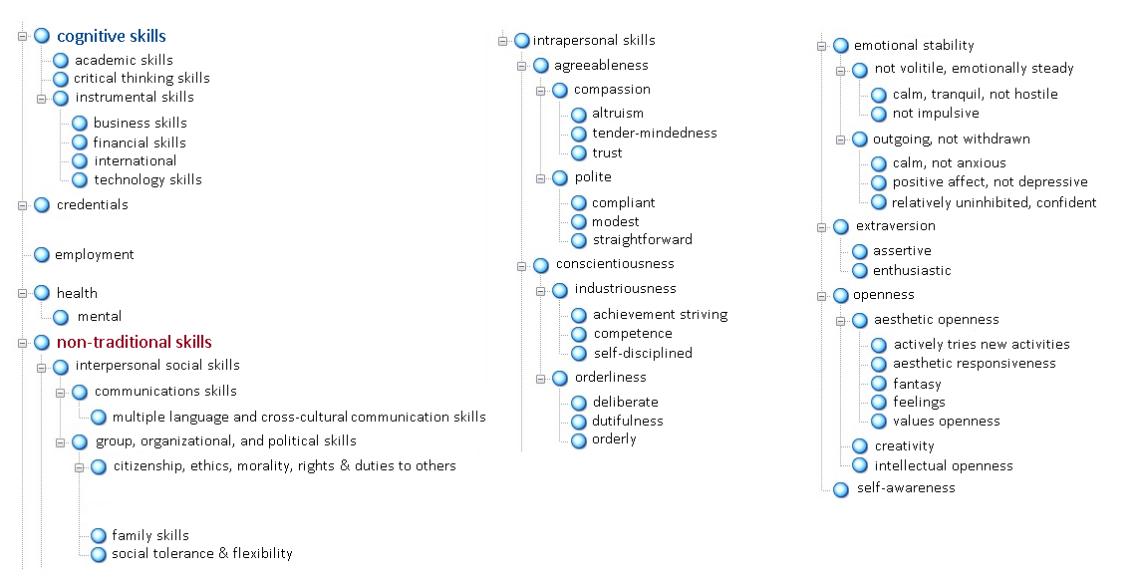
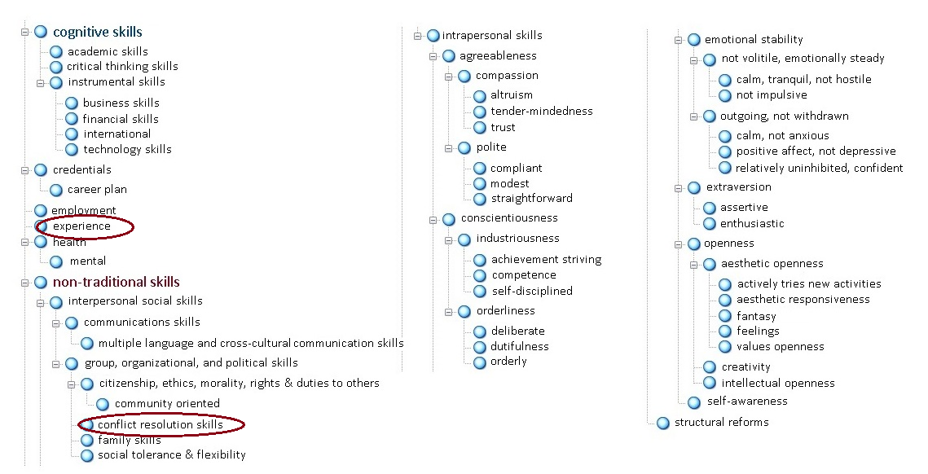
The business focus groups added a few themes:
Since the conceptual framework is similar to previous ones, the responses will be comparable to previous responses, too:
And did not use others, which left:

Slide 72
When the question emphasized the needs of employers and the skills lacking in Kansas youth, how did employers’ descriptions change?
The proportions of non-academic skills to academic skills stayed about the same, about 3-to-1.
Intrapersonal skills to the interpersonal, did too, at about 3-to-1.

Slide 73
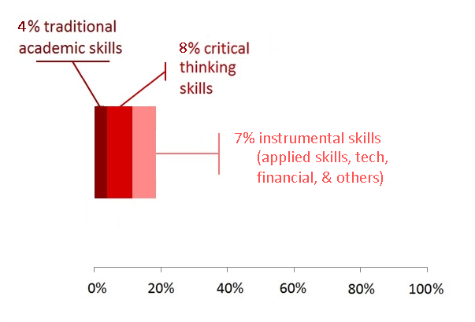
What changed?
The emphasis on hard skills increased.
When employers described the skills of the ideal youth, the proportions of
traditional academic skills, critical thinking, and applied skills were:
But when asked about their needs and the skills lacking in youth, employers increased the proportions of all these skills:
Notes:
How do we interpret this? When thinking about ideally skilled youth, does the relative value of these hard skills seem less important? Or, when thinking about what their businesses need, what their employees are lacking, do skills gain in relative importance? Since the data we have from employers was limited to 27 focus groups and the responses to this question were limited, it is hard to give much weight to this apparent difference.

Slide 74
The last question put to the employer focus groups:
How can business and industry partner with K-12 and higher education in creating the 24-year old that has those skills and abilities?
Notes:
The answers to this question will tell us how well the community suggestions fit with the business and industry suggestions.

Slide 75
Coding the responses into themes yielded this conceptual framework:
Notes:
The most prominent offer was for experiential training—internships, mentoring, job shadowing, interviews, and exposures to the real world of work. This is a familiar theme—it was sounded by the community groups when they were describing the role of K-12 education in cultivating the ideal youth (slide 32), and again when they suggested collaboration between higher ed and business and industry (slide 48).
Also prominent were the “information sharing assets”—”assets” was a term suggested by one of the business focus groups. This general theme is similar to the “labor market responsiveness” theme that the community groups suggested was part of higher education’s role (slide 42).
Within this group of information sharing assets, the most prominent theme was the suggestion for curriculum coordination, planning, and curriculum design. This theme echoed in the community groups suggestion for curricular planning and coordination between higher ed and K-12 (slide 47).
At 191 items, the volume of these responses was comparatively low. Ideally, we would have preferred more, but given our time frame, convening more business and industry groups wasn’t possible.

Slide 76
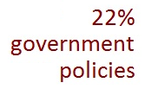
The first-level frequencies were:
This theme is the most voluminous because versions of experiential training, like internships and job shadowing, were frequently cited. Other human capital investments, like employer-provided mentors, are also included here.
Government policies include incentives for employers, like tax credits, new rules or requirements for schools, and provisions to protect students and employers.
Information sharing assets include collaborative projects like coordinated curriculum planning, and feedback loops between K-12, higher education, and employers.
These include proposals to advocate or promote education, to promote business and industry within schools, or to support new services, like expanding company counseling services to cover career planning services for students, or supporting employee mentors.
A small number of items suggested that business and industry commit to improving community family and social services. One proposed merging education and industry, moving “industry into the classroom and the classroom into industry.”
Notes:
A small number of items suggested that business and industry commit to improving community family and community social services, or changing school climates. One proposed merging education and industry, moving “industry into the classroom and the classroom into industry.”

Slide 77
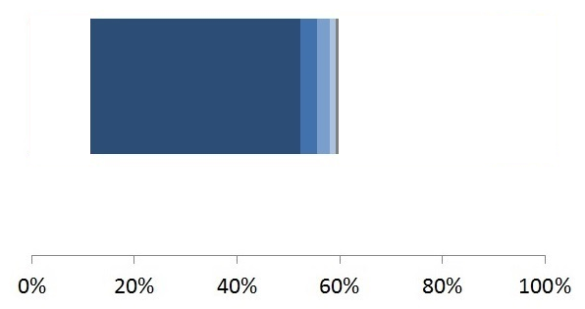
Detail of human capital investments:
A much smaller proportion of suggestions are for training of staff—for example, training teachers, principals, and counselors in real-work settings so they make their teaching and advising more relevant. A small number also suggest similar exposures and partnering with parents, including their employees who are parents.
About half of these items suggest direct experiential training—internships, job shadowing, mentorships, direct employment, and interview practice. Another set proposes bringing business and real-life experiences into the classroom through some form of joint teaching, from joint curriculum planning to professionals and technically skilled employees acting as guest teachers. Extra-curricular experiences—youth entrepreneur programs, company tours, and other business exposures—are also included here.

Slide 78
The 2nd largest theme:
Notes:
Why a theme called “information sharing assets?”

Slide 79
Why a theme called “information sharing assets?”
Consider the way some business and industry focus groups framed the problem:
Our task is to build a “workforce development information system.”
We need a “mentoring database,” an asset somehow designed so that schools, businesses, and parents will use and value it.
We need “a paradigm shift,” and “a structure going forward.”
Our problem is to prepare students “for jobs that may not have been created yet.”

Slide 80
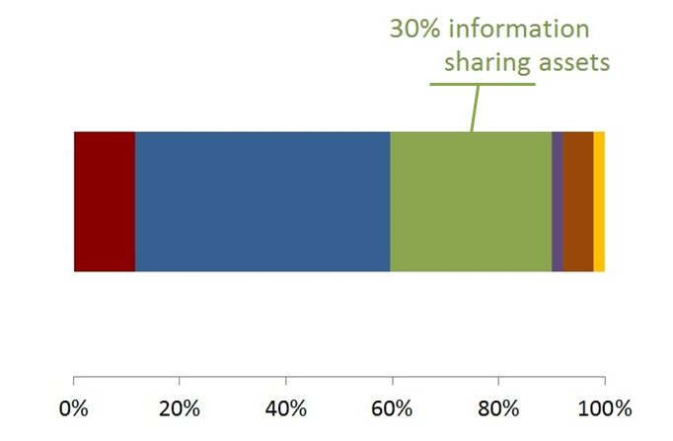
Why a theme called “information sharing assets?”
Community and employer focus groups used the term “partnership” as though Kansas needed a new public-private venture for communication, planning, and coordinating labor market demand and training.
When asked about the role of higher education in cultivating the ideal student, the community focus groups suggested a parallel theme—labor market responsiveness. This theme suggested collaboration between education and businesses for the accurate forecasting of labor market demands, for an adaptive, responsive curricula, and for continuous career planning and training.

Slide 81
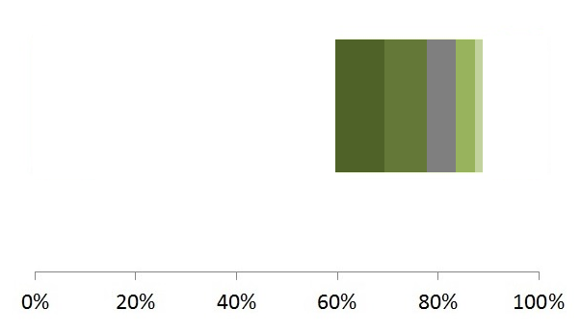
Sub-themes like those in higher ed’s labor market responsiveness make up information sharing assets
Awarding internships competitively, assign credit for them, coordinating mentors—some items recognized that experiential learning will require a coordination system.
A small number suggested that this labor market skill development system be very inclusive—that it include career exploration for young children, and new training for older workers.
Some suggest feedback loops—information exchanges between education and employers that facilitate continuous improvements in teaching, curriculum, mentoring, and skill certification. One suggests a feedback loop that forecasts future skill demands.
These items suggest that business and industry, and education, communicate, coordinate, plan, and design, an integrated, real-world curriculum. Together.
These are suggestions for organizations that can support the collaboration between education and employers—from chambers of commerce, business and industry advisory councils, to industry-specific liaisons.
Notes:
Awarding internships competitively, assign credit for them, coordinating mentors—a system of experiential learning will require some coordination system.

Slide 82
What are some of the take-home lessons from the business & industry focus groups?
The strongest offer of collaboration is in experiential training—internships, mentorships, job shadowing, and formative experiences
Joint planning of an integrated curriculum is also suggested, and will require coordinating organizations, and feedback loops
Education leaders would need to provide incentives and supporting policies

Slide 83
To achieve our goals, we will need to understand:
the forces driving labor market demand, especially for young, new workers, and
the origins of non-academic skills and how to best cultivate them.
This evidence suggests that Kansas communities, educators and employers are largely in agreement:
we want experiential training that is responsive to quickly changing technologies and business needs
we want to better cultivate key, non-academic skills, like conscientiousness, self-discipline, and communication skills.
Notes:
What forces are driving labor market oversupply of young, new workers—the students we work to prepare—and the undersupply of particular niches of highly and middle skilled workers?
What are the developmental origins of personality skills?
What do the developmental origins imply about the best ways to cultivate these skills?

